Slide 1

SAMSUNG PRISM
Mid Review Report
OD81CIT
Principal Component Analysis (Shallow Learning Algorithm)
Under the guidance of
Dr N K Karthikeyan
Dr E Arul
Himanshu Arora
Sourav Ghosh
Team :
Yogapriya H
Prasanna R
Laleth I N
Javagar M

Slide 2
PRINCIPLE COMPONENT ANALYSIS
Problem Statement
Principal component analysis (PCA) is a technique for reducing the dimensionality of datasets, in order to increase its interpretability and at the same time minimizing information loss.
ML algorithms in order to train them require large amount of data
There are often difficult to interpret and takes more resources
PCA reduces a d dimensional data set to fewer dimensions and identifies the principle components

Slide 3
EXPECTED KPI’s
Implementing PCA in C++
Implement an API to receive requests for dimensionality reduction
Applying PCA for the provided data when request is received
To reduces the dimensions of the given data, without considering the origin

Slide 4
KPI’s ACHIEVED
Implementation of PCA using C++
Parameter | Details
Lines of code | 87
Algorithm | Gets a csv file as input Converts it into eigen matrix Computes the feature matrix Modifies the original data Saves the output matrix as a csv file
Data sets used | https://www.kaggle.com/c/titanic/data

Slide 5
DATA SET
The Titanic dataset was obtained from https://www.kaggle.com/c/titanic/data
It has dimension of 889 X 16 ie. 16 variables and 889 entries
DATA UNDERSTANDING
The dataset has the details about the passengers of Titanic, like name, age, gender, etc.
It is generally used to test algorithms the result is to find who survived
DATA PRE-PROCESSING CHALLENGES
To process the data in such a way that it does not contain any character or labels, since the PCA algorithm can only work with numbers
Pre processed the data using python

Slide 6
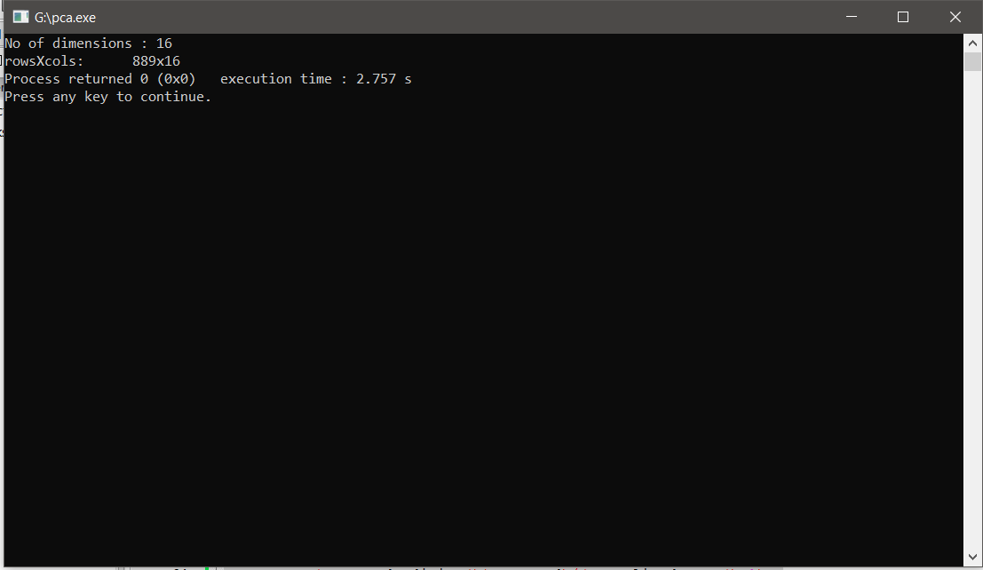
IMPLEMENTATION ON TITANIC DATASET

Slide 7
TECHINICAL CHALLENGES
Programming in C++
Converting a csv data file into an workable Eigen Matrix and vice versa
SOLVED BY
Learning C++ programming language
Refiring to eigen library documentations and tutorials

Slide 8
NEW EXPECTATIONS
Design C++ and Java wrappers: train(..) and predict(..) APIs
Unit tests (C++), Instrumentation Tests (Java)

Slide 9
Thank you

