Slide 1
إِمَارَة · Imara
MOSQUE DIGITAL PLATFORM
End-to-End Demo Presentation
29 October 2026 · Hj Suhaimi, Vice Chairman
👤 Buyer
🛡 Admin
🏪 Merchant
mosque-os-ai.vercel.app

Slide 2
COMPLETE 7-STEP AUTOMATED FLOW
How Imara works — end to end
1
👤
Buyer buys
→ Email to buyer (ack) + email to admin (verify)
2
👤
Buyer tracks
→ /orders auto-refreshes every 30s
3
🛡
Admin verifies
→ Email to buyer — e-coupon + QR link ✅
4
👤
Buyer gets coupon
→ /coupons/[token] — QR code on screen
5
🏪
Merchant redeems
→ Email to admin — redemption notification ✅ NEW
6
🏪
Merchant history
→ /merchant/history — KPI cards & payout
7
🛡
Admin settles
→ /admin/settlements — Mark Settled per merchant

Slide 3
👤
SECTION 1
Buyer Flow
How a community member buys an e-coupon via PayNow

Slide 4
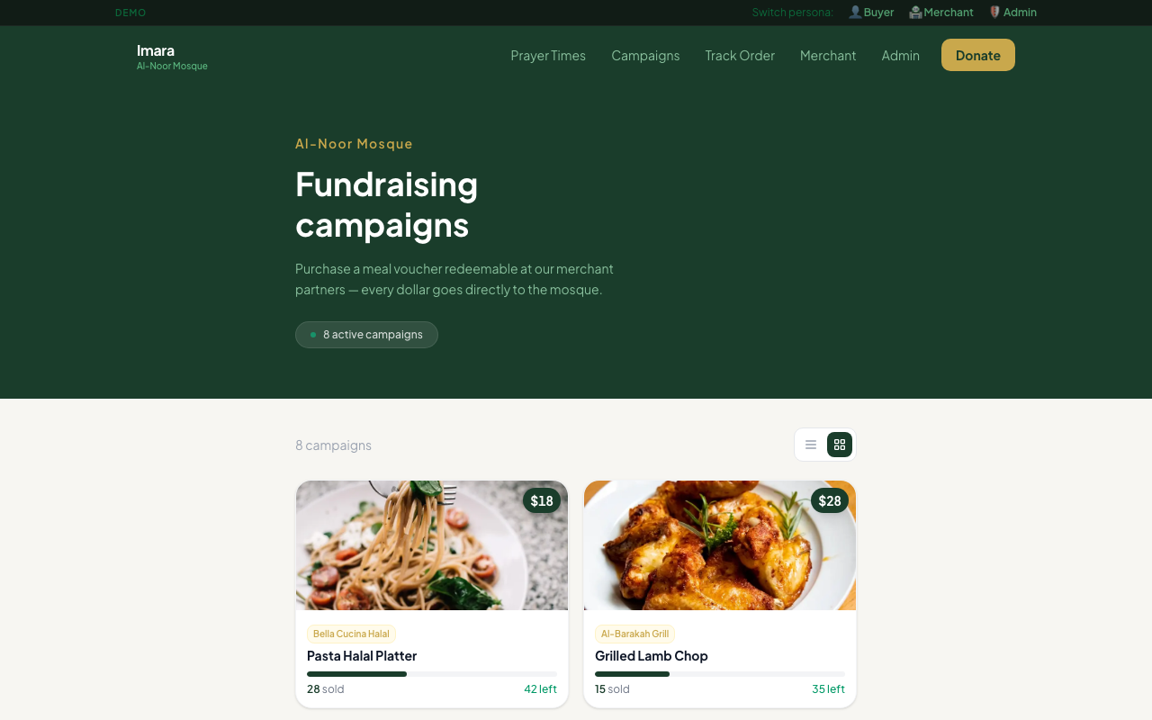
1
Browse Campaigns
👤 Buyer
⬅ 8 live campaigns
🌐
Visit mosque-os-ai.vercel.app
Price shown clearly
📋
No login required — fully public
🛍
Click any campaign card to view details
💰
Price, merchant & availability shown
🛒
Click 'Buy Voucher' to start checkout
Grid / list toggle
🖥 02 Buyer Campaigns
💡 Demo bar → 👤 Buyer lands directly on /campaigns — no navigation needed

Slide 5
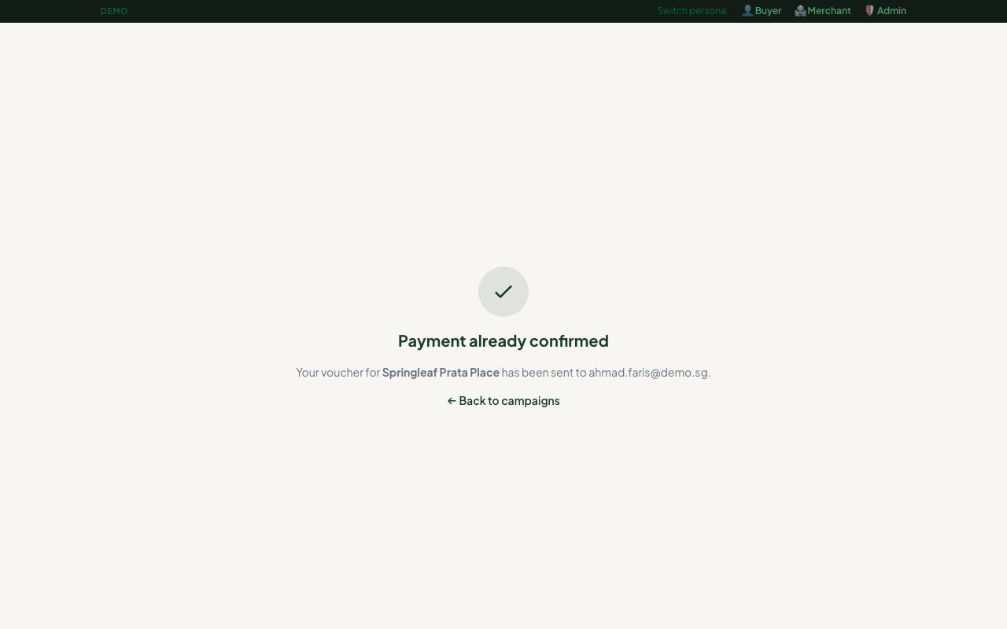
2
Checkout & PayNow Payment
👤 Buyer
📱 Scan QR with bank app
📝
Fill: name, email, quantity → Proceed
📱
PayNow QR shown — scan with DBS/OCBC/UOB
🔢
UEN: 6596805367 (mosque's PayNow ID)
UEN: 6596805367
📋
Use IMA-XXXXXX as payment reference
Reference: IMA-XXXXXX
⏱
30-minute countdown to complete transfer
✅
Click 'I've completed payment'
📧
Buyer gets acknowledgment email
📧
Admin gets 'New payment to verify' email
30-min countdown timer
🖥 05 Buyer Paynow
💡 Zero fees — full amount hits mosque bank directly via PayNow, no gateway deduction

Slide 6
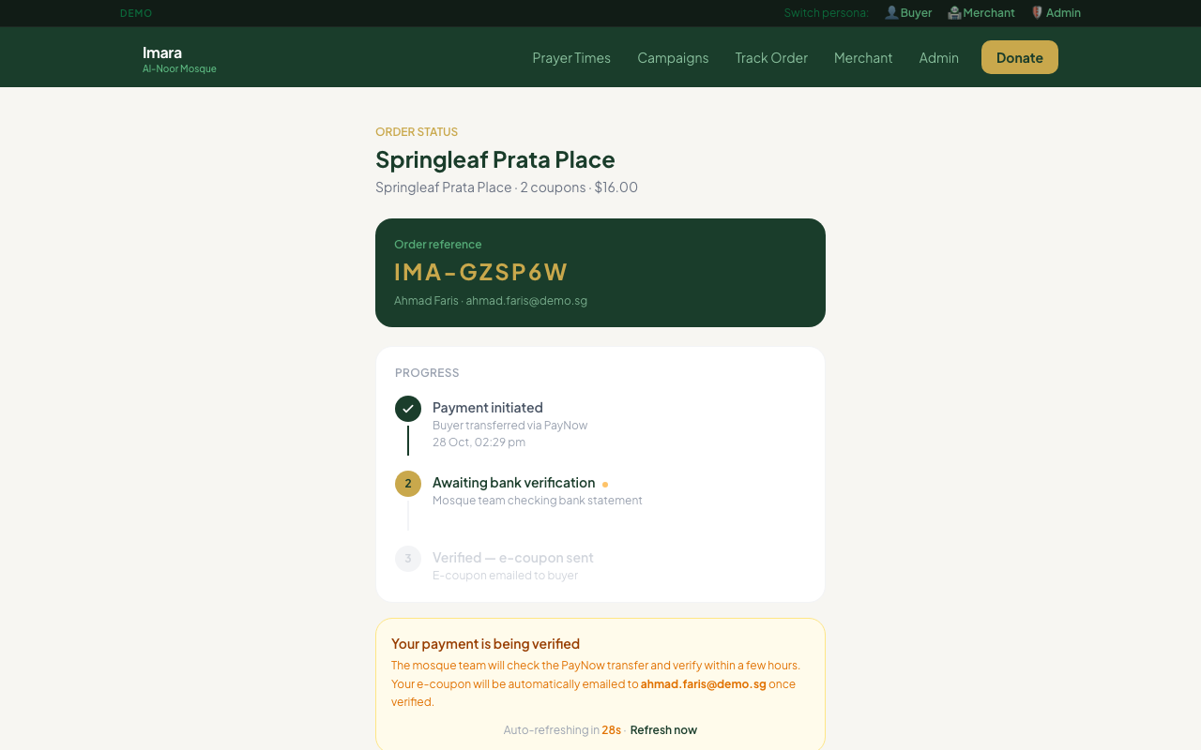
3
Payment Success & Order Tracking
👤 Buyer
Order Reference prominent
🎉
Success page shows reference: IMA-XXXXXX
🔖
Green 'Check order status →' button to bookmark
🔍
Nav → Track Order → /orders anytime
Step 2 pulsing amber ●
📊
3-step timeline shows current position:
✓
Step 1: Payment initiated
●
Step 2: Awaiting bank verification ← amber
○
Step 3: Verified — e-coupon sent
🔄
Auto-refreshes every 30 seconds
Auto-refreshes every 30s
🖥 07C Buyer Order Status
💡 Buyer can bookmark /orders/[reference] — page updates automatically when admin verifies

Slide 7
🛡
SECTION 2
Admin Flow
How the mosque committee verifies payments and releases e-coupons

Slide 8
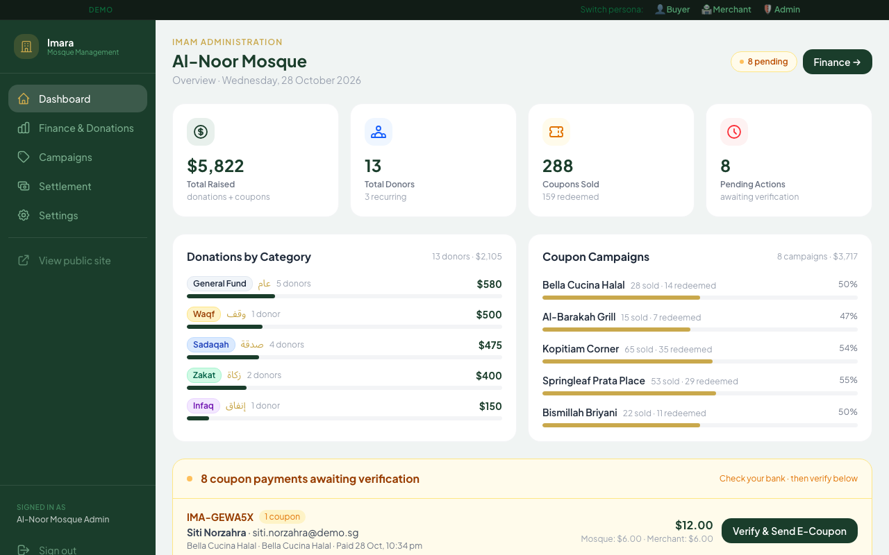
4
Admin Dashboard — Pending Verification Panel
🛡 Admin
🟡 Amber panel = action needed
📧
Admin receives email: 'New PayNow payment'
🔐
Login: admin / Imara@2026 → /admin/login
Order details + amount shown
🟡
Amber panel appears with order details:
📋
Reference, buyer, campaign, amount, time
🏦
Check mosque bank app — confirm transfer
✅
Click 'Verify & Send E-Coupon'
🎫
Coupon token XXXX-XXXX-XXXX generated
Verify & Send E-Coupon →
📧
Buyer receives e-coupon email instantly
KPI cards: totals at a glance
🖥 11 Admin Dashboard
💡 Amber panel appears on BOTH /admin dashboard AND /admin/finance — admin can verify from either page

Slide 9
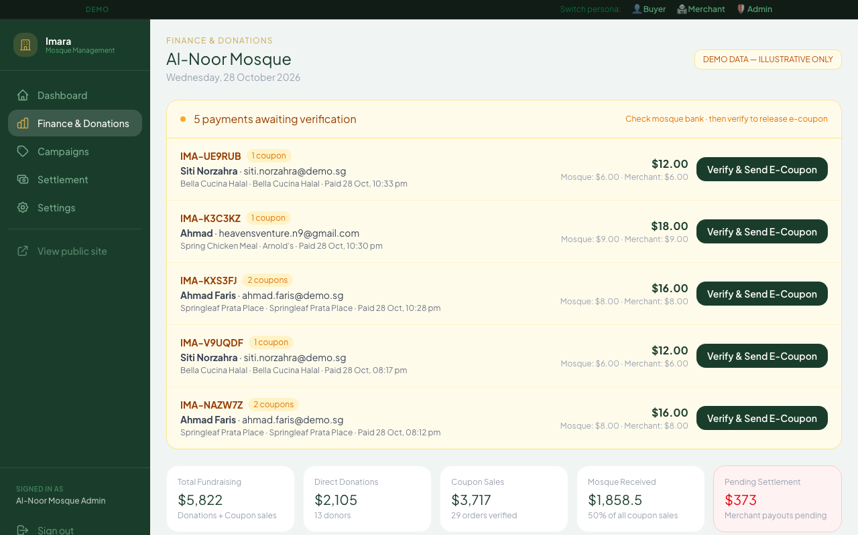
5
Finance, Settlements & Campaigns
🛡 Admin
Pending settlement amount
📊
Finance page: weekly revenue bar chart
Settle now → link
🔢
Campaign performance table (sold vs available)
💰
Pending settlement box → 'Settle now →'
📋
Campaigns page: create, edit, set dates
⚙️
Settings: mosque name, admin email
📈
KPIs: Total Raised · Donors · Coupons Sold
Weekly revenue chart
🖥 12 Admin Finance
💡 All admin pages share the same dark green sidebar — Finance, Campaigns, Settlement, Settings

Slide 10
🎫
SECTION 3
E-Coupon & Merchant Redemption
Buyer receives QR code · Merchant scans and redeems

Slide 11
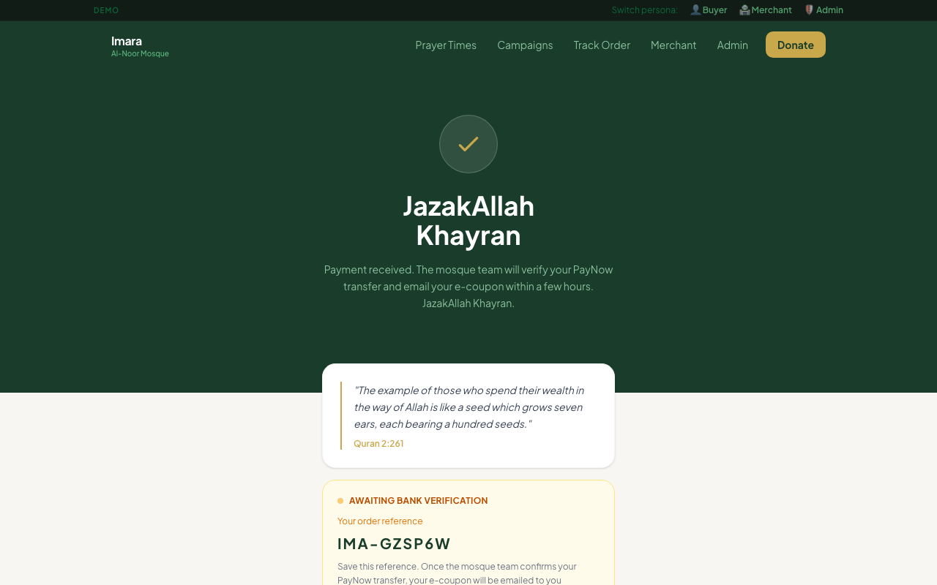
6
Buyer Receives E-Coupon Email
👤 Buyer
Reference shown prominently
📧
Email: 'Your e-coupon is ready'
🎫
Coupon token: XXXX-XXXX-XXXX
🔗
'View coupon & QR code →' button in email
📱
Tap → /coupons/[token] — large QR on screen
✅
Order tracking: Step 3 now green ✓ 'Verified'
'Check order status' button
🏪
Buyer visits merchant and shows QR
📋
2 coupons bought → 2 separate tokens in email
🖥 06 Buyer Success
💡 If buyer loses the email, they can find the coupon via Nav → Track Order → /orders

Slide 12
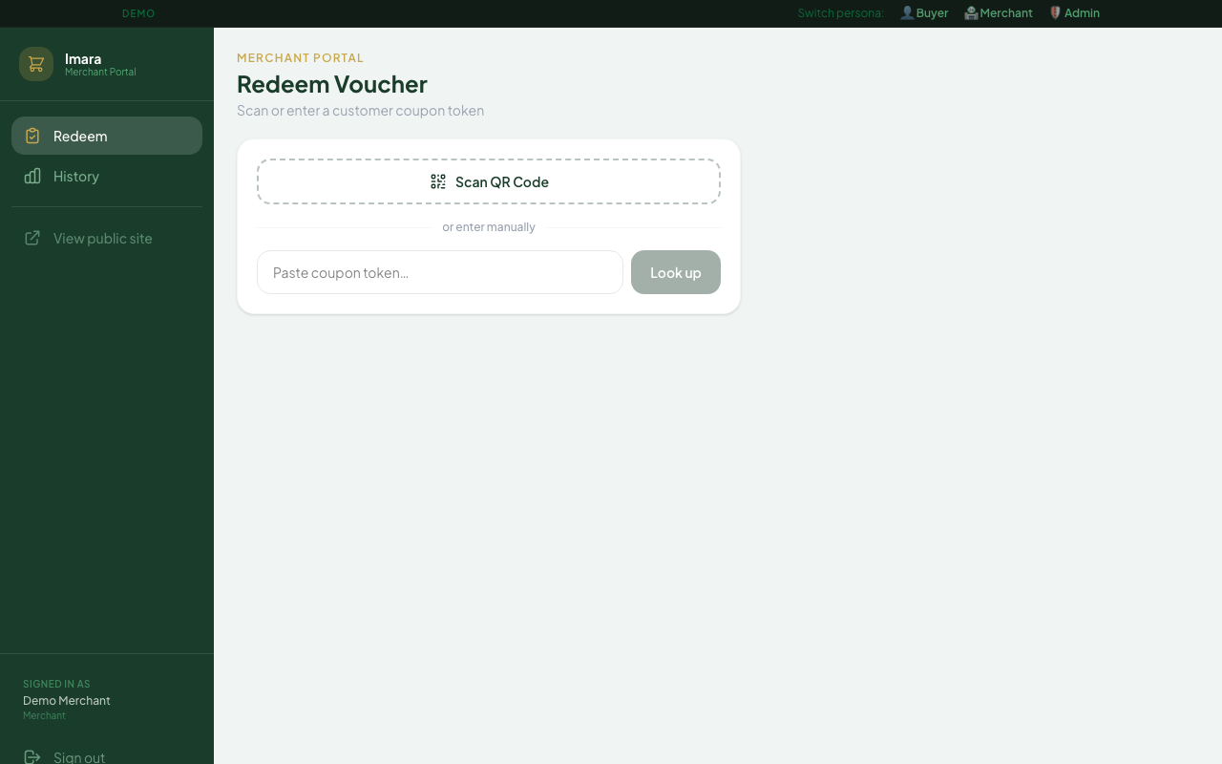
7
Merchant Redeems E-Coupon
🏪 Merchant
Dark sidebar = merchant portal
🔐
Demo bar → 🏪 Merchant (bypass PIN for demo)
📷
OPTION A: Scan QR Code (Android Chrome)
📷 Scan QR button
→
Camera opens → points at buyer's screen → auto-fill
⌨️
OPTION B: Paste token XXXX-XXXX-XXXX → Look up
Or paste token manually
📱
OPTION C: iPhone native Camera → 'Open in Safari'
✅
Coupon card: ✓ VALID · campaign · S$XX
🔴
Click 'Confirm & Mark Redeemed'
📧
Admin notified by email instantly
🖥 21 Merchant Redeem
💡 After redemption: merchant sees 'Voucher Redeemed!' — coupon atomically marked, cannot be double-spent

Slide 13
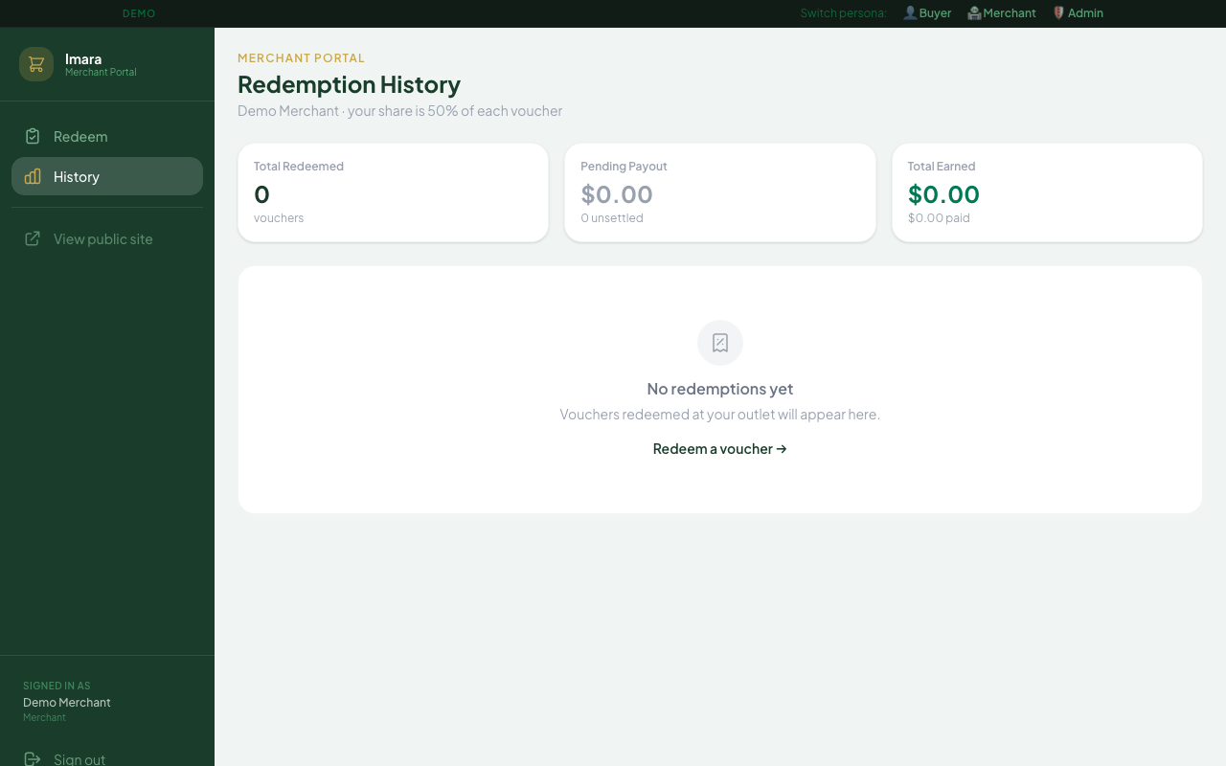
8
Merchant History & KPI Cards
🏪 Merchant
Total Redeemed (count)
Pending Payout (S$)
Total Earned
📊
History page: KPI cards at top
🔢
Total Redeemed — number of coupons
💰
Pending Payout — merchant's 50% not yet settled
💵
Total Earned — all-time merchant portion
📋
Per-coupon list with dates below KPIs
🖥 22 Merchant History
💡 Pending Payout clears to S$0 after admin clicks 'Mark Settled' on /admin/settlements

Slide 14
💰
SECTION 4
Admin Settlement
Mosque calculates and pays merchant partners

Slide 15
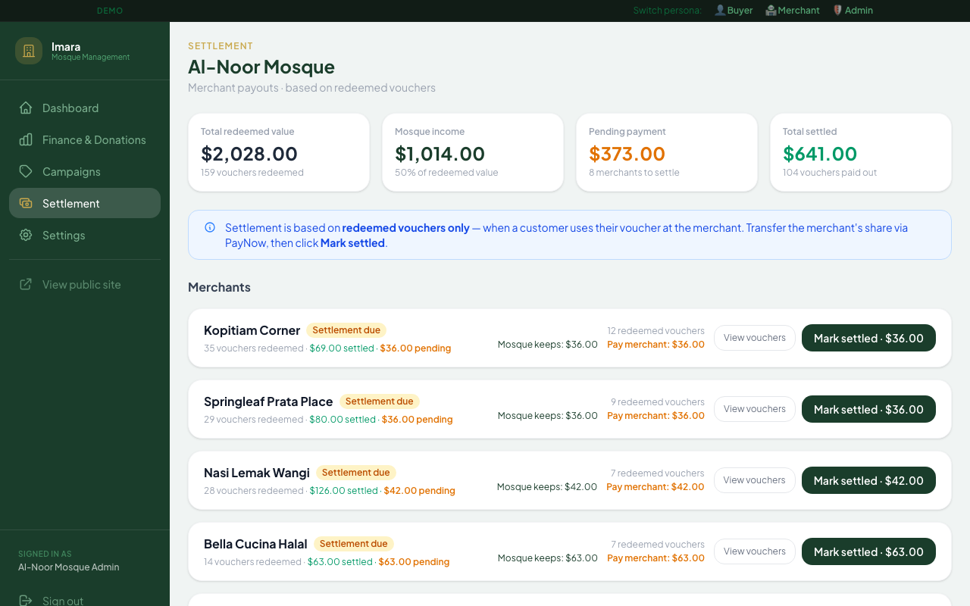
9
Admin Settles with Merchant
🛡 Admin
Grouped by merchant
📧
Admin receives: 'Coupon redeemed · Merchant · S$X'
💰
Sidebar → Settlement (or Finance → 'Settle now →')
📊
Page shows redeemed coupons by merchant:
🕌
Mosque portion 50%: S$XX (kept)
50% mosque portion
50% merchant portion
🏪
Merchant portion 50%: S$XX (to pay)
🏦
Admin PayNows S$XX to merchant (manual transfer)
✅
Click 'Mark Settled' → timestamp recorded
📋
Settlement only for REDEEMED coupons (service done)
Mark Settled →
🖥 13 Admin Settlements
💡 Settlement is triggered by redemption (service delivered), not purchase — ensures merchant earns only after serving

Slide 16
Key Identifiers — Order Reference vs Coupon Token
ORDER REFERENCE
COUPON TOKEN
IMA-Y5MNEA
ABCD-EFG2-HJK3
Created
When buyer places order
Created
When admin verifies payment
1 order
→
1+ tokens
Used by
Buyer — to track order status
Used by
Merchant — to redeem voucher
Page
/orders (Track Order in nav)
Page
/merchant/redeem (Redeem page)
Also on
PayNow page as payment reference
Also on
/coupons/[token] — QR code
Example
IMA-Y5MNEA, IMA-GZSP6W
Example
ABCD-EFG2-HJK3, WXYZ-1234-PQRS
Buyer uses this
for tracking
Merchant uses this
for redemption
💡 Serial number links them: IMA-Y5MNEA-01, IMA-Y5MNEA-02 (one per coupon quantity purchased)

Slide 17
50 / 50 Split — How the Money Flows
Example: 1 × Roti Prata Combo · S$8 total via PayNow
🕌 S$4 → Mosque
🏪 S$4 → Merchant
Fundraising proceeds
Reimbursement for meal served
✅
Zero platform fees
PayNow direct — full S$8 received by mosque, no gateway deduction
🔒
Unsettled until redeemed
Merchant is only paid after they serve the customer — not on purchase
📋
Full audit trail
Every token timestamped: created → redeemed → settled
🎫
Multi-coupon orders
3 × S$8 = S$24 → 3 separate coupon tokens, each redeemable once
📊
Automatic calculation
Settlement page calculates exact amounts — admin just clicks Mark Settled

Slide 18
إِمَارَة · Imara
Developing · Building · Flourishing
🔗 Live URL
mosque-os-ai.vercel.app
🛡 Admin login
admin / Imara@2026 → /admin/login
🏪 Merchant
PIN: 1234 → /merchant/login
💳 PayNow UEN
6596805367
📧 Admin email
mdghazali.ahmad@gmail.com
🎬 Demo bar
Switch personas instantly on every page
Zero platform fees · PayNow · Open source · Built for Singapore mosques

