Slide 1
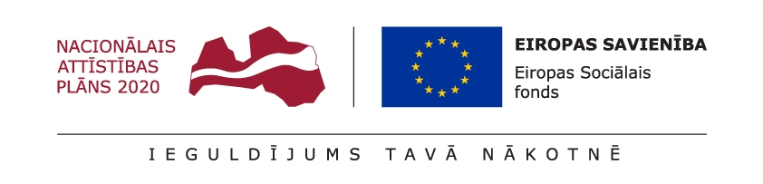
Programmatūras testēšana
Tēma Nr.5 _Testu plānošana
Uzdevumi

Slide 2
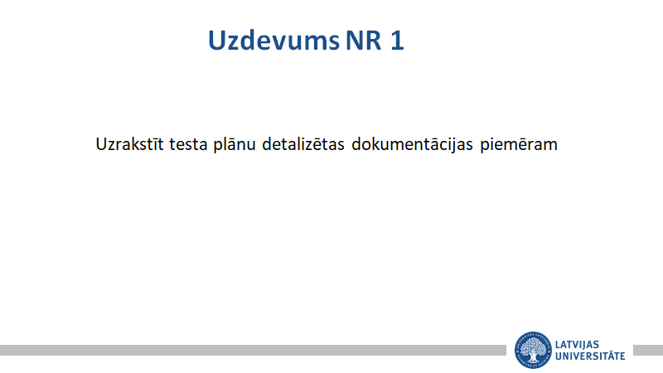

Slide 3
Piemērs.
Test Plan
Session use case
✓ ATM
▪ Operator:
o Will vertify and enter total cash on hand before starting machine, after will turn on machine with ‘’ON’’ switch.
▪ Bank:
o Customer will be required to insert an ATM card and enter PIN, both of which will be sent to the bank for validation as part of each transaction.
▪ User/customer:
o Card inserted in card reader slot
➢ Card is readed
o Customer asked to enter PIN
▪ Pin successful
• Can do several transactions and select them from menu. After each successful transaction the customer asked whether he/she would like to perform another (will be promted again to re-enter PIN).

Slide 4
▪ If yes, completes another transaction.
▪ If no, card is ejected from the machine.
▪ Pin un-successful
• Has total of three attempts to retry PIN entry.
▪ If failed, ATM permanently retains card.
▪ If successful can return to successful PIN attempt case.
➢ Card is not readed
o Cannot read due to damaged stripe
▪ Card is ejected
• Error screen is displayed and session not started.
o Cannot read due to improper insertation
• Error screen is displayed and session not started.

Slide 5
Cash withdrawal transaction use case
✓ ATM o Operator:
o Will vertify and enter total cash on hand before starting machine, after will turn on machine with ‘’ON’’ switch
. o User/Customer: o Customer chooses withdrawal transaction from menu enters successful PIN.
• Customer chooses type of account to withdraw.
o Then chooses dollar amount from menu of possible amounts.
▪ If successful gives out money and asks do you want to make another transaction, or end session.
▪ If unsuccessful initiates failed transaction extension.
o Bank:
▪ System verifies that it has sufficient money on hand to complete the request. The bank is notified by every transaction.
• If ATM has sufficient amount the request is processed.
o Sends customers card number, PIN, chosen account and amount to the bank.

Slide 6
▪ IF transaction is approved:
▪ The machine dispenses the correct amount of cash and issues a receipt. Transaction is completed.
▪ IF transaction is not approved:
▪ Due to incorrect pin, the Incorrect PIN extension is executed.
▪ All other disapprovals are reported to the session, which initiates the Failed transaction extension.
• If ATM does not have sufficient amount, system reports a failure to the session.
o Initiates the Failed transaction extension to report the problem.
Deposit transaction use case
✓ ATM
o Operator:
o Will vertify and enter total cash on hand before starting machine, after will turn on machine with ‘’ON’’ switch.
o After successful customers account crediting/deposit transaction, operator turns machine on a ‘’OFF’’ switch, manually approves deposit envelope contents, reload the machine with cash, blank receipts, etc. – Not clear how many times a day or at end of the day.

Slide 7
o User/customer:
▪ Customer chooses deposit transaction from menu enters successful PIN.
• Customer chooses type of account to deposit to. o Then chooses dollar amount from menu of possible amounts.
▪ If successful gives out money and asks do you want to make another transaction, or end session.
▪ If unsuccessful initiates failed transaction extension.
o Bank:
▪ The bank is notified by every transaction. The system sends the customers card number, PIN, chosen account, amount of transaction.
❖ IF transaction is approved machine accepts envelope within a time period from customer and issues receipt: ▪ Machine accepts envelope from customer and issues receipt.
o The bank completes debiting the customer’s account for the amount. Transaction is complete.
❖ IF transaction is not approved:
❖ Due to incorrect pin, the Incorrect PIN extension is executed.
❖ All other disapprovals are reported to the session, which initiates the Failed transaction extension.
▪ If transaction is disapproved due to a failure to the session, or any other reason.
o Initiates the Failed transaction extension to report the problem.

Slide 8
Transfer Transaction use case
✓ ATM o Bank:
▪ When customer chose transaction, account, amount, system sends this information to bank, which either approves or disapproves the transaction.
➢ IF transaction is approved machine issues receipt.
➢ Bank considers the transaction complete.
➢ IF transaction is not approved:
➢ Due to incorrect pin, the Incorrect PIN extension is executed. Bank considers transaction incomplete.
➢ All other disapprovals are reported to the session, which initiates the Failed transaction extension. Balance
Inquiry transaction use case.
✓ ATM o Bank: ▪ When customer chose transaction, account, amount, system sends this information to bank, which either approves or disapproves the transaction.
➢ IF transaction is approved bank sends the balance to the machine with the approval.
➢ System prints it on receipt. Bank considers the transaction complete.

Slide 9
➢ IF transaction is not approved:
➢ Due to incorrect pin, the Incorrect PIN extension is executed. Bank considers transaction incomplete.
➢ All other disapprovals are reported to the session, which initiates the Failed transaction extension. Invalid PIN
Extension user case
✓ ATM o Bank:
▪ Customer will be required to insert an ATM card and enter PIN, both of which will be sent to the bank for validation as part of each transaction. o Customer asked to enter PIN.
▪ Pin successful. • Can do several transactions (will be asked to re-enter PIN) and select them from menu. After each successful transaction, the customer asked whether he/she would like to perform another.
▪ If yes, completes another transaction. ▪ If no, card is ejected from the machine.
▪ Pin un-successful. • Has total of three attempts to retry PIN entry.
▪ If failed, ATM permanently retains card.
▪ If successful can return to successful PIN attempt case.
Failed Transaction Extension user case ✓ ATM ▪ Transaction use case is failed other reason than repeated entries of invalid PIN. • Screen displayed informing customer of the problem. o Asked customer whether he/she wants to do another transaction

Slide 10
Failed Transaction Extension user case
✓ ATM ▪ Transaction use case is failed other reason than repeated entries of invalid PIN.
• Screen displayed informing customer of the problem.
o Asked customer whether he/she wants to do another transaction.

Slide 11
