Slide 1
Logging with Log4J

Slide 2
Introduction
Logging - chronological and systematic record of data processing events in a program. Possible goals:
  Create an audit trail
  Investigate usage patterns
  Discover problems and debug
Log4J is the most popular Java approach to logging

Slide 3
Auditing and Usage Patterns
Transactions in any system may be recorded as audit/paper trail, which allows to discover all the operations done with the business objects. This allows to protect the system against malevolent people.
Large volumes of audit data can be used to find out how the system is typically used (e.g. in Web server logs).

Slide 4
Logging vs. Debugging
Logging is faster then using a debugger.
Logging can be used to diagnose problems in the production stage as well as during development.
Logging is easier than debugging in a distributed computing environment.
To use logging as a debugging tool we need to record lots of events.

Slide 5
Activities Similar to Logging
All these may write to a storage device. The mode and purpose of writing is different.
  Tracing
  Debugging
  Error Handling
  Logging

Slide 6
Various Logs
Various logs may be driven by:
  Tracing the program flow, intercepting method calls
  Details of method execution at a granular level
  Error conditions and exceptions that have occurred in the system
  History of business events
  Interactions with users and other systems

Slide 7
Approaches to Logging
System.out.println
  Not very fast
  Not easy to customize. Could use like this:
  Class Sample {
    public static final boolean debug = true;
    public void test(){
      if (debug) System.out.println("Only during development");
    }
  }
Custom logging API
  Build vs buy decision
Open Source (like Log4j)

Slide 8
Java Specification JSR47
Logging to serve various target groups
Configure logging from a property file and also at runtime
Log granularity (by function, by level, by custom filter)
Connect to existing logging services
Provide internationalization
Available for public review at http://java.sun.com/aboutJava/communityprocess/review/jsr047/index.html

Slide 9
Log4J background
In 1996, the SEMPER project developed a tracing API
Later modified by IBM at their Zurich research lab (www.zurich.ibm.com)
Currently maintained by Source Forge (www.sourceforge.net).
Open source
Release 1.0+ documentation at http://jakarta.apache.org/log4j/index.html

Slide 10
Log4J Design Principles
Log4j claims to be fast and flexible: speed first, flexibility second.
Although log4j has a many features, its first design goal was speed. Some log4j components have been rewritten many times to improve performance.

Slide 11
Performance
After development - should log messages stay in the code?
  When logging is turned off the cost of a log request is a method invocation plus an integer comparison. This takes a few nanoseconds.
  The typical cost of an executed log request is about 100 microseconds. This is the cost of formatting the log message and sending it to the destination.

Slide 12
Hidden costs of logging
Method invocation involves the "hidden" cost of parameter construction. To avoid the parameter construction cost you could write:
if (logger.isDebugEnabled()) {
logger.debug("Entry " + i + " is " + String.valueOf(entry[i]));
}
instead of
logger.debug("Entry " + i + " is " + String.valueOf(entry[i]));
Event better: avoid concatenation altogether; send objects to the logger (which have toString() method)

Slide 13
Basic API
Printing messages are of the form:.
debug(Object message, Throwable t)
debug(Object message)
If the 1st argument is a String object, it will be written in its present form. Other objects rendered by a registered Object renderer for its class or using the Object.toString method.

Slide 14
Basic Usage Example
Standard usage.
class Foo {
Logger logger;
public Foo() {
logger = Logger.getInstance(getClass());
logger.info(“Constructing foo”);
}
public String doStuff(long x){
logger.debug(“doing stuff”);
}
}

Slide 15
Priorities
Five recognized message priorities:
  DEBUG,INFO,WARN,ERROR ,FATAL
Priority specific log methods following the the form:
  debug(Object message);
  debug(Object message, Throwable throwable);
General log methods for wrappers and cutom priorites:
  log(Priority level, Object message);
  log(Priority level, Object message,Throwable throwable);
Localized log methods supporting ResourceBundles:
  L7dlog(Priority level, String message, Throwable throwable)
  L7dlog(Priority level, Object[] params, Throwable throwable)
  setResourceBundle(ResourceBundle);

Slide 16
Loggers
Loggers define a hierarchy and give the programmer run-time control on which statements are printed or not.
Loggers are assigned priorities. A log statement is printed depending on its priority and its category.
Used to support output to multiple logs (Appenders) at the same time.
Log4j.category.com.mycompany.finance=INFO, FIN_Appender
This will direct all log messages in package com.mycompany.finance with priority > INFO.

Slide 17
Logger Names
You can name by locality. It turns out that instantiating a logger in each class, with the logger name equal to the fully-qualified name of the class, is a useful and straightforward approach.
However, this is not the only way for naming. A common alternative is to name loggers by functional areas. For example, the "database" logger, "RMI" logger, "security" logger, or the "XML" logger.

Slide 18
Benefits of using fully qualified class names for categories.
It is very simple to implement.
It is very simple to explain to new developers.
It automatically mirrors your application's own modular design.
It can be further refined at will.
Printing the category automatically gives information on the locality of the log statement.

Slide 19
Root category
If no category is defined via a configuration file or programmatically, then all messages will be sent to the root category.
All Categories define a priority level and an Appender.
Ex of definition in (log4j.properties):
Log4j.rootCategory=WARN, ROOT_Appender

Slide 20
Appenders
An Appender is a object that sends log messages to their final destination.
FileAppender – Write to a log file
SocketAppender – Dumps log output to a socket
SyslogAppender – Write to the syslog.

Slide 21
Appenders con’t
NTEventLogAppender – Write the logs to the NT Event Log system.
RollingFileAppender – After a certain size is reached it will rename the old file and start with a new one.
SocketAppender – Dumps log output to a socket
SMTPAppender – Send Messages to email
JMSAppender – Sends messages using Java Messaging Service
Or create your own. Not that difficult.

Slide 22
PatternLayout – Customize your message
Used to customize the layout of a log entry. The format is closely related to conversion pattern of the printf function in ‘c’ The following options are available:
c - Used to output the category of the logging event.
C - Used to output the fully qualified class name of the caller issuing the logging request.
d - Used to output the date of the logging event. The date conversion specifier may be followed by a date format specifier enclosed between braces. For example, %d{HH:mm:ss,SSS} or %d{dd MMM yyyy HH:mm:ss,SSS}. If no date format specifier is given then ISO8601 format is assumed
F - Used to output the file name where the logging request was issued.
l - Used to output location information of the caller which generated the logging event. (C+M+L)
L - Used to output the line number from where the logging request was issued.

Slide 23
PatternLayout – Customize your message
n - Outputs the platform dependent line separator character or characters.
M - Used to output the method name where the logging request was issued.
p - Used to output the priority of the logging event.
t - Used to output the name of the thread that generated the logging event.
x - Used to output the NDC (nested diagnostic context) associated with the thread that generated the logging event.

Slide 24
Sample log4j.properties
# Set options for appender named "ROOT_Appender"
# It should be a RollingFileAppender, with maximum file size of 10 MB# using at most one backup file. The layout is using a pattern layout. ISO8061 date format with context printing enabled.
log4j.appender.ROOT_Appender=org.log4j.RollingFileAppender
log4j.appender.ROOT_Appender.File=out.log
log4j.appender.ROOT_Appender.MaxFileSize=10MB
log4j.appender.ROOT_Appender.MaxBackupIndex=1
log4j.appender.ROOT_Appender.layout=org.log4j.PatternLayout
log4j.appender.ROOT_Appender.layout.ConversionPattern=%d{ISO8601} %p %t %x - %m%n
# Root category set to DEBUG using the ROOT_Appender appender defined above.
log4j.rootCategory=INFO, ROOT_Appender
log4j.category.com.emaritz.registration.ejb=DEBUG

Slide 25
Architecture
The Log4j package is distributed under the Apache Software License
The latest Log4j version can be found at http://logging.apache.org/log4j/
Log4j has been ported to the C, C++, C#, Perl, Python, Ruby, and Eiffel languages

Slide 26
Continue...
Why Log4j is so popular
  Log4j is designed to be fast and extensible
  Log4j is simple and easy to use
  Able to disable certain log statements while allowing others to print unhindered
Log4j has three main components:
  Logger: handling the majority of log operations
  Appender: controlling the output of log operations
  Layout: formatting the output for Appender

Slide 27
Component --- Logger
Logger has 7 levels
  ALL
  DEBUG
  INFO
  WARN
  ERROR
  FATAL
  OFF

Slide 28
Loggers - continued
The behaviour of loggers is hierarchical
  A logger is said to be an ancestor of another logger if its name followed by a dot is a prefix of the descendant logger name
  For example, the logger named “ca.hippo" is a parent of the logger named "ca.hippo.bugtracking“
  The root logger resides at the top of the logger hierarchy

Slide 29
Loggers - continued
  The logger level is either set explicitly or inherited from the parent (see table below)
Logger Name | Assigned Level | Inherited Level
Root | DEBUG | DEBUG
X | INFO | INFO
X.Y | none | INFO
X.Y.Z | ERROR | ERROR

Slide 30
Logger - continued
Logging requests
  debug, info, warn, error, fatal and log are methods of a logger instance to log a message
  logger.info("Hippo starts") is a logging request of level INFO
  A logging request is said to be enabled if its level is higher than or equal to the level of its logger. Otherwise, the request is said to be disabled

Slide 31
Logger - continued...
  A logger without an assigned level will inherit one from the hierarchy
  This rule is at the heart of log4j

Slide 32
Logger inheritance example
  import org.apache.log4j.*;
  public class LogDemo1 {
  static Logger logger = Logger.getLogger(LogDemo1.class);
  static Logger childLogger = Logger.getLogger("logging.demo.LogDemo1.child");
  public static void main(String args[]) {
  String pattern = "Message: %m %n";
  PatternLayout layout = new PatternLayout(pattern);
  ConsoleAppender appender = new ConsoleAppender(layout);
  logger.addAppender(appender);
  logger.setLevel(Level.DEBUG);
  logger.debug("Enabled message");
  logger.setLevel(Level.INFO);
  logger.debug("Disabled message");
  childLogger.debug("Child DEBUG message");
  childLogger.info("Child INFO message");
  }
  }

Slide 33
Component --- Appender
An output destination of a logger is called an appender
Currently, appenders exist for:
  console, files, GUI components, remote socket servers, JMS, NT Event Loggers, and remote UNIX Syslog daemons. It is also possible to log asynchronously

Slide 34
Appenders - Continued
Accordingly we have many appender type:
  ConsoleAppender, DailyRollingFileAppender, FileAppender, RollingFileAppender, WriterAppender, WriterAppender, SocketAppender, SocketHubAppender, SyslogAppendersends, TelnetAppender
Log4j allows logging requests to print to multiple destinations

Slide 35
Appenders - continued
The addAppender method adds an appender to a given logger
Appenders are inherited additively from the logger hierarchy
  Each enabled logging request for a given logger will be forwarded to all the appenders in that logger as well as the appenders higher in the hierarchy

Slide 36
Appenders - continued
Appender accumulation is no longer additive by setting the logger’s additivity flag to false
  L1.L2.L3.L4
  L1(f1), L2(f2), L3(f3, false), L4(f4)
Examples: together with Layout

Slide 37
Component --- Layout
Layout is responsible for formatting the output for Appender
There are three types of Layout available:
  SimpleLayout: (Level - log message)
  PatternLayout formats the output based on a conversion pattern specified, or if none is specified, the default conversion pattern
  HTMLLayout formats the output as a HTML table

Slide 38
Pattern Example
import org.apache.log4j.Level;
import org.apache.log4j.Logger;
import org.apache.log4j.PatternLayout;
import org.apache.log4j.ConsoleAppender;
public class LogDemo2 {
static Logger logger = Logger.getLogger(LogDemo2.class);
public static void main(String args[]) {
String pattern = "Milliseconds since program start: %r %n"
+ " Classname of caller: %C %n"
+ " Date in ISO8601 format: %d{ISO8601} %n"
+ " Location of log event: %l %n"
+ " Message: %m %n %n";
PatternLayout layout = new PatternLayout(pattern);
ConsoleAppender appender = new ConsoleAppender(layout);
logger.addAppender(appender);
logger.setLevel((Level) Level.DEBUG);
logger.debug("Here is some DEBUG");
try {
Thread.sleep(1000);
} catch (InterruptedException e) {
}
logger.debug("Here is more DEBUG");
}
}

Slide 39
Output from Example
Milliseconds since program start: 0
Classname of caller: logging.demo.LogDemo2
Date in ISO8601 format: 2006-05-05 08:39:07,371
Location of log event: logging.demo.LogDemo2.main(LogDemo2.java:21)
Message: Here is some DEBUG
Milliseconds since program start: 1012
Classname of caller: logging.demo.LogDemo2
Date in ISO8601 format: 2006-05-05 08:39:08,383
Location of log event: logging.demo.LogDemo2.main(LogDemo2.java:26)
Message: Here is more DEBUG

Slide 40
BasicConfigurator Example
import org.apache.log4j.*;
public class Demo {
static Logger log = Logger.getLogger(Demo.class.getName());
public static void main(String[] args) {
BasicConfigurator.configure();
log.info("Starting up...");
log.setLevel(Level.WARN);
log.info("This message should not appear!");
try {
// Divide by zero.
int x = 5;
int y = 20 / (5 - x);
} catch (Exception e) {
log.error("Oops!", e);
}
}
}

Slide 41
Output from Example2
0 [main] INFO Demo - Starting up...
10 [main] ERROR Demo - Oops!
java.lang.ArithmeticException: / by zero
at Demo.main(Demo.java:17)

Slide 42
Using external configuration file
Options do not have to be hard-coded within the software
Options can be changed without having to recompile the software
It is slightly slower
There are two ways in which one can specify the external configuration file:
  Plain text file (PropertyConfigurator)
  XML file (DOMConfigurator)

Slide 43
Example: log4j.properties
log4j.rootLogger=DEBUG, myAppender
log4j.appender.myAppender=org.apache.log4j.ConsoleAppender
log4j.appender.myAppender.layout=org.apache.log4j.PattenLayout
log4j.appender.myAppender.layout.ConversionPattern= \
%-4r [%t] %-5p %c %x - %m%n

Slide 44
Example: Usaging in Java
import org.apache.log4j.Logger;
import org.apache.log4j.PropertyConfigurator;
public class Hippo {
static Logger logger = Logger.getLogger(Hippo.class);
public static void main(String args[]) { PropertyConfigurator.configure(
"log4j.properties");
logger.debug("Here is some DEBUG"); logger.info("Here is some INFO");
logger.warn("Here is some WARN");
logger.error("Here is some ERROR");
}
}

Slide 45
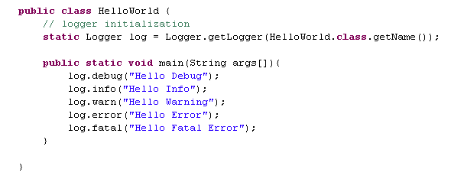
Example4 (using external configuration)

Slide 46
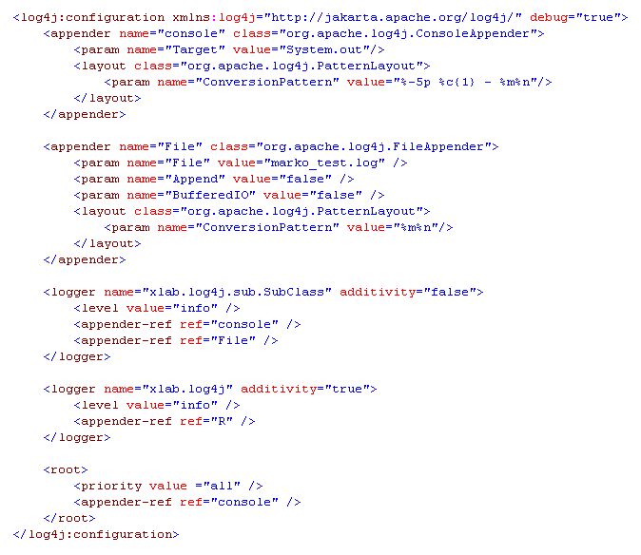
Example5: XML-based Configuration

Slide 47
Topics not covered
The support of nested diagnostics contexts (NDC) by Log4j
XML Configuration
XMLLayout
Custom Priority classes
Custom Layout classes
Object renderers.

Slide 48
Reference
http://logging.apache.org/log4j/index.html
http://supportweb.cs.bham.ac.uk/documentation/tutorials/docsystem/build/tutorials/tutorialshome.html (http://supportweb.cs.bham.ac.uk/documentation/tutorials/docsystem/build/tutorials/log4j/log4j.html )
http://www.third-bit.com/2005-winter/log4j.ppt

