Slide 1

Clean Code
Homicidal Maniacs Read Code, Too

Slide 2
Course Goals
Write simple, expressive code
Identify and fix code smells
Refactor legacy code into clean code
Review code effectively

Slide 3
What is Clean Code?
Readable
Maintainable
Testable
Elegant

Slide 4
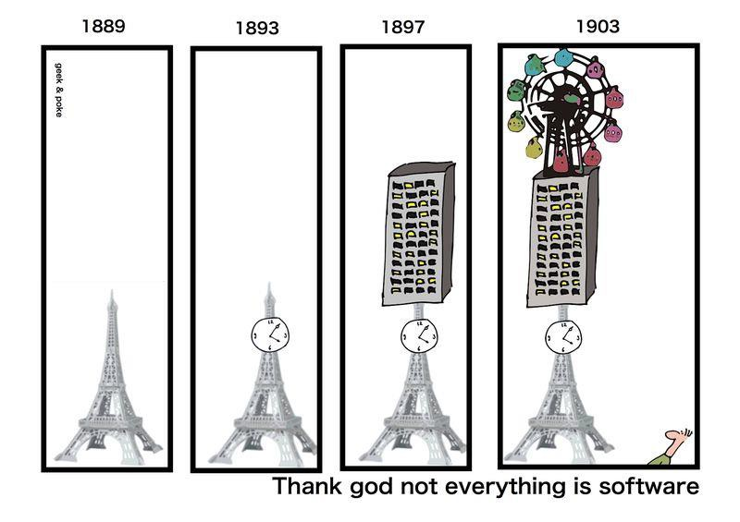
http://geekandpoke.typepad.com/geekandpoke/2012/03/thank-god-not-everything-is-software.html

Slide 5
Why Do We Care?
There’s no such thing
as write-once code
Bug Fixes
Business Changes
Enhancements
New Functionality

Slide 6
What Prevents Clean Code?
Ignorance
Stubbornness
Short-Timer Syndrome
Arrogance
Job Security
Scheduling

Slide 7
What Prevents Clean Code?
Number one reason:
“I’ll clean it up later.”
Pro Tip: “Later” never comes.

Slide 8
The Truth about Clean Code
Clean Code saves time.
We can’t take a short-term view of software.
We need to look at the lifespan of the
application.

Slide 9
How Do You Write Clean Code?
Rule of Thumb:
Imagine that the developer
who comes after you
is a homicidal maniac
who knows where you live.
-Unknown

Slide 10
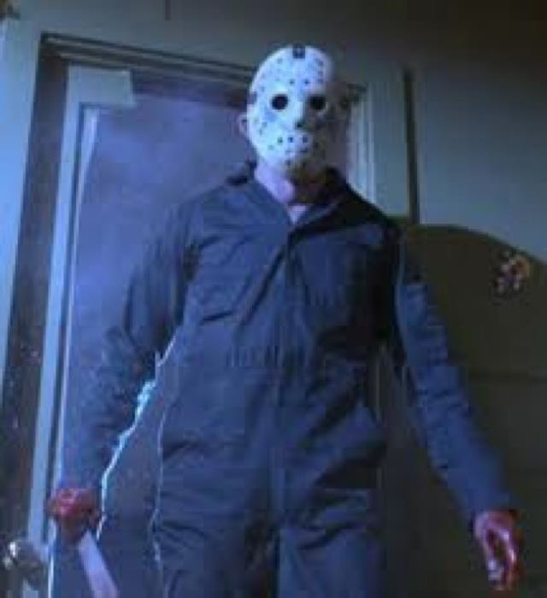
The Next
Developer
Json

Slide 11
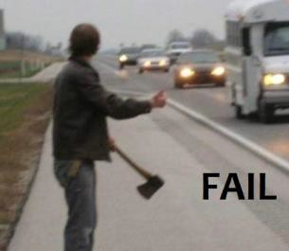
This Might
Take Awhile

Slide 12
The Problem
Readable (by mere mortals)
Maintainable
Testable
Elegant
All of these qualities are subjective.

Slide 13
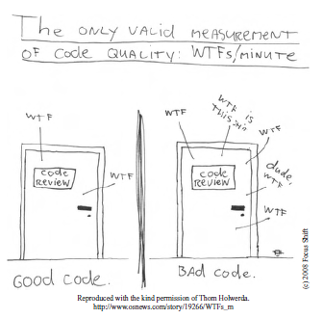
Code Quality

Slide 14
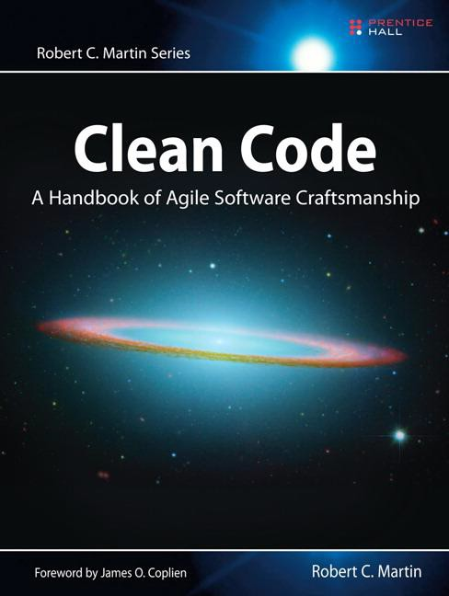

Robert C. Martin
Michael C. Feathers

Slide 15
Be a Clean Code Advocate
The Boy Scout Rule
Always leave the campground cleaner than you found it.
The Clean Coder Rule
Always leave the code
cleaner than you found it.

Slide 16
Thank You!

