Slide 1

Chapter 2 Meaningful Names

Slide 2
How to choose good names?
Increase your vocabulary
Read docs and codes a lot!
Watch tech events, eg. IO, DevSummit, .Net conf, …
Review release notes

Slide 3
Intention revealing names
Name of a variable, function, class Should tell you:
Why it exist
What it does
How it is used

Slide 4
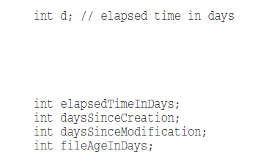
Intention revealing names

Slide 5
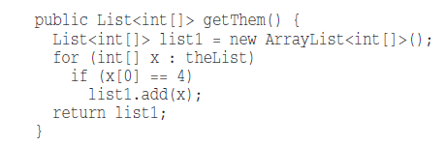
Intention revealing names
Notes:
The problem isn’t the simplicity of the code but the implicity of the code
What kinds of things are in theList?
What is the significance of the zeroth subscript of an item in theList?
What is the significance of the value 4?
How would I use the list being returned?

Slide 6
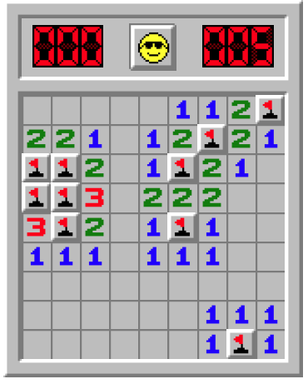
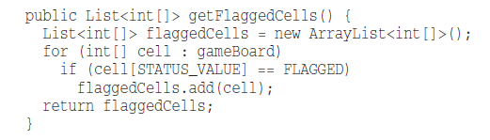
Intention revealing names
Notes:
Say that we’re working in a mine sweeper game.
theList => gameBoard (list of cells)
status value of 4 = flagged

Slide 7
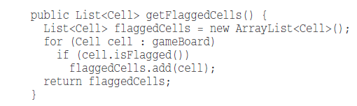
Intention revealing names
Notes:
write a simple class for cells instead of using an array of ints.

Slide 8
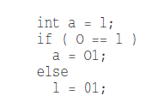
Avoid disinformation
hp, aix, btn
accountList
Notes:
hp, aix, btn => different meaning in different contexts
accountList might be group of accounts with type of Set, Map, … => accounts is better

Slide 9
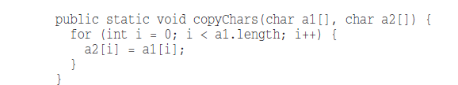
Meaningful distinction
TheCustomer, CustomerData, CustomerInfo ??
Notes:
a1 = source, a2 = destination

Slide 10
Pronounceable Names
Don't compact names for sake of smaller words, eg.
pref
mnger
genymdhms
Notes:
genymdhms => generation date, year, month, day, hour, minute, and second

Slide 11
Searchable Names
Categury
KetabTable
a, att

Slide 12
Avoid Encodings
Hungarian notation => frmReserve, tblStudent, btnAdd
Member prefix => mLatitude
Interface & Implementation => IShape, ICategory prefer to use, Shape and ShapeImpl
Type encoding => PhoneNumber phoneString;
Notes:
This adds unnecessary mental mapping
Why Impl instead of I => I don’t want my users knowing that I’m handing them an interface.

Slide 13
Class names
Noun or noun phrases (Not a verb)
Account, Customer, WikiPage
avoid words like : Manager, Processor, Data or Info

Slide 14
Method names
Verbs or phrase names
postPayment(), deletePage(), save()
isPosted(), hasReader() for Boolean results
Notes:
Boolean functions should answer Yes/No

Slide 15
Don’t Be Cute
whack() instead of kill()
getOut() instead of exit()
deleteTheTrash() instead of forceDelete()
holyHandGrenade() instead of deleteItems()

Slide 16
One Word per Concept
to get items => fetch, retrieve, get
delete => erase, remove, delete, destroy
save => store, save, apply

Slide 17
Don’t Pun
Avoid using the same word for two purposes
using add instead of insert for a method which is putting single parameter to a collection is a pun

Slide 18
Solution Domain Names
Use computer science (CS) terms
AccountVisitor
JobQueue
AuthenticationRepository

Slide 19
Problem Domain Names
Don’t use names that are out of context and are not from that specific domain
In car app => Engine instead of power source
In ecommerce app => Cart instead of purchase basket

Slide 20
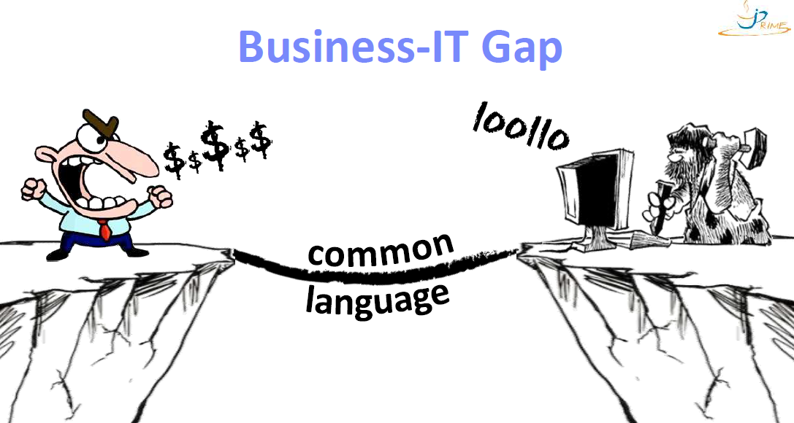
Problem Domain Names

Slide 21
Add Meaningful Context
Separate your concerns using well-named :
• Constant
• Function
• Class
• Namespace
• Package
• Module
Notes:
leaving constants alone
grouping related object into a class => firstName, lastName, street, city, state => Address

Slide 22
Vocabulary: Technical debt
Cost of additional rework caused by choosing an easy solution now instead of using a better approach that would take longer

Slide 23
Tool: CodeLF
A search tool helps dev to solve the naming things problem
Search over projects from Github, Bitbucket, GitLab, … to find real-world usage variable names.
https://unbug.github.io/codelf/
Notes:
Use terms like : Provide synonyms or antonyms in Google

Slide 24
Thank You!

