Slide 1

Chapter 3 Functions

Slide 2
Small, small, small
The first rule of functions is that they should be small.
The second rule of functions is that they should be smaller than that.

Slide 3
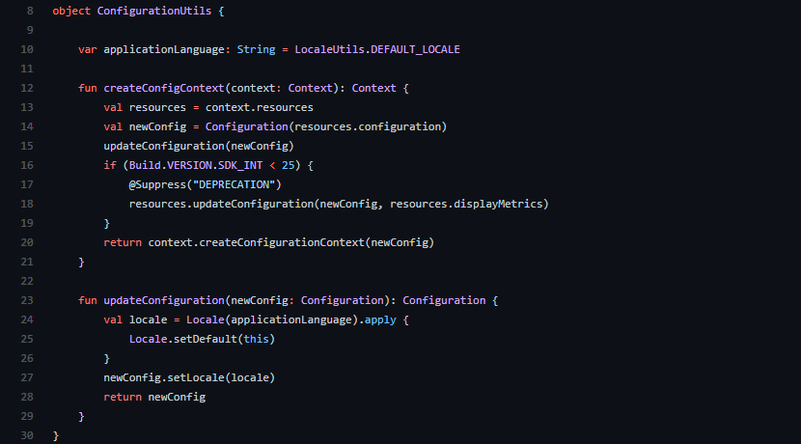
Small, small, small
< 20 Lines
120 Characters (Max)
Notes:
Line counts should not be longer than a screen size

Slide 4
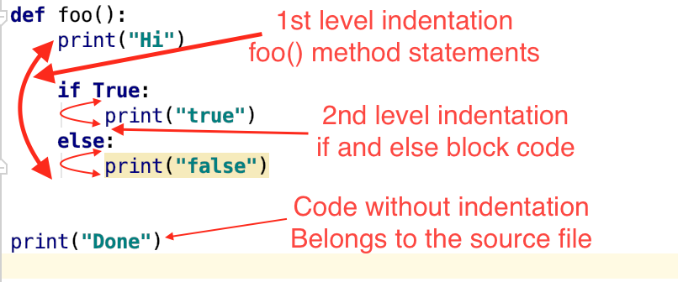
Blocks and Indenting
if/when/while/switch => One line long
1 or 2 Indentation level

Slide 5
Do one thing
Functions should do one thing.
They should do it well.
They should do it only.
Notes:
Find out a function that is doing more than one thing:
See if you can extract another function with a different name

Slide 6
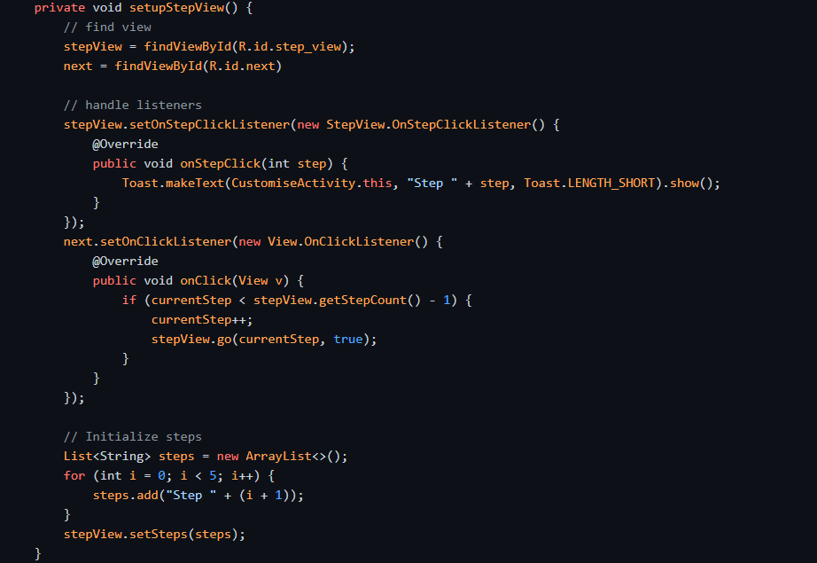
1
2
Sections within function
3
Notes:
Functions that do one thing cannot be reasonably divided into sections.

Slide 7
One Level of Abstraction per Function
High level of abstraction getHtml()
intermediate level of abstraction String pagePathName = PathParser.render(pagePath);
remarkably low level
.append("\n")
Notes:
Mixing level's of abstraction make's function confusing.

Slide 8
The Stepdown Rule
Reading Code from Top to Bottom
Read the program as though it were a set of TO paragraphs

Slide 9
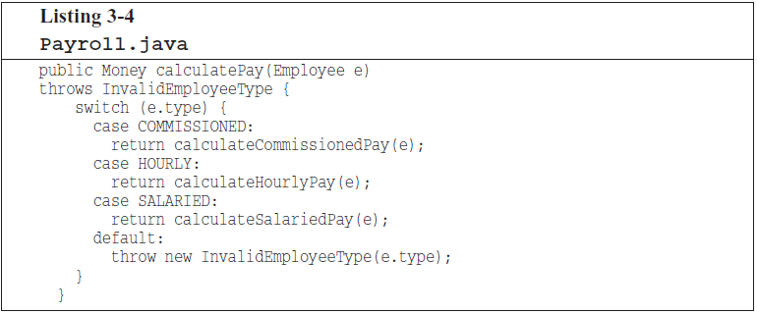
Switch Statements

Slide 10
Switch Statements
It’s large, when added new type it will grow
Does more than One thing
Violates the Single Responsibility Principle (there is more than one reason for it to change)
Violates the Open Closed Principle (it must change whenever new types are added)

Slide 11
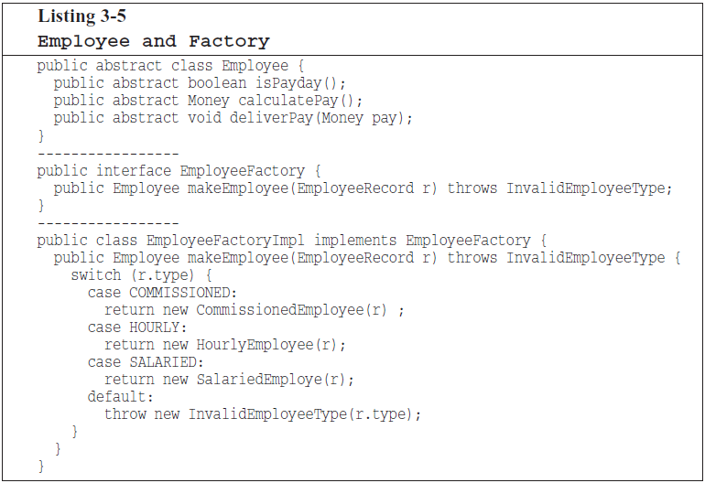
Notes:
they can be tolerated if they appear only once, are used to create polymorphic objects, and are hidden behind an inheritance relationship
so that the rest of the system can’t see them

Slide 12
Function arguments
Number of arg(s) | Should I use ? | Example
Zero | Ideal | executeMaintainance ()
1 or 2 | Good | logEvent(category: String, action: String)
3 | Avoid where possible | sendDataToRemote(data: Data, url: String, port: Int)
< 3 | Not recommended | makeThumbnail(file: File, size: Int, height: Int, width: Int)
Notes:
How many possible combination of values should be tested for each function?
Use objects to pack arguments into one

Slide 13
Flag arguments
render(isHeader: Boolean)
This function is loudly telling us it is doing more than one thing

Slide 14
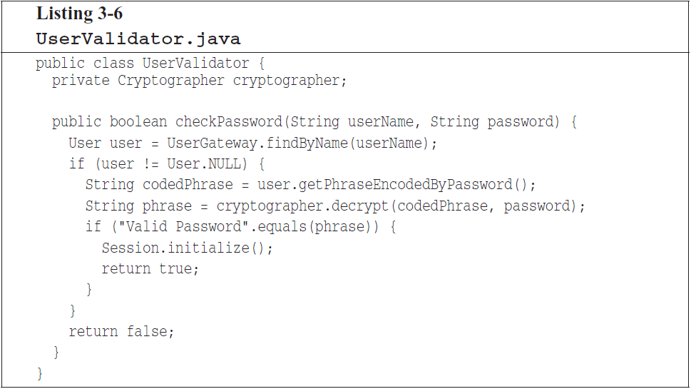
Have no side effect
Notes:
Can you spot the side effect ?
The side effect is the call to Session.initialize().

Slide 15
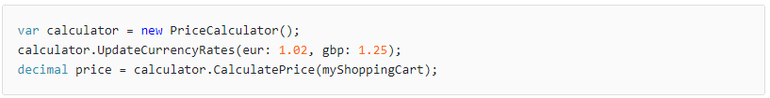
Vocabulary: Temporal coupling
when there are two or more members of a class that need to be invoked in a particular order.
https://enterprisecraftsmanship.com/posts/temporal-coupling-and-immutability
Notes:
checkPassword can only be called at certain times (in other words, when it is safe to initialize the session).
If it is called out of order, session data may be inadvertently lost.

Slide 16
Output arguments
What does this function do?
appendFooter(s);
public void appendFooter(StringBuffer report)
report.appendFooter();
Notes:
- Does this function append s as the footer to something?
- Does it append some footer to s?
- Is s an input or an output?

Slide 17
Command Query Separation
Consider this signature:
public boolean set(String attribute, String value);
What does this function do?
if (set("username", "unclebob"))...
Notes:
Is it asking whether the “username” attribute was previously set to “unclebob”?
is it asking whether the “username” attribute was successfully set to “unclebob”?

Slide 18
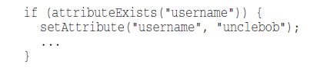
Command Query Separation

Slide 19
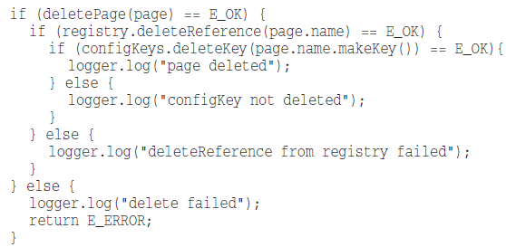
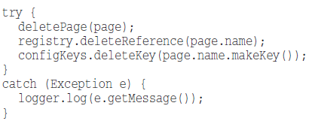
Prefer Exceptions to Returning Error Codes
Notes:
violation of command query separation.
lead to deeply nested structures
caller must deal with the error immediately

Slide 20
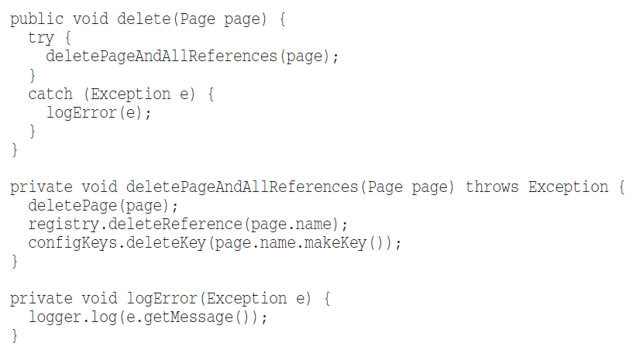
Extract Try/Catch Blocks
Notes:
- Separate concerns to the right focused place

Slide 21
Error Handling Is One Thing
Do nothing else than error handling
Try at the very first line of function
Nothing else after catch/finally blocks
Notes:
Just like functions that do one thing => error handling is also one thing

Slide 22
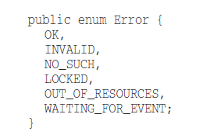
The Error.java Dependency Magnet
What happens if we add a new error?
Notes:
Use exception to add a new error type, so that you won’t need to change other classes

Slide 23
Don’t Repeat Yourself (DRY)
Costs:
Change every occurrence when one is changed
Bloat codebase with long and twisted code
Root of all evil !
Notes:
Show them what is duplicate code

Slide 24
How Do You Write Functions Like This?
Use iteration rule to reach a good code
Notes:
At first try, it’s ok to have:
duplicate code
complicated loops
clumsy code
You just jot down anything pops up into your mind and then start to refactor
Just like a writer that want’s to write a paper

Slide 25
Vocabulary: Best practices
Set of proven techniques for a particular problem.
Eg. Security, Network, Database, Cache, …

Slide 26
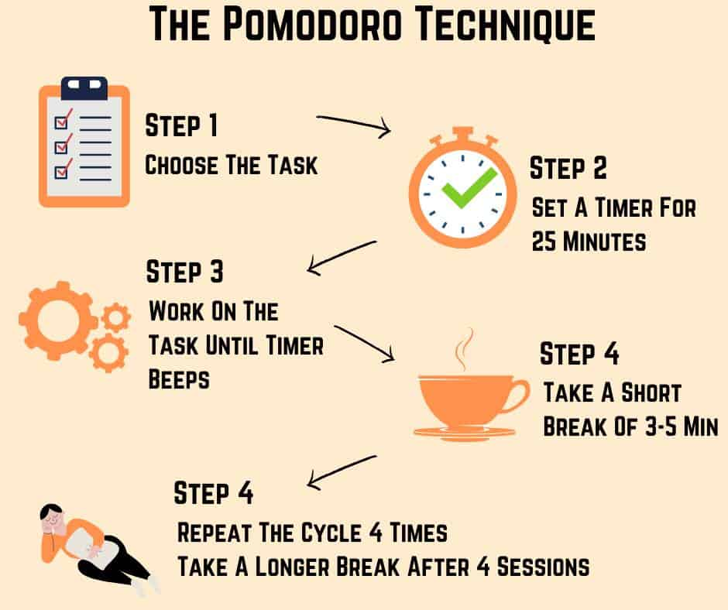
Notes:
Tell them about PomoTodo app for windows

Slide 27
Practice: Checklist for PR
Create a list of measurements to check when you’re done with a task and created a pull request (merge request) to be reviewed by your colleague
Definition of done :
We have a list of do and don’t to be checked
Naming + Functions chapters
https://github.com/javaherisaber/CleanCode

Slide 28
Practice: Checklist for PR
Code of conduct:
Clone project into your local machine
Create a branch with name cr23_{your_name}
Write down your task to Code Review checklist.md
Push your changes to remote
Use English only
https://github.com/javaherisaber/CleanCode

Slide 29
Thank You!

