Slide 1
Chapter 8: Boundaries

Slide 2
Using Third-Party Code
Any kind of reusable software component written by others which is added as dependency to our code.
Interface providers strive for broad applicability
Interface users want it to be focuesed on their needs

Slide 3
How do you learn a new 3rd party library or tool?

Slide 4
Exploring and learning boundaries
Reading documentation and codelabs
Building, Running, Debugging
Pressing dot to see options
Watching video tutorial
Asking someone to get you started
Using directly in test drive project

Slide 5
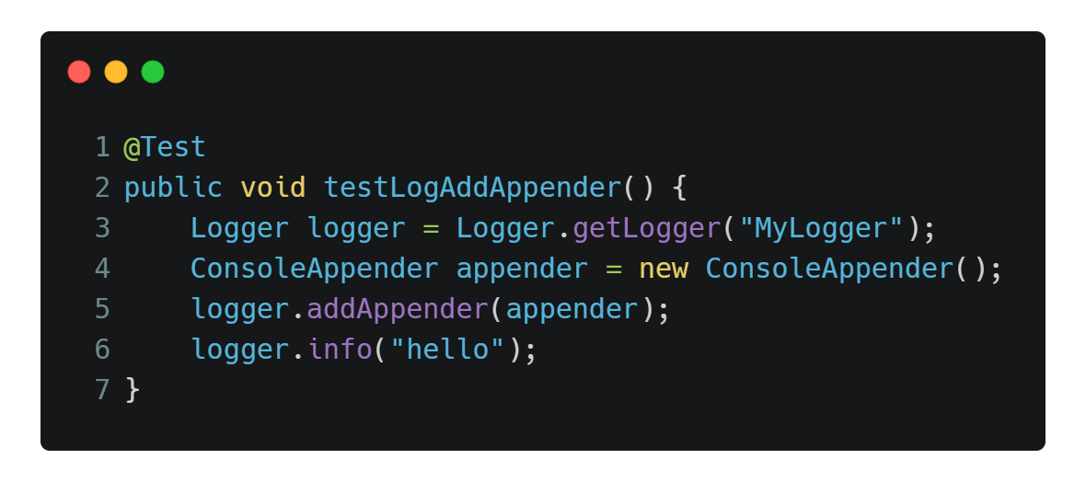
Exploring and learning boundaries
There’s another option you can take
Writing Learning tests
Notes:
You can notice incompatibilities when boundaries changes
Boundary tests ease the migration.

Slide 6
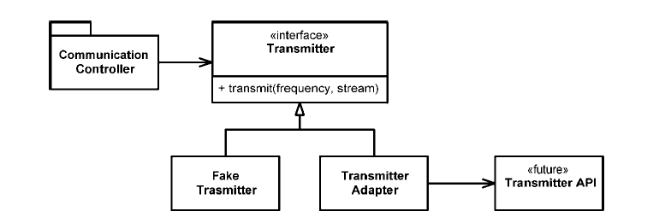
Using code that does not yet exist
Notes:
Here we don’t know how Transmitter api would be written
We created Transmitter interface to be able to mock api

Slide 7
Clean boundaries
Make a clear separation between your code and 3rd party
Reduce dependencies on 3rd party in your codebase
Isolate them in some kind of Wrapper or Adapter classes
You may use Special Case pattern to apply these rules
Write tests to keep them under control

Slide 8
Deep dive
a technique used to rapidly immerse a group or team into a situation for problem solving or idea creation. This approach is often used for brainstorming product or process development.

Slide 9
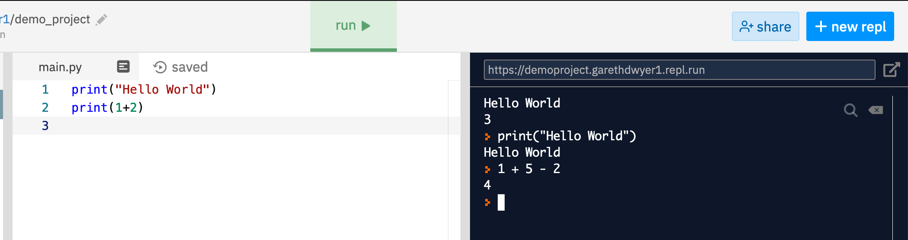
REPL and Jupyter
a shell interface that reads each line of input, evaluates that line, and then prints the result.
Notes:
REPL = Read-Eval-Print-Loop

Slide 10
Thank you

