Slide 1
Servlets
Modified slides from Dr.Sagiv

Slide 2
Introduction

Slide 3
What is a Servlet?
Servlets are Java programs that can be run dynamically from a Web Server
Servlets are a server-side technology
A Servlet is an intermediating layer between an HTTP request of a client and the Web server

Slide 4
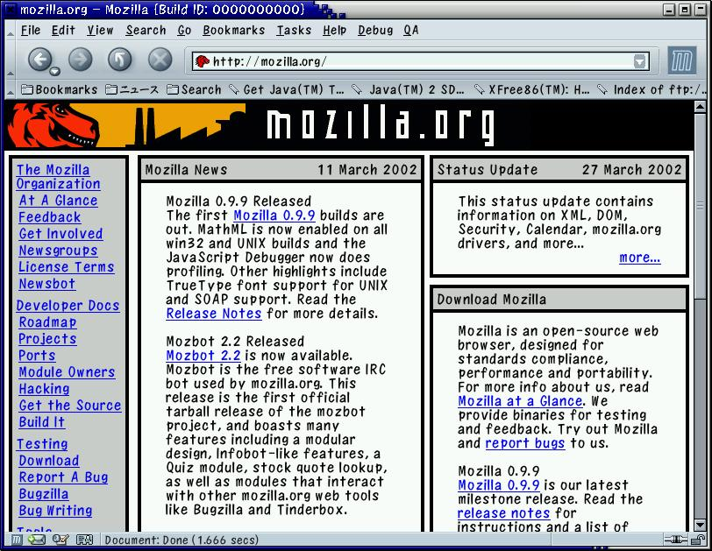
A Java Servlet
request
request
Servlet
response
response
Web browser
Web server

Slide 5
An Example
http://www.mscs.mu.edu:9080/praveen/servlet/ServletTest
(accessible only from campus)

Slide 6
What do Servlets do?
Read data sent by the user (e.g., form data)
Look up other information about the request in the HTTP request (e.g. authentication data, cookies, etc.)
Generate the result (may do this by talking to a database, file system, etc.)
Format the result in a document (e.g., make it into HTML)
Set the appropriate HTTP response parameters (e.g. cookies, content-type, etc.)
Send the document to the user

Slide 7

Supporting Servlets
To run Servlets, the Web server must support them
  Apache Tomcat
    Also functions as a module for other Apache servers
  Sun Java System Web Server and Java System Application Server
  IBM's WebSphere Application Server
  BEA’s Weblogic Application Server
  Macromedia’s Jrun – an engine that can be added to Microsoft’s IIS, Apache’s Web servers and more...
  Oracle Application Server
  …
We will use this for our class.

Slide 8
Creating a Simple Servlet

Slide 9
The Servlet Interface
Java provides the interface Servlet
Specific Servlets implement this interface
Whenever the Web server is asked to invoke a specific Servlet, it activates the method service() of an instance of this Servlet
(HTTP)
response
MyServlet
service(request,response)
(HTTP)
request

Slide 10
HTTP Request Methods
POST - application data sent in the request body
GET - application data sent in the URL
HEAD - client sees only header of response
PUT - place documents directly on server
DELETE - opposite of PUT
TRACE - debugging aid
OPTIONS - list communication options

Slide 11
Servlet Hierarchy
service(ServletRequest, ServletResponse)
Servlet
Generic Servlet
doGet(HttpServletRequest , HttpServletResponse)
doPost(HttpServletRequest HttpServletResponse)
doPut
doTrace
…
HttpServlet
YourOwnServlet

Slide 12
Class HttpServlet
Class HttpServlet handles requests and responses of HTTP protocol
The service() method of HttpServlet checks the request method and calls the appropriate HttpServlet method:
  doGet, doPost, doPut, doDelete, doTrace, doOptions or doHead
This class is abstract

Slide 13
Creating a Servlet
Extend the class HTTPServlet
Implement doGet or doPost (or both)
Both methods get:
  HttpServletRequest: methods for getting form (query) data, HTTP request headers, etc.
  HttpServletResponse: methods for setting HTTP status codes, HTTP response headers, and get an output stream used for sending data to the client
Many times, we implement doPost by calling doGet, or vice-versa

Slide 14
HelloWorld.java
import java.io.*;
import javax.servlet.*;
import javax.servlet.http.*;
public class TextHelloWorld extends HttpServlet {
public void doGet(HttpServletRequest req, HttpServletResponse res) throws ServletException, IOException {
PrintWriter out = res.getWriter();
out.println("Hello World");
}
public void doPost(HttpServletRequest req, HttpServletResponse res) throws ServletException, IOException {
doGet(req, res);
}
}

Slide 15
Returning HTML
By default, no content type is given with a response
In order to generate HTML
  Tell the browser you are sending HTML, by setting the Content-Type header
  Modify the printed text to create a legal HTML page
You should set all headers before writing the document content. Can you guess why?

Slide 16
HelloWorld.java
public class HelloWorld extends HttpServlet {
public void doGet(HttpServletRequest request,
HttpServletResponse response)
throws ServletException, IOException {
PrintWriter out = response.getWriter();
out.println("<html><head><title>Hello World</title></head>\n");
out.println("<body>");
out.println("<h2>" + new java.util.Date() + "</h2>\n");
out.println("<h1>Hello World</h1>\n</body></html>"); }
}

Slide 17
Configuring the Server
<web-app>
<servlet>
<servlet-name>hello</servlet-name>
<servlet-class>HelloWorld</servlet-class>
</servlet>
<servlet-mapping>
<servlet-name>hello</servlet-name>
<url-pattern>/hello</url-pattern>
</servlet-mapping></web-app>
</web-app>
web.xml
myApp/WEB-INF/classes/HelloWorld.class

Slide 18
Getting Information
From the Request

Slide 19
An HTTP Request Example
  GET /default.asp HTTP/1.0
  Accept: image/gif, image/x-xbitmap, image/jpeg, image/png, */*
  Accept-Language: en
  Connection: Keep-Alive
  Host: magni.grainger.uiuc.edu
  User-Agent: Mozilla/4.04 [en] (WinNT; I ;Nav)
  Cookie:SITESERVER=ID=8dac8e0455f4890da220ada8b76f; ASPSESSIONIDGGQGGGAF=JLKHAEICGAHEPPMJKMLDEM
  Accept-Charset: iso-8859-1,*,utf-8

Slide 20
Getting HTTP Data
Values of the HTTP request can be accessed through the HttpServletRequest object
Get the value of the header hdr using getHeader("hdr") of the request argument
Get all header names: getHeaderNames()
Methods for specific request information: getCookies, getContentLength, getContentType, getMethod, getProtocol, etc.

Slide 21
public class ShowRequestHeaders extends HttpServlet {
public void doGet(HttpServletRequest request,HttpServletResponse
response) throws ServletException, IOException {
response.setContentType("text/html");
PrintWriter out = response.getWriter();
String title = "Servlet Example: Showing Request Headers";
out.println(
"<html><head><title>" + title + "</title></head><body>\n"
+ "<h1>" + title+ "</h1>\n"
+ "<h2>Request Method: "+request.getMethod()+"</h2>"
+ "<h2>Request URI: "+request.getRequestURI()+"</h2>"
+ "<h2>ServletPath: "+request.getServletPath()+"</h2>"
+ "<h2>Request Protocol: "+request.getProtocol()+"</h2>"
+ "<table border=\"1\">\n"
+ "<tr><th>Header Name</th><th>Header Value</th></tr>");

Slide 22


Enumeration headerNames = request.getHeaderNames();
while (headerNames.hasMoreElements()) {
String headerName = (String) headerNames.nextElement();
out.println("<tr><td>" + headerName + "</td>"
+"<td>"+request.getHeader(headerName)+"</td></tr>");
}
out.println("</table>\n</body></html>");
}
public void doPost(HttpServletRequest request,HttpServletResponse
response) throws ServletException, IOException {
doGet(request, response);
}
}
}

Slide 23
User Input in HTML
Using HTML forms, we can pass parameters to Web applications
<form action=… method=…> …</form> comprises a single form
  action: the address of the application to which the form data is sent
  method: the HTTP method to use when passing parameters to the application (e.g. get or post)

Slide 24
The <input> Tag
Inside a form, INPUT tags define fields for data entry
Standard input types include: buttons, checkboxes, password fields, radio buttons, text fields, image-buttons, text areas, hidden fields, etc.
They all associate a single (string) value with a named parameter

Slide 25

GET Example
<form method="get"
action="http://www.google.com/search">
<p><input name="q" type="text" />
<input type="submit" />
<input type="reset" />
</p>
</form>
http://www.google.com/search?q=servlets

Slide 26

POST Example
<form method="post"
action="http://www.google.com/search">
<p><input name="q" type="text" />
<input type="submit" />
<input type="reset" />
</p>
</form>
Google doesn’t support POST!
POST /search HTTP/1.1
Host: www.google.com
…
Content-type: application/x-www-form-urlencoded
Content-length: 10
<empty-line>
q=servlets

Slide 27
Getting the Parameter Values
To get the value of a parameter named x:
  req.getParameter("x")
  where req is the service request argument
If there can be multiple values for the parameter:
  req.getParameterValues("x")
To get parameter names:
  req.getParameterNames()

Slide 28
<html><head><title>Sending Parameters</title>
<style type="text/css">
p{display:table-row} span{display:table-cell; padding:0.2em}
</style></head><body>
<h1>Please enter the parameters</h1>
<form action="SetColors" method="get">
<p>Background color:
<span><input type="text" name="bgcolor"/></span></p>
<p>Font color:
<span><input type="text" name="fgcolor"/> </span> </p>
<p>Font size:
<span><input type="text" name="size"/></span></p>
<h2>
<input type="submit" value="Submit Parameters"/></h2>
</form>
</body></html>
parameters.html

Slide 29
An Example (cont)
public class SetColors extends HttpServlet {
public void doGet(HttpServletRequest
request,HttpServletResponse response)
throws ServletException, IOException {
response.setContentType("text/html");
PrintWriter out = response.getWriter();
String bg = request.getParameter("bgcolor");
String fg = request.getParameter("fgcolor");
String size = request.getParameter("size");
SetColors.java

Slide 30
An Example (cont)
out.println("<html><head><title>Set Colors Example"
+"</title></head>");
out.println("<body style=\"color:" + fg +
";background-color:" + bg + ";font-size:"+ size + "px\">");
out.println("<h1>Set Colors Example</h1>");
out.println("<p>You requested a background color " + bg + "</p>");
out.println("<p>You requested a font color " + fg + "</p>");
out.println("<p>You requested a font size " + size + "</p>");
out.println("</body></html>");
}
SetColors.java

Slide 31
Handling Post
You don't have to do anything different to read POST data instead of GET data!!
<form action="http://www.mscs.mu.edu:9080/praveen/servlet/HelloWorldExample"
method="post"> …
public void doPost(HttpServletRequest request,
HttpServletResponse response)
throws ServletException, IOException {
doGet(request, response);
}

Slide 32
Creating the
Response of the Servlet

Slide 33
HTTP Response
The response includes:
  Status line: version, status code, status message
  Response headers
  Empty line
  Content
HTTP/1.1 200 OK
Content-Type: text/html
Content-Length: 89
Server: Apache-Coyote/1.1
<HTML><HEAD><TITLE>HELLO WORLD</TITLE></HEAD>
<BODY><H1>Hello World </H1></BODY></HTML>

Slide 34
Setting the Response Status
Use the following HttpServletResponse methods to set the response status:
  setStatus(int sc)
    Use when there is no error, like 201 (created)
  sendError(sc), sendError(sc, message)
    Use in erroneous situations, like 400 (bad request)
    The server may return a formatted message
  sendRedirect(String location)
    Redirect to the new location

Slide 35
Setting the Response Status
Class HTTPServletResponse has static integer variables for popular status codes
  for example:
    SC_OK(200), SC_NOT_MODIFIED(304),
    SC_UNAUTHORIZED(401), SC_BAD_REQUEST(400)
Status code 200 (OK) is the default

Slide 36
Setting Response Headers
Use the following HTTPServletResponse methods to set the response headers:
  setHeader(String hdr, String value), setIntHeader(String hdr, int value)
    Override existing header value
  addHeader(String hdr, String value), addIntHeader(String hdr, int value)
    The header is added even if another header with the same name exists

Slide 37
Specific Response Headers
Class HTTPServletResponse provides setters for some specific headers:
  setContentType
  setContentLength
    automatically set if the entire response fits inside the response buffer
  setDateHeader
  setCharacterEncoding

Slide 38
More Header Methods
containsHeader(String header)
  Check existence of a header in the response
addCookie(Cookie)
sendRedirect(String url)
  automatically sets the Location header
Do not write into the response after sendError or sendRedirect

Slide 39
The Response Content Buffer
The response body is buffered
Data is sent to the client when the buffer is full or the buffer is explicitly flushed
Once the first data chunk is sent to the client, the response is committed
  You cannot set the response line nor change the headers. Such operations are either ignored or cause an exception to be thrown

Slide 40
Buffer Related Methods
setBufferSize, getBufferSize
  What are the advantages of using big buffers? what are the disadvantages?
flushBuffer
resetBuffer
  Clears the body content
reset
  Clears any data that exists in the buffer as well as the status code and headers
isCommitted

Slide 41
Supporting HTTP Methods

Slide 42
The HEAD Method
The default implementation of doHead is executing doGet and excluding the response body
In addition, the size of the body is calculated and added to the headers
You do not have to override this method

Slide 43
OPTIONS and TRACE
doOptions returns the supported methods:
  For example, if you override doGet then the following header will be returned:
    Allow: GET, HEAD, TRACE, OPTIONS
doTrace returns the request itself in the body of the message, for debugging purposes
You usually do not override these methods
  Override doOptions if you offer some new methods…

Slide 44
Unsupported Methods
By default, the methods doPost, doGet, doPut and doDelete return an error status code 405 with the message:
  HTTP method XXX is not supported by this URL
In particular, you have to override doGet and doPost if you want to return an appropriate response for these methods
  Many applications support only one of GET/POST

Slide 45
Servlet Life Cycle

Slide 46
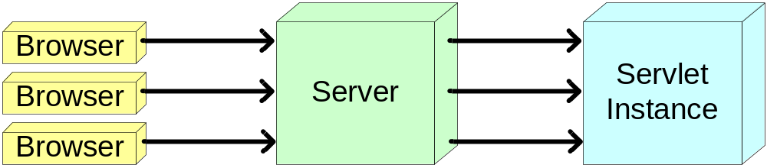
Servlet Life Cycle
The server loads the Servlet class and initializes one instance of it
Each client request is handled by the Serlvet instance in a separate thread
The server can remove the Servlet
The Servlet can remain loaded to handle additional requests

Slide 47
Servlet Life Cycle
When the Servlet in instantiated, its method init() is begin invoked
  External parameters are supplied
Upon a request, its method service() is being invoked
Before the Servlet removal, its method destroy() is being invoked

Slide 48
Servlet Life Cycle
Deal with requests:
call the
service method
Calling the
init method
Destroy the Servlet:
call the
destroy method
Servlet
Instance
ServletConfig
Garbage
Collection
Servlet Class

Slide 49
Initializing Servlets
The method init has a parameter of type ServletConfig
ServletConfig has methods to get external initialization parameters
  In Tomcat, these parameters are set in web.xml
To make initializations, override init() and not init(ServletConfig)
  init() is automatically called by after performing default initializations

Slide 50
A web.xml Example
<web-app>
…
<servlet>
<servlet-name>InitExample</servlet-name>
<servlet-class>ServletInit</servlet-class>
<init-param>
<param-name>login</param-name>
<param-value>snoopy</param-value>
</init-param>
</servlet>
…
</web-app>

Slide 51
public class ServletInit extends HttpServlet {
String _login = null;
Calendar _initTime = null;
public void init() throws ServletException {
_login = this.getInitParameter("login");
_initTime = new GregorianCalendar();
}
public void doGet(HttpServletRequest req,
HttpServletResponse res) throws ServletException, IOException {
PrintWriter out = res.getWriter();
res.setContentType("text/html");
out.println("<html><head><title>Initialization</title><body><h2>"
+ "I am the Servlet of <i>" + _login+ "</i><br/>"
+ "I was initialized at " + _initTime.get(Calendar.HOUR_OF_DAY)
+ ":"+ _initTime.get(Calendar.MINUTE)
+ ":"+ _initTime.get(Calendar.SECOND)
+ "</h2></body></html>"); }}
ServletInit.java

Slide 52
Loading a Servlet on Startup
A Servlet is usually loaded when it is first being called
You can set Tomcat to load a specific Servlet on startup in the Servlet declaration inside web.xml
<servlet>
<servlet-name>InitExample</servlet-name>
<servlet-class>ServletInit</servlet-class>
<load-on-startup/>
</servlet>

Slide 53
Destroying Servlets
The server may remove a loaded Servlet, Why?:
  asked to do so by administrator(e.g. Server shutdown)
  Servlet was idle a long time
  server needs to free resources
The server removes a Servlet only if all threads have finished or a grace period has passed
Before removing, calls the destroy() method
  can perform cleanup, e.g., close database connections

Slide 54
Thread Synchronization
Multiple threads are accessing the same Servlet object at the same time
Therefore, you have to deal with concurrency
init() and destroy() are guaranteed to be executed only once (before/after all service executions)

Slide 55
The Servlet Context

Slide 56
The Servlet Context Object
A Servlet context represents the Web application that Servlets live in
There is one Servlet context per application
You can get the Servlet context using the method getServletContext()
The Servlet context has many methods
For example, you can store in it objects that are kept throughout the application's life

Slide 57
An Example: Service Count
public class CounterServlet extends HttpServlet {
public void init() throws ServletException {
Integer counter =
(Integer)getServletContext().getAttribute("counter");
if(counter == null) {
getServletContext().setAttribute("counter",new Integer(0));
}
}

Slide 58
public void doGet(HttpServletRequest req,HttpServletResponse
res) throws ServletException, IOException {
PrintWriter out = res.getWriter();
res.setContentType("text/html");
int counter = 0;
synchronized(this) {
counter = ((Integer)getServletContext().
getAttribute("counter")).intValue();
getServletContext().
setAttribute("counter",new Integer(++counter));
}
out.println("<html><head><title>Counter</title><body><h1>"
+ "[" + counter + "]</h1></body></html>");
}}

Slide 59
Context Listeners
A context listener is an object that reacts to the following events:
  Context initialization
  Context destruction
We can use a context listener to perform application initialization or termination tasks
To implement such a listener,
  Implement the interface ServletContextListener
  Register the listener with the server

Slide 60
Cheating with Service Count
public class CounterInitializer implements
ServletContextListener {
public void contextInitialized(ServletContextEvent sce) {
sce.getServletContext().
setAttribute("counter",new Integer(1000));
}
public void contextDestroyed(ServletContextEvent sce) {}
}
<web-app>
<listener>
<listener-class>CounterInitializer</listener-class>
</listener>
</web-app>

