Slide 1
Servlets
Part 2
Modified slides from Dr.Sagiv

Slide 2
Servlets and Cookies
Cookie Example

Slide 3
Servlets and Cookies
Java Servlet API provides comfortable mechanisms to handle cookies
The class javax.servlet.http.Cookie represents a cookie
  Getter methods:
    getName(), getValue(), getPath(), getDomain(), getMaxAge(), getSecure()…
  Setter methods:
    setValue(), setPath(), setDomain(), setMaxAge()…

Slide 4
Servlets and Cookies (cont)
Get the cookies from the service request:
Cookie[] HttpServletRequest.getCookies()
Add a cookie to the service response:
  HttpServletResponse.addCookie(Cookie cookie)

Slide 5
An Example
getname.html
<html>
<head><title>Insert your Name</title></head>
<body> <h1>What is your name?</h1>
<form action="welcomeback" method="get">
<p>
<input type="text" name="username" />
<input type="submit" />
</p>
</form>
</body>
</html>

Slide 6
An Example (cont)
WelcomeBack.java
public class WelcomeBack extends HttpServlet {
public void doGet(HttpServletRequest req, HttpServletResponse res)
throws ServletException, IOException {
String user = req.getParameter("username");
if (user == null) { // Find the "username" cookie
Cookie[] cookies = req.getCookies();
for (int i = 0; cookies != null && i < cookies.length; ++i) {
if (cookies[i].getName().equals("username"))
user = cookies[i].getValue();
}
} else res.addCookie(new Cookie("username", user));

Slide 7
An Example (cont)
if (user == null) // No parameter and no cookie
res.sendRedirect("getname.html");
res.setContentType("text/html");
PrintWriter out = res.getWriter();
out.println("<html><body><h1>Welcome Back " + user
+ "</h1></body></html>");
}
}
WelcomeBack.java

Slide 8
Session Management with Servlets

Slide 9
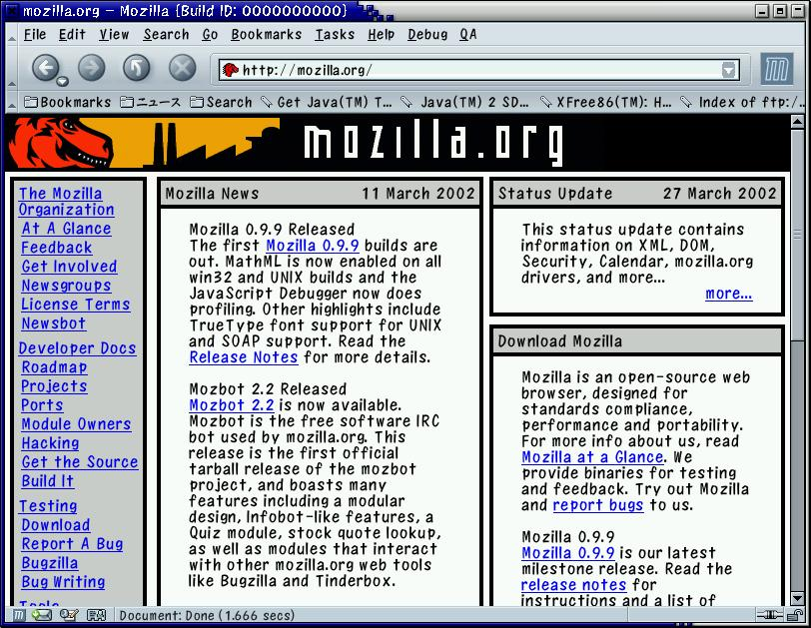

Session Cookies
request
request
Servlet
id₁
put cookie id₁
response
response
id₁
Web browser 1
Create Session
Web server

Slide 10
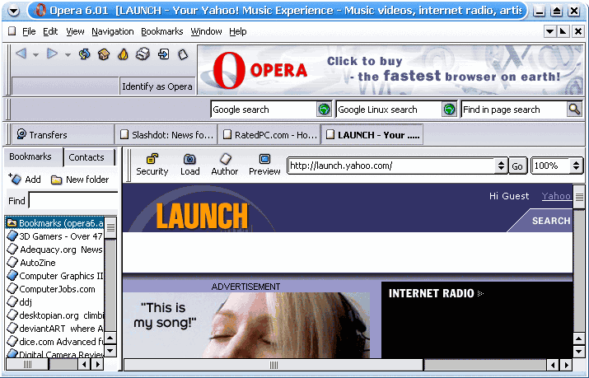
Session Cookies
request
request
Servlet
put cookie id₂
id₂
id₂
response
response
id₁
Web browser 2
Create Session
Web server

Slide 11
Session Cookies
request
request
Servlet
Cookie: id₁
id₁
id₂
response
response
id₁
Web browser 1
Session read/write
Web server

Slide 12
Session Cookies
request
request
Servlet
Cookie: id₂
id₂
id₂
response
response
id₁
Web browser 2
Session read/write
Web server

Slide 13
sessionId
list

Slide 14
Accessing the Session Data
The session object is represented by the class HttpSession
Use the methods getSesssion() or getSession(true) of the doXXX request to get the current HttpSession object, or to create one if it doesn’t exist
  When a new session is created, the server automatically add a session cookie to the response
Use getSession(false) if you do not want to create a new session when no session exists

Slide 15
HttpSession Methods
Session data is accessed in a hash-table fashion:
  setAttribute(String name,Object value)
    Where is this value stored?
  Object getAttribute(String name)
More methods:
  removeAttribute, getAttributeNames
  isNew, invalidate, getId
  getCreationTime, getLastAccessedTime
  getMaxInactiveInterval, setMaxInactiveInterval

Slide 16
Example: A Basic Shopping Cart
In the following example a basic shopping cart for an online store is implemented
The application consists of two Servlets:
  Store.java: the main store site
  ShoppingCart.java: handles cart manipulation

Slide 17
Online-Store Example
Store.java
public class Store extends HttpServlet {
public void doGet(HttpServletRequest req, HttpServletResponse res) throws ServletException, IOException {
res.setContentType("text/html");
PrintWriter out = res.getWriter();
out.println("<html><head>"
+ "<link rel=\"stylesheet\" type=\"text/css\""
+ " href=\"cartstyle.css\"/></head><body>");
HttpSession session = req.getSession();
if (session.getAttribute("item-list") == null) {
out.println("<h1>Hello new visitor!</h1>");
session.setAttribute("item-list", new LinkedList());
}
List itemList = (List) session.getAttribute("item-list");

Slide 18
Online-Store Example (cont)
out.println("<h2>Your Shopping Cart:</h2><ol>");
for (Iterator it = itemList.iterator(); it.hasNext();)
out.println("<li>" + it.next() + "</li>");
out.println("</ol>");
out.println("<form method=\"post\" action=\"cart\">");
out.println("<p>Add item:<input name=\"item\" type=\"text\"/>"
+ "<input type=\"submit\" value=\"send\"/></p>"
+ "<p><input type=\"submit\" value=\"empty cart\" "
+ "name=\"clear\"/></p></form>");
out.println("</body></html>");
}
}
Store.java

Slide 19
Online-Store Example (cont)
ShoppingCart.java
public class ShoppingCart extends HttpServlet {
public void doPost(HttpServletRequest req, HttpServletResponse
res) throws ServletException, IOException {
res.setContentType("text/html");
PrintWriter out = res.getWriter();
List items = (List) req.getSession().getAttribute("item-list");
out.println("<html><head><link rel=\"stylesheet\""
+ " type=\"text/css\" href=\"cartstyle.css\"/>"
+ "</head><body>");

Slide 20
Online-Store Example (cont)
if (req.getParameter("clear") != null) {
items.clear();
out.println("<h2>Your Shopping Cart is Empty!</h2>");
} else {
String item = req.getParameter("item");
items.add(item);
out.println("<h2>The item <i>" + item +
"</i> was added to your cart.</h2>");
}
out.println("<h2><a href=\"store\">Return to the store</a></h2>");
out.println("</body></html>");
}}
ShoppingCart.java

Slide 21
URL Rewriting
request
request
Servlet
response
response
id₁
Web browser
Create Session
Web server
<HTML>…
<A HREF=“servletURL;sessID=id₁”>
…</HTML>

Slide 22
URL Rewriting
request
request
Servlet
(no cookie)
id₂
response
response
id₁
Web browser 1
Session read/write
Web server
<HTML>…
<A HREF=“servletURL;sessID=id₁”>
…</HTML>
GET servletURL;sessID=id₁ HTTP/1.0

Slide 23
Servlet URL Rewriting
Use the following methods of the doXXX response object to rewrite URLs:
  String encodeURL(String url)
    Use for HTML hyperlinks
  String encodeRedirectURL(String url)
    Use for HTTP redirections
These methods contain the logic to determine whether the session ID needs to be encoded in the URL
For example, if the request has a cookie, then url is returned unchanged
Some servers implement the two methods identically

Slide 24
Back to our Store
The Store example assumes that the client supports cookies
To fix the program, we should encode the links we supply:
Store.java:
"<form method=\"post\" action=\"" +
res.encodeURL("cart") + "\">"
ShoppingCart.java:
“<a href=\"" + res.encodeURL("store") + "\">"

Slide 25
The Session Listener
The session listener reacts to the following events:
  A new session has been created
  A session is being destroyed
To obtain a session listener, implement the interface javax.servlet.http.HttpSessionListener

Slide 26
Session-Listener Example (cont)
public class CartInitializer implements HttpSessionListener {
public void sessionCreated(HttpSessionEvent se) {
List itemList = new LinkedList();
se.getSession().setAttribute("item-list",itemList);
itemList.add("A Free Apple");
}
public void sessionDestroyed(HttpSessionEvent se) {}
}
CartInitializer.java
<listener>
<listener-class>CartInitializer</listener-class>
</listener>
web.xml

Slide 27
The Servlet Context

Slide 28
Uses of ServletContext
For communicating with the Servlet container (e.g., Tomcat server), we use the ServletContext object
One context is shared among all Web-application Servlets
Can store Web application initialization parameters
Can store and manipulate application-shared attributes
Can be used to access the logger
Can be used to dispatch requests to other resources

Slide 29
ServletContext Methods
Access initialization parameters:
  getInitParameter(String name), getInitParameterNames()
Read Web-application attributes:
  getAttribute(String name), getAttributeNames()
Manipulate Web-application attributes:
  setAttribute(String, Object), removeAttribute(String)
Transform context-relative paths to absolute paths:
  getRealPath(String path), URL getResource(String path)

Slide 30
ServletContext Methods
Write to the application log:
  log(String msg), log(String message, Throwable exception)
Get a resource dispatcher (discussed later):
  RequestDispatcher getRequestDispatcher(String path)
Name and version of the Servlet container:
  String getServerInfo()

Slide 31
Note about ServletContext
There is a single ServletContext per Web application
Different Sevlets will get the same ServletContext object, when calling getServletContext during different sessions
You can lock the context to protect a critical section from all Web-application accesses

Slide 32
The Request Dispatcher

Slide 33
The Request Dispather
The RequestDispatcher object is used to send a a client request to any resource on the server
Such a resource may be dynamic (e.g. a Servlet or a JSP file) or static (e.g. a HTML document)
To send a request to a resource x, use:
  getServletContext().getRequestDispatcher("x")

Slide 34
Request Dispatcher Methods
void forward(ServletRequest request, ServletResponse response)
  Forwards a request from a Servlet to another resource
void include(ServletRequest request, ServletResponse response)
  Includes the content of a resource in the response

Slide 35
Passing on Data
3 different ways to pass parameters for the forwarded Servlet or JSP
  Data that will be used only for this request:
    request.setAttribute("key", value);
  Data will be used for this client (also for future requests):
    session.setAttribute("key", value);
  Data that will be used in the future for every client
    context.setAttribute("key", value);

Slide 36
An Example
The Servlet JokesAndImages enables a user to choose a random joke or a random image
The server has 5 images in the directory images/ and five jokes (txt files) in the directory jokes/
Empty requests are forwarded to a HTML file that enables the user to choose a joke or an image
Requests to a joke are forwarded to the servlet Jokes
Requests to an image are forwarded to a random image from the directory images/

Slide 37
Jokes and Images
<html>
<head><title>Images and Jokes</title></head>
<body>
<h1>Please Select:</h1>
<form method="post" action="JokesAndImages">
<h2>
<input type="submit" name="joke"
value="A Joke" />
<input type="submit" name="image"
value="An Image" />
</h2>
</form>
</body></html>
imagesJokesOptions.html

Slide 38
Jokes and Images (cont)
public class JokesAndImages extends HttpServlet {
public void doPost(HttpServletRequest req, HttpServletResponse res) throws ServletException, IOException {
int randomNum = 1 + Math.abs((new Random()).nextInt() % 5);
if (req.getParameter("joke") != null) {
req.setAttribute("jokeNumber", new Integer(randomNum));
getServletContext().getRequestDispatcher("/Jokes").forward(req,res);
} else if (req.getParameter("image") != null) {
getServletContext().getRequestDispatcher("/images/image" +
randomNum + ".gif").forward(req, res);
} else getServletContext().getRequestDispatcher
("/imagesJokesOptions.html"). forward(req,res);
}
public void doGet ... }}
JokesAndImages.java

Slide 39
Jokes and Images (cont)
public class Jokes extends HttpServlet {
public void doPost(HttpServletRequest req, HttpServletResponse res)
throws ServletException, IOException {
res.setContentType("text/html");
PrintWriter out = res.getWriter();
out.println("<html><body><h1>A Joke</h1><pre>");
int jokeNum = ((Integer) req.getAttribute("jokeNumber")).intValue();
getServletContext().getRequestDispatcher
("/jokes/joke" + jokeNum + ".txt").include(req, res);
out.println("\n</pre>");
out.println("<a href=\"" + req.getRequestURL() + "\">Back</a>");
out.println("</body></html>");
}}
Jokes.java

Slide 40
Forwarding versus Redirection
By default, SendRedirect does not preserve parameters of the request
SendRedirect ends up with a different URL on the client

