Slide 1
Inheritance

Slide 2



Mountain Bike
Road Bike
Objects may have common properties but belong to different classes.
We can relate them in Class Hierarchy
Tandem Bike

Slide 3
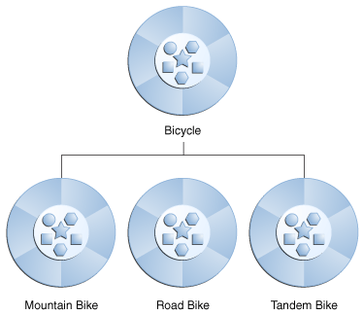

Slide 4
Inheritance can be defined as the process where one object acquires the properties of another.
Java allows each class to have one direct
super-class, and each super-class has the potential for an unlimited number of subclasses.

Slide 5
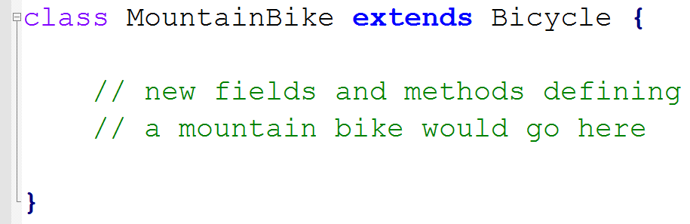
At the beginning of your class declaration, use the extends keyword, followed by the name of the class to inherit from:
This gives MountainBike all the same fields and methods as Bicycle, yet allows its code to focus exclusively on the features that make it unique.

Slide 6
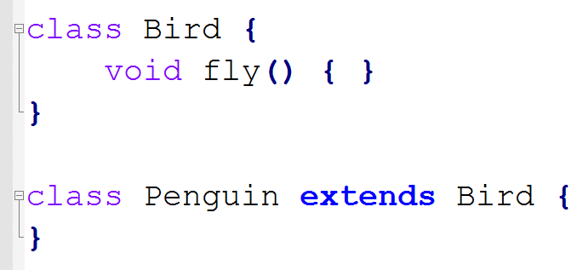
Be careful while writing methods in parent class
Assuming all birds fly; we can write fly( ) method in parent class and extends birds from this class.
Does
Penguin fly?

Slide 7
IS-A Relationship
inheritance use keyword extends and implements. These words would determine whether one object IS-A type of another.
IS-A is a way of saying :
This object is a type of that object.

Slide 8
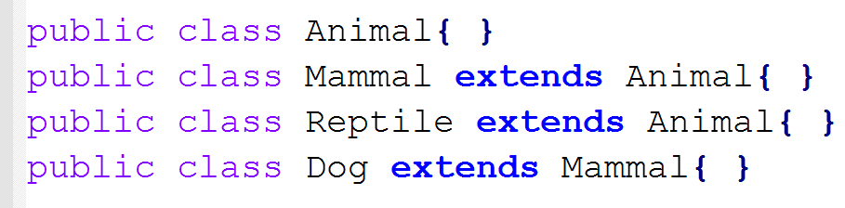
Now based on the above example, In Object Oriented terms following are true:
Animal is the superclass of Mammal class.
Animal is the superclass of Reptile class.
Mammal and Reptile are sub classes of Animal class.
Dog is the subclass of both Mammal and Animal classes.

Slide 9
considering IS-A relationship we can say:
Mammal IS-A Animal
Reptile IS-A Animal
Dog IS-A Mammal
Hence :
Dog IS-A Animal as well

Slide 10
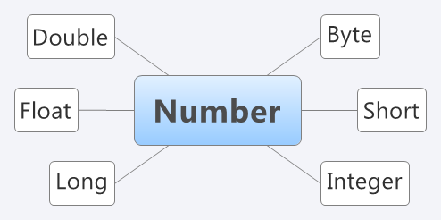
Java.lang.Number
All the wrapper classes (Byte, Short, Integer, Long, Float, Double) are subclasses of the abstract class Number.

Slide 11
Autoboxing is the automatic conversion that the Java compiler makes between the primitive types and their corresponding object wrapper classes.
Autoboxing :
Converting an int to an Integer, a double to a Double
Unboxing :
If the conversion goes the other way
Integer x = 5; // boxes int to an Integer object
x = x + 10; // unboxes the Integer to a int

Slide 12
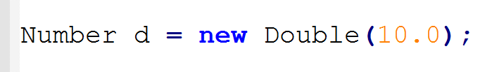
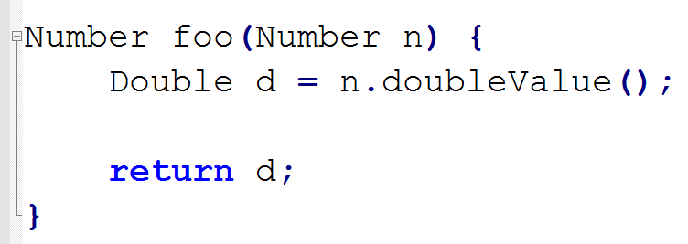
A Method can return sub-type
The above polymorphism rule apply to method return type also.

Slide 13
