Slide 1
Instanceof :
The Type Comparison Operator

Slide 2
The instanceof operator compares an object to a specified type.
You can use it to test if an object is an instance of a class, an instance of a subclass, or an instance of a class that implements a particular interface.

Slide 3
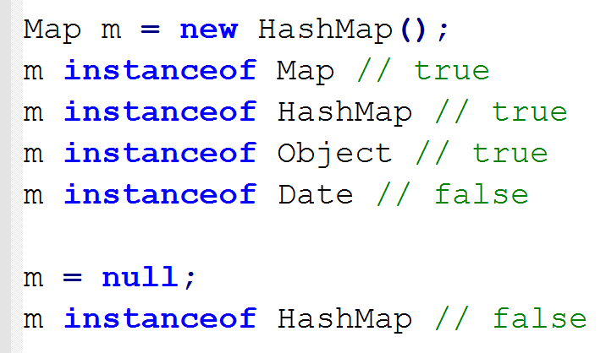
HashMap is a sub-type of Map
The instanceof operator returns true if we ask if an object is an instanceof one of its parent classes.

Slide 4
Beware of instanceof operator
Many hold that the instanceof operator should be used only as a last resort, and that an overridden method is usually (but not always) a better alternative.
inexperienced programmers may mistakenly use instanceof where an overidden method is more appropriate.

Slide 5
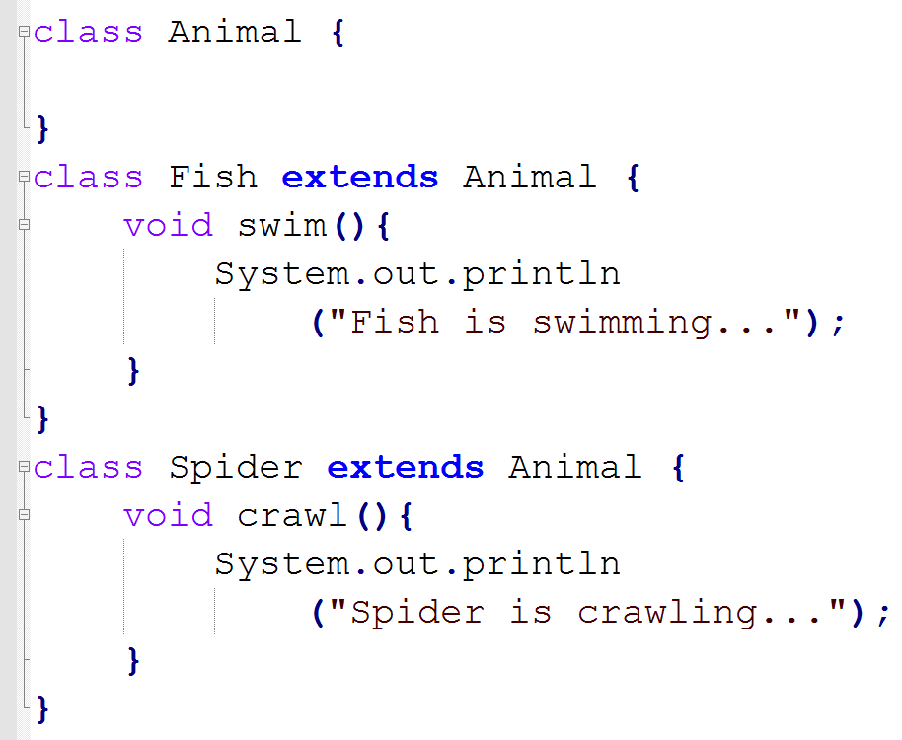

Slide 6
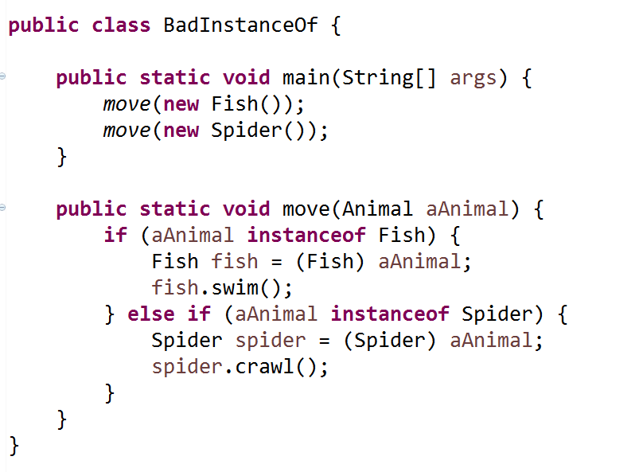
Fish is swimming...
Spider is crawling...

Slide 7
From Effective C++, by Scott Meyers :
Anytime you find yourself writing code of the form
"if the object is of type T1, then do something, but if it's of type T2, then do something else,"
- slap yourself.
The solution is is to use overridden method and polymorphism.

Slide 8
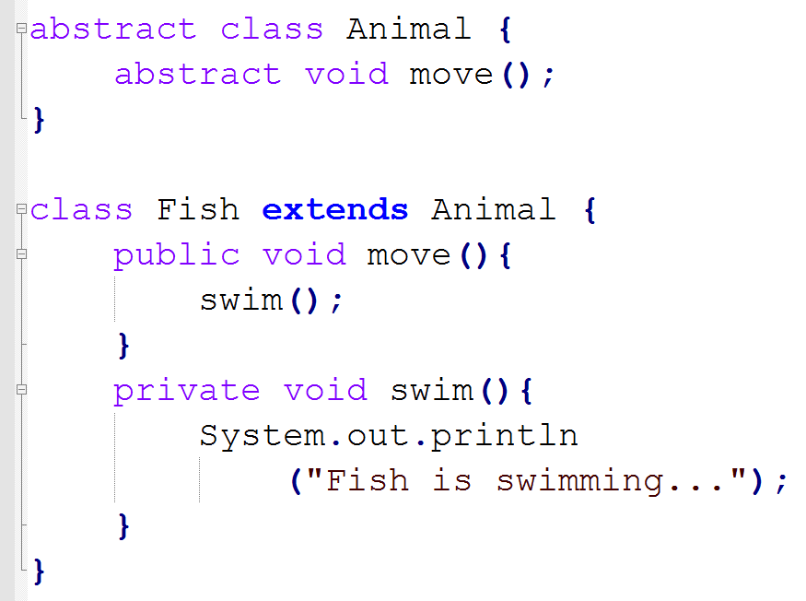

Slide 9
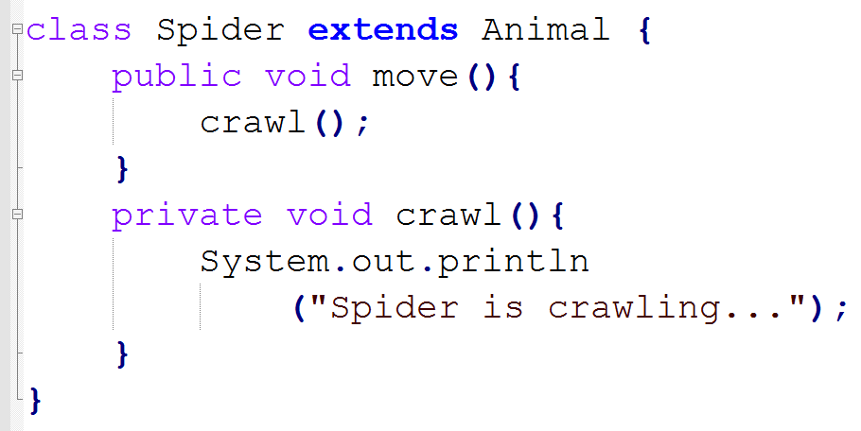
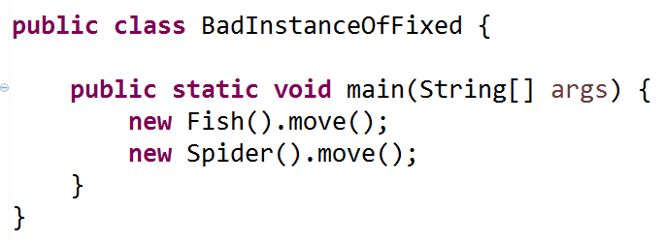
Fish is swimming...
Spider is crawling...

