Slide 1
Java Access Modifiers

Slide 2
Java provides a number of access modifiers to set access levels for classes, variables, methods and constructors. The four access levels are:
Visible to the class only (private).
Visible to the package. the default. No modifiers are needed.
Visible to the world (public).
Visible to the package and all subclasses (protected).

Slide 3
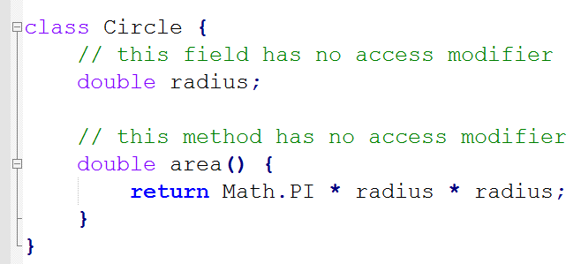
Default Access Modifier - No keyword
Package restricted - A variable or method declared without any access control modifier is available to any other class in the same package.

Slide 4
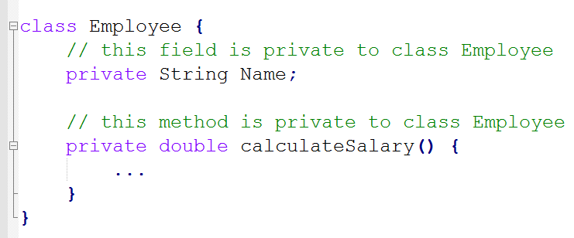
Private Access Modifier
Methods, Variables and Constructors that are declared private can only be accessed within the declared class itself.

Slide 5
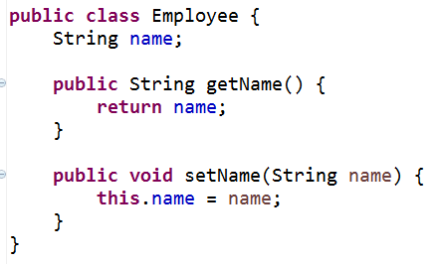
Variables that are declared private can be accessed outside the class if public getter methods are present in the class.

Slide 6
Private access modifier is the most restrictive access level.
Using the private modifier is the main way that an object encapsulates itself and hide data from the outside world.
Class and interface cannot be private.

Slide 7
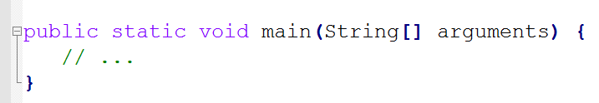
Public Access Modifier
A class, method, constructor, interface etc declared public can be accessed from any other class.
However if the public class we are trying to access is in a different package, then the public class still need to be imported.
Because of class inheritance, all public methods and variables of a class are inherited by its subclasses.

Slide 8
Protected Access Modifier
Variables, methods and constructors which are declared protected
in a superclass can be accessed only by the subclasses in other package
or any class within the package of the protected members' class.
Rationale: If we define it as public, then it would become accessible to all the outside world. But our intention is to expose it to its subclass only, that’s why we used protected modifier.

Slide 9
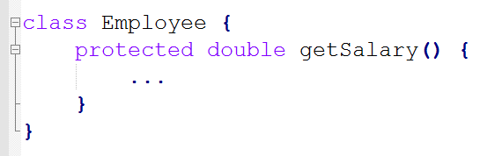
The protected access modifier cannot be applied to class and interface.

Slide 10
private
default
More
Restrictive
Less
Restrictive
protected
public
Accessibility

Slide 11
public
Protected
private
Default
class
Java Package
For Java Sub classes

Slide 12
public
private
Protected
Default
class
Java Package
For Java Other classes

Slide 13
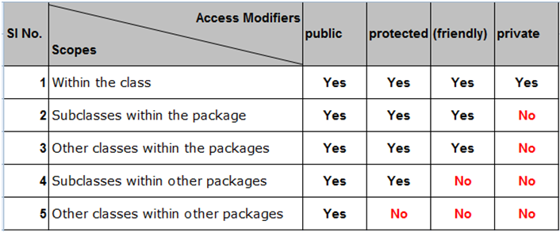
Java Access Modifiers Summary

