Slide 1
Isolation Forest for Log Anomaly Detection
Understanding Its Importance, Comparison, and Application in Log Analysis

Slide 2
History of Isolation Forest
- Introduced in 2008 by Fei Tony Liu, Kai Ming Ting, and Zhi-Hua Zhou.
- Developed to efficiently detect anomalies using a tree-based approach.
- Different from traditional density-based and distance-based methods.

Slide 3
Why Do We Need Isolation Forest?
- Scalability: Handles large datasets efficiently.
- Efficiency: Faster than distance-based methods.
- Effective for High-Dimensional Data: Works well with log data.
- Unsupervised Learning: Does not require labeled data.

Slide 4
Why Isolation Forest is Good for Log Analysis?
- Works Well with High-Dimensional Logs.
- Fast Processing of Real-Time Logs.
- Detects Rare Anomalies Efficiently.
- Handles Unlabeled Data.
- Less Memory Intensive.

Slide 5

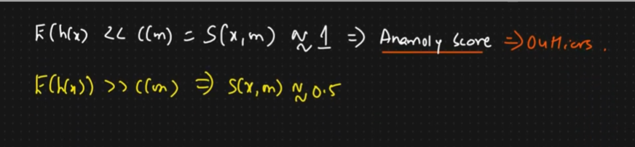
Mathematical Foundations [1/2]
- Anomaly Score Formula:
h(x) is the average path length of an instance x in the isolation trees
(h(x)) is the expected path length of x over all trees.

Slide 6
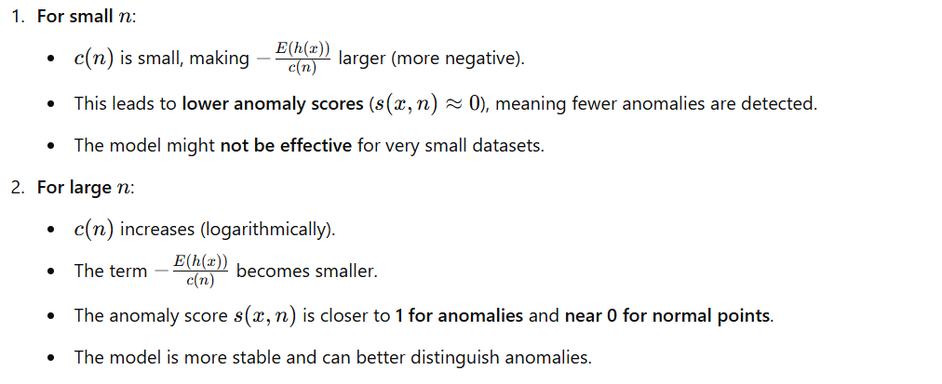
Mathematical Foundations [2/2]

Slide 7
Why
Why Isolation Forest is the Best for Log Analysis
Scalable & Fast – Handles millions of log entries efficiently.
Unsupervised Learning – Works without labeled data, making it ideal for unknown log patterns.
Handles High-Dimensional Logs – Works well on logs with many categorical and numerical fields.
Memory Efficient – Does not store entire datasets in memory.
Resistant to Noise – Unlike LOF or One-Class SVM, it is not sensitive to noisy log entries.

Slide 8
Comparison

Slide 9
Algorithm | Approach | Complexity | Handles High-Dimensional Data | Works on Unlabeled Data | Detects Global & Local Anomalies | Real-Time Capability | Robust to Noise | Suitable for Log Analysis?
Isolation Forest | Tree-based partitioning | O(nlog⁡n)O(n \log n)O(nlogn) | ✅ Yes | ✅ Yes | ❌ Only global anomalies | ✅ Yes (fast) | ✅ Yes | ✅ Best for logs
One-Class SVM | Boundary-based (kernel) | O(n2)O(n^2)O(n2) | ❌ No | ✅ Yes | ❌ Only global anomalies | ❌ No (slow) | ❌ Sensitive to noise | ❌ Not ideal
Local Outlier Factor (LOF) | Density-based | O(n2)O(n^2)O(n2) | ❌ No | ✅ Yes | ✅ Both global & local | ❌ No (slow) | ❌ Sensitive to density changes | ❌ Not ideal
Autoencoders | Neural Network Embedding | High | ✅ Yes | ❌ No (needs training) | ✅ Both global & local | ❌ No (requires training) | ✅ Yes (if trained well) | ✅ Good, but needs labeled data
PCA (Principal Component Analysis) | Projection-based | O(n2)O(n^2)O(n2) | ❌ No | ✅ Yes | ❌ Global anomalies only | ❌ No (offline) | ❌ Sensitive to linear patterns | ❌ Not ideal

Slide 10
Advantages
- Linear Time Complexity O(n log n).
- Low Memory Usage.
- No Assumption on Data Distribution.
- Works in High Dimensions.

Slide 11
Disadvantages
- Less Effective with Small Datasets.
- May Misclassify Rare Normal Events.
- Feature Selection Sensitivity.

