Slide 1


Streamlit
The fastest way to build and share data apps with zero web development experience
Javalingappa(Java)
javaindubai@gmail.com
Senior Developer

Slide 2
Agenda
Introduction to self and Streamlit – 2 min
Streamlit technical – 15 min
Create Hello world Project ( audience interactive)
Different ways to display text on UI
Display data/charts (Dataframe/Visualization)
Widgets – Input, Text Areas, buttons, select box many more ..
User inputs and interaction
Control flows
Styling
Configurations
Display Progress bar/info/error/warning/success messages
Streamlit other examples – 5 min
QA – 3 minutes

Slide 3

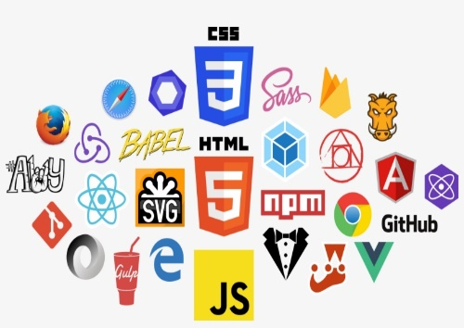
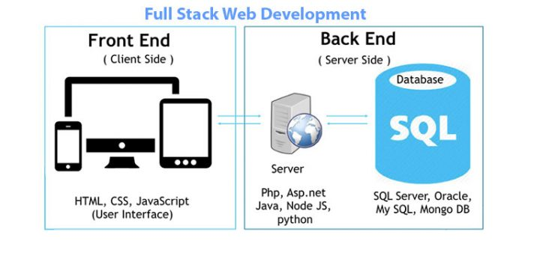
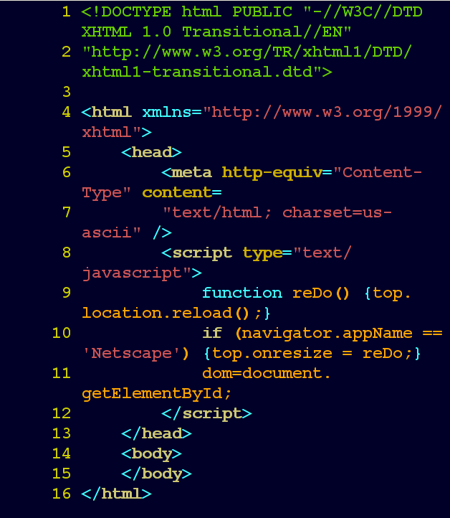



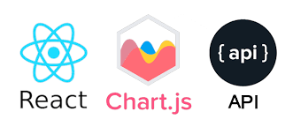
General Web Application Components
UI Components
Backend Components
Web Servers
Charts JS Libraries

Slide 4
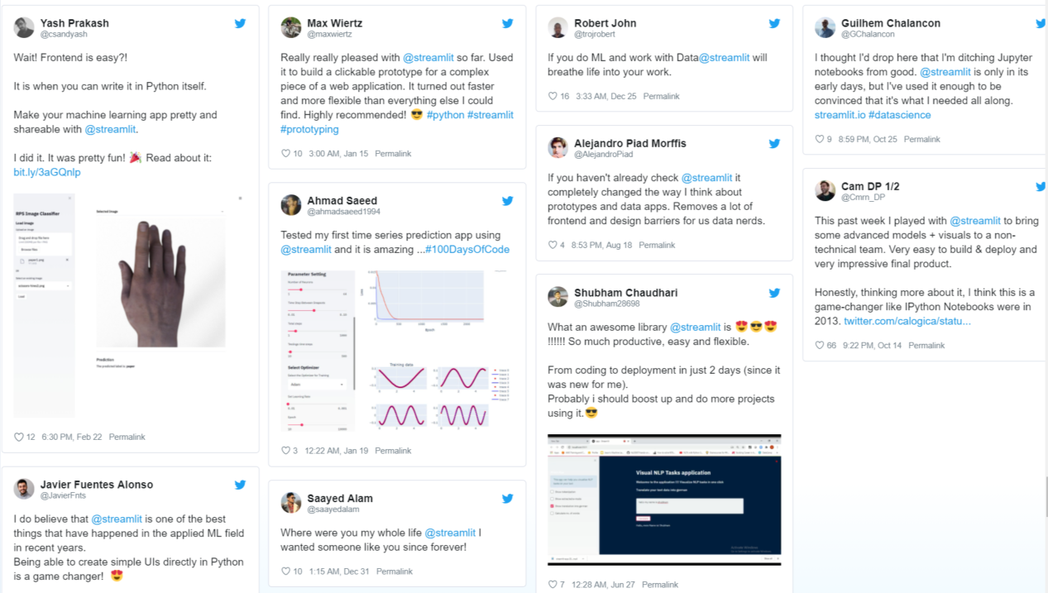
What is Streamlit?
Streamlit is an open-source app framework for Machine Learning and Data Science teams. Create beautiful data apps in hours, not weeks. All in pure Python
Founded in 2018
Release Beta version in 2019 as Open Source
In June of 2020 Streamlit announced a $21 million Series A investment
In March 2nd 2022, Snowflake acquire Streamlit for $800M

Slide 5
Advantages of Streamlit
It embraces Python scripting; No HTML knowledge is needed!
Less code is needed to create a beautiful application.
No callbacks are needed since widgets are treated as variables.
Data caching simplifies and speeds up computation pipelines.
Quickly Build and Deploy a Dashboard/Visualization
Moto of Streamlit - “Turn Python scripts into interactive Apps”
Streamlit enables machine learning and data visualisation tools that were “repeatable, shareable, modifiable, and usable throughout an organization”
Multi-Page Application Support

Slide 6
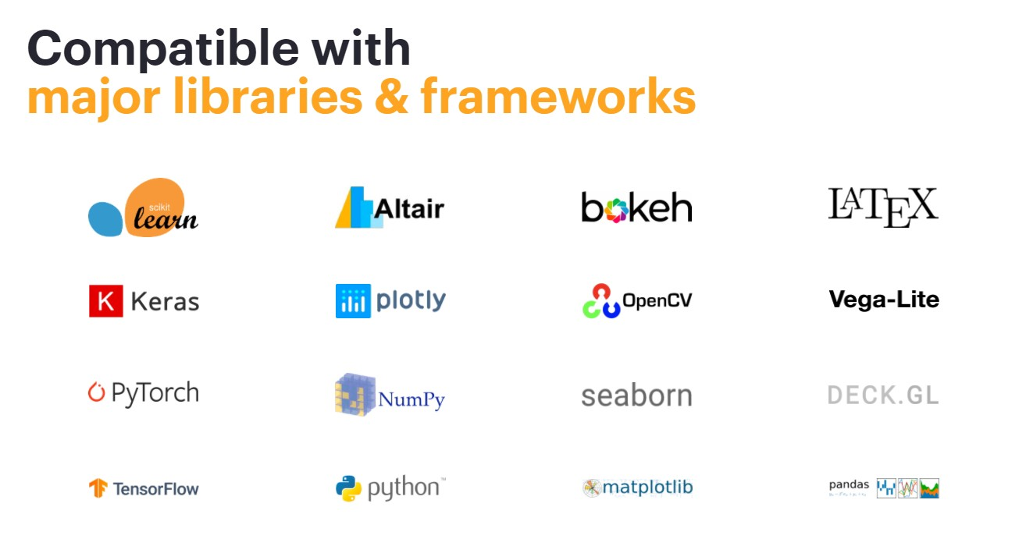

Slide 7
Streamlit : Technical Discussion

Slide 8
Installation and Hello World
Installation:
pip install streamlit - this command installs streamlit and all its dependency whichever the env we created like conda, virtual or pip env
Usage:
Just import streamlit as below to use further in our application
import streamlit as st
Run: we can use below command to run the hello world example of streamlit
streamlit hello
In the next slide lets find out all the available functions/api’s/variables to use in Streamlit st

Slide 9
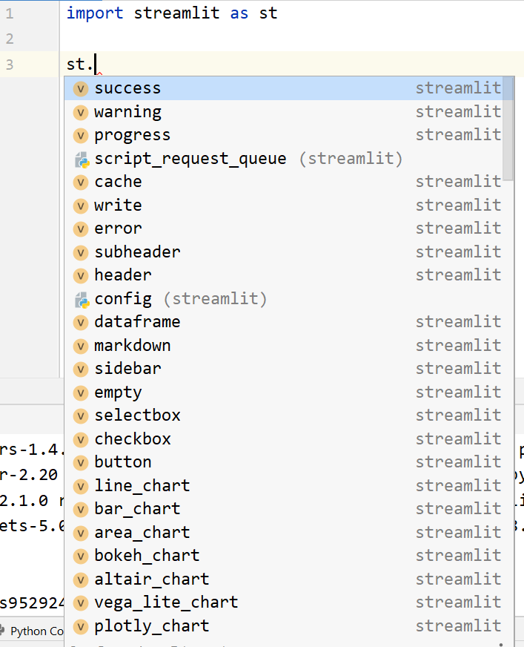
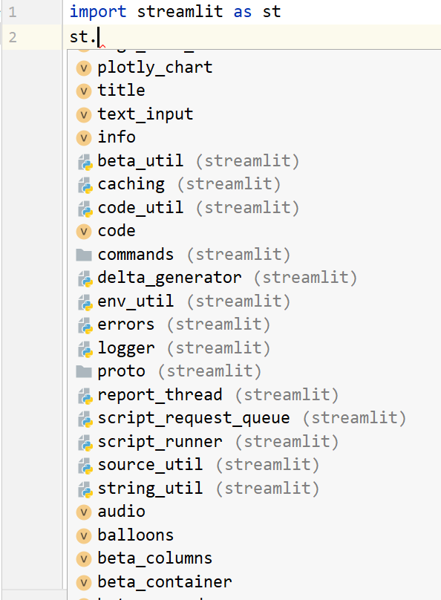
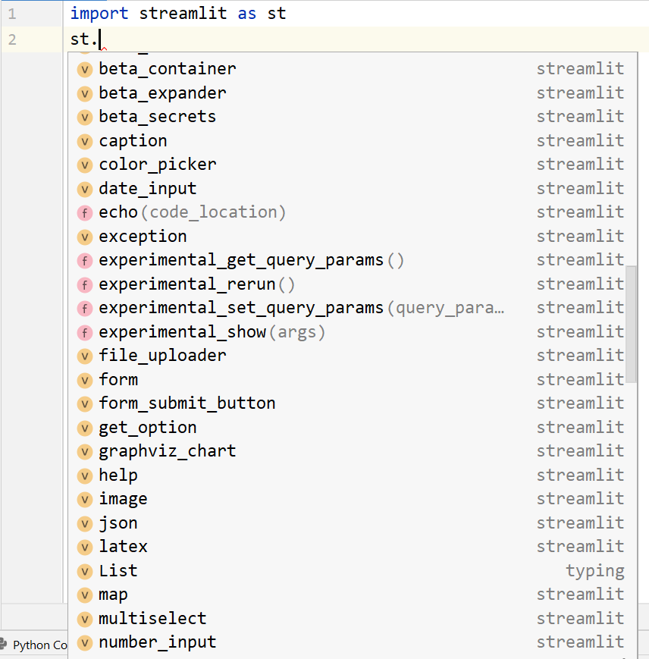
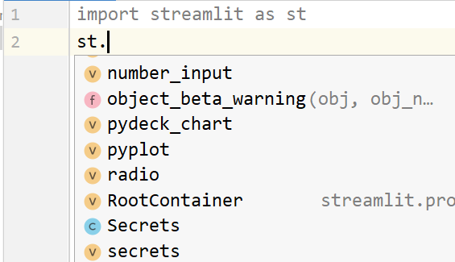
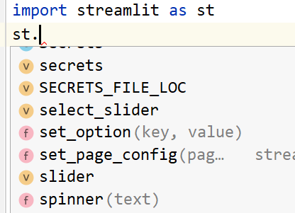
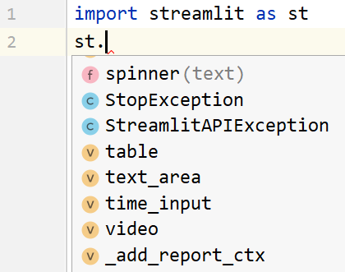

Slide 10
Display Data on UI
st.write()
st.header()
st.title()
st.text()
st.markdown()

Slide 11
Streamlit Widgets
st.text_input()
st.image()
st.video()
st.video()
st.text_area()
st.button()
st.checkbox()
st.selectbox()
st.multiselect()
st.radio()
st.slider()

Slide 12
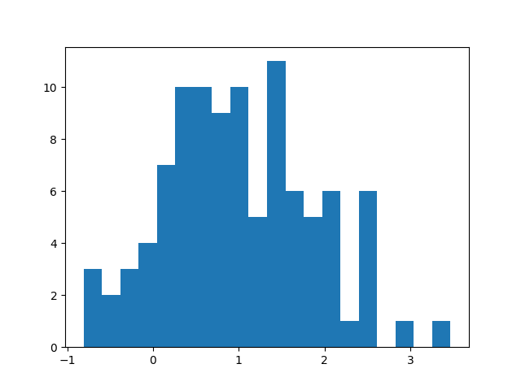
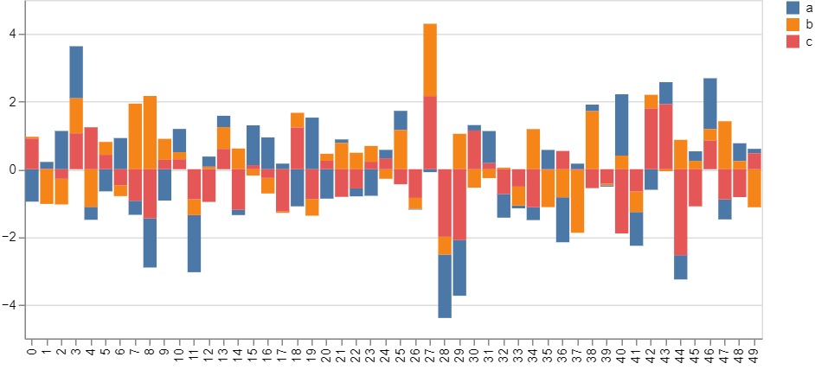
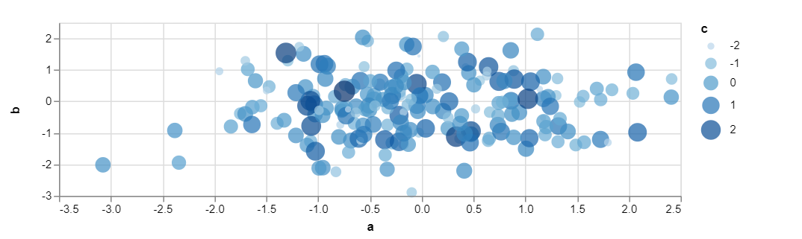
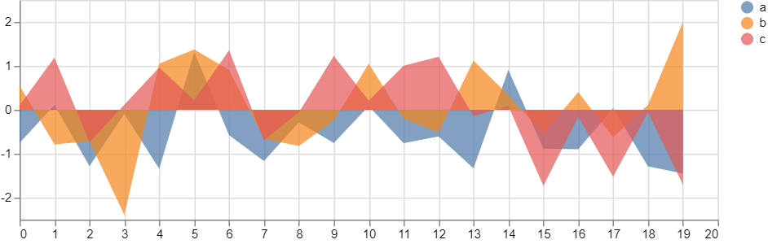
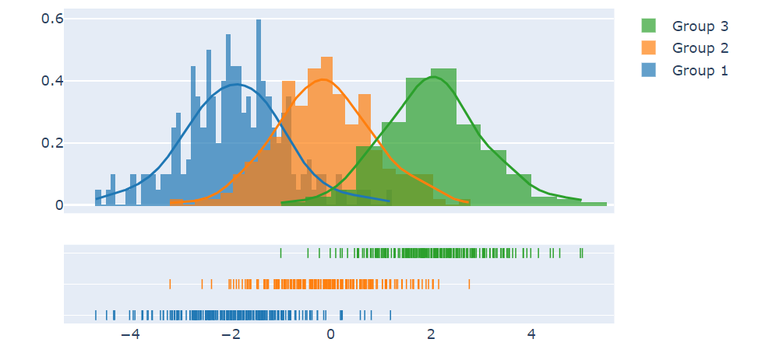
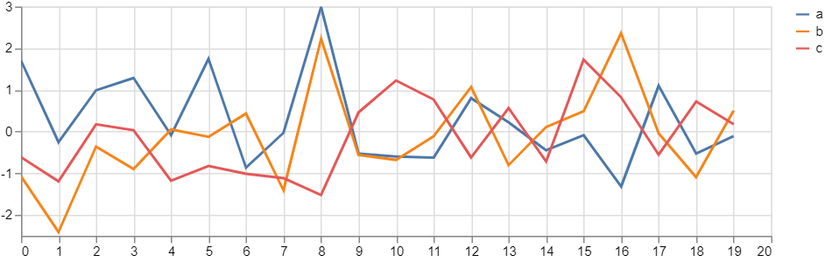
DataFrame and Charts
st.dataframe()
st.line_chart()
st.area_chart()
st.bar_chart()
st.altair_chart()
st.vega_lite_chart()
st.ploty_chart()
st.pyplot()

Slide 13
Streamlit Configuration File – config.toml
[theme] base="light" primaryColor="#6eb52f" secondaryBackgroundColor="#fddadda" textColor = "#262730" font="serif" [server] port=9999 address='localhost'
maxUploadSize=1028

Slide 14
Food Demand Forecasting
DEMO

Slide 15
References
https://streamlit.io/
https://docs.streamlit.io/
https://discuss.streamlit.io/
https://github.com/streamlit/streamlit
https://www.youtube.com/@pythontechie
https://github.com/javaindubai

