Slide 1
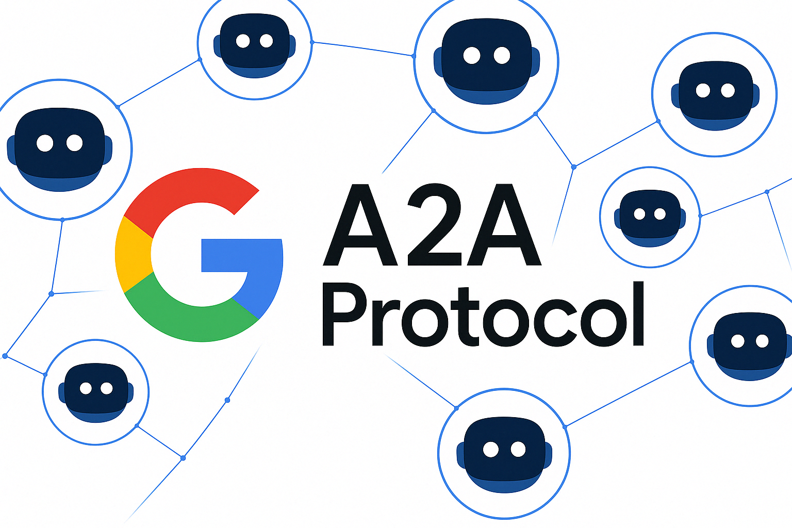
Architectural Anatomy of the A2A Protocol

Slide 2
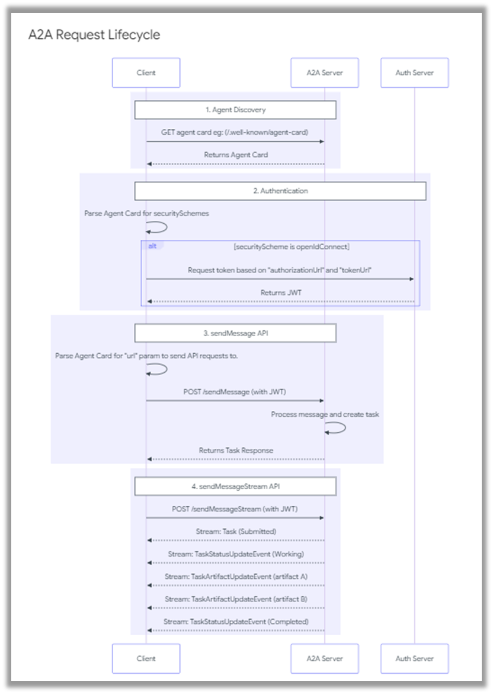
The A2A Request Lifecycle

Slide 3
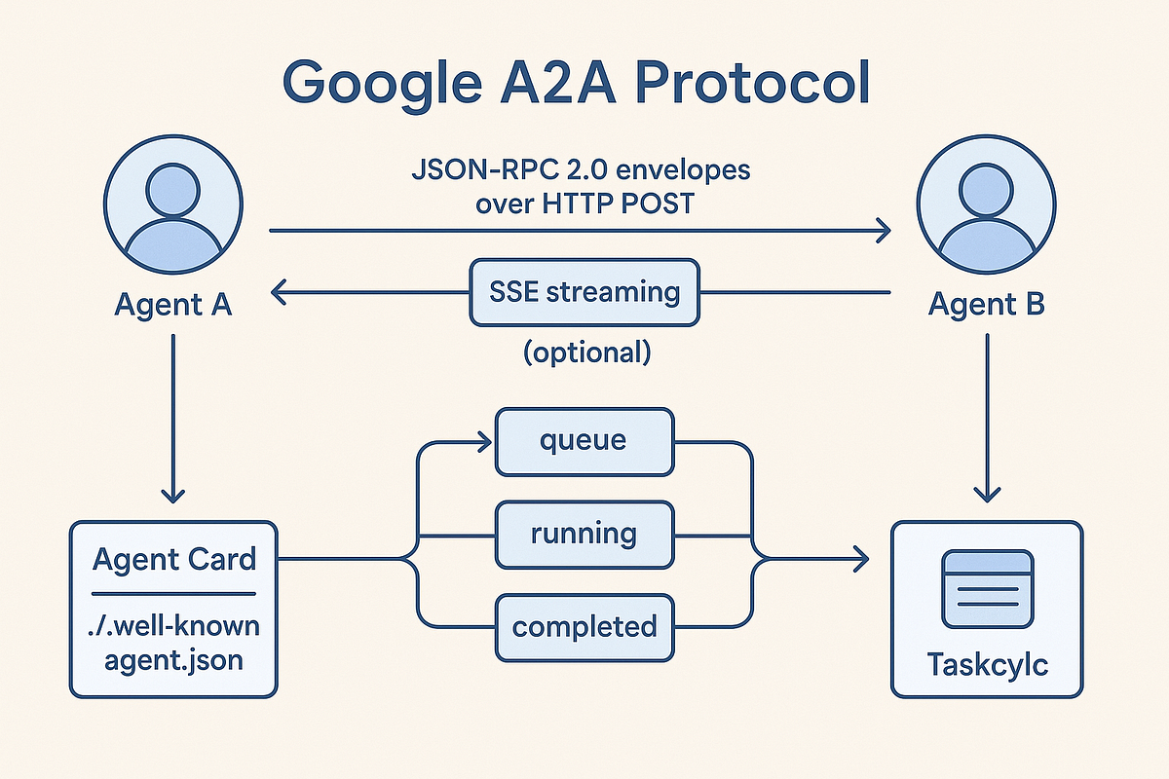
JSON-RPC Transport Stream in A2A
A2A JSON-RPC Transport & Streaming
Uses JSON-RPC 2.0 as the message envelope
Transported over HTTP POST (request → response)
Supports stateless invocation between agents
SSE streaming (optional) for incremental updates
Streaming enables long-running tasks without blocking
Task states flow as: queued → running → completed
Works with task IDs for async tracking
No tight coupling — agents communicate via open protocol

Slide 4
Agent Discovery via the Agent Card

Slide 5
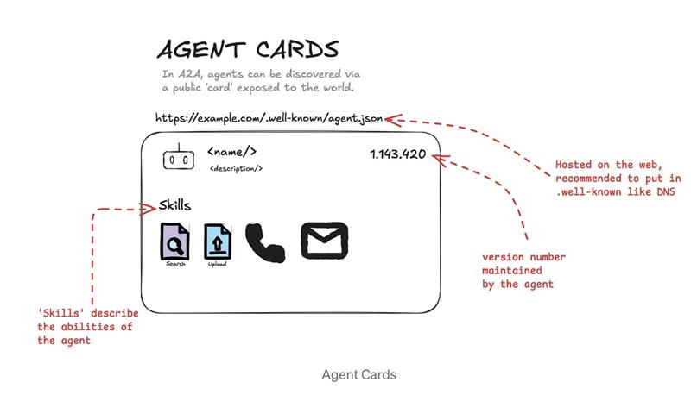
A2A Agent Card
Agent Cards (A2A)
Public agent identity exposed via a standard card
Hosted at /.well-known/agent.json for easy discovery
Describes who the agent is and what it can do
Lists agent skills / capabilities (tools, actions)
Includes agent metadata (name, description, version)
Enables agent discovery without prior integration
Foundation for agent-to-agent collaboration

Slide 6
Agent Authentication using OpenID and OAuth

Slide 7
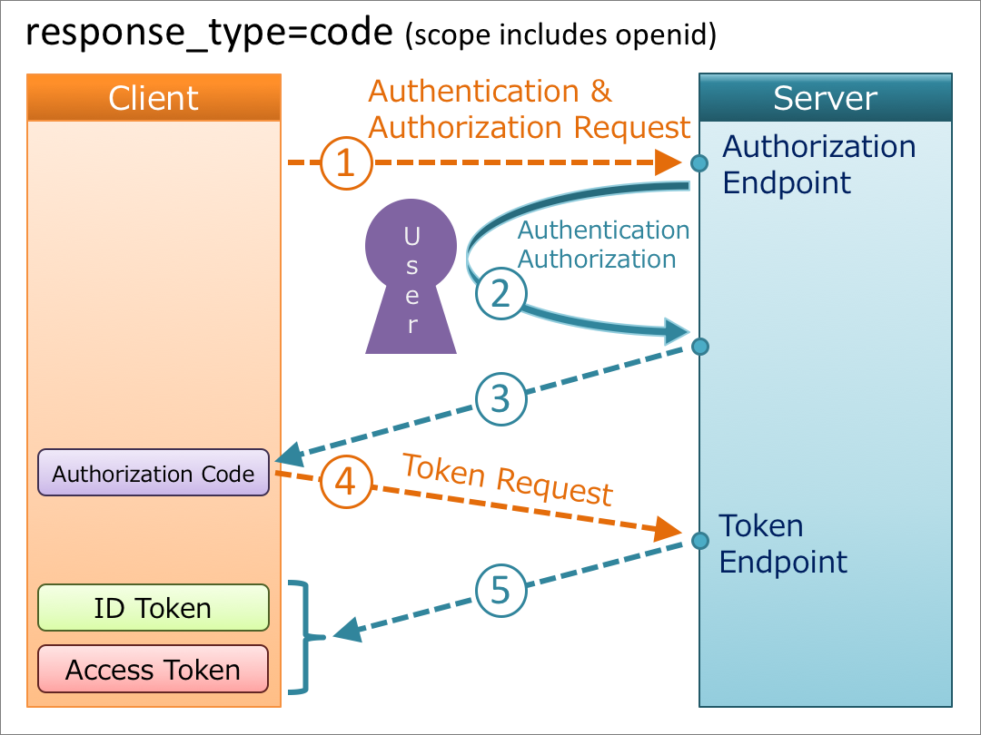
Auth Mechanisms in A2A
Agent Card Declaration: The A2A server's Agent Card describes the authentication schemes it supports in its security field and aligns with those defined in the OpenAPI Specification for authentication.
Out-of-Band Credential Acquisition: The A2A Client obtains the necessary credentials, such as OAuth 2.0 tokens or API keys, through processes external to the A2A protocol itself. Examples include OAuth flows or secure key distribution.
HTTP Header Transmission: Credentials must be transmitted in standard HTTP headers as per the requirements of the chosen authentication scheme. Examples include Authorization: Bearer <TOKEN> or API-Key: <KEY_VALUE>.

Slide 8
Agent and Client Message Stream Interaction

Slide 9
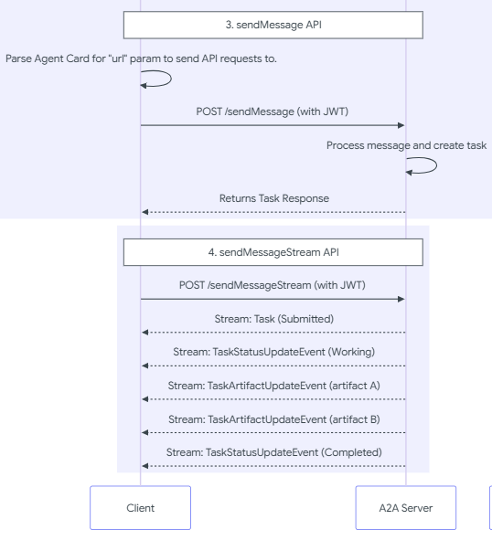
“Tasks” – Stateful Units of Work
Description - A stateful unit of work initiated by an agent, with a unique ID and defined lifecycle.
Purpose - Facilitates tracking of long-running operations and enables multi-turn interactions and collaboration.
Context (ContextID): A server-generated identifier that can be used to logically group multiple related Task objects, providing context across a series of interactions.

Slide 10
“Messages”, “Parts” and “Artifacts”
Element | Description | Key Purpose
Message | A single turn of communication between a client and an agent, containing content and a role ("user" or "agent"). | Conveys instructions, context, questions, answers, or status updates that are not necessarily formal artifacts.
Part | The fundamental content container (for example, TextPart, FilePart, DataPart) used within Messages and Artifacts. | Provides flexibility for agents to exchange various content types within messages and artifacts.
Artifact | A tangible output generated by an agent during a task (for example, a document, image, or structured data). | Delivers the concrete results of an agent's work, ensuring structured and retrievable outputs.

