Slide 1

Agent-to-Agent (A2A)

Slide 2
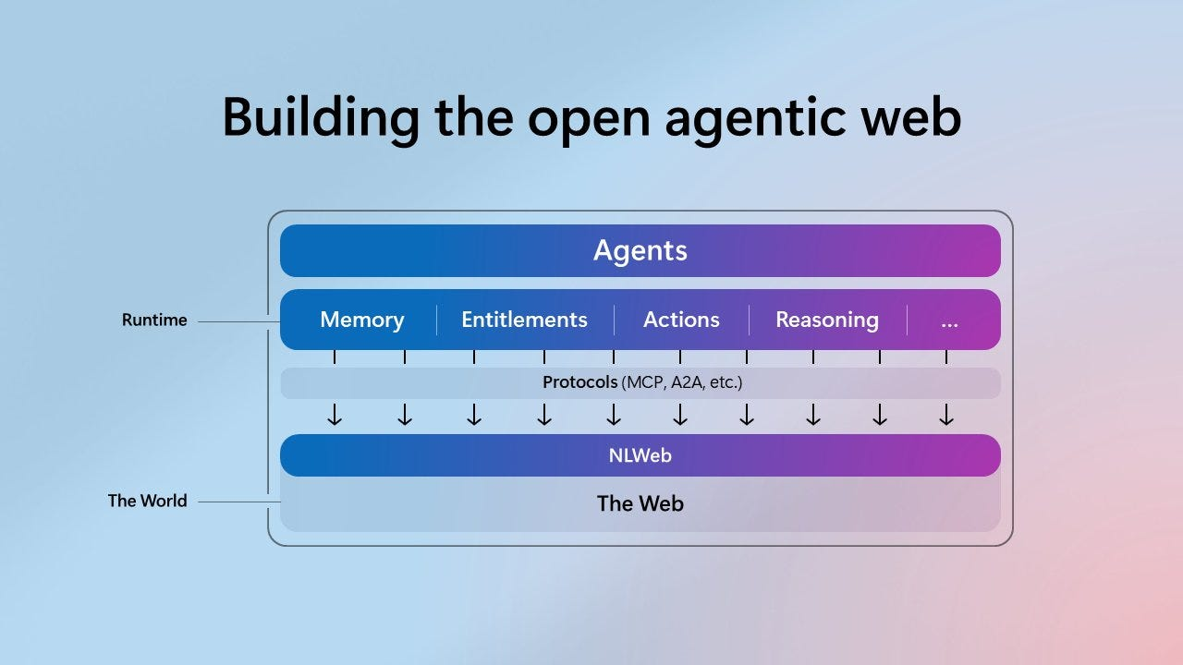
The Open Agentic Web
The web is evolving from human-driven interactions to agent-driven interactions
Agents are no longer isolated apps — they are first-class web citizens
A2A enables agents to talk to other agents, not just APIs or tools

Slide 3
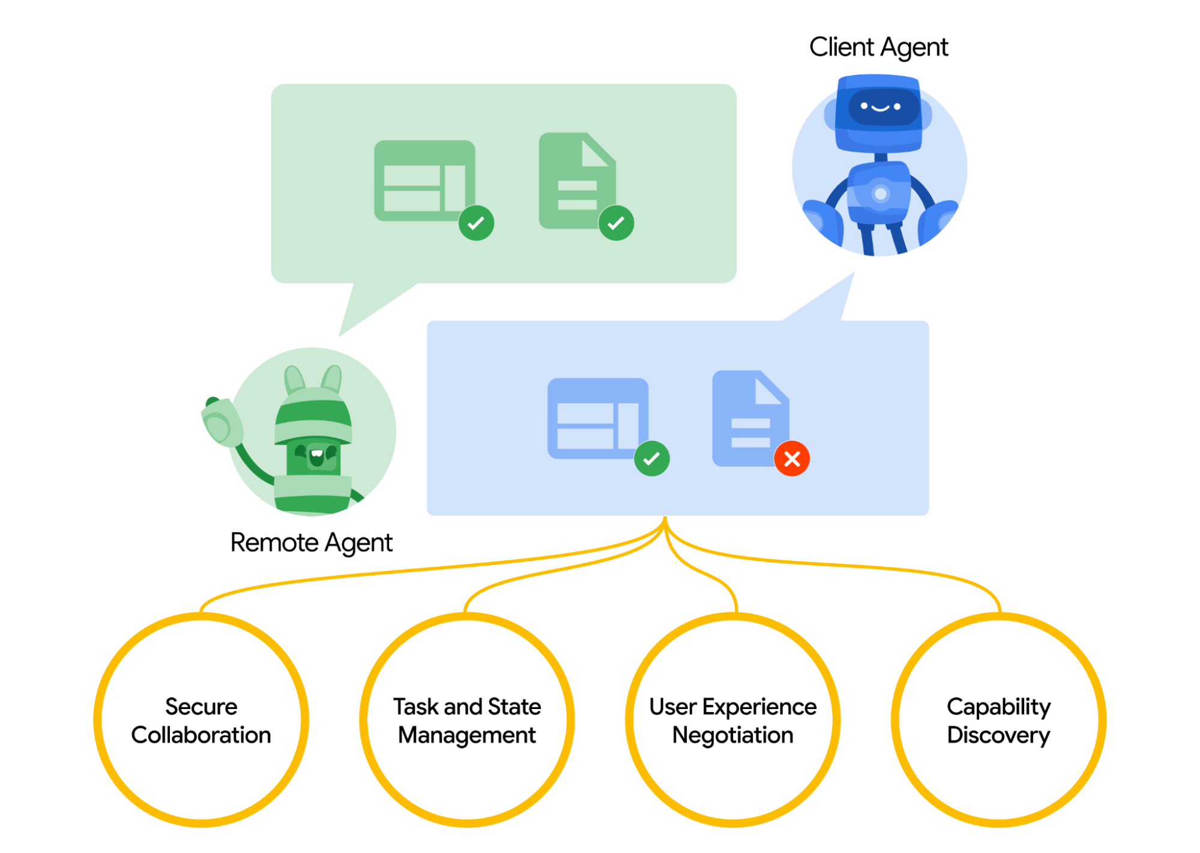
Introducing A2A
High-level flow
1) A Client Agent delegates work to a Remote Agent
2) The Remote Agent evaluates the request and responds per capability and policy
3) Results are returned with explicit success / failure signals
4) Interaction is agent-native, not just API calls

Slide 4
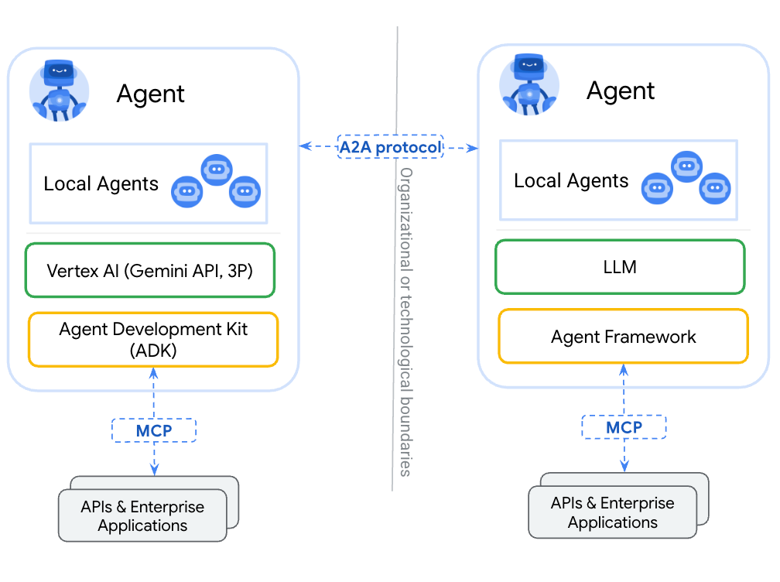
How Does A2A work with MCP?
MCP connects agents to tools
A2A connects agents to other agents
Together, they enable open, interoperable agent ecosystems

Slide 5
