Slide 1
Computer Organization & Architecture
Virendra Singh Shekhawat
Department of Computer Science and Information Systems

Slide 2
Module-7 (Lecture-2)
[Ref. Computer Organization and Architecture , 8th Ed. by William Stallings]
Topics: Pipeline Hazards: Data Hazards, Resource Hazards, Control Hazards, RISC Pipeline

Slide 3
Four Stage Pipeline
Fetch: Read the instruction from the memory
Decode: Decode the instruction and fetch the source operand(s)
Execute: Perform the ALU operation
Write: Store the result in the destination location
Note:
Each stage in pipeline is expected to complete its operation in one clock cycle; hence the clock period should be sufficiently long to complete the task being performed in any stage.

Slide 4
Stalls/Hazards in Pipeline
Any condition that causes the pipeline to stall is called Hazard
Data Hazards
Any condition in which either the source or the destination operands of an instruction are not available at the expected time in the pipeline

Slide 5
Data Hazards
Read After Write Hazard
I1: R1=R1+R2
I2: R3=R1+3

Slide 6
Solution for RAW Dependency
Hardware Solution
Operand Forwarding
Software Solution
Inserting NOP (No- Operation) instructions between I1 and I2

Slide 7
Resource Hazards
One instruction may need to access memory as part of the Write stage while another instruction is being Fetched
If instruction and data are in same cache unit there is a conflict
Called as Structural or Resource conflict or Resource Hazard

Slide 8
Instruction/Control Hazards
If the required instruction is not available-
Example: Cache miss for instruction fetch, Branch instruction
Called as control hazards or Instruction hazards

Slide 9
Example: Instruction Hazard
Cycle/Instr
1 | 2 | 3 | 4 | 5 | 6 | 7 | 8
I₁
I₂ (Br)
I₃
I₄
I_{k}
F1 | D1 | E1 | W1
F2 | D2 | E2
F3 | D3 | X
F4 | X
Fk | Dk | Ek | Wk
Conditional branch?
Unconditional branch?

Slide 10
Handling Unconditional Branch
Branch will always be taken
Compute branch target address as soon as possible
Needs extra hardware to do it at Decode stage (e.g. Four stage pipeline)
Many processors employ fetch unit that can fetch instructions before they are needed

Slide 11
Handling Conditional Branches-1
The decision to the branch can’t be made until the execution of that instruction
Multiple Streams
Have two pipelines
Prefetch each branch into a separate pipeline
Use appropriate pipeline
Drawbacks
Leads to bus & register contention
Multiple branches lead to further pipelines being needed
Used in IBM 370/168
Notes:
42

Slide 12
Handling Conditional Branches-2
Pre-fetch Branch Target
Studies suggest that conditional branches are taken more than 50% of time
Branch target prefetching gives better result
Used by IBM 360/91
Loop Buffer
Very fast memory maintained by fetch stage of pipeline keeps n most recently fetched instructions, sequentially
Check buffer before fetching from memory
Very good for small loops or jumps
Used in CRAY-1

Slide 13
Review Questions
Consider the following sequence of instructions:
I1: add R1, R0, #20 (R1← R0 + 20)
I2: mul R2, R3, #2 (R2← R3*2)
I3: and R4, R1, R2 (R4← R1 and R2)
I4: add R5, R4, R2 (R5← R4 + R2)
These instructions are executed in a computer that has a four stage pipeline (Fetch, Decode, Execute, Write) discussed in this class. Assume that all stages for all instructions requires one cycle each, except the Execution stage of multiply instruction which requires two cycles.
Draw a diagram to describe the operation being performed by each pipeline stage during each clock cycle. Show the stalls in pipeline, if any.

Slide 14
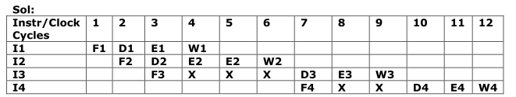
Solution
I1: add R1, R0, #20 (R1← R0 + 20)
I2: mul R2, R3, #2 (R2← R3*2)
I3: and R4, R1, R2 (R4← R1 and R2)
I4: add R5, R4, R2 (R5← R4 + R2)

Slide 15
Prediction Based Algorithms for Handling Conditional Branches
Predict never taken
Assume that jump will not happen. Always fetch next instruction
Predict always taken
Assume that jump will happen. Always fetch target instruction
Predict by opcode
Some instructions are more likely to result in a jump than others. Can get up to 75% success
Taken/Not taken switch
Based on previous history.
Notes:
45

Slide 16
1-Bit Branch Predictor

Slide 17
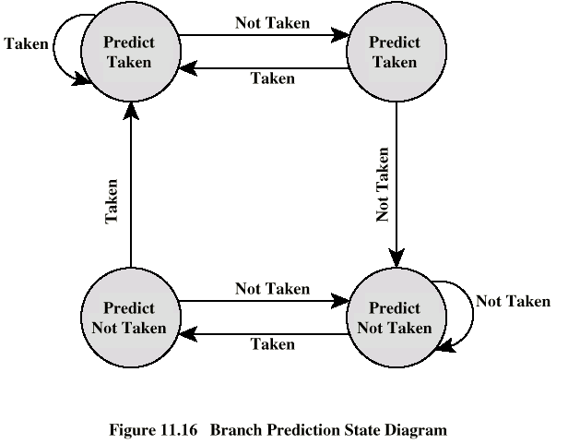
Two Bit Branch Predictor

Slide 18
Delayed Branch
Do not take jump until you have to…
Rearrange instructions
Example
LOOP Shift_left R1
Decrement R2
Brp LOOP
NEXT Add R1,R3
LOOP Decrement R2
Brp LOOP
Shift_left R1
NEXT Add R1,R3
Reordered Instructions
The location following a branch instruction is called a branch delay slot
The objective is to utilize the slot by putting useful instruction.

Slide 19
RISC Pipelining
Most instructions are register to register
I: Instruction fetch
E: Execute
ALU operation with register input and output
For load and store
I: Instruction fetch
E: Execute
Calculate memory address
D: Memory
Register to memory or memory to register operation

Slide 20
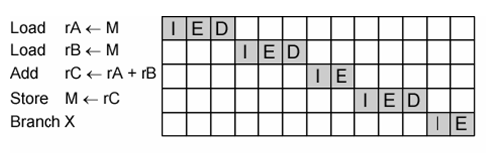
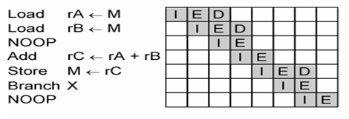
RISC Pipeline Example

Slide 21
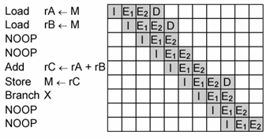
Four Stage RISC Pipelining
E stage usually involves an ALU operation, it may be longer. So we can divide into two stages
E1: Register file read
E2: ALU operation and register write

Slide 22
Summary
Pipeline Hazards
Data Hazards
Resource Hazards
Instruction Hazards
Branch Prediction Algorithms
RISC Pipeline as an Example

Slide 23
Thank You!

