Slide 1
Computer Organization & Architecture
Virendra Singh Shekhawat
Department of Computer Science and Information Systems

Slide 2
Module-7 (Lecture-3)
[Ref. Computer Organization and Architecture , 8th Ed. by William Stallings]
Topics: Instruction Level and Machine Level Parallelism, Superscalar Pipeline and Superscalar Processor Design Elements, Hazards and Solutions

Slide 3
Introduction
Scalar pipeline improves performance
By overlapping various instruction stages
Unable to exploit Instruction Level Parallelism (ILP) completely!
A new term called Superscalar is coined (1987) to exploit ILP of a program

Slide 4
What is Superscalar?
Multiple independent instruction pipelines are used to execute instructions independently and concurrently
Common instructions (arithmetic, load/store, conditional branch) initiated simultaneously and executed independently
Improve the performance of the execution of instructions operated on scalar quantities
Equally applicable to RISC & CISC but in practice usually RISC

Slide 5
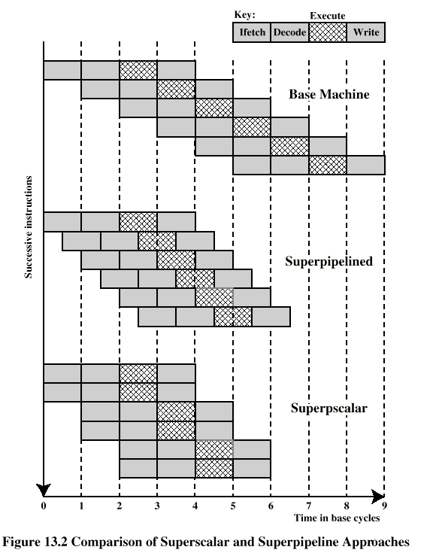
Super Scalar vs. Super Pipeline
Super Pipeline
Many pipeline stages need less than half a clock cycle
Double internal clock speed gets two tasks per external clock cycle

Slide 6
Limitations
Superscalar approach depends on the ability to execute multiple instructions in parallel
How to maximize the ILP
Compiler based optimization
Hardware techniques
Limited by following dependencies or hazards
Instruction / Procedural
Resource
Data Hazards
RAW, WAR, WAW

Slide 7
Procedural/Instruction Hazards
Can not execute instructions after a branch in parallel with instructions before a branch
Also, if instruction length is not fixed, instructions have to be decoded (partially) to find out how many fetches are needed
This prevents simultaneous fetches
So superscalar techniques are applicable to a RISC or RISC like architecture

Slide 8
Resource Conflict
Two or more instructions requiring access to the same resource at the same time
e.g. two arithmetic instructions
Solution
Can duplicate resources. e.g. have two arithmetic units

Slide 9
Data Hazards/Conflicts
Example Program
R3= R3 + R5; (I1)
R4= R3 + 1; (I2)
R3= R5 + 1; (I3)
R7= R3 + R4 (I4)
Identify the hazards among above instructions
I1 and I2 ?
I3 and I4 ?
I2 and I3 ?
I1 and I3 ?

Slide 10
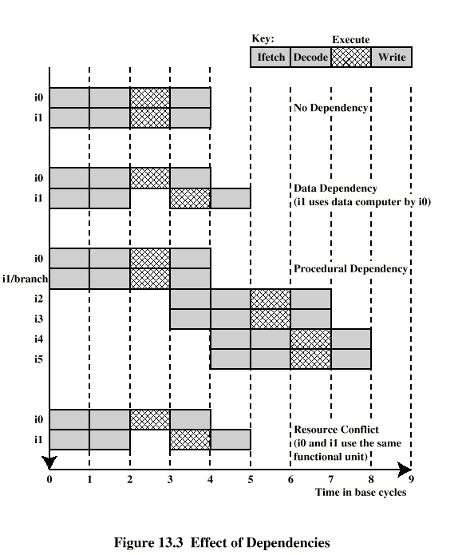
Effect of Hazards/ Dependencies

Slide 11
Superscalar Processor Design Issues
Instruction level parallelism
If instructions in a sequence are independent, execution can be overlapped
Degree of instruction level parallelism is governed by data and procedural dependency
Machine Parallelism
Ability to take advantage of instruction level parallelism
Governed by number of parallel pipelines
Note
A program may not have enough instruction level parallelism to take full advantage of machine parallelism

Slide 12
Instruction Issue Policy
Instruction Issue
Refer to the process of initiating instruction execution in the processor’s functional units
Occurs when instruction moves from the decode stage to the first execute stage
Instruction Issue Policy
Refer to the protocol used to issue instructions
Processor look ahead to locate instructions that can be brought into the pipeline and executed
Ordering issues
Order in which instructions are fetched, executed and change contents of registers and memory

Slide 13
Issue Policies
In-order issue with in-order completion
In-order issue with out-of-order completion
Out-of-order issue with out-of-order completion

Slide 14
Example: Issue Policies-1
Assumptions
A super Scalar Pipeline capable of fetching and decoding two instructions at a time
The next two instructions must wait until the pair of decode pipeline stages has cleared
Having three separate functional units (two integer arithmetic and one floating point arithmetic)
Two instances of the write back pipeline stage

Slide 15
Example: Issue Policies-2
Constraints
I1 requires two cycles to execute
I3 and I4 conflict for the same functional unit
I5 depends on the value produced by I4
I5 and I6 conflict for a functional unit

Slide 16
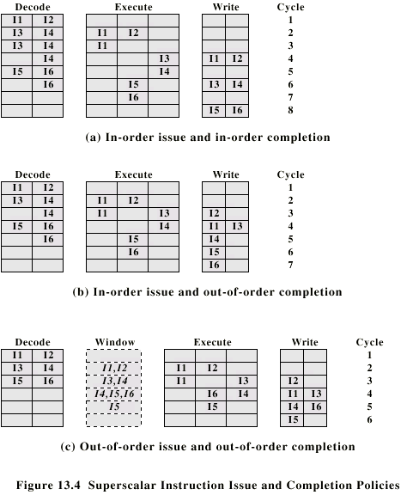
In-Order Issue In-Order Completion

Slide 17
In-Order Issue Out-of-Order Completion
It improves the performance of instructions that requires multiple cycles
E.g. I2 is allowed to run to completion prior to I1. Results I3 completed earlier i.e. saving one cycle (Better than previous)

Slide 18
Out-of-Order Issue Out-of-Order Completion
Decouple decode stage from execution stage by introducing a buffer called instruction window
Since instructions have been decoded, processor can look ahead

Slide 19
Register Renaming
When out of order techniques are used
WAW and WAR hazards occur because register contents may not reflect the correct ordering from the program
WAW and WAR dependencies are known as storage conflicts
Compilers use optimized registers allocation which leads to more storage conflicts
Register Renaming is used to deal with this
Similar to resource duplication

Slide 20
Register Renaming
R3b:=R3a + R5a (I1)
R4b:=R3b + 1 (I2)
R3c:=R5a + 1 (I3)
R7a:=R3c + R4b (I4)
Inference
The same original register reference in several different instructions may refer to different actual registers, if different values are needed
R3:= R3 + R5; (I1)
R4:= R3 + 1; (I2)
R3:= R5 + 1; (I3)
R7:= R3 + R4 (I4)

Slide 21
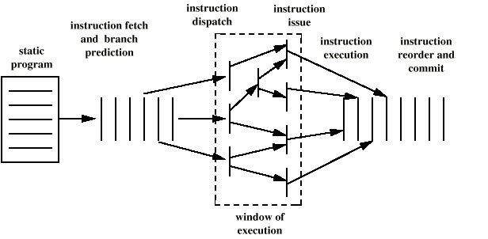
Superscalar Execution

Slide 22
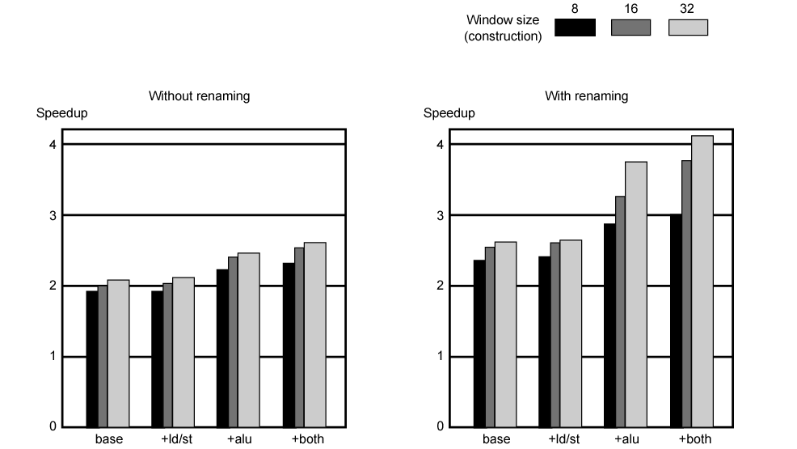
Machine Parallelism
To enhance the performance of the Super Scalar Processors
Duplication of Resources, Out of order instruction issue
Register Renaming

Slide 23
Review Questions
How instruction level parallelism is different from machine parallelism?
Identify the various data hazards among the following instructions?
I1: R1=20
I2: R1=R3+R4
I3: R2=R4-10
I4: R4=R1+R2
I5: R2=R1+40

Slide 24
Summary
Instruction level Parallelism vs. Machine level parallelism
Superscalar Pipeline’s Performance Limitation Factors
Superscalar Processor Design Issues
Register Renaming
Eliminates WAR and WAW hazards

Slide 25
Thank You!

