Slide 1
COA The memory

Slide 2
Interesting information
the 1st drive with a capacity 1 GByte , produced
by IBM in 1980
weighed 250 kg
cost $40,000
size of a kitchen appliance

Slide 3
Magnetic disk
A disk is a circular platter constructed of nonmagnetic material, called the substrate, coated with a magnetizable material.
Traditionally, the substrate has been an aluminum or aluminum alloy material. More recently, glass substrates have been introduced.
The glass substrate has a number of benefits
Improvement in the uniformity of the magnetic film surface to increase disk reliability
A significant reduction in overall surface defects to help reduce read-write errors
Better stiffness to reduce disk dynamics
Greater ability to withstand shock and damage

Slide 4
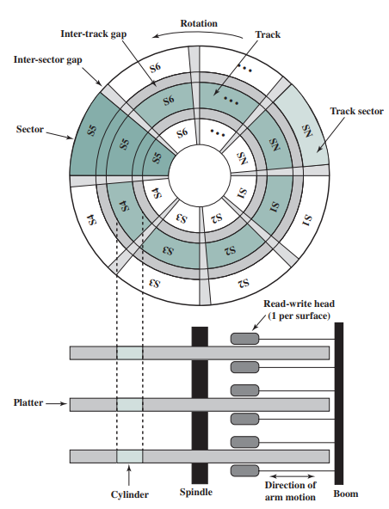
Disk Data Layout

Slide 5
Organization of Data on a Disk
Sector 2, track
n
Sector 0, track 1
Sector 0, track 0
The set of corresponding tracks on all surfaces of a stack of disk form a cylinder
The data are accessed by specifying the surface number, the track and the sector number
Organization of one surface of a disk.

Slide 6
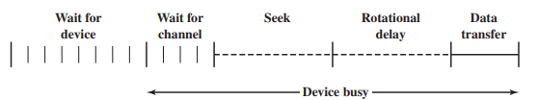
Disk Performance Parameter
Seek time: is the time required to move the disk arm to the required track.
Rotational delay: Disks, other than floppy disks, rotate at speeds ranging from 3600 rpm (for handheld devices such as digital cameras) up to, as of this writing, 20,000 rpm;
Transfer time : The transfer time to or from the disk depends on the rotation speed of the disk T = b /rN
T = transfer time ;b = number of bytes to be transferred; N = number of bytes on a track ; r = rotation speed, in revolutions per second
T_{total} = T_{s} + 1/2r + b/rN

Slide 7
A timing comparison
Consider a disk with an advertised average seek time of 4 ms, rotation speed of 15,000 rpm, and 512-byte sectors with 500 sectors per track. Suppose that we wish to read a file consisting of 2500 sectors for a total of 1.28 Mbytes
First, let us assume that the file is stored as compactly as possible on the disk. That is, the file occupies all of the sectors on 5 adjacent tracks (5 tracks * 500 sectors/track = 2500 sectors). This is known as sequential organization
Average seek 4 ms; Average rotational delay 2 ms
Read 500 sectors= b/rN= (512X500 X 60)/(15000 X500X512)=4 ms ; Thus Total=10 ms
Suppose that the remaining tracks can now be read with essentially no seek time.
That is, the I/O operation can keep up with the flow from the disk. Then, at most, we need to deal with rotational delay for the four remaining tracks. Thus each successive track is read in 2 + 4 = 6 ms.
To read the entire file, Total time = 10 + (4 * 6) = 34 ms = 0.034 seconds

Slide 8
A timing comparison
Consider a disk with an advertised average seek time of 4 ms, rotation speed of 15,000 rpm, and 512-byte sectors with 500 sectors per track. Suppose that we wish to read a file consisting of 2500 sectors for a total of 1.28 Mbytes
Now let us calculate the time required to read the same data using random access rather than sequential access;
that is, accesses to the sectors are distributed randomly over the disk.
For each sector, we have
Average seek 4 ms
Rotational delay 2 ms
Read 1 sector = b/rN= (512X 60)/(15000 X500X512)= 0.008 ms
Which is 6.008 ms
Total time = 2500 * 6.008 = 15,020 ms = 15.02 second

Slide 9
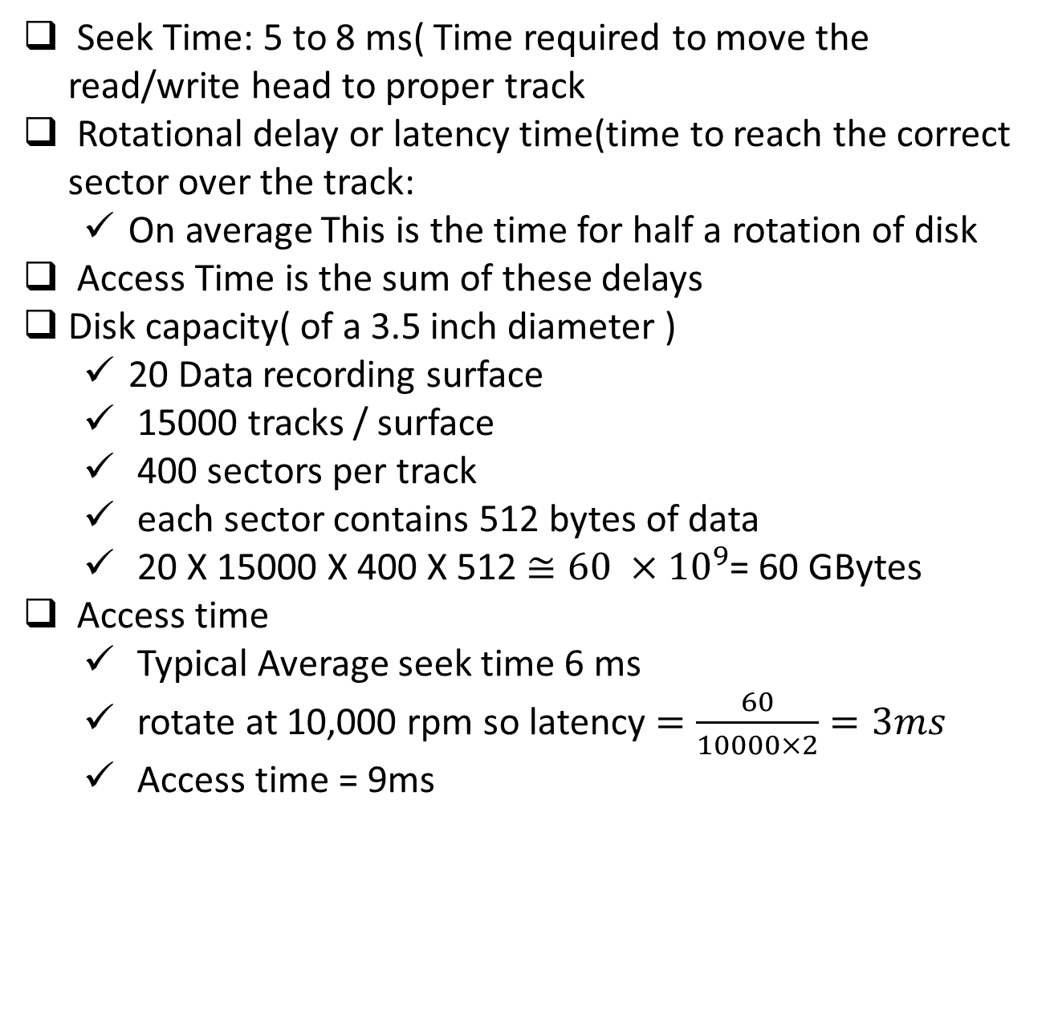
Access Time
Seek Time: 5 to 8 ms( Time required to move the read/write head to proper track
Rotational delay or latency time(time to reach the correct sector over the track:
On average This is the time for half a rotation of disk
Access Time is the sum of these delays
Disk capacity( of a 3.5 inch diameter )
20 Data recording surface
15000 tracks / surface
400 sectors per track
each sector contains 512 bytes of data
20 X 15000 X 400 X 512 $≅60 ×{10}^{9}$= 60 GBytes
Access time
Typical Average seek time 6 ms
rotate at 10,000 rpm so latency $=\frac{60}{10000×2}=3ms$
Access time = 9ms

Slide 10
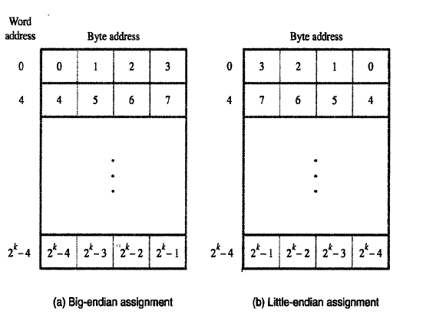
Some basic concepts
Maximum size of the Main Memory is determined by the addressing scheme
byte-addressable(big endian or…
Little endian)
CPU-Main Memory Connection
Processor
k
-bit
Memory
address bus
MAR
n
-bit
data bus
Up to 2
k
addressable
MDR
locations
Word length =
n
bits
Control lines
R
/
W
( , MFC, etc.)

Slide 11
Big Endian or Little Endian
16 bit address capable of 2^16= 64k Mempry locations
What abt with 32 bit instructions?
2^32= 4 G memory locations

Slide 12
Memory timing definitions
Memory Access time: The time between initiation of a task and its completion for example time elapsed between Read and MFC (memory function complete)
Memory Cycle time: the minimum time delay between two successive memory operations , eg: the time between two successive write operations
Memory cycle time is usually larger than the Memory access time

Slide 13
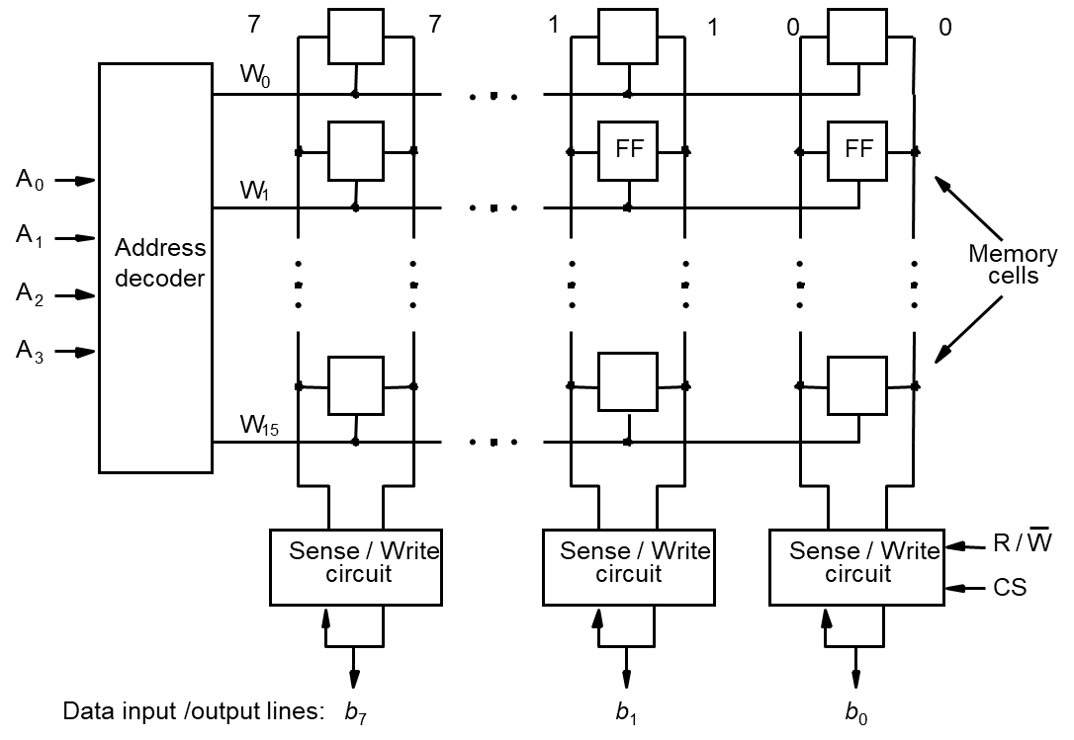
Internal organization of memory chips
16 X 8 orgaization

Slide 14
Internal organization of memory chips
Each memory cell can hold one bit of information.
Memory cells are organized in the form of an array.
One row is one memory word.
All cells of a row are connected to a common line, known as the “word line”.
Word line is connected to the address decoder.
Sense/write circuits are connected to the data input/output lines of the memory chip.
The memory circuit stores 128 bits
Requires 14 external connections for address data and control lines
& another two for Vdd and Grnd

Slide 15
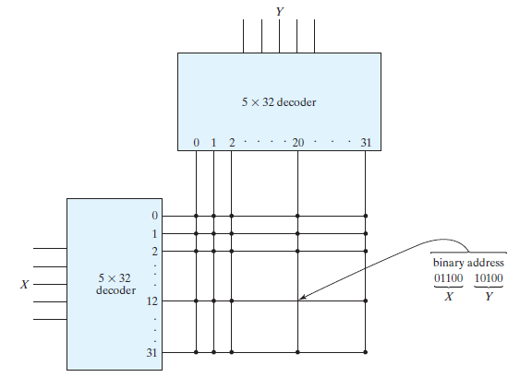
Address is 404 for a 1K‐word memory.
Comparison wrt to Decoder requirement
How many AND(NAND) gates required for 10 to 1k decoder?
How many AND(NAND) gates required for 5 to 32k decoder?

Slide 16
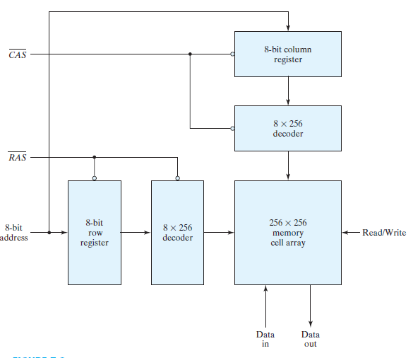
Address multiplexing for a 64K DRAM
After a time equivalent to the settling time of the row selection, RAS goes back to the 1 level.
Registers are used to store the addresses of the row and column.
CAS must go back to the 1 level before initialing another memory operation.

Slide 17
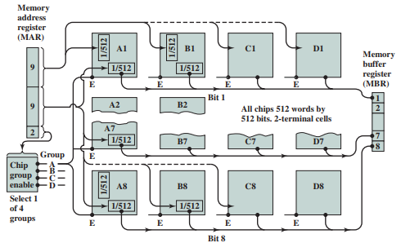
Memory organisation
Figure indicates how to construct a module of chips that can store 1 MB based on a group of four 256-Kbyte chips. Let’s say this module of chips is packaged as a single 1-MB chip, where the word size is 1 byte. Give a high-level chip diagram of how to construct an 8-MB computer memory using eight 1-MB chips. Be sure to show the address lines in your diagram and what the address lines are used for.

Slide 18
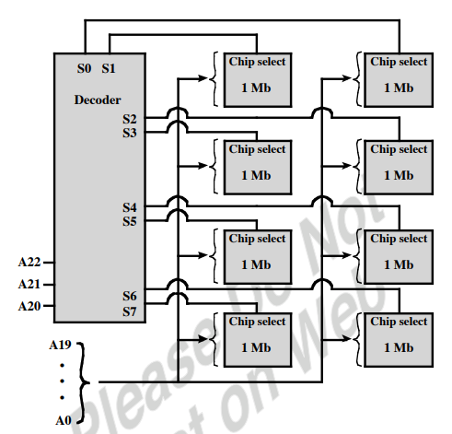
Memory organisation

Slide 19
SRAM Cell
Two transistor inverters are cross connected to implement a basic flip-flop.
The cell is connected to one word line and two bits lines by transistors T1 and T2
When word line is at ground level, the transistors are turned off and the latch retains its state
Read operation: In order to read state of SRAM cell, the word line is activated to close switches T1 and T2. Sense/Write circuits at the bottom monitor the state of b and b’
b
′
b
T
T
1
X
Y
2
Word line
Bit lines

Slide 20
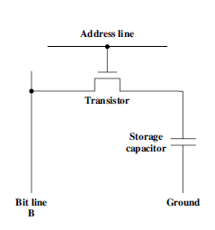
DRAMS
The address line is activated when the bit value from this cell is to be read or written
The transistor acts as a switch
In a read operation the sense amplifier connected to bit line decides whether the voltage is above some threshold
Then it drives the bit line to the full voltage representing 1
for zero the bit line is grounded thus discharging the capacitor completely

Slide 21
Asynchronous DRAMs
Static RAMs (SRAMs):
Consist of circuits that are capable of retaining their state as long as the power is applied.
Volatile memories, because their contents are lost when power is interrupted.
Access time of static RAMs are in the range of few nanoseconds.
However, the cost is usually high.
Dynamic RAMs (DRAMs):
Do not retain their state indefinitely. So called dynamic
Contents must be periodically refreshed.
Contents may be refreshed while accessing them for reading.

Slide 22
DRAM operation
Consider a dynamic RAM that must be given a refresh cycle 64 times per ms. Each refresh operation requires 150 ns; a memory cycle requires 250 ns.
What percentage of the memory’s total operating time must be given to refreshes?

Slide 23
DRAM timing
Figure shows a simplified timing diagram for a DRAM read operation over a bus. The access time is considered to last from t1 to t2. Then there is a recharge time, lasting from t2 to t3, during which the DRAM chips will have to recharge before the processor can access them again.
Assume that the access time is 60 ns and the recharge time is 40 ns. What is the memory cycle time? What is the maximum data rate this DRAM can sustain, assuming a 1-bit output?
b. Constructing a 32-bit wide memory system using these chips yields what data transfer rate?

Slide 24
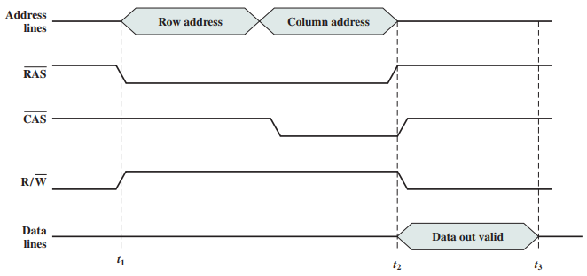
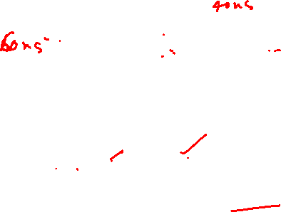
DRAM timing

Slide 25
Internal organization of 2M X 8 dynamic memory chip
Arranged in 4k X 4k
Each row can store 512 bytes. 12 bits to select a row, and 9 bits to select a group in a row. Total of 21 bits.
First apply the row address, RAS signal latches the row address. Then apply the column address, CAS signal latches the address.
Timing of the memory unit is controlled by a specialized unit which generates RAS and CAS.
This is asynchronous DRAM
R
A
S
Row
Row
4096
×
(
512
×
8
address
)
latch
decoder
cell array
A
20
⁄
A
Sense / Write
CS
-
9
8
-
0
circuits
R
/
W
Column
Column
address
decoder
latch
C
A
S
D
D
7
0

Slide 26
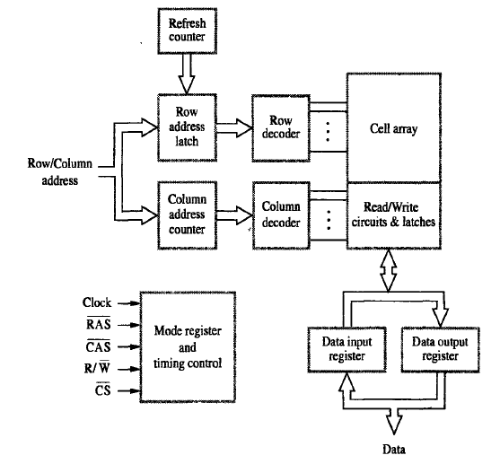
Synchronous DRAMS
Operation is directly synchronized
with processor clock signal.
The outputs of the sense circuits are
connected to a latch.
During a Read operation, the
contents of the cells in a row are
loaded onto the latches.
During a refresh operation, the
contents of the cells are refreshed
without changing the contents of
the latches.
Data held in the latches correspond
to the selected columns are transferred
to the output.
For a burst mode of operation,
successive columns are selected using
column address counter and clock.
CAS signal need not be generated
externally. A new data is placed during
rising edge of the clock

Slide 27
Static memories implementation : example
Start here 12/04/2024
Implement a memory unit of 2M words of 32 bits each.
Use 512kx8 static memory chips.
Each column consists of 4 chips.
Each chip implements one byte data.
A chip is selected by setting its chip select control line to 1.
Selected chip places its data on the data output line, outputs of other chips are in high impedance state.
21 bits to address a 32-bit word.
High order 2 bits are needed to select the row, by activating the four Chip Select signals.
19 bits are used to access specific byte locations inside the selected chip.

Slide 28
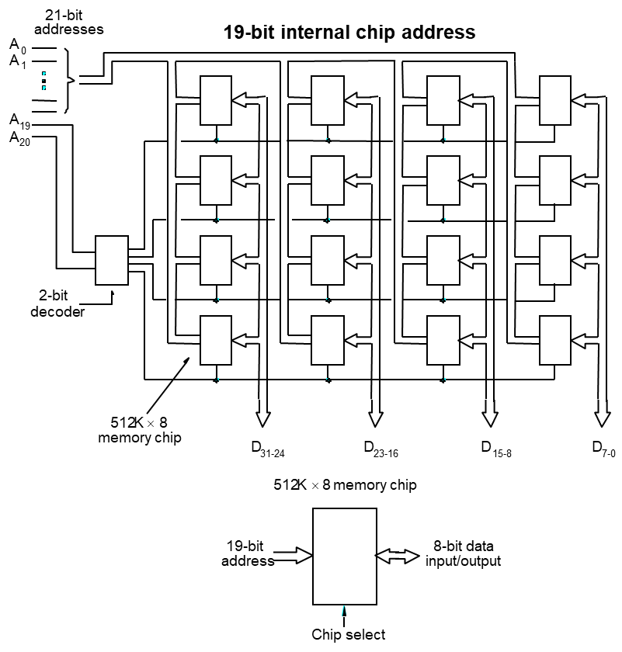
Static memories implementation of 2M X 32 bits
Implemented as
512k X 8 X 4

Slide 29
Latency, Bandwidth, and DDRSDRAMs
Memory latency is the time it takes to transfer a word of data to or from memory
Memory bandwidth is the number of bits or bytes that can be transferred in one second.
DDRSDRAMs: on both edges
Cell array is organized in two banks

Slide 30
Memory controller
Row/Column
Address
address
R
A
S
R
/
W
Memory
C
A
S
Request
controller
R
/
W
Processor
Memory
C
S
Clock
Clock
Data

Slide 31
Refreshing overhead
When used with DRAM chips which do not have a self refreshing capability Memory controller has to provide all the information needed for refreshing
Consider a memory of 8k= 8192 Rows
4 cycles to refresh each row then 8192 X 4 = 32768 cycles to refresh all rows
In typical SDRAMs a typical refresh period is 64 ms
at a clock rate of 133Mhz
time needed to refresh all rows = 32768/133MHz = 0.246ms
overhead= 0.246/64= 0.0038 = 0.4% total time available for accessing memory

Slide 32
Interleaving
Divides the memory system into a number of memory modules. Each module has its own address buffer register (ABR) and data buffer register (DBR).
Arranges addressing so that successive words in the address space are placed in different modules.
When requests for memory access involve consecutive addresses, the access will be to different modules.
Since parallel access to these modules is possible, the average rate of fetching words from the Main Memory can be increased.

Slide 33
Methods of address layouts
k
bits
m
bits
Module
Address in module
MM address
ABR
DBR
ABR
DBR
ABR
DBR
Module
Module
Module
0
i
n
-
1
Consecutive words are placed in a module.
High-order k bits of a memory address determine the module.
Low-order m bits of a memory address determine the word within a module.
When a block of words is transferred from main memory to cache, only one module is busy at a time.

Slide 34
Methods of address layouts(Interleaving)
m
bits
k
bits
Address in module
Module
MM address
Consecutive words are located in consecutive modules.
Consecutive addresses can be located in consecutive modules.
While transferring a block of data, several memory modules can be kept busy at the same time.
ABR
DBR
ABR
DBR
ABR
DBR
Module
Module
Module
0
i
2
k
-
1

Slide 35
Example
9 | 0000
8 | 0001
7 | 0010
6 | 0011
5 | 0100
4 | 0101
3 | 0110
2 | 0111
1 | 1000
15 | 1001
14 | 1010
13 | 1011
12 | 1100
11 | 1101
10 | 1110
0 | 1111
 | 00
00 | 9
01 | 5
10 | 1
11 | 12
 | 01
00 | 8
01 | 4
10 | 15
11 | 11
 | 10
00 | 7
01 | 3
10 | 14
11 | 10
 | 11
00 | 6
01 | 2
10 | 13
11 | 0

Slide 36
Example: (Definition of cylinders)
A disk has 24 recording surface has 14000 cylinders. There is an average of 400 sectors per track. Each sector contains 512 Bytes of data
What is the maximum number of bytes that can be stored?
The maximum number of bytes that can be stored on this disk is 24 X14000 X400X 512 = 68.8 X 10⁹ bytes
What is the data transfer rate in bytes per second at a rotational speed of 7200rpm?
The data transfer rate is (400 X 512 X 7200)/60 = 24.58 X 10⁶ bytes/s.

Slide 37
The number of cylinders of a disk drive exactly equals the number of tracks on a single surface in the drive. It comprises the same track number on each platter, spanning all such tracks across each platter surface that is able to store data
Example: Contnd
A disk has 24 recording surface has 14000 tracks. There is an average of 400 sectors per track. Each sector contains 512 Bytes of data
Using a 32 bit word , suggest a suitable addressing scheme for the disk, assuming that there are 512 bytes / Sector
Need 9 bits to identify a sector, 14 bits for a track, and 5 bits for a surface.
Thus, a possible scheme is to use address bits A₈₋₀ for sector,
A₂₂₋₉ for track,
and A₂₇₋₂₃ for surface identification. Bits A31-28 are not used.

Slide 38
Example
What is the average time to read or write a 512-byte sector for a typical disk rotating at 15,000 RPM? The advertised average seek time is 4 ms, the transfer rate is 100 MB/sec, and the controller overhead is 0.2 ms. Assume that the disk is idle so that there is no waiting time.
Sol:
Average disk access time = average seek time + average rotational
Delay + transfer time + controller overhead
rotational latency Also called rotational delay.
The time required for the desired sector of a disk to rotate under the read/write head;
usually assumed to be half the rotation time.
seek The process of positioning a read/write head over the proper track on a disk & seek time is the time consumed in it

Slide 39
What is the average time to read or write a 512-byte sector for a typical disk rotating at 15,000 RPM? The advertised average seek time is 4 ms, the transfer rate is 100 MB/sec, and the controller overhead is 0.2 ms. Assume that the disk is idle so that there is no waiting time.
Sol:
Average disk access time = average seek time + average rotational
Delay + transfer time + controller overhead
=4.0 ms + 0.5 rotation /15,000 RPM + 0.5 KB/100 MB/sec + 0.2 ms
= 4.0 + 2.0 + 0.005 + 0.2 = 6.2 ms
If the measured average seek time is 25% of the advertised average time, then it is
1.0 ms + 2.0 ms + 0.005 ms + 0.2 ms = 3.2 ms

Slide 40
Example:
Design a 16-bit memory of total capacity 8192 bits using SRAM chips of size 64 X 1 bit. Give the array configuration of the chips on the memory board showing all required input and output signals for assigning this memory to the lowest address space. The design should allow for both byte and 16-bit word accesses.
Sol:
Number of total addressable locations of 16 bits= 8192/16= 512
no of 64 X 1 chips required 8192/64= 128 chips
There will be 128/16=8 row of 16 bits
512 can be rranged into 8 rows X 64 columns
For 8 rows no of decoder bits 3
For 64 columns no of decoder bits 6

Slide 41
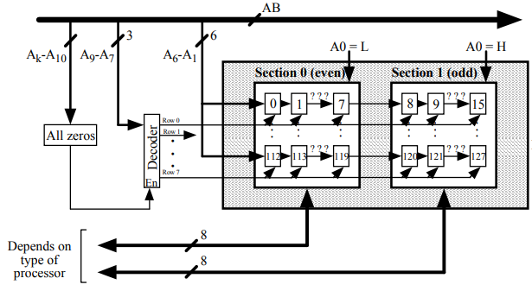
Solution

Slide 42
Example
Consider a dynamic RAM that must be given a refresh cycle 64 times per ms. Each refresh operation requires 150 ns; a memory cycle requires 250 ns.What percentage of the memory’s total operating time must be given to refreshes?

Slide 43
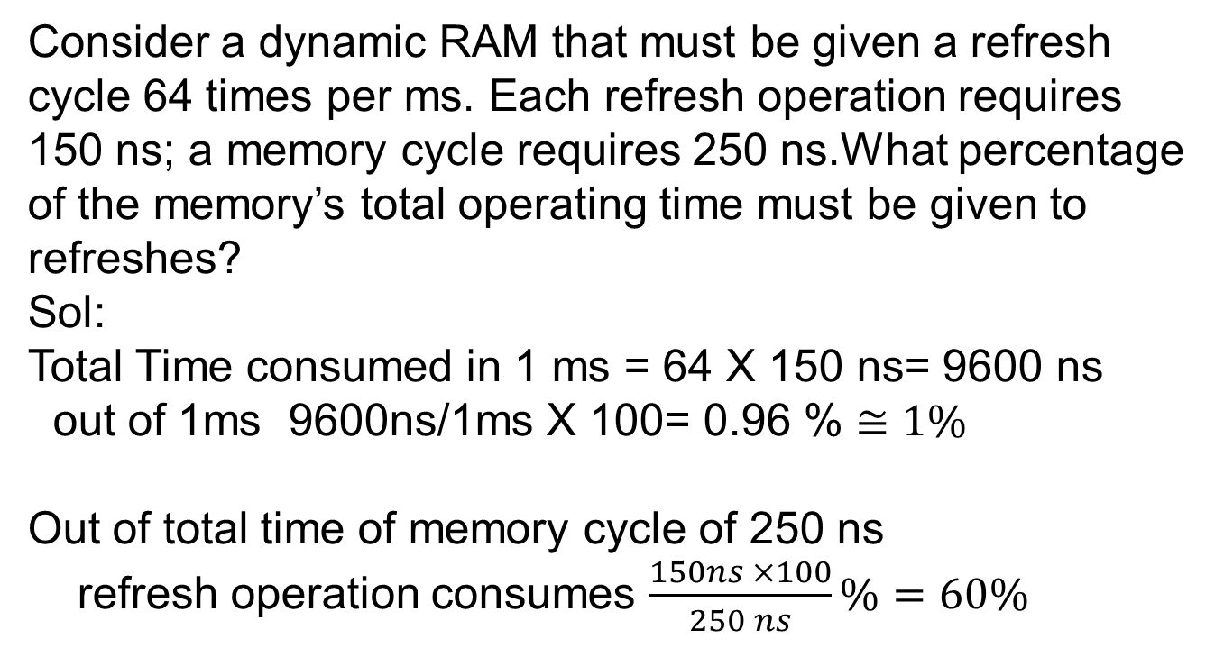
Example
Consider a dynamic RAM that must be given a refresh cycle 64 times per ms. Each refresh operation requires 150 ns; a memory cycle requires 250 ns.What percentage of the memory’s total operating time must be given to refreshes?
Sol:
Total Time consumed in 1 ms = 64 X 150 ns= 9600 ns
out of 1ms 9600ns/1ms X 100= 0.96 % $≅1\%$
Out of total time of memory cycle of 250 ns
refresh operation consumes $\frac{150ns ×100}{250 ns}\%=60\%$

Slide 44
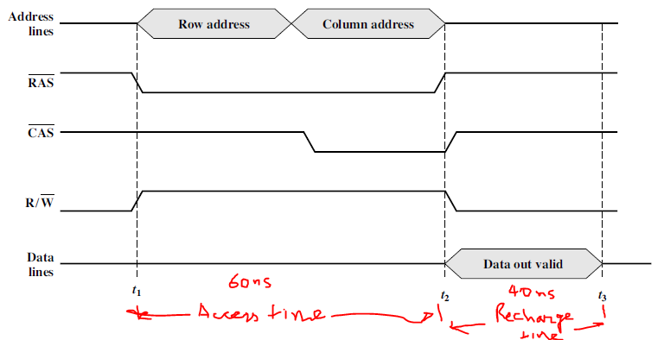
Figure shows a simplified timing diagram for a DRAM read operation over a
bus.

Slide 45
What is the memory cycle time?
What is the maximum data rate this DRAM can sustain, assuming a
1-bit output?

Slide 46
What is the memory cycle time?
What is the maximum data rate this DRAM can sustain, assuming a
1-bit output?
Sol: memory cycle time = (60+ 40)=100 ns

Slide 47
What is the memory cycle time?
What is the maximum data rate this DRAM can sustain, assuming a
1-bit output?
Sol: memory cycle time = (60+ 40)=100 ns
1 bit in 100ns so 1/100ns per/ sec= 10Mbps

Slide 48
What is the memory cycle time?
What is the maximum data rate this DRAM can sustain, assuming a
1-bit output?
Sol: memory cycle time = (60+ 40)=100 ns
1 bit in 100ns so 1/100ns per/ sec= 10Mbps
Constructing a 32-bit wide memory system using these chips yields what data transfer rate?

Slide 49
What is the memory cycle time?
What is the maximum data rate this DRAM can sustain, assuming a
1-bit output?
Sol: memory cycle time = (60+ 40)=100 ns
1 bit in 100ns so 1/100ns per/ sec= 10Mbps
Constructing a 32-bit wide memory system using these chips yields what data transfer rate?
Ans 320Mbps= 320Mbps/8 = 40MB/s

Slide 50

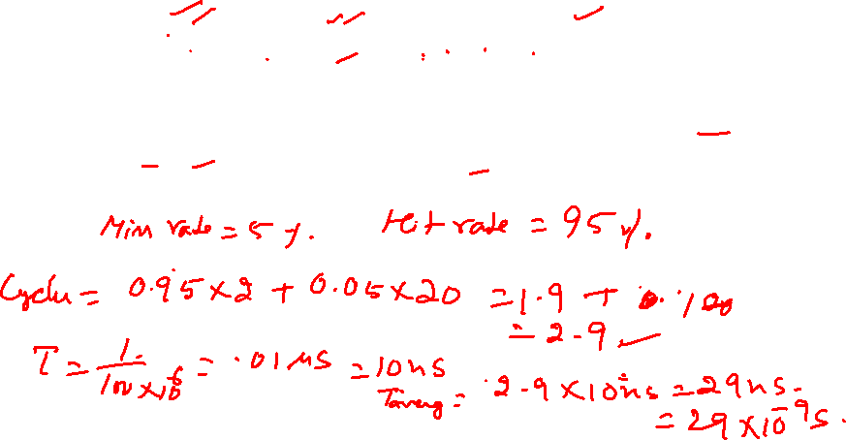
Multiple level cache
Average Access Time
Given a 100 MHz machine with a with a miss penalty of 20 cycles, a hit time of 2 cycles, and a miss rate of 5%, calculate the average memory access time (AMAT).

Slide 51
Multiple level cache
Given a 100 MHz machine with a with a miss penalty of 20 cycles, a hit time of 2 cycles, and a miss rate of 5%, calculate the average memory access time (AMAT).
AMAT = hit_time + miss_rate x miss_penalty
Since the clock rate is 100 MHz, the cycle time is:
1/(100 MHz) = 10 ns
which gives
AMAT = 10 ns x (2 + 20 x 0.05) = 30 ns
Note: Here we needed to multiply by the cycle time because the hit_time and miss_penalty were given in cycles.

Slide 52
Multiple level cache
Suppose doubling the size of the cache decrease the miss rate to 3%, but causes the hit time to increases to 3 cycles and the miss penalty to increase to 21 cycles. What is the AMAT of the new machine?

Slide 53
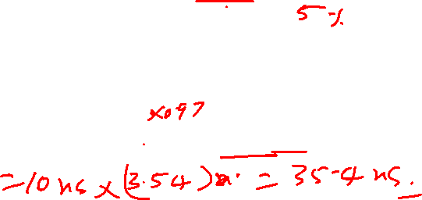
Multiple level cache
Suppose doubling the size of the cache decrease the miss rate to 3%, but causes the hit time to increases to 3 cycles and the miss penalty to increase to 21 cycles. What is the AMAT of the new machine?
For the new machine:
AMAT = 10 ns x (3 + 21 x 0.03) = 36.3 ns

Slide 54
Mass Storage
Many systems today need to store many terabytes of data
Don’t want to use single, large disk
too expensive
failures could be dangerous
Would prefer to use many smaller disks

Slide 55
RAID
Redundant Array of Independent Disks
Basic idea is to connect multiple disks together to provide
large storage capacity
faster access to reading data
redundant data
Many different levels of RAID systems
differing levels of redundancy, error checking, capacity, and cost

Slide 56
Striping
Take file data and map it to different disks
Allows for reading data in parallel
file data
block 0
block 1
block 2
block 3
Disk 0
Disk 1
Disk 2
Disk 3

Slide 57
MIRRORING
file data
block 0
block 1
block 2
block 3
block 4
0 block 0
1 block 1
2 block 2
3 block 3
4 block 4
5
0 block 0
1 block 1
2 block 2
3 block 3
4 block 4
5
sectors
sectors
Disk 0
Disk 1

Slide 58
Mirroring
Keep two copies of data on two separate disks
Gives good error recovery
if some data is lost, get it from the other source
Expensive
requires twice as many disks
Write performance can be slow
have to write data to two different spots
Read performance is enhanced
can read data from file in parallel

Slide 59
Parity
Way to do error checking and correction
Add up all the bits that are 1
if even number, set parity bit to 0
if odd number, set parity bit to 1
To actually implement this, do an exclusive OR of all the bits being considered
Consider the following 2 bytes
byte parity
10110011 1
01101010 0
If a single bit is bad, it is possible to correct it

Slide 60
RAID Level-0
Often called striping
Break a file into blocks of data
Stripe the blocks across disks in the system
Simple to implement
disk = file block % number of disks
sector = file block / number of disks
provides no redundancy or error detection

Slide 61
RAID Level-0
file data
block 0
block 1
block 2
block 3
block 4
0 block 0
1 block 2
2 block 4
3
4
5
0 block 1
1 block 3
2
3
4
5
sectors
sectors
Disk 0
Disk 1

Slide 62
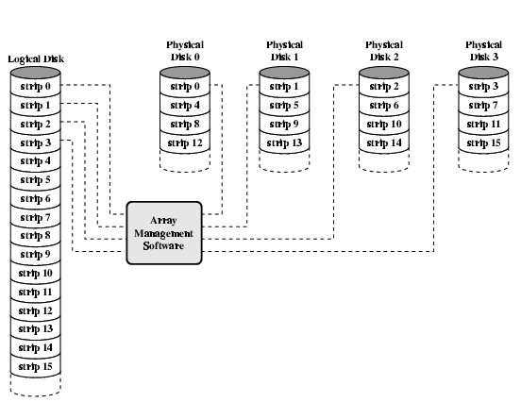
Data Mapping For RAID 0

Slide 63
RAID Level-1
A complete file is stored on a single disk
A second disk contains an exact copy of the file
Provides complete redundancy of data
Read performance can be improved
file data can be read in parallel
Write performance suffers
must write the data out twice
Most expensive RAID implementation
requires twice as much storage space

Slide 64
RAID Level-1
file data
block 0
block 1
block 2
block 3
block 4
0 block 0
1 block 1
2 block 2
3 block 3
4 block 4
5
0 block 0
1 block 1
2 block 2
3 block 3
4 block 4
5
sectors
sectors
Disk 0
Disk 1

Slide 65
RAID Level 2
Uses Bit-level striping with Hamming codes for ECC
Number of disks required depends on exact implementation
Only fair fault tolerance
Advantages
Random Read performance=fair
Sequential Read Performance=very good
Sequential Write performance=good
Disadvantages
Random Write Performance=poor
Requires a complex controller
High overhead for check disks
Not used in modern systems

Slide 66
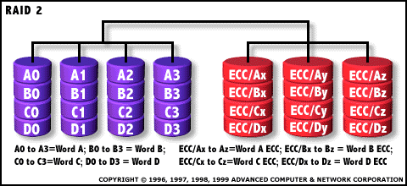
RAID Level 2

Slide 67
RAID Level 3
Uses byte-level striping with dedicated parity
Requires minimum three drives to implement
Has good fault-tolerance
Advantages
Random Read Performance=good
Sequential Read performance=very good
Sequential Write performance=fair to good
Lowest overhead for check disks
Disadvantages
Random Write performance=poor
Complex controller design

Slide 68
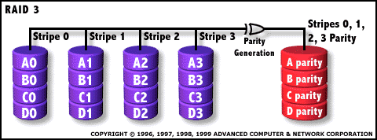
RAID Level 3

Slide 69
RAID Level 4
Uses Block-level striping with dedicated parity
Requires minimum of 3 drives to implement
Has good fault-tolerance
Advantages
Random Read Performance=very good
Sequential Read and Write performance=good
Lowest overhead of check disks
Disadvantages
Quite complex controller design
Random write performance=poor
Not commonly used

Slide 70

RAID Level 4

Slide 71
RAID Level 5
Uses Block-level striping with distributed parity
Requires a minimum of 3 drives to implement
Advantages
Random Read performance=very good
Random Write performance=fair
Sequential Read and Write performance=good
Lowest overhead of check disks
Disadvantages
Most complex controller design
Difficult to rebuild in the event of a disk failure

Slide 72
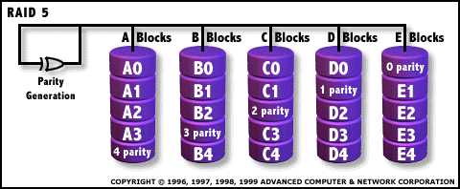
RAID Level 5

Slide 73
RAID 6
Two parity calculations
Stored in separate blocks on different disks
User requirement of N disks needs N+2
High data availability
Three disks need to fail for data loss
Significant write penalty

Slide 74
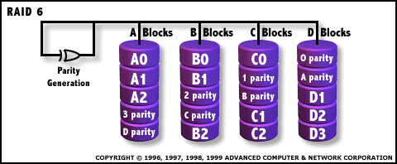
RAID Level 6
Raid Level 6 uses Block-level striping with dual distributed parity

Slide 75
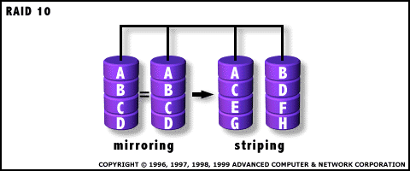
RAID Level 1+0
Uses Mirroring and striping without parity

Slide 76
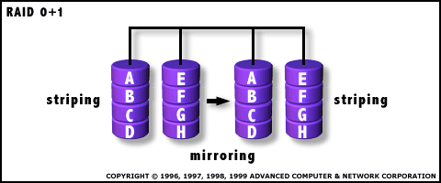
RAID Level 0+1
Uses Mirroring and striping without Parity

