Slide 1
R.K.Tiwary

Slide 2
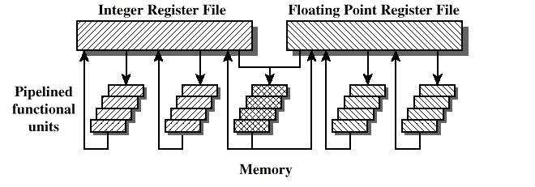
What is Superscalar?
Common instructions (arithmetic, load/store, conditional branch) can be initiated and executed independently
Equally applicable to RISC & CISC
In practice usually RISC
In this example, two integer, two floating-point, and one memory (either load or store) operations can be executing at the same time.

Slide 3
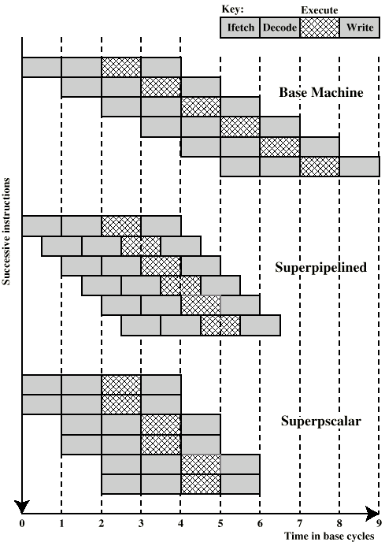
Superscalar v Superpipelined
FI
DI
EI
WB
Simple 4-stage pipeline
Superpipelined
Many pipeline stages need less than half a clock cycle
Double internal clock speed gets two tasks per external clock cycle
Superscalar allows parallel fetch execute
Degree 2

Slide 4
Superscalar approach
Instruction level parallelism
Compiler based optimisation
Hardware techniques
Limited by
True data dependency
Procedural dependency
Resource conflicts
Output dependency
Antidependency

Slide 5
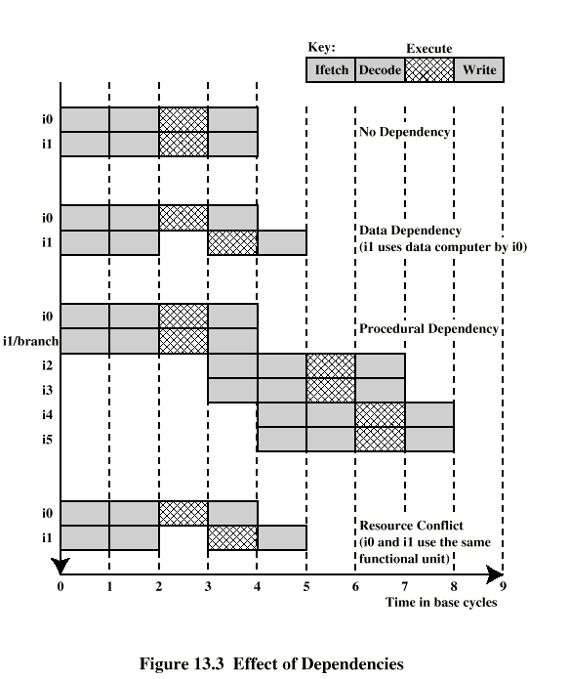
Effect of Dependencies
True Data Dependency
ADD r1, r2 (r1 := r1+r2;)
MOVE r3,r1 (r3 := r1;)
Can fetch and decode second instruction in parallel with first
Can NOT execute second instruction until first is finished
Procedural Dependency
Can not execute instructions after a branch in parallel with instructions before a branch
Also, if instruction length is not fixed, instructions have to be decoded to find out how many fetches are needed
This prevents simultaneous fetches
Degree 2

Slide 6
Effect of Dependencies
Resource Conflict
Two or more instructions requiring access to the same resource at the same time
e.g. two arithmetic instructions
Can duplicate resources
e.g. have two arithmetic units
Degree 2

Slide 7
Dependency due to memory Cycle
MOV EAX, eff ; load register EAX with the contents of
effective memory address eff
MOV EBX, EAX ;load EBX with the contents of EAX
For RISC processor
two or more cycles when the load is a cache hit
tens or even hundreds of cycles for a cache miss
sol: for the compiler to reorder instructions
This scheme is less effective in the case of a superscalar pipeline:
The independent instructions executed during the load are likely to be executed on the first cycle of the load, leaving the processor with nothing to do until the load completes

Slide 8
Design Issues:Instruction-Level Parallelism and Machine Parallelism
Instruction level parallelism
Instructions in a sequence are independent
Execution can be overlapped
Governed by data and procedural dependency
Example
Independent
Load R1 ← R2
Add R3 ← R3, “1”
Add R3 ← R3, “1”
Machine Parallelism
Ability to take advantage of instruction level parallelism
Governed by number of parallel pipelines
Showing Dependency
Add R4 ← R3, R2
Add R4 ← R4, R2
Store [R4] ← R0

Slide 9
Instruction Issue Policy
Instruction issue policy to refer to the protocol used to issue instructions
Three types of orderings are important
Order in which instructions are fetched
Order in which instructions are executed
Order in which instructions change registers and memory
the processor must accommodate the various dependencies and conflicts.

Slide 10
superscalar instruction issue policies
In-order issue with in-order completion
In-order issue with out-of-order completion
Out-of-order issue with out-of-order completion
In-Order Issue In-Order Completion
Issue instructions in the order they occur
Not very efficient
May fetch >1 instruction
Instructions must stall if necessary

Slide 11
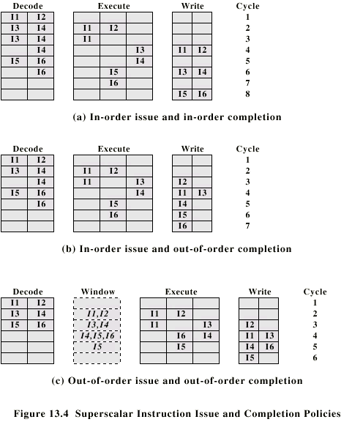
In-Order Issue In-Order Completion (Diagram)
I1 requires two cycles two execute
I3 & I4 conflict for the same functional unit
I5 depends on the value produced by I4
I5 and I6 conflict for a functional unit
Superscalar Instruction Issue and Completion Policies

Slide 12
In-Order Issue Out-of-Order Completion (Diagram)
Superscalar Instruction Issue and Completion Policies

Slide 13
In-Order Issue Out-of-Order Completion
Output dependency
I1: R3 ← R3 op R5
I2: R4 ← R3 + 1
I3: R3 ← R5 + 1
I4: R7 ← R3 op R4
I2 depends on result of I1 – True data dependency: Instruction I2 cannot execute before instruction I1
If I3 completes before I1, the result from I1 will be wrong - output (read-write) dependency
I4 must wait for I3, because it uses a result pro duced by I3.
I3 must complete after I1 to produce the correct output values in I4
Eg. Of a Write after write (WAW) dependency.
Here more difficult to deal with instruction interrupts and exceptions as at the time of interruption, instructions ahead of the instruction that caused the interrupt must have completed

Slide 14
Out-of-Order Issue Out-of-Order Completion
Decouple decode pipeline from execution pipeline
Can continue to fetch and decode until this pipeline is full
When a functional unit becomes available an instruction can be executed
Since instructions have been decoded, processor can look ahead

Slide 15
Antidependency
Read after-write(RAW) dependency
I1: R3 ← R3 op R5
I2: R4 ← R3 + 1
I3: R3 ← R5 + 1
I4: R7 ← R3 op R4
Instruction I3 cannot complete execution before instruction I2 begins execution and has fetched its operands. This is so because I3 updates register R3, which is a source operand for I2.
The term antidependency is used because the constraint is similar to that of a true data dependency, but reversed:

Slide 16
Reduced Instruction Set Computer
Key features
Large number of general purpose registers
or use of compiler technology to optimize register use
Limited and simple instruction set
Emphasis on optimising the instruction pipeline
All operations on data apply to data in registers
The only operations that affect memory are load and store operations
The instruction formats are few in number, with all instructions typically being one size.

Slide 17
Basic Pipelining: A "Typical" RISC ISA
32-bit fixed format instruction (3 formats)
ALU instructions, Load/Store, Branches and Jumps
32 32-bit GPR (R0 contains zero, DP take pair)
3-address, reg-reg arithmetic instruction
Single address mode for load/store: base + displacement
no indirection
Simple branch conditions /Jump

Slide 18
A simple implementation of a RISC Instruction Set
Every instruction can be implemented in at most 5 cycles.
Instruction fetch cycle (IF): send PC to memory and fetch the current instruction; Update the PC to the next PC by adding 4.
Instruction decode/register fetch cycle (ID): decode the instruction and read the registers. For a branch, do the equality test on the registers, and compute the target address
Execution/effective address cycle (EX): The ALU operates on the operands prepared in the prior cycle, performing:
Memory reference: ALU adds the base register and the offset.
LW 100(R1) => 100 + R1
Register-Register ALU instruction: ALU performs the operation specified by the opcode on the values read from the register file. ADD R1,R2,R3 => R1 + R2
Register-Immediate ALU instruction: ALU performs the operation specified by the opcode on the first values read from the register file and the immediate. ADD R1,3,R2 => R1 + 3

Slide 19
A simple implementation of a RISC Instruction Set
Every instruction can be implemented in at most 5 cycles.
Memory access (MEM). Read the memory using the effective address computed in the previous cycle if the instruction is a load; If it is a store, write the data to the memory
Write-back cycle (WB). For Register-Register ALU instruction or load instruction, write the result into the register file, whether it comes from the memory (for a load) or from the ALU (for an ALU instruction)
Branch instructions require 2 cycles, store instructions require 4 cycles, others require 5 cycles.

Slide 20
An example of an instruction execution
ADD R3, R1, R2 => R3 = R1 + R2;
IR
ALU
PC
Reg File
Memory

Slide 21
Instruction Fetch (IF)
ADD R3, R1, R2 => R3 = R1 + R2;
IR
ALU
PC
Memory
000001000010001000011…
Reg File
000011000111111100000…

Slide 22
Instruction Fetch (IF)
ADD R3, R1, R2 => R3 = R1 + R2;
IR
ALU
PC
Memory
000001000010001000011…
Reg File
000011000111111100000…

Slide 23
Instruction Fetch (IF)
ADD R3, R1, R2 => R3 = R1 + R2;
IR
000001000010001000011…
ALU
PC
Memory
000001000010001000011…
Reg File
000011000111111100000…
Fetch the instruction

Slide 24
Instruction Fetch (IF)
ADD R3, R1, R2 => R3 = R1 + R2;
IR
000001000010001000011…
ALU
Memory
000001000010001000011…
PC
Reg File
000011000111111100000…
Fetch the instruction
Move PC to the next instruction

Slide 25
Instruction Decode (ID)
ADD R3, R1, R2 => R3 = R1 + R2;
IR
000001000010001000011…
ALU
Reg File
R0
Reg File
0
R1
x
R2
y
R3
z
Memory
R31
…

Slide 26
Instruction Decode (ID)
ADD R3, R1, R2 => R3 = R1 + R2;
IR
000001000010001000011…
ALU
Reg File
ADD
R0
Reg File
0
R1
x
R2
y
decode the instruction
R3
z
Memory
R31
…

Slide 27
Instruction Decode (ID)
ADD R3, R1, R2 => R3 = R1 + R2;
IR
000001000010001000011…
ALU
Reg File
ADD
R1
R0
Reg File
0
R1
x
R2
y
decode the instruction
R3
z
Memory
R31
…

Slide 28
Instruction Decode (ID)
ADD R3, R1, R2 => R3 = R1 + R2;
IR
000001000010001000011…
ALU
Reg File
ADD
R1
R2
R0
Reg File
0
R1
x
R2
y
decode the instruction
R3
z
Memory
R31
…

Slide 29
Instruction Decode (ID)
ADD R3, R1, R2 => R3 = R1 + R2;
IR
000001000010001000011…
ALU
Reg File
ADD
R1
R2
R3
R0
Reg File
0
R1
x
R2
y
R3
z
Memory
R31
…

Slide 30
Instruction Decode (ID)
ADD R3, R1, R2 => R3 = R1 + R2;
IR
x
000001000010001000011…
ALU
y
Reg File
ADD
R1
R2
R3
R0
Reg File
0
R1
x
R2
y
R3
z
Memory
R31
…

Slide 31
Execution (EX)
ADD R3, R1, R2 => R3 = R1 + R2;
IR
x
000001000010001000011…
ALU
y
Reg File
Memory

Slide 32
Execution (EX)
ADD R3, R1, R2 => R3 = R1 + R2;
IR
x
000001000010001000011…
ALU
x + y
y
Reg File
Execute the operation
Memory

Slide 33
Writeback (WB)
ADD R3, R1, R2 => R3 = R1 + R2;
IR
x
000001000010001000011…
ALU
x + y
y
Reg File
R0
Reg File
0
R1
x
R2
y
Write the result to the register
R3
z
Memory
R31
…

Slide 34
Writeback (WB)
ADD R3, R1, R2 => R3 = R1 + R2;
IR
x
000001000010001000011…
ALU
x + y
y
Reg File
R0
Reg File
0
R1
x
R2
y
Write the result to the register
R3
x + y
Memory
R31
…

