Slide 1
Classes
Module 4
Notes:
Version: 12/09/2019 17:55:23

Slide 2
Disclaimer

Slide 3

Objectives
After completing this learning, you will be able to:
Understand what a Class is
Work With Methods
Work with Advanced Object Features

Slide 4
Classes Overview
What are classes
Custom data types can be created with sets of unique properties and methods
Requires PowerShell v5+
Create instances of unique class just like any other data type
Supports static members as well
What do they help with
Packaging up output in a more professional way than normal [PSCustomObject] data
Making it easier and faster to create multiple copies of custom objects
Enabling creation of a suite of tools by standardizing output/input
Ex. *-Service all support returning or receiving [ServiceController] objects
Adding custom methods to data will avoid extra functions in scripts
Differentiate between objects with the same properties
Notes:
Another good analogy “A class becomes a template for an object.”

Slide 5
Simplification and Standardization
Using a PScustomObject
$person = [pscustomobject]@{
Name= "Kory"
age = 29
Office= "Home"
Title= "PFE"
Planet= "Earth"
Dimension= "c137"
}
$person.GetType().fullname
System.Management.Automation.PSCustomObject
Annoying / Unclear
Pscustomobject returned
Pscustomobject full name
Hard to reuse / duplicate
Using a PScustomObject
Notes:
Another good analogy “A class becomes a template for an object.”

Slide 6
Simplification and Standardization (Continued)
Using a PowerShell Class
$person = [person]::new("Kory",29,"home","PFE","Earth","C137")
$person | GM
TypeName: person
Name MemberType Definition
---- ---------- ----------
…
age Property int age {get;set;}
dimension Property string dimension {get;set;}
Name Property string Name {get;set;}
Office Property string Office {get;set;}
planet Property string planet {get;set;}
title Property string title {get;set;}
Concise/Precise
Objects Class returned
Objects Class full name
easy to reuse / duplicate
Notes:
Another good analogy “A class becomes a template for an object.”

Slide 7
The Person Class
A PowerShell Person class in its simple form
class person
{
[string] $Name
[int32] $age
[string] $Office
[string] $title
[string] $planet
[string] $dimension
}
Notes:
Optional slide to show classes and intro the next unit
The Person class from the previous sample declared as a class in its most simple form.

Slide 8

Demonstration
Classes Introduction

Slide 9

Questions?

Slide 10
Class Basics

Slide 11
Class Syntax
Create a class
Use the “Class” keyword
Any custom name you want
Open and closed curly braces
Declaration of type
Name of the class
class Person
{
}
Code brackets to contain the class

Slide 12
Class Syntax cont.
Add Properties (information)
Strongly type data if you want
Default is [Object]
Variable will be the property name
class Person
{
# Public Properties
[String] $Name
[Int32] $Age
}

Slide 13
Class Syntax cont. (Continued)
class Person
{
# Public Properties
[String] $Name
[Int32] $Age
#public methods
[String] SaySomething()
{
return "Something!"
}
}
Add Properties (information)
Strongly type data if you want
Default is [Object]
Variable will be the property name
Add Methods (actions)
Strongly type return data if you have any
Default is [void]
Friendly name with Parenthesis
Must use “Return” to pass out data

Slide 14
Creating an Instance of your Class
New-Object
New-Object using a hash table
Default Constructor
$person = New-Object -TypeName Person
$person.name = "Kory"
$person.age = 28
$vals = @{
name = "Kory"
age = 28
}
$person = New-Object -TypeName Person -Property $vals
$person = [person]::new()
$person.name = "Kory"
$person.age = 28
Syntax covered later in this module.

Slide 15
Demonstration
Class Basics

Slide 16
Questions?

Slide 17
Doing More With Methods

Slide 18
Class and their methods
Methods can be declared within a class
Method can than be called just like a normal object
A method makes it possible to execute a piece of code from the class
Classes can declare multiple methods to overload them

Slide 19
Simple Method
Class Person
{
}
Calling the method will run the code
The Method Code
The Method Name
Class method is declared like a function:
[String] SaySomething()
{
return "Something!"
}
$person = New-Object -TypeName person
$person.SaySomething()
>Something!

Slide 20
Methods with Parameters
Param() is not allowed in a class method
Listed inside the parenthesis next to the name
Supports strong typing
Used like any other method
[String] SaySomething($something)
{
return "$Something!"
}
[String] SaySomething([string]$something)
$person.SaySomething("That was so funny")
>That was so funny!

Slide 21
Overloading a Method
[String] SaySomething($something)
{
return "$Something!"
}
[String] SaySomething()
{
return "Something!"
}
> $person.SaySomething()
> Something!
> $person.SaySomething("That was so funny")
> That was so funny!
Need multiple input variations for the same method?
Define multiple methods with the same name, but different parameters
Think of it like parameter sets for methods

Slide 22
$This
Variable used in classes to interact with its’ own members
Variable that contains the whole object
One major use: prevent duplicate code in method overloads
Used to leverage current data in methods, or change properties from a method

Slide 23
$This – example with Methods
Class Person
{
[String]SaySomething($something)
{
return "$Something!"
}
[String]SaySomething()
{
return "Something!"
}
}
$person = New-Object -TypeName person
$person.SaySomething()
>Something!
SaySomething($something)
Will return its input
SaySomething()
Just returns “Something!”

Slide 24
$This – example with Methods cont.
Class Person
{
[String] SaySomething($something)
{
return "$Something!"
}
[String] SaySomething()
{
return $this.SaySomething("Something")
}
}
$person = New-Object -TypeName person
$person.SaySomething()
>Something!
No need to initialize the object or repeat code
Using $this and calling the method in need

Slide 25
$This
Magic variable used in classes to interact with its own members
One major use: prevent duplicate code in method overloads
[String] SaySomething($something)
{
return "$Something!"
}
[String] SaySomething()
{
return "Something!"
}
$person.SaySomething()
> Something!
[String] SaySomething($something)
{
return "$Something!"
}
[String] SaySomething()
{
return $this.SaySomething("Something")
}
$person.SaySomething()
> Something!
Basically the same code!
If we want to edit it, we now have to go to every single overload

Slide 26
$This - Example with Properties
$This used in “GrowOlder” Method to update the “Age” property
class Person
{
[int]$Age
[void] GrowOlder([int32] $years)
{
$this.Age += $years
}
}
> $person.Age = 28
> $person.GrowOlder(10)
> $person.Age
> 38

Slide 27
Demonstration
Creating Class Methods

Slide 28
Questions?

Slide 29
Advanced Object Features

Slide 30
Classes – Advanced features
Classes can use:
Constructors
Static members
Hidden members
Enums
Classes can inherit members from other classes
Best practice: when using many classes declare them in a separate script file

Slide 31
Basic Constructors
Method called to create your object
Default one takes in no params and sets no values
Can redefine to set default values
Name must match class name
No return value specified – it knows you are giving back your custom class
Use $this to touch the properties
[person]::new()
$person.name = "Kory"
$person.age = 28
person()
{
$this.Name = "Kory"
$this.Age = 28
}
$person = [person]::new()
$person.name
> Kory
Notes:
Jvales:
-

Slide 32
Constructor Overloads
Can take in parameter values (usually to define properties on creation)
Overload them like methods
Use $this to touch the properties
person ([String] $Name, [int32] $Age)
{
$this.Name = $Name
$this.Age = $Age
}
$person = [person]::new("Kory",28)
$person
> Name Age
> ---- ---
> Kory 28

Slide 33
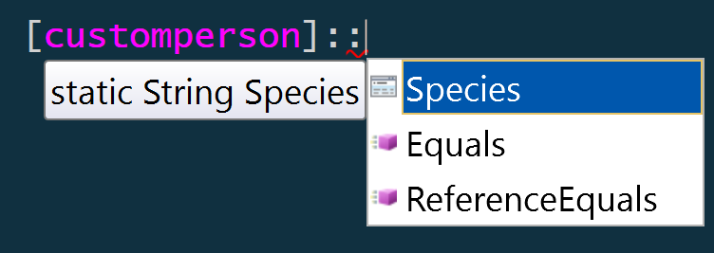
Static members
Live on the type itself
Properties that never change
Methods that don’t need $This
Instances need to use $Data::Property, not $Data.Property
class person
{
…
# Static Properties
static [string] $Species = "Totally real human"
…
}
[person]::Species
> Totally real human
Notes:
Properties that don’t change – would be if you made an object like a bicycle and wanted to the number of wheels. It will always be 2 otherwise it’s a unicycle or tricycle. This matters if you create like 1,000 of them because you can use 1 piece of memory instead of 1,000+
We can’t leverage $this, because it isn’t part of an instance it is actually just a single, unchanging piece of memory for quick access and efficiency.
Useful for creating a static toolbox like [math], such as [math]::Pi or [Math]::Round()
Get-member:
[person] | gm -static

Slide 34
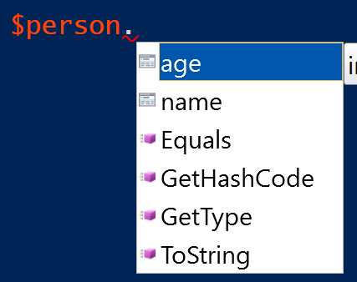
Hidden Members
Hidden from get-member and auto complete
Accessible like any other member
-Force flag will show them on get-member
class person
{
…
# Hidden Properties
hidden [String] $RealSpecies = "Cephalopod"
…
}
$person.RealSpecies
> Cephalopod
Notes:
Useful to hide a bunch of excess members that you don’t think people will need often or that you only usually use internally with methods and such

Slide 35
Hidden Members (Continued)
$person | GM -Force
Name MemberType
---- ----------
pstypenames CodeProperty
psadapted MemberSet
psbase MemberSet
psextended MemberSet
psobject MemberSet
Equals Method
GetHashCode Method
GetType Method
get_Age Method
get_Name Method
get_RealSpecies Method
SaySomething Method
set_Age Method
set_Name Method
set_RealSpecies Method
ToString Method
Age Property
Name Property
RealSpecies Property
Default hidden PS members
$person | GM
Name MemberType
---- ----------
Equals Method
GetHashCode Method
GetType Method
SaySomething Method
ToString Method
Age Property
Name Property
Auto Generated hidden methods
Our hidden Property

Slide 36
Inheritance
Create a modified version of an existing class
Gets most existing members, which you can override
Only default Constructor is inherited
Able to add new members

Slide 37
Inheritance - Example
class person
{
...
person()
{
$this.name = "Temp Name"
$this.age = 30
}
...
}
$person = [person]::new()
$person
> name age
> ---- ---
> Temp Name 30
class Cronenberg : person
{
# Static Members
static [String]$Species = "Human"
# Hidden Properties
hidden [String]$RealSpecies = "Cronenberg"
}
$person = [Cronenberg]::new()
$person
> name age
> ---- ---
> Temp Name 30
Can call base class constructors
Subclass (arguments) : base (argumentsToBaseClassConstructor) { ... }
Notes:
Cronenberg Is a reference to a horror movie film maker, which is also used as an alien species in cartoons such as Rick and Morty

Slide 38
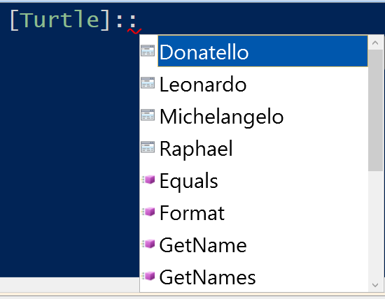
Enums
Basic sub types for pre-defined values
Can be created within a class or separately
Enum Turtle
{
Donatello
Leonardo
Michelangelo
Raphael
}
Notes:
Take a look at the ENUM example to show using the enums as strong types and errors
JVALES:
Strongly typed
Limited to a set or predefined values
Creates auto-complete experience
Can make classes even better

Slide 39
Enums (Continued)
Enum Turtle
{
Donatello
Leonardo
Michelangelo
Raphael
}
function TurtlesInTest
{
param([turtle]$Turtle)
Switch($Turtle)
{
…
}
}
TurtlesInTest -Turtle 'Shredder'
Cannot process argument transformation on parameter 'Turtle'. Cannot convert value "Shredder"
to type "Turtle". Error: "Unable to match the identifier name Shredder to a valid enumerator name. Specify one
of the following enumerator names and try again:
Donatello, Leonardo, Michelangelo, Raphael"
Notes:
Take a look at the ENUM example to show using the enums as strong types and errors

Slide 40
Load into Scripts
To reuse custom class, can keep it in its own file and “Dot-Source” it from scripts
. $PSScriptRoot\Myperson.PS1
$person = [person]::new("Kory",29)
Notes:
This is the same as best practice for function toolboxes should be (or make a module!)

Slide 41
Demonstration
Advanced Features

Slide 42
Questions?

Slide 43

PowerShell Classes

Slide 44
Microsoft

