Slide 1
Java Melody : method calls
- Only main classes and method calls are displayed in the following diagrams
- Diagrams were made using Architexa

Slide 2
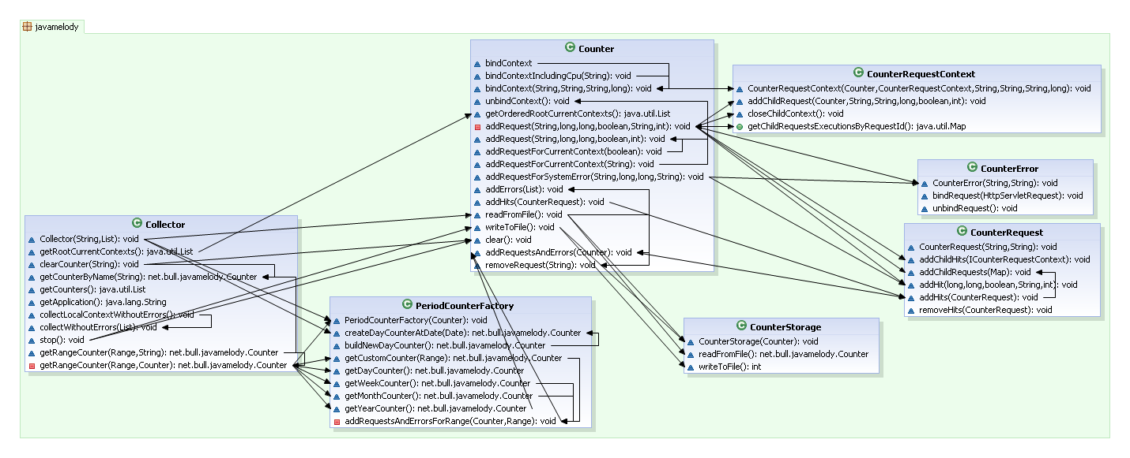
Collector and counter

Slide 3
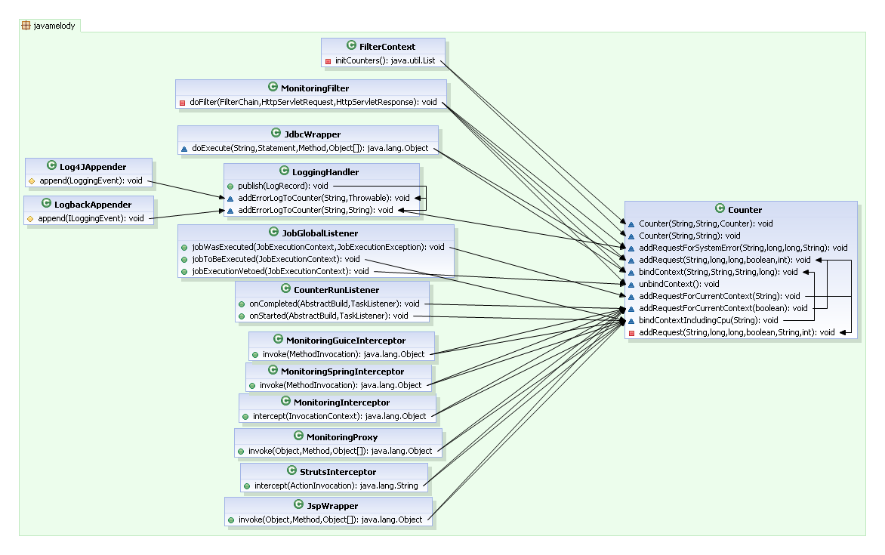
Probes and counter

Slide 4
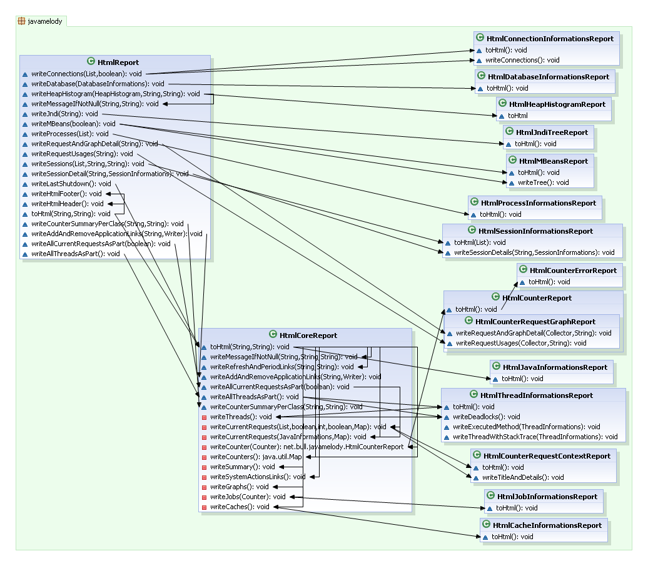
Html reports

Slide 5
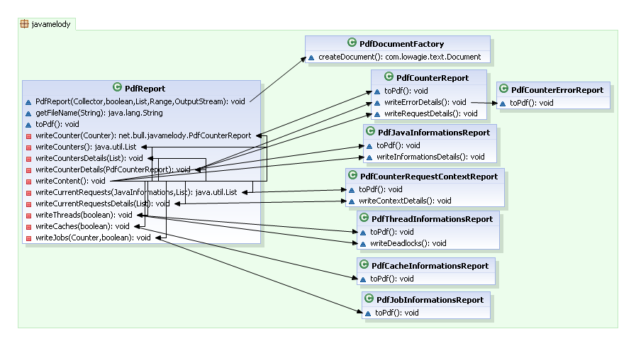
Pdf reports

