Slide 1
The tidyverse
Katie Lennard

Slide 2
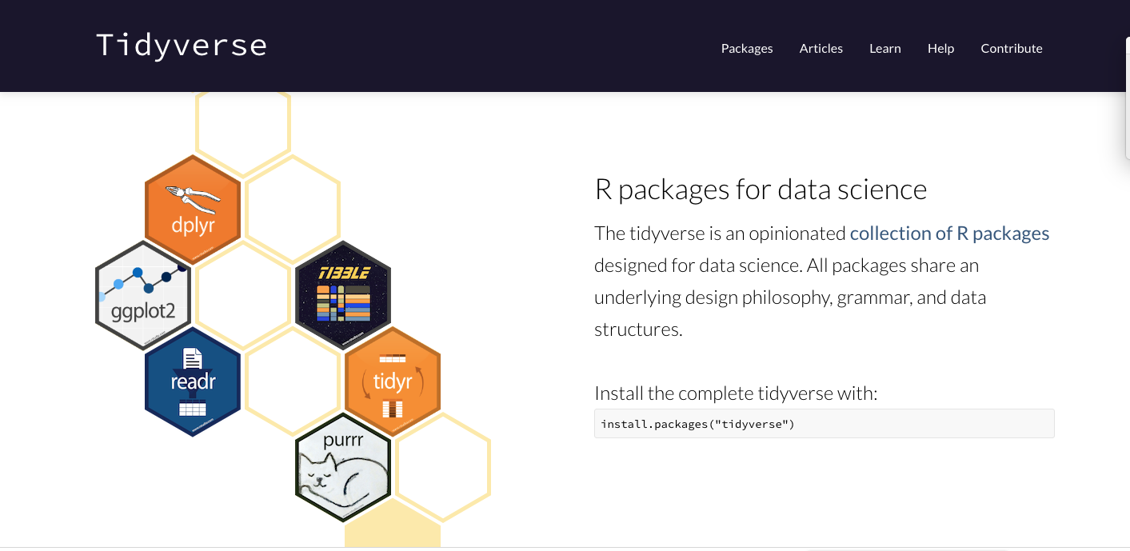
https://www.tidyverse.org/

Slide 3
dplyr package
six ‘verbs’ for a language of data manipulation
select(): subset columns
filter(): subset rows on conditions
mutate(): create new columns by using information from other columns
group_by() and summarize(): create summary statistics on grouped data
arrange(): sort results
count(): count discrete values
All verbs work similarly:
The first argument is a data frame
The subsequent arguments describe what to do with the data frame, using the variable names (without quotes)
The result is a new data frame
Uses ‘tibbles’ instead of data frames
Tibbles are data frames, but slightly tweaked to work better in the tidyverse

Slide 4
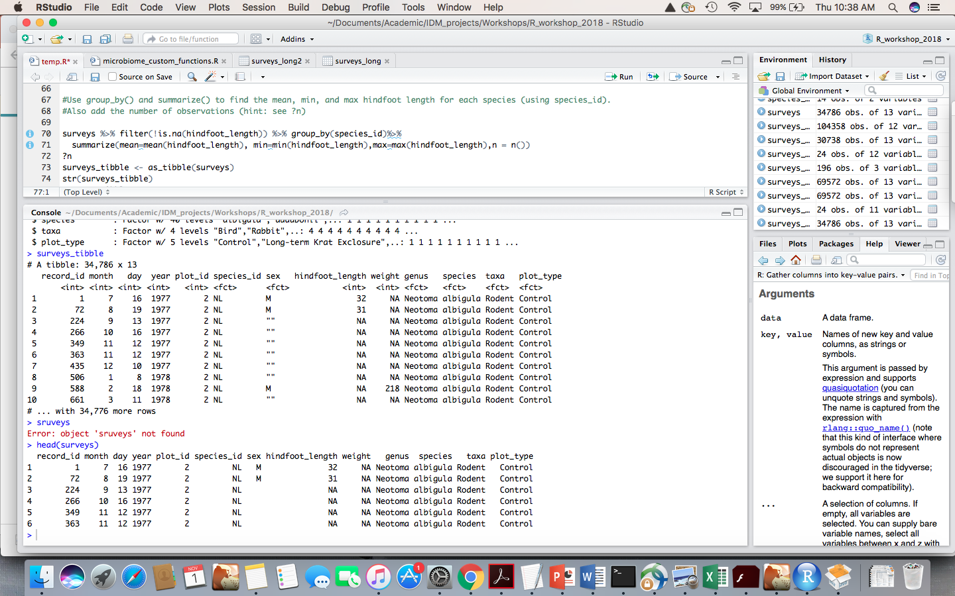
dplyr vs. base R: dataframe vs. tibble

Slide 5
dplyr vs. base R?
filter(df, x == 1, y == 2, z == 3) instead of df[df$x == 1 & df$y ==2 & df$z == 3, ].
dplyr: don’t need to repeat the name of the data frame
dataframe (base R) vs. tibble (dplyr)

Slide 6
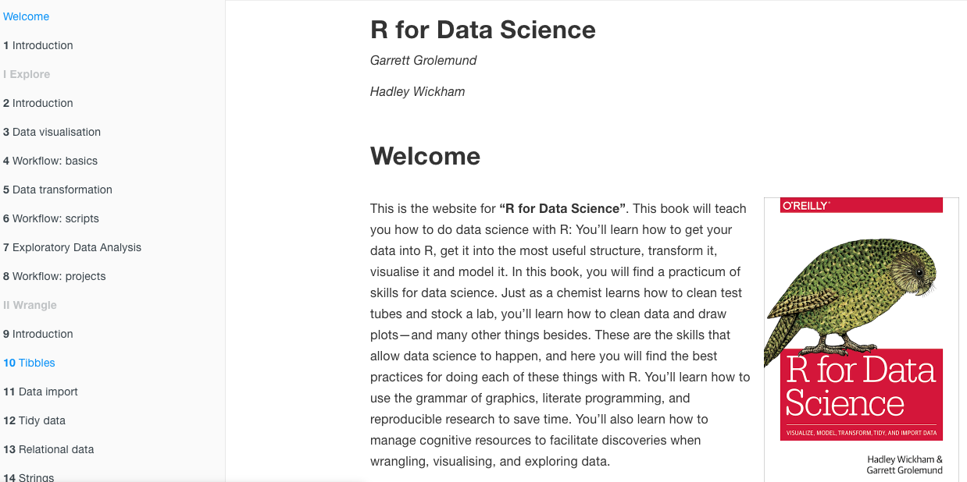
R for Data Science ebook – Hadley Wickham

Slide 7
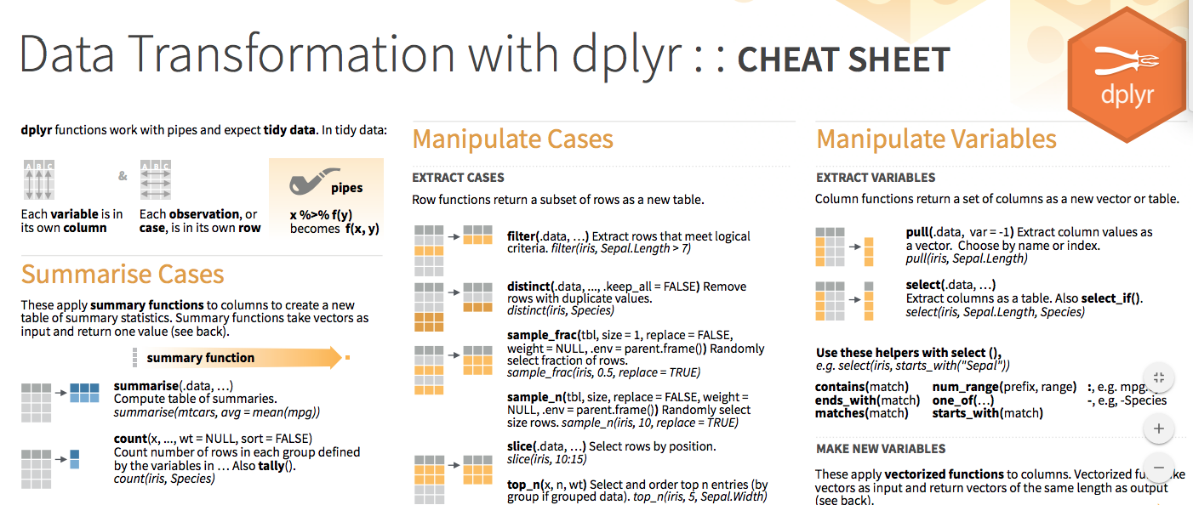
dplyr cheat sheet here

