Slide 1
Why you’re going to love R (eventually ;)
7 November 2018
Katie Lennard

Slide 2
What is R?
R is an open source programming language used for statistical analyses
Rstudio is the user-friendly interface commonly used when programming in R
Allows you to see your R script, console and plot results all on one screen
Easy package installation & updates

Slide 3
Why learn R?
Non-programming point-and-click stats software can be dangerous..
Are you sure you know what you’re doing or what it is doing?
R = written commands which has several advantages:
You have to think about what you’re writing and know what each command is doing
Your analysis is now reproducible because you’ve written each command in an R script file (more and more journals require this)
Easy collaboration – send your script to an expert for feedback
Niche packages that are likely only available through R
E.g. you’re working on 16S microbiome data, which has a very specific distribution (custom R packages phyloseq, metagenomeSeq)
Publication quality graphics, customizable (fun)

Slide 4
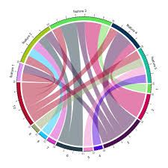
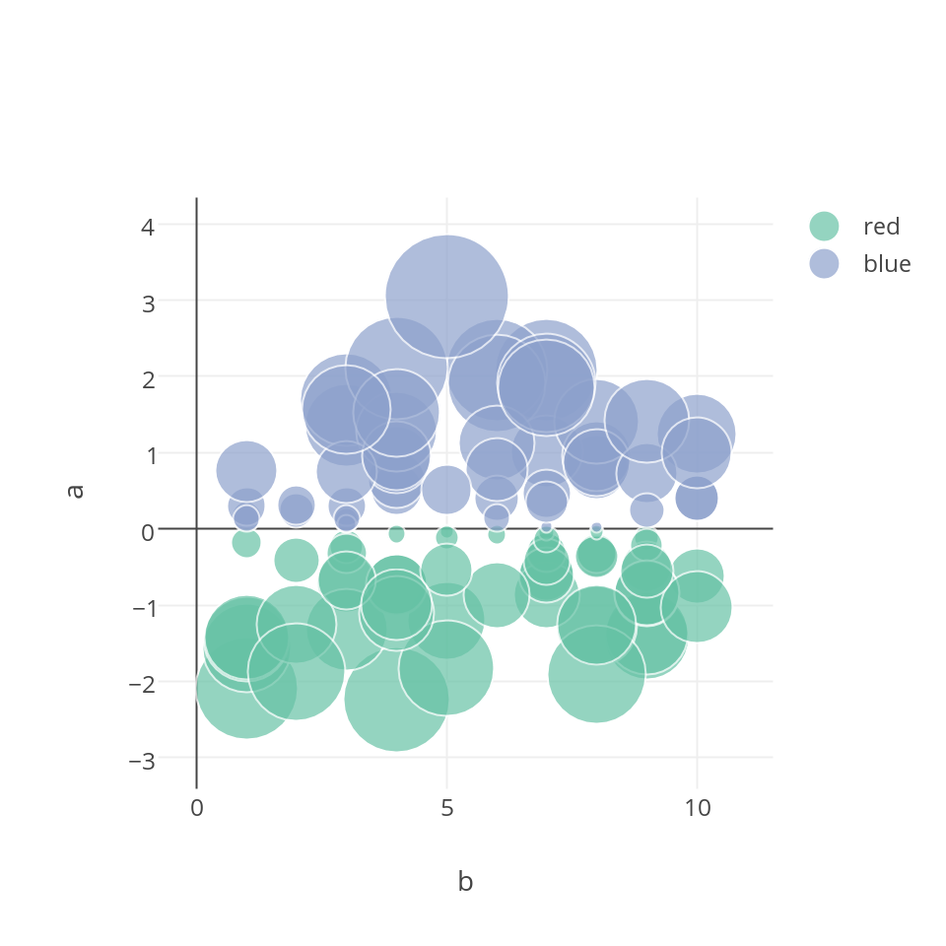
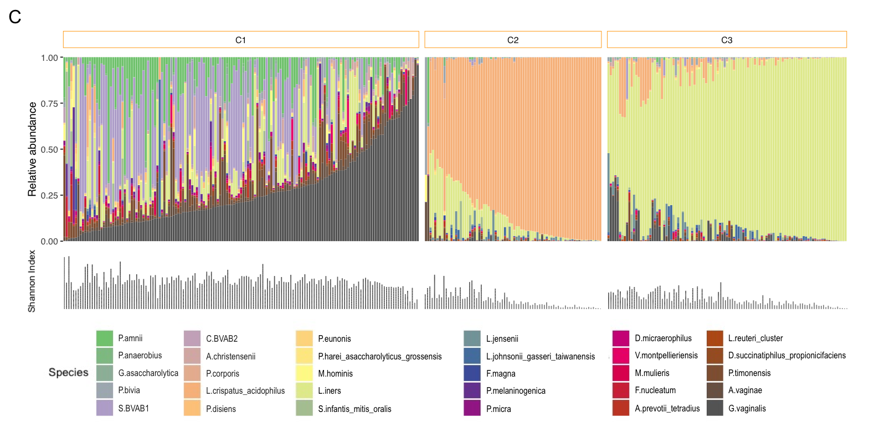
All the pretty plots…

Slide 5
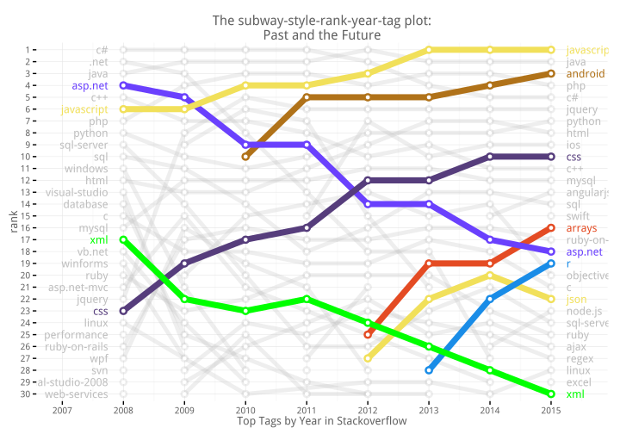
Why learn R?
Free, open-source and cross platform
HELP?! Large community, plenty user forums
If you get an error someone else has had it too (and posted about it)
Plot created with package ggplot2 (we’ll get there)
stackoverlow example
R

Slide 6
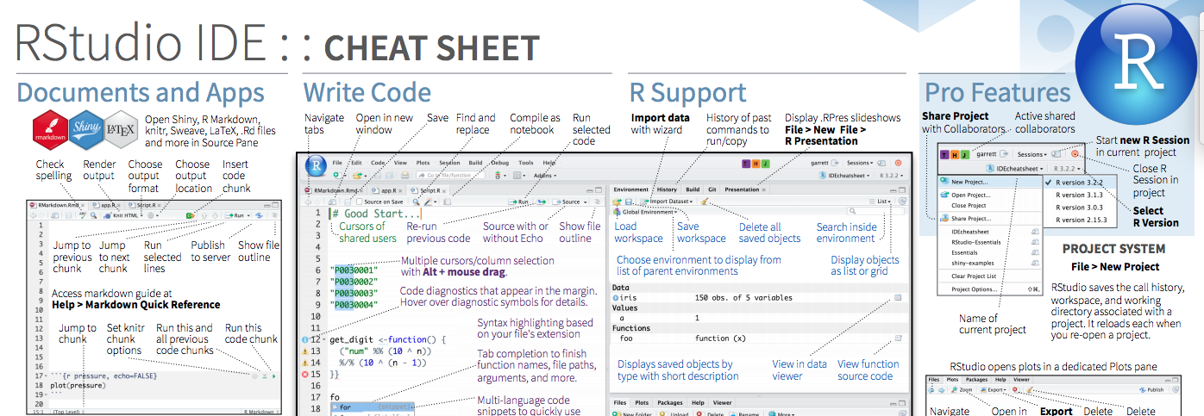
Using R in RStudio
All the information you need to write code available in a single window
Shortcuts, autocompletion, highlighting
Rstudio IDE cheat sheet

