Slide 1
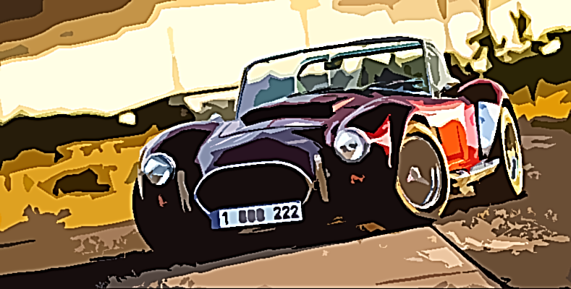
Capstone #1 Vehicle Manufacturing Dataset

Slide 2
Agenda
Introduction
Load and Exploring Dataset
Data Preprocessing
Visualization
Conclusion

Slide 3
Introduction
Dataset source → Vehicle manufacturing dataset from Kaggle
Analyze data and uncover valuable information

Slide 4
Objectives
Analyze data and uncover valuable pricing and market trends.
Answer questions such as
What are the most manufactured cars?
What are the most competitive price, color, and model?

Slide 5
Load and Exploring Dataset
Get information about the dataset
Number of samples (Cars)
What are the included features

Slide 6
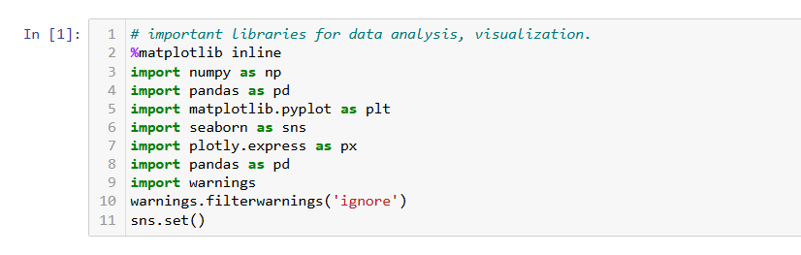
Import Libraries

Slide 7
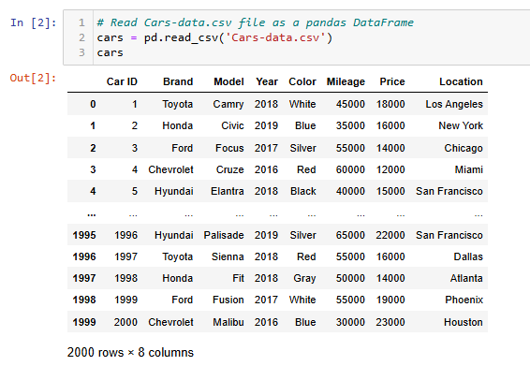
Read Data
2000 sample
8 features

Slide 8
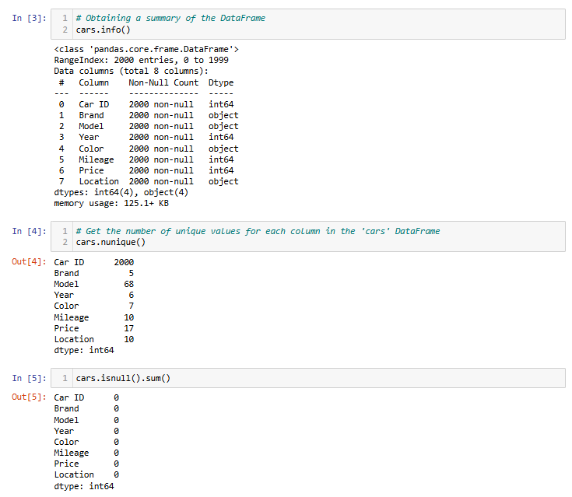
Get information about the data

Slide 9
Data Preprocessing
Cleaning Dataset
Check and handle missing values
Remove unwanted features

Slide 10
Check and handle missing values

Slide 11
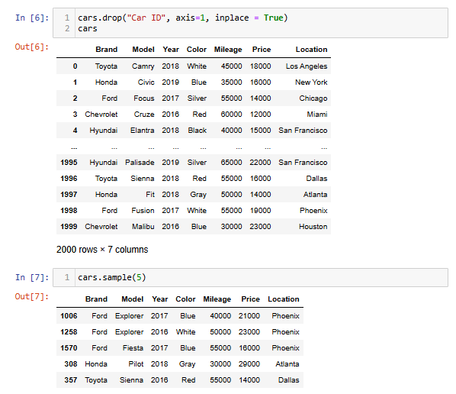
Remove Feature

Slide 12
Visualization
Visualize information by using variety of figures such as bar plot, pie plot, scatter plot … .
Get better understanding of the Dataset and uncover valuable information.

Slide 13
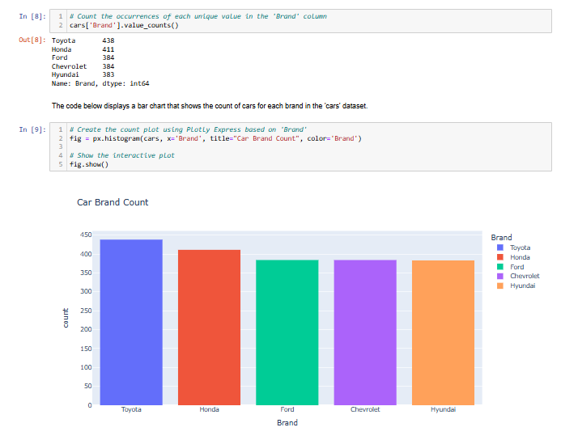
Car Brand Count

Slide 14
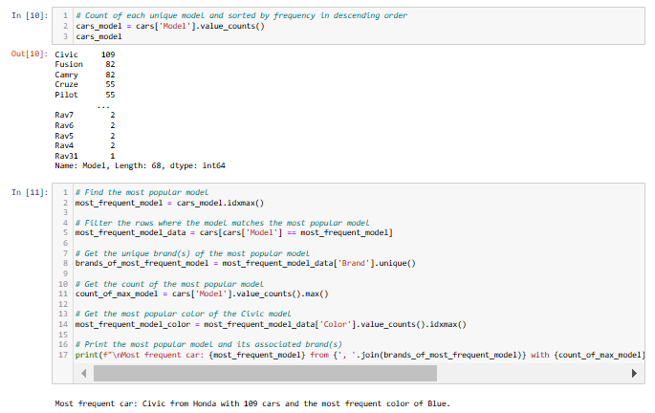
Most Frequent Car

Slide 15
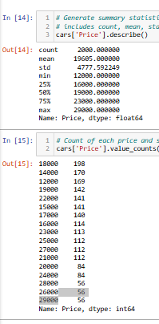
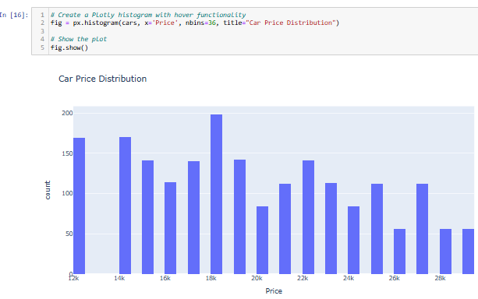
Car Price Distribution

Slide 16
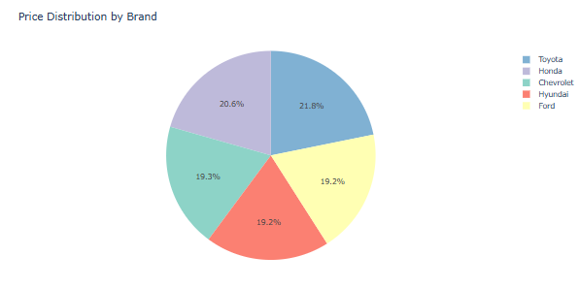
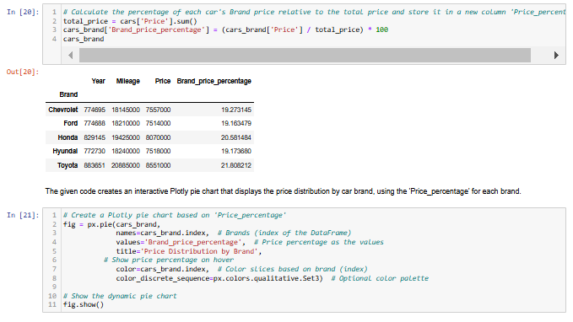
Price Distribution by Brand

Slide 17
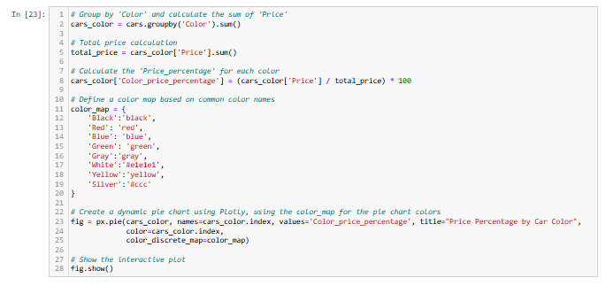
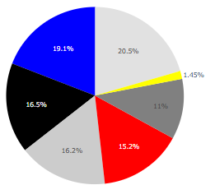

Price Distribution by Color

Slide 18
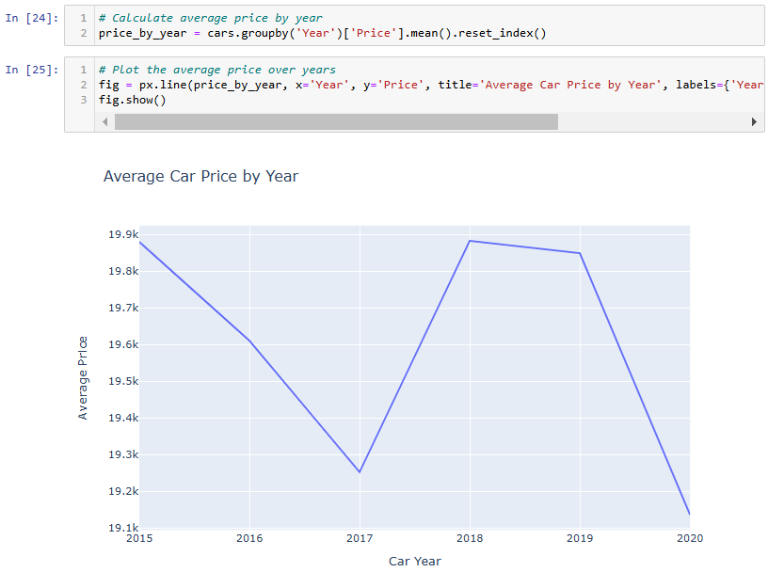
Price Analysis by Year

Slide 19
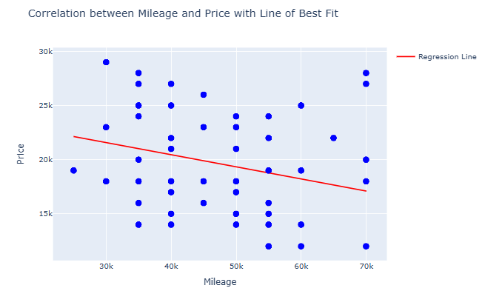
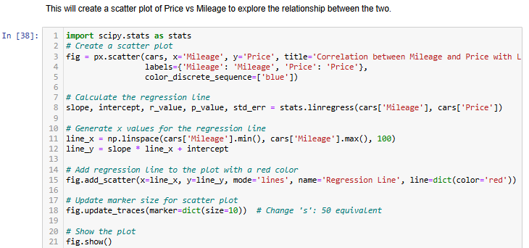
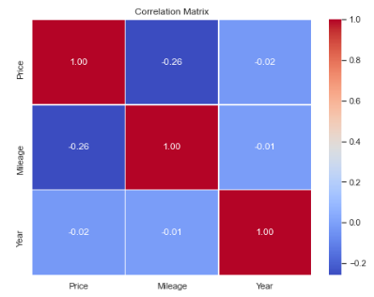
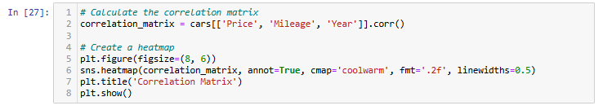
Price vs Mileage

Slide 20
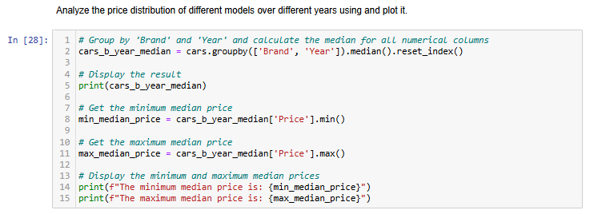
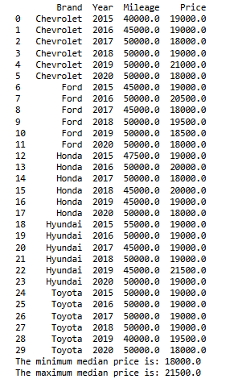

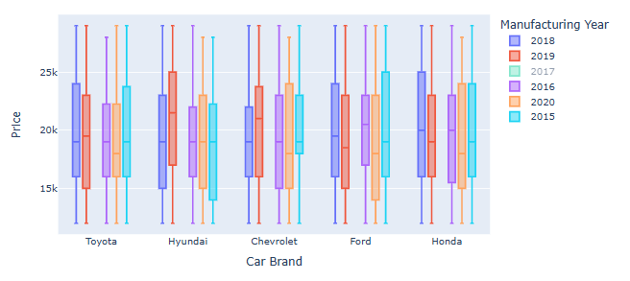
Price Distribution by Cars Brand and Year

Slide 21
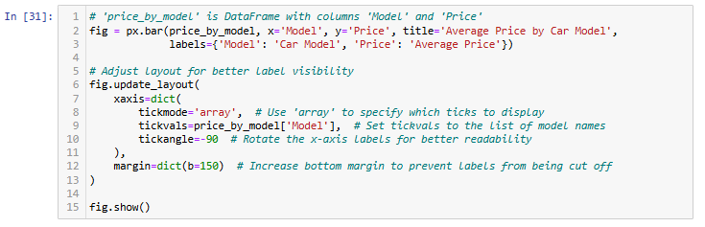
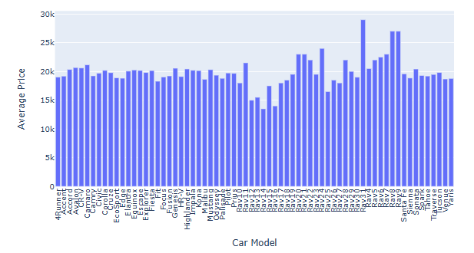
Average Price by Car Model

Slide 22
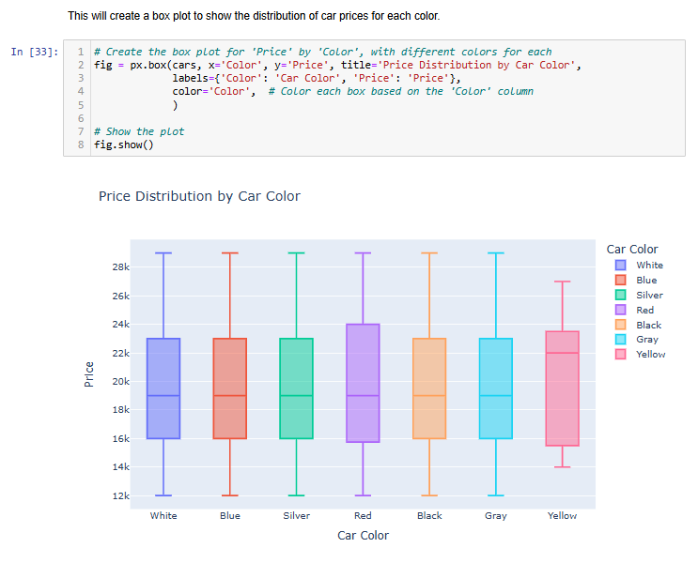
Price Distribution by Color

Slide 23
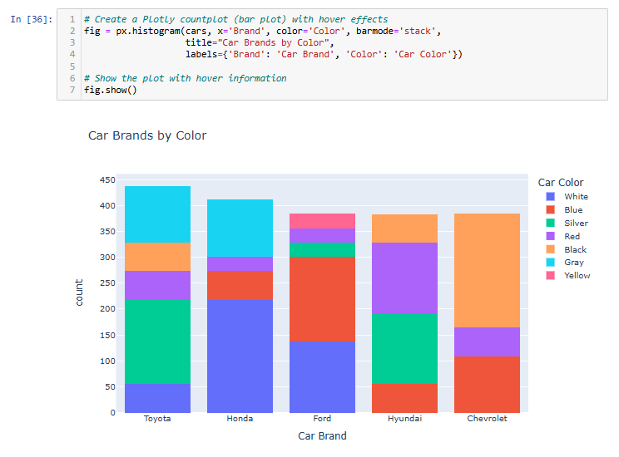
Car Brands by Color

Slide 24
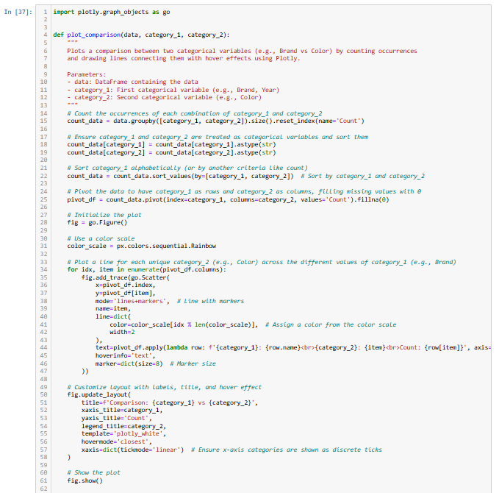
Compare Two Categorical Variable

Slide 25
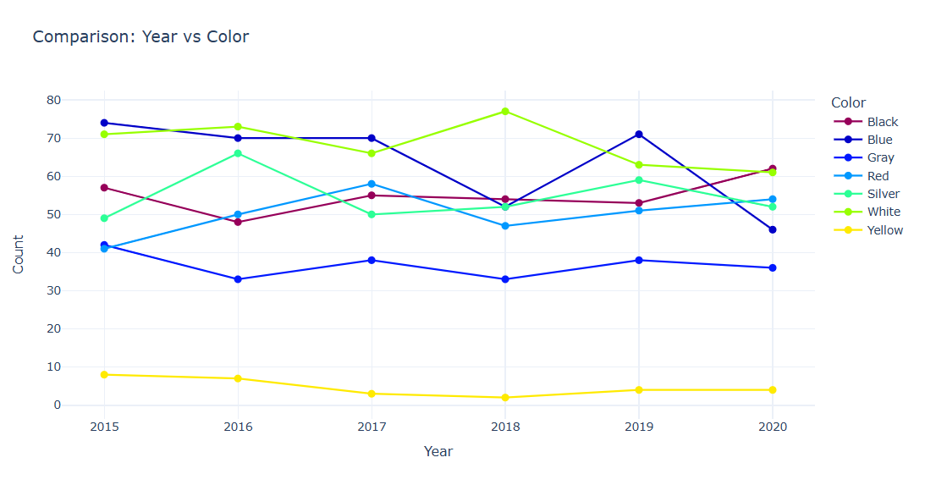
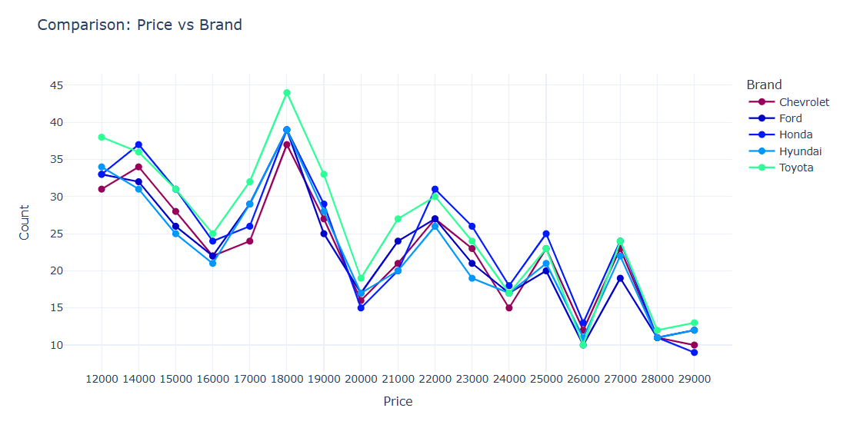
Comparison

Slide 26
Conclusion
Read and load data
Exploring and getting information about the data set
Data preprocessing
No missing data
Car ID column was removed
Visualization and getting information
Most cars are from Toyota brand
Most frequent car price is 18000
Correlation between milage and price shows that when the milage increases the price decreases.
Yellow cars seems to be limit edition and specific model while other colors offer greater variability in pricing probably du to wider mix of car models such as economy, luxury, or old cars.
Most manufactured cars are white and blue
The peak at price 18000 reflects a popular mid-range vehicle segment, probably balancing affordability and features. This shows strong demand and competition in the mid-range market.

Slide 27
Thank you!

