Slide 1


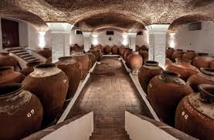


TOMAHAWKS
Group Presentation
“Wine - “Topic of Analysis TBD

Slide 2
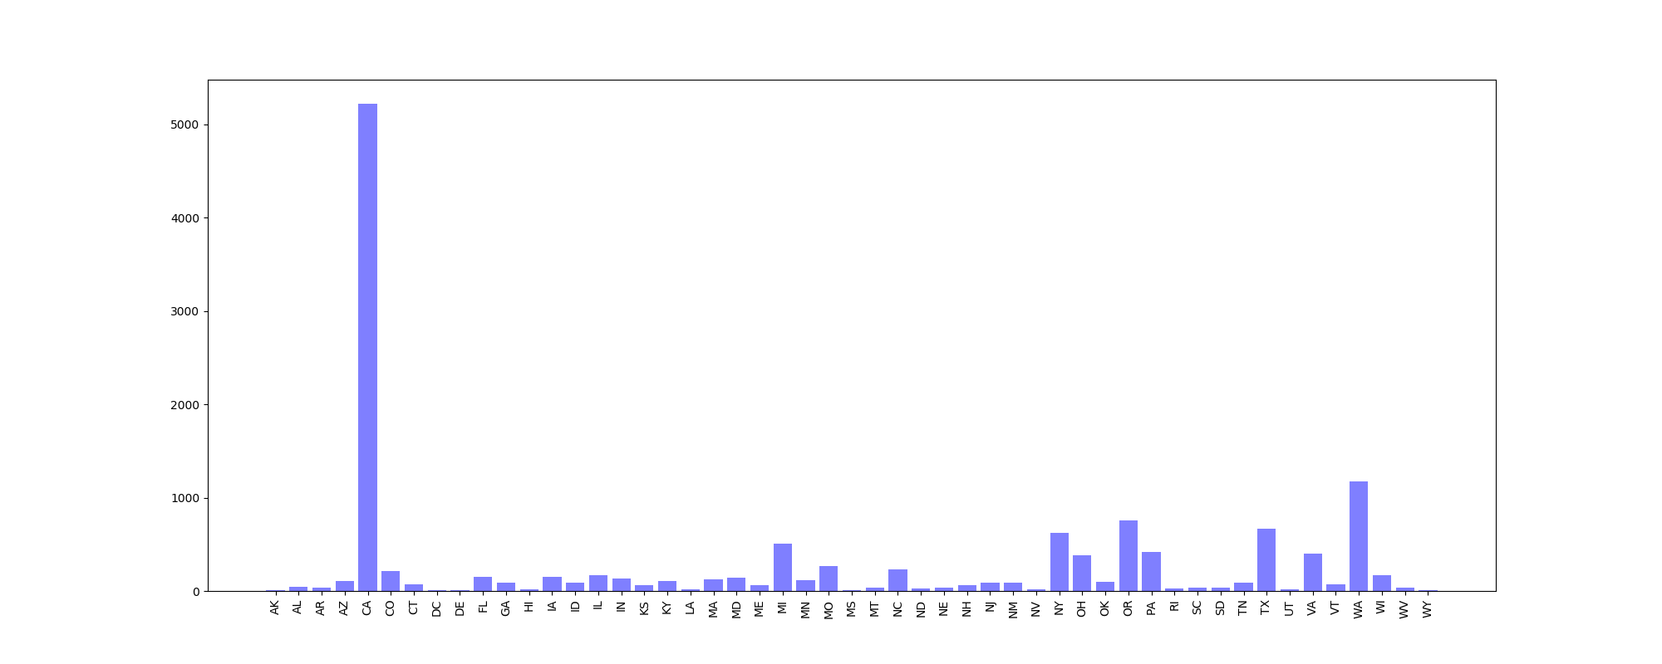

# of Wine Producers by State
Total #US Wine Producers:
13,513
Largest US Wine Producing States:
# of Producers State % of Total
5,217 CA 38.61
1,171 WA 8.67
758 OR 5.61
623 NY 4.61
Data Source:https://catalog.data.gov/dataset/bonded-wine-producers-count-by-state-1999-june-30-2017
DEPARTMENT OF THE TREASURY
Alcohol and Tobacco Tax and Trade Bureau
Data derived from TTB Tableau data source.
Includes all wineries who hold an Active Permit with TTB as of 06/30/2019.
TOMAHAWKS

Slide 3
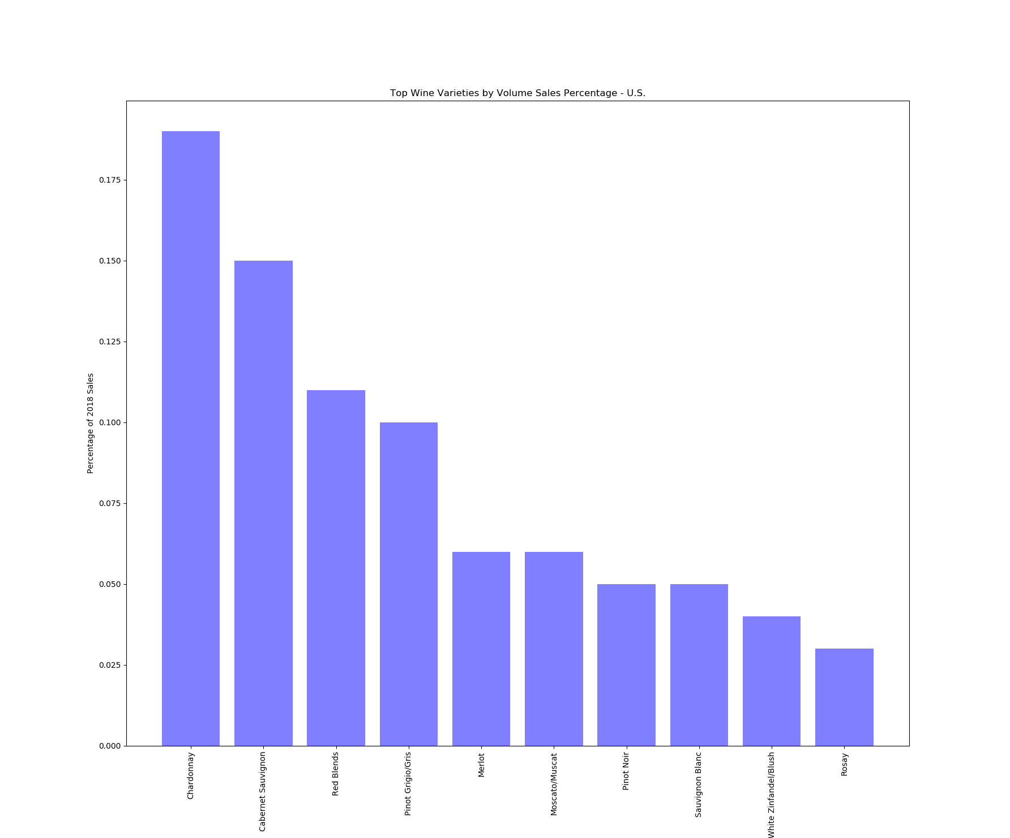

Wines Varieties Ranked By Sales Volume Percentage
Data source: https://www.wineinstitute.org/resources/pressroom/06242019
The Wine Institute 2019 statistics report on California and U.S. 2018 Wine Sales
According to Nielsen-measured U.S. off-premise sales, top-selling varietals by volume share are:
TOMAHAWKS

Slide 4

U.S Annual Sales:
California Only Annual Sales:
TOMAHAWKS

Slide 5

Wines Varieties Ranked By Wine Scores
Average Cost per Bottle
TOMAHAWKS

Slide 6

Summary of Analysis
During 2018 there were _____ Wine Producers in the United States that produced ______ gallons of _____ wines, ____wines, and ____ wines. Collectively, wineries across the US sold ______ bottles of wine generating ________ billion in annual sales nationally. Of the available varieties _______, ________, ________ economically demonstrate the highest demand based on their annual sales volumes.
For the palate to tell the tale of consumer preference, we now look at statistics from wine ratings based on variety, location, winery, price, and description.
TOMAHAWKS

