Slide 1


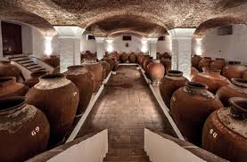


TOMAHAWKS
Group Presentation: Project 1
Rob
Michael
Regina
Adam
Wine: The Voice of the Expert, the Voice of the Consumer, and a Practical Guide to Help Navigate Both

Slide 2
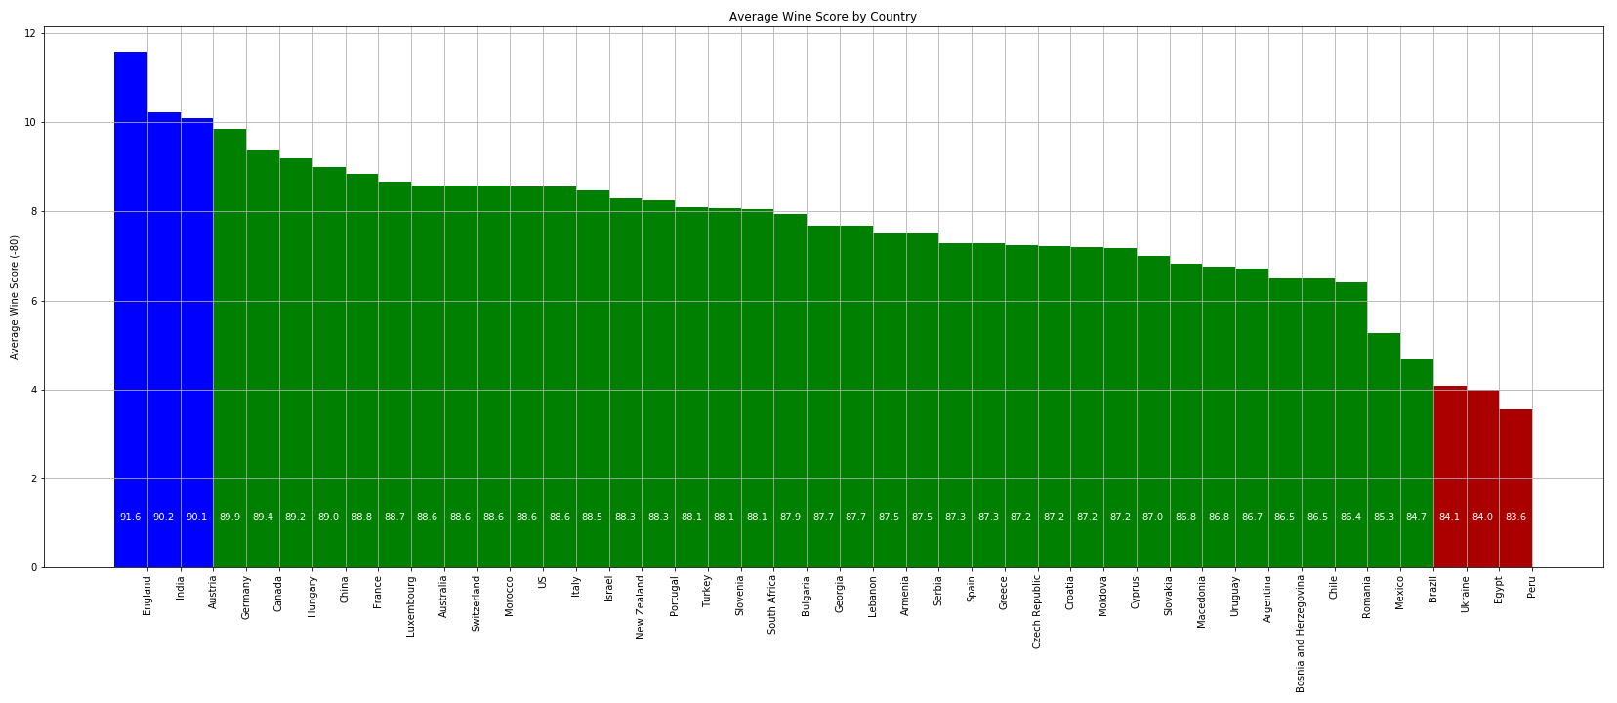

Summary of Aalyss
Roger Voss: 20% =25k @ 25ml/sip = 860 bottles!
Wines Ranked by Score and Country
Data Source: https://www.kaggle.com/zynicide/wine-reviews/downloads/wine-reviews.zip/4
country points price
Argentina 86.710263 24.510117
Armenia 87.500000 14.500000
Australia 88.580507 35.437663
Kaggle Data – Wine Enthusiast Magazine Reviews
The data was scraped from Wine Enthusiast during the week of Nov 22, 2017. -- 129K rows/samples & 707 listed varieties!
TOMAHAWKS

Slide 3
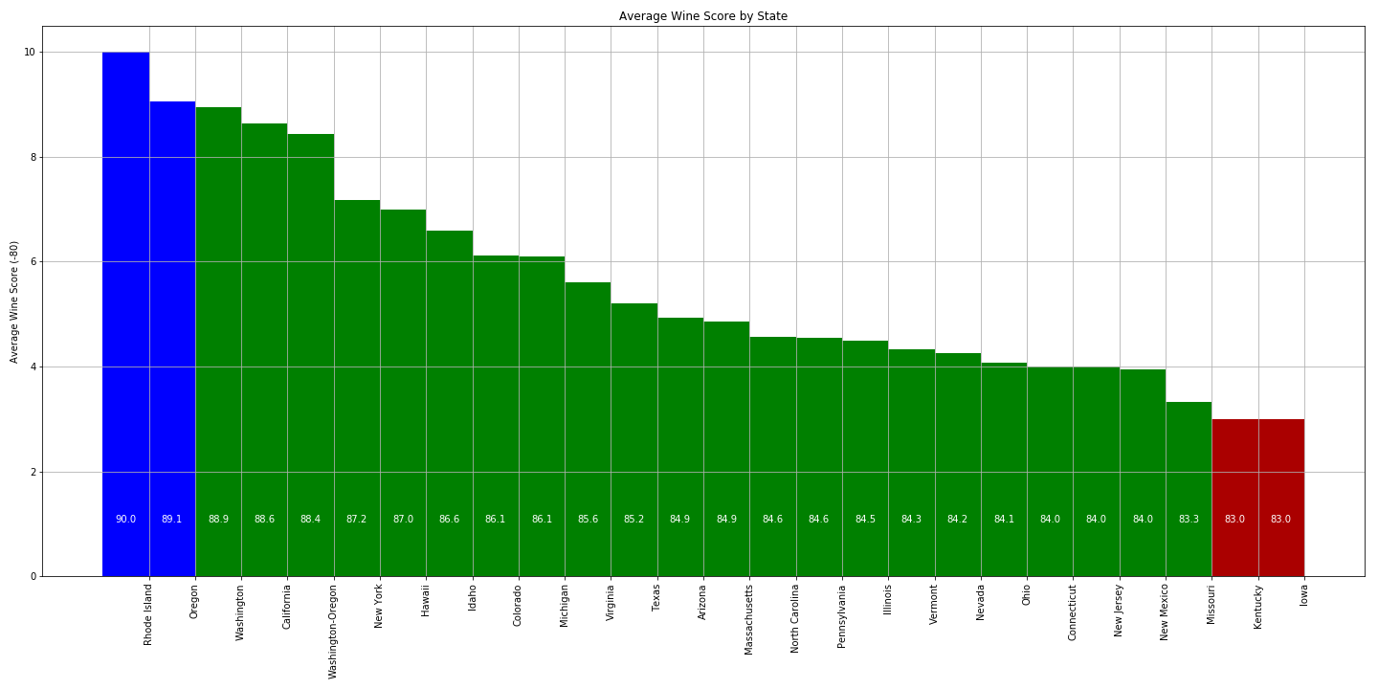
Wines Ranked by Score and US State
Data Source: https://www.kaggle.com/zynicide/wine-reviews/downloads/wine-reviews.zip/4
Kaggle Data – Wine Enthusiast Magazine Reviews
The data was scraped from Wine Enthusiast during the week of Nov 22, 2017. -- 54K rows/samples & 257 listed varieties!
US state points price
Arizona 84.926829 29.200000
California 88.627776 39.041048
Colorado 86.117647 32.985294
TOMAHAWKS

Slide 4
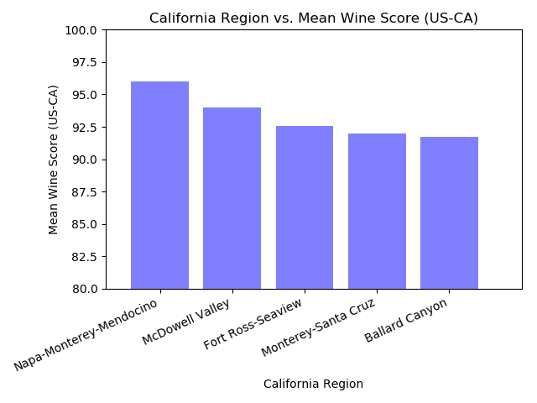
The Voice of the Expert in California…
TOMAHAWKS
Kaggle Data –
Wine Enthusiast Magazine Reviews
The data was scraped from Wine Enthusiast during the week of Nov 22, 2017.
180 regions & 194 listed varieties!

Slide 5
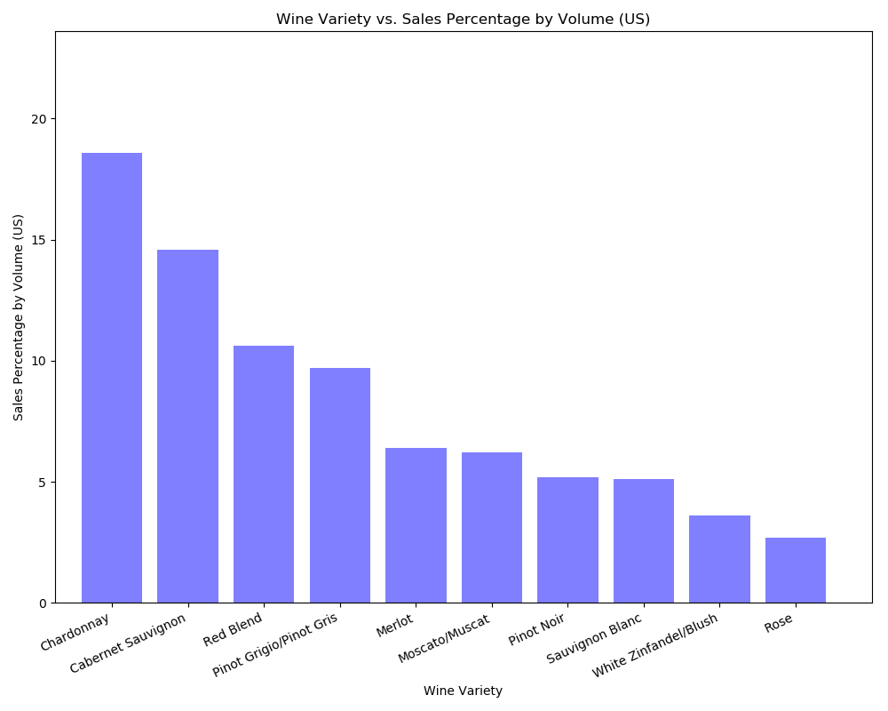
The Voice of the Consumer in the US…
Data source: https://www.wineinstitute.org/resources/pressroom/06242019
The Wine Institute 2019 statistics report on California and U.S. 2018 Wine Sales according to Nielsen-measured U.S. off-premise sales, top-selling varietals by volume share.
TOMAHAWKS

Slide 6
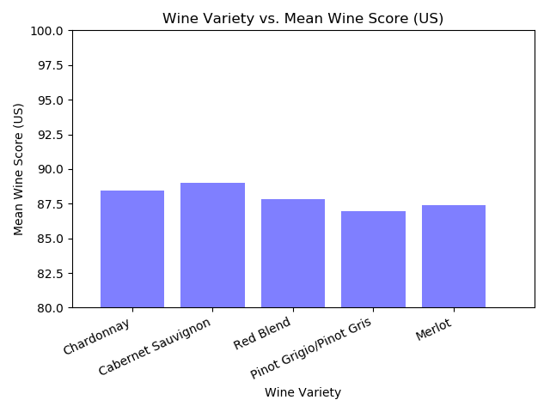
The Voice of the Expert in the US…
Kaggle Data –
Wine Enthusiast Magazine Reviews
The data was scraped from Wine Enthusiast during the week of Nov 22, 2017.
TOMAHAWKS

Slide 7
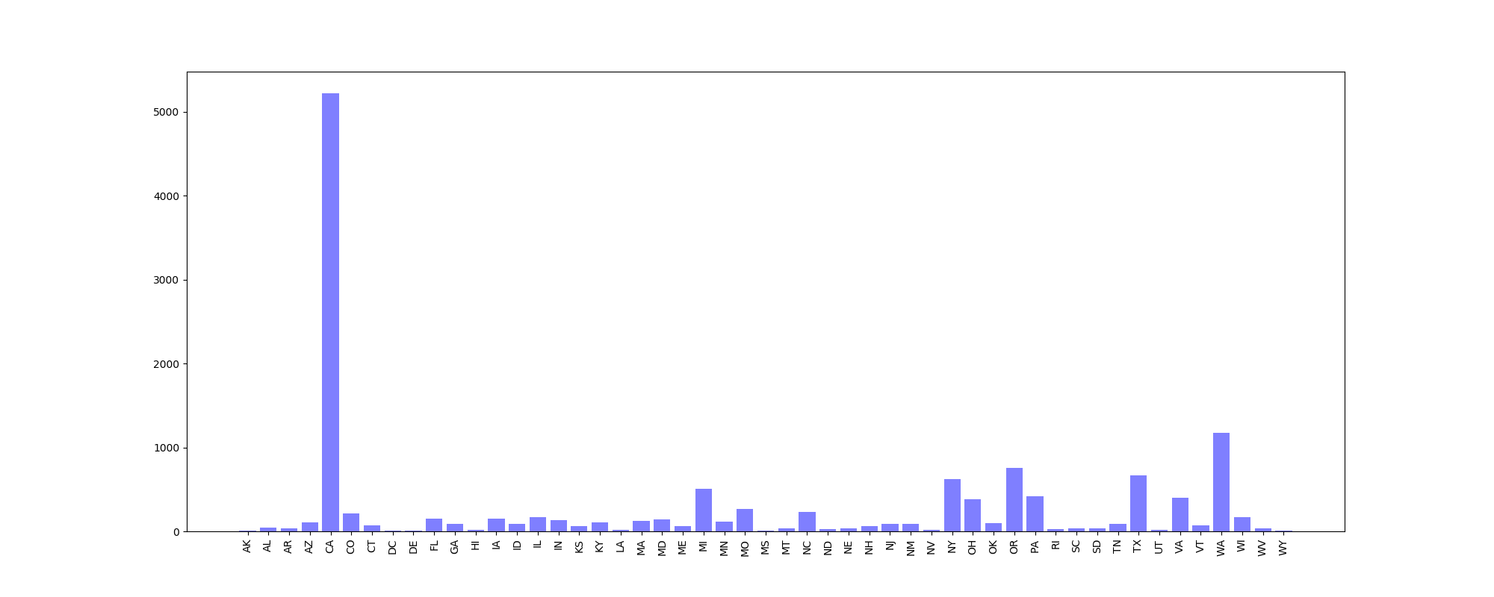

Number of Wine Producers
by US State
Total Number of US Wine Producers:
13,513
Largest US Wine Producing States:
Producers State % of Total
5,217 CA 38.61
1,171 WA 8.67
758 OR 5.61
623 NY 4.61
Data Source:https://catalog.data.gov/dataset/bonded-wine-producers-count-by-state-1999-june-30-2017
DEPARTMENT OF THE TREASURY
Alcohol and Tobacco Tax and Trade Bureau
Data derived from TTB Tableau data source.
Includes all wineries who hold an Active Permit with TTB as of 06/30/2019.
TOMAHAWKS

Slide 8
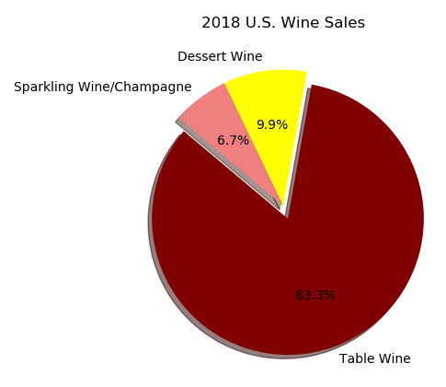
US Wine Sales by Percentage
Data source: https://www.wineinstitute.org/resources/pressroom/06242019
The Wine Institute 2019 statistics report on California and U.S. 2018 Wine Sales according to Nielsen-measured U.S. off-premise sales, top-selling varietals by volume share.
TOMAHAWKS

Slide 9
Wines Varieties Ranked By Sales Volume Percentage
Data source: https://www.wineinstitute.org/resources/pressroom/06242019
The Wine Institute 2019 statistics report on California and U.S. 2018 Wine Sales
according to Nielsen-measured U.S. off-premise sales, top-selling varietals by volume share.
TOMAHAWKS

Slide 10


November 2017 Reviews
What wines offer the best overall value based on their rating vs. their price?
“Bang For Buck Score”: Rating - Price
Data Source:
https://www.kaggle.com/zynicide/wine-reviews
129,970 Wines Reviewed
TOMAHAWKS

Slide 11
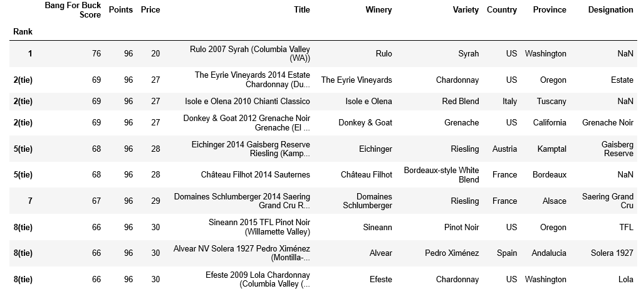
November 2017 Reviews
Data Source:
https://www.kaggle.com/zynicide/wine-reviews
129,970 Wines Reviewed
TOMAHAWKS

Slide 12
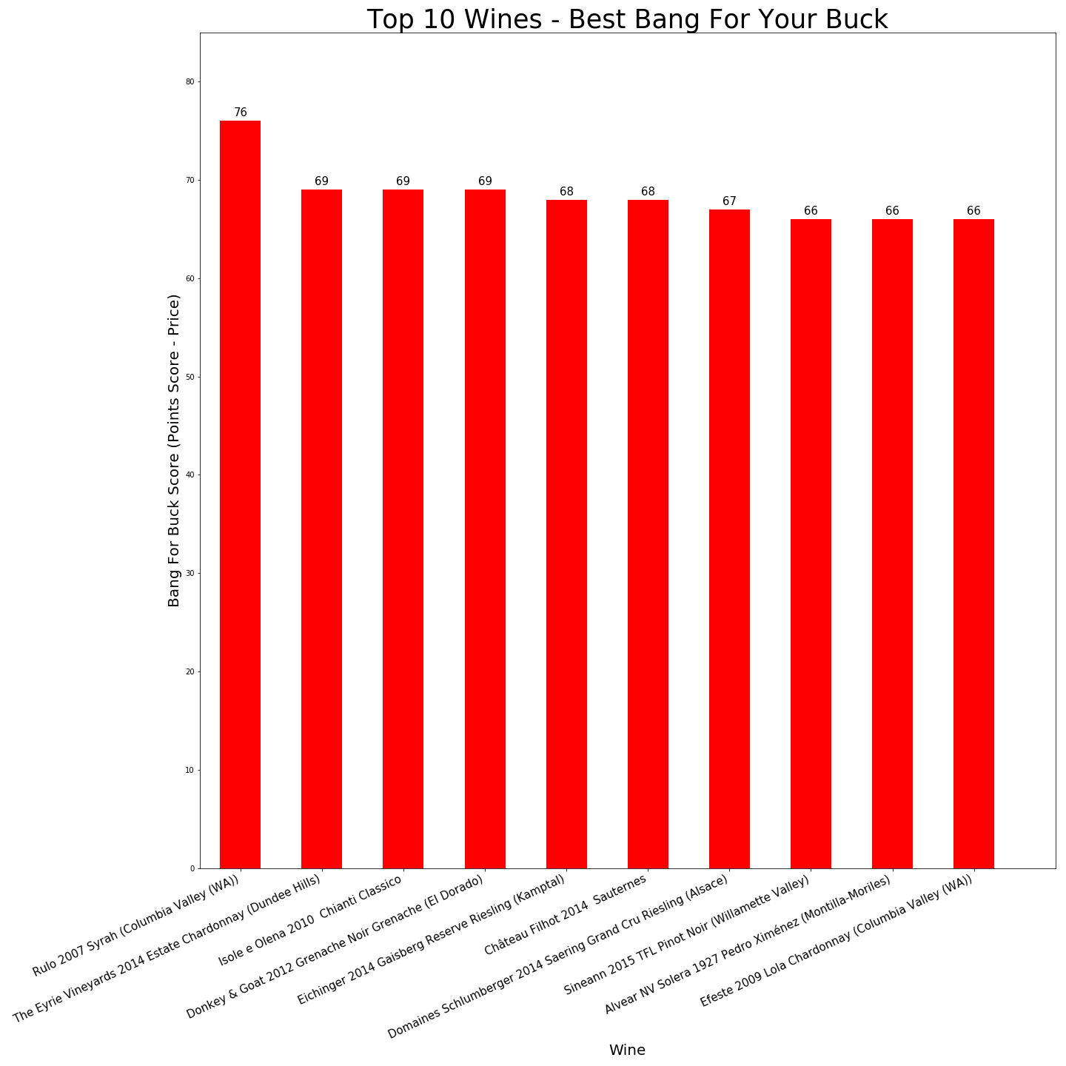
November 2017 Reviews
Data Source:
https://www.kaggle.com/zynicide/wine-reviews
129,970 Wines Reviewed
TOMAHAWKS

Slide 13
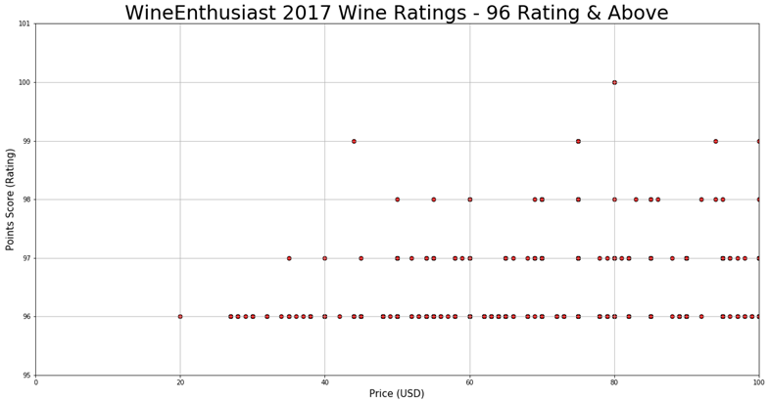
November 2017 Reviews
Data Source:
https://www.kaggle.com/zynicide/wine-reviews
129,970 Wines Reviewed
TOMAHAWKS

Slide 14

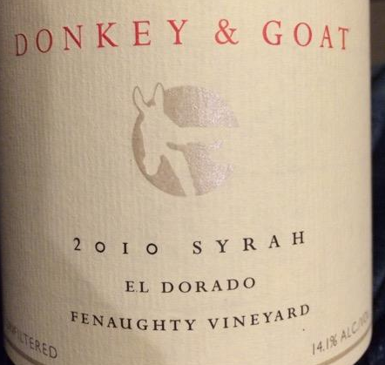


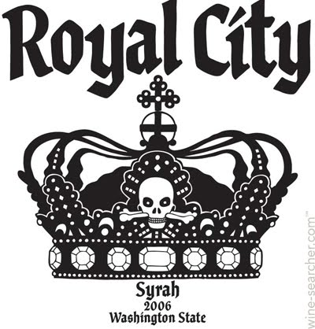

November 2017 Reviews
96 Rating: Rulo 2007 Syrah (Columbia Valley (WA)) - $20.00
97 Rating: Donkey & Goat 2010 Fenaughty Vineyard Syrah (El Dorado) - $35.00
98 Rating: Pirouette 2008 Red Wine Red (Columbia Valley (WA)) - $50.00
99 Rating: Failla 2010 Estate Vineyard Chardonnay (Sonoma Coast) - $44.00
100 Rating (Tie): Charles Smith 2006 Royal City Syrah (Columbia Valley (WA)) & Cayuse 2008 Bionic Frog Syrah (Walla Walla Valley (WA)) - $80.00
Data Source:
https://www.kaggle.com/zynicide/wine-reviews
129,970 Wines Reviewed
TOMAHAWKS

