Slide 1
ACTION

Slide 2
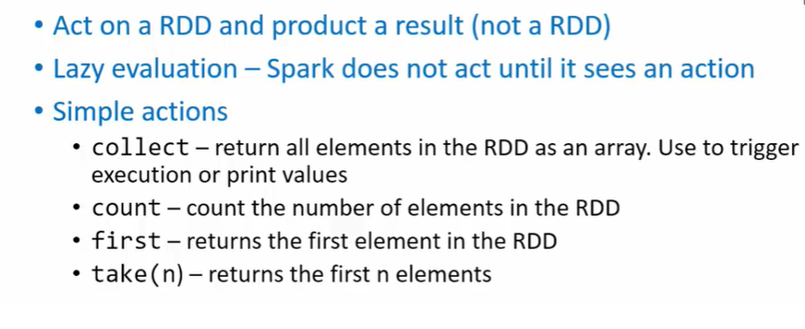
ACTION

Slide 3
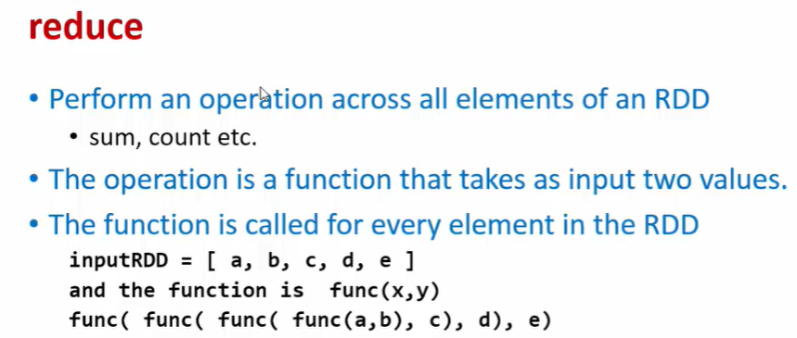
REDUCE

Slide 4
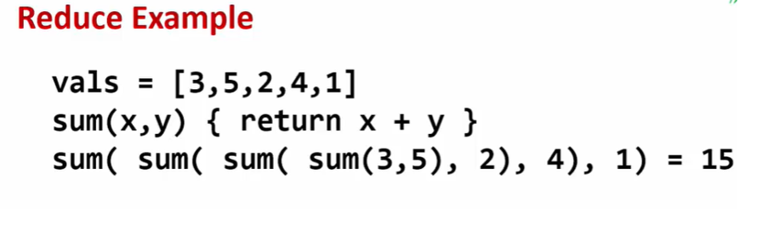

Slide 5
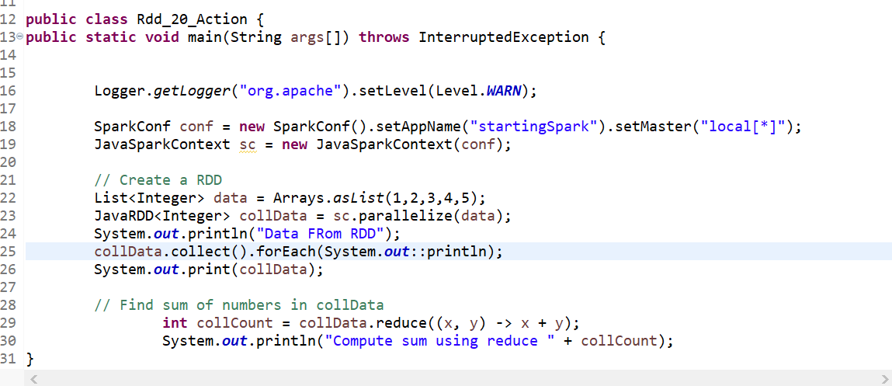

Slide 6
// Find sum of numbers in collData
int collCount = collData.reduce((x, y) -> x + y);
System.out.println("Compute sum using reduce " + collCount);

Slide 7
Ex-2 :: AUTO DATA
Find Shortest Line in RDD
for that we're going to be writing an inline class and inline reduce class.
// Find shortest line in autoData with lambda function
String shortest = autoData.reduce(new Function2<String, String, String>() {
public String call(String x, String y) {
return (x.length() < y.length() ? x : y);
}
});
System.out.println("The shortest string is " + shortest);
here you have a new class that you define based on an interface called function 2.
function to is

Slide 8
Function2 is a template of three parameters.
We saw function which we use to map that out only two parameters here.
Function 2 has three parameters.
The first two parameters are the inputs.
Which basically means the parameters the values you are picking from the RDD and passing and
the first value can be an individual value or a computed value based on all the previous values.
The second value is the next value and the third is the Output.
So you are also you implement a function called call which has 2 input
parameters x,y.

Slide 9
So do remember that based on the type of parameters you have you need to change the data types also.
make sure that the data types are correct because sometimes you might be comparing Interger but You have to Return String

Slide 10
ASSIGNMENT
Use external function to compute Average MPG for all Cars

Slide 11
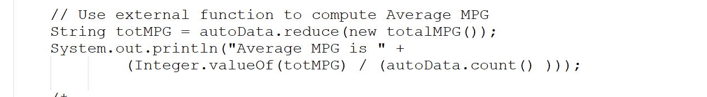
Ex-3::: Use external function to compute Average MPG for all Cars
To compute the average mpg → first find the total mpg.
I'm going to use Reduce function and to find total mpg.
I have a total mpg class that I have defined.

Slide 12
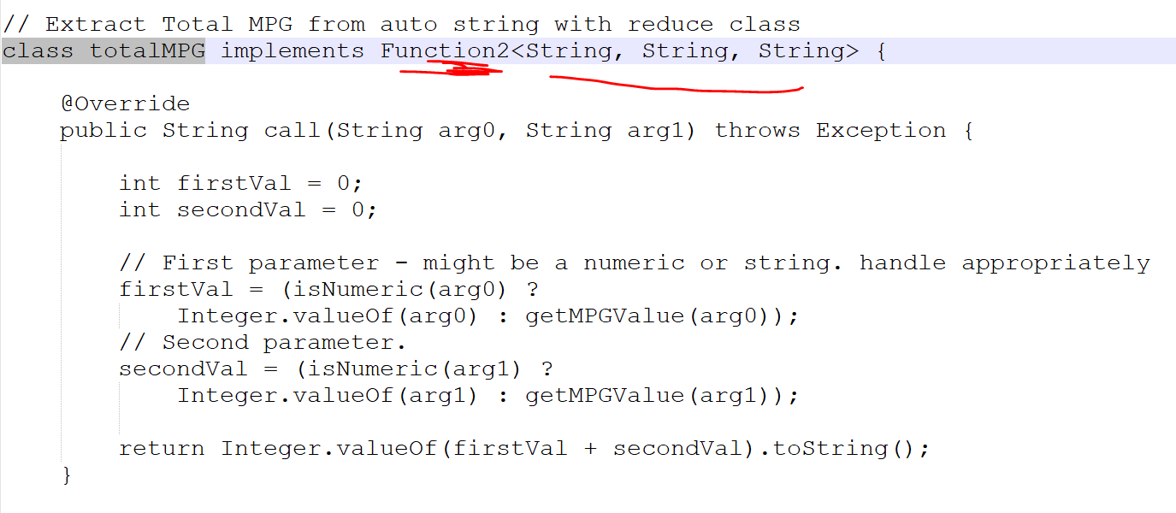

Slide 13
So given that the input output is of type string you need to continue to use string even though internally you might be computing something else and the output is also going to be string because the output is being evaluated REcursive

Slide 14
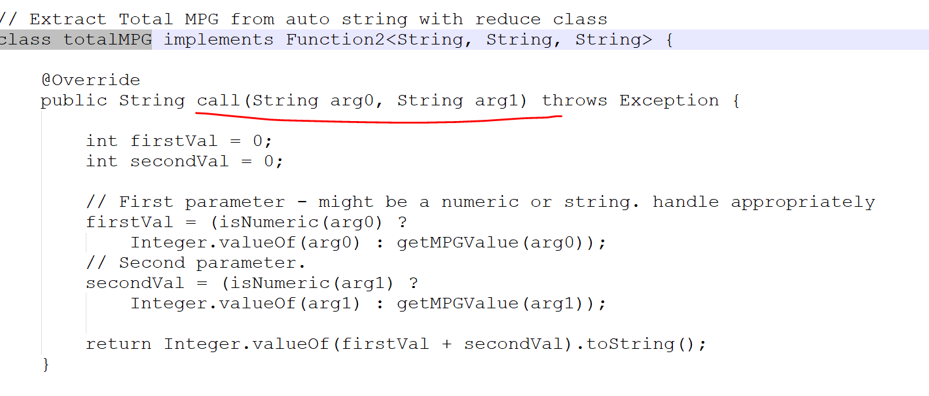

Slide 15
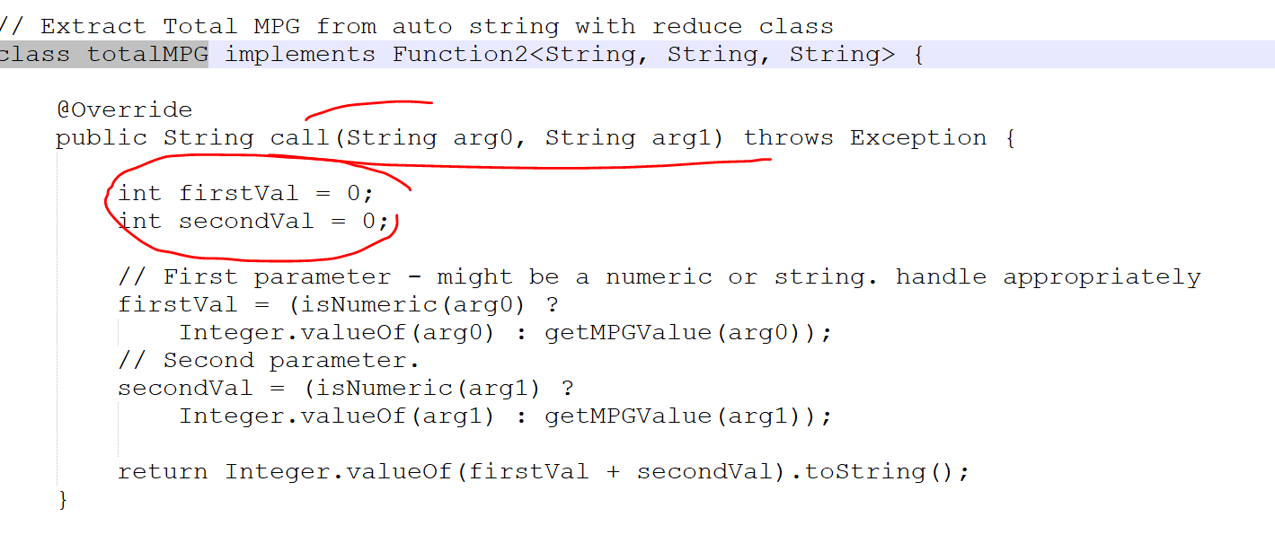
again we implement the call function which takes as input strings and then returns back a string.
So inside we got two records the first record and the second record.
the first record might be something that is already computer or it might be a new string.

Slide 16
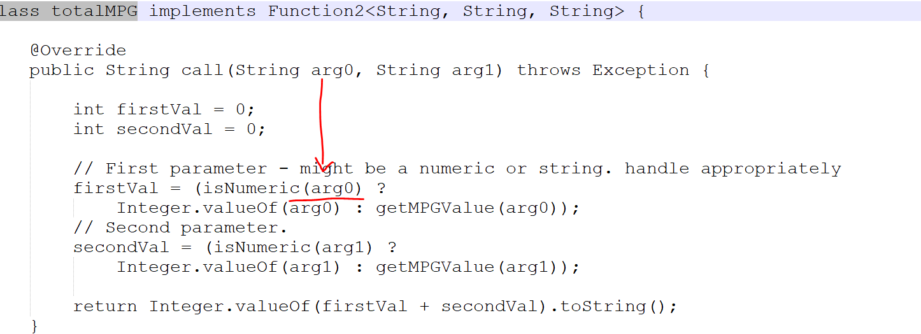
for several reasons is we're going to check what is the firstval and the second val.
If Arg 0 came in that is the first string is of type numeric which means it has a value that is passed from the previous communication.
We just converted the integer and store it in the firstVal.
or if it is going to be a string which means it is going to be the bare. Then we call this function called getMPGValue() .
Do Same for the 2nd Parameter As Well….

Slide 17
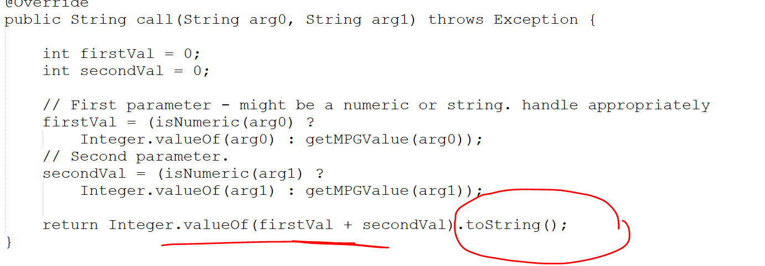

Slide 18
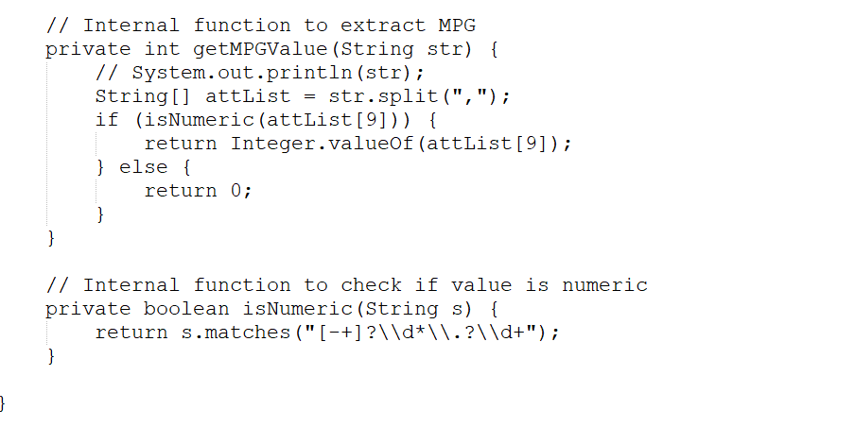

Slide 19
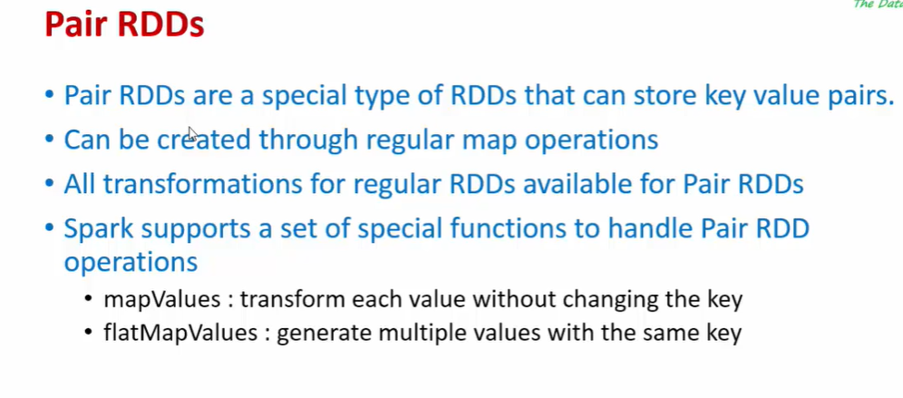
PAIR RDD

Slide 20
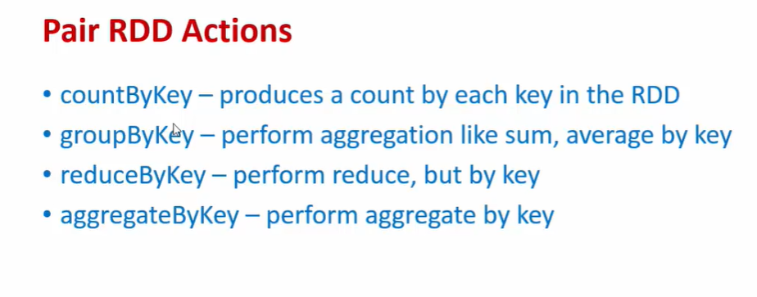

Slide 21
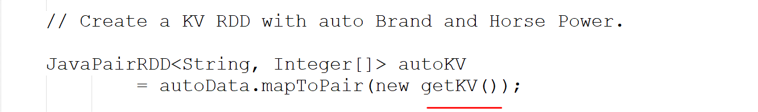
LAB:: Calculate Av Horsepower By Each Brand
Create a KV RDD with auto Brand and Horse Power.
So the brand becomes the key and all the values that you collect and compute becomes the values.

Slide 22
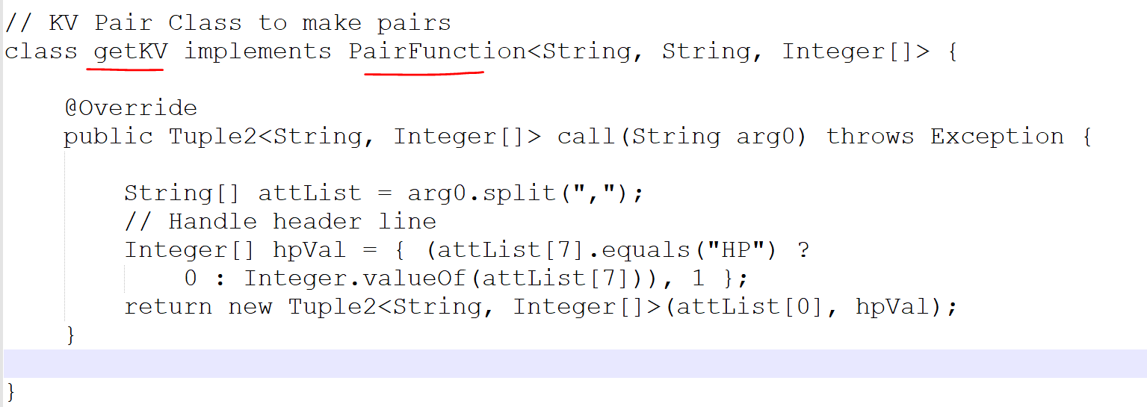
getKv Function
Pair function got three parameters the three parameters.
Our first one is the input.
And the second one is the key part and the third one is value.
value can anything in this case it is a list of integers or array of integers.

Slide 23
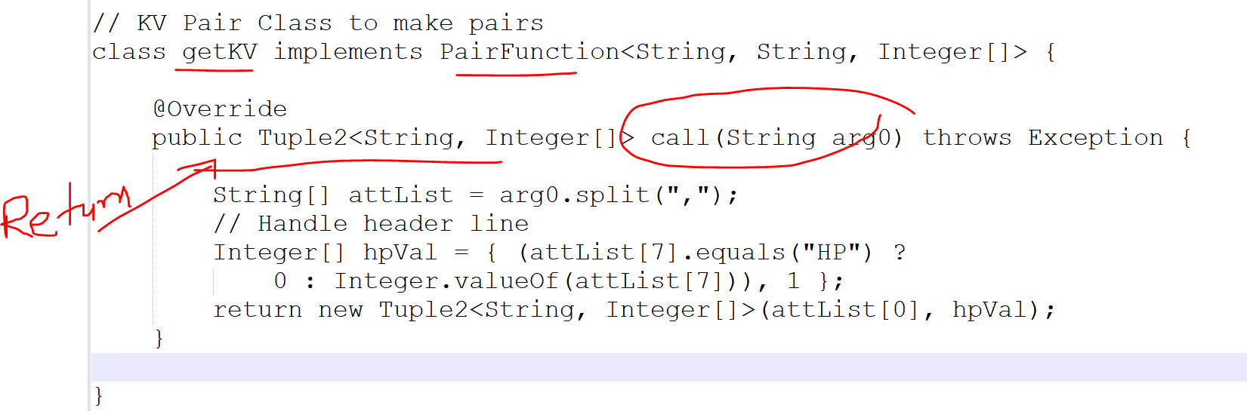
We also have a call functions here which also works a very similar way.
The input is going to be the string so every string( every record) in the original Autodata RDD is going to be passed to this function and this function is gone to return done a key and Value.
the key being the Brand and the value being the horsepower.
and account and

Slide 24
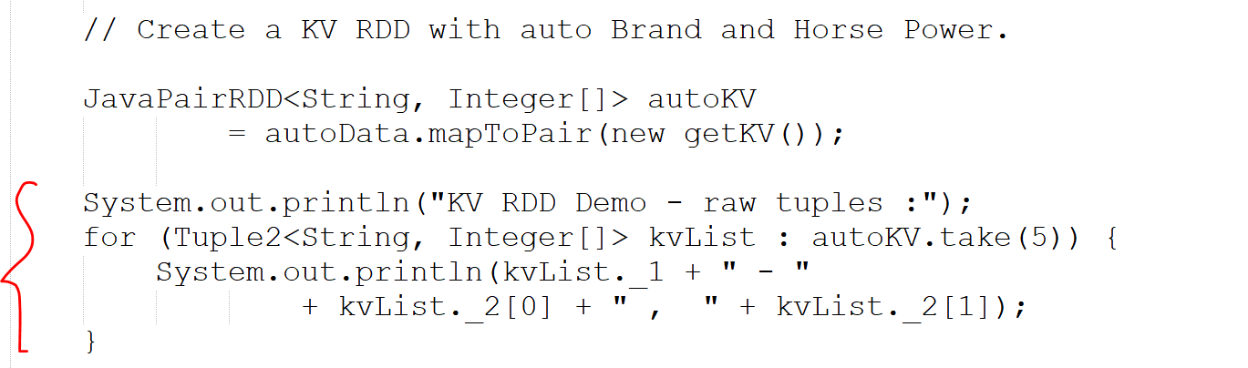
How to Print OutPut

Slide 25
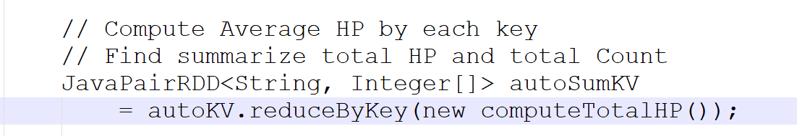
Next::
// Compute Average HP by each key
// Find summarize total HP and total Count

Slide 26
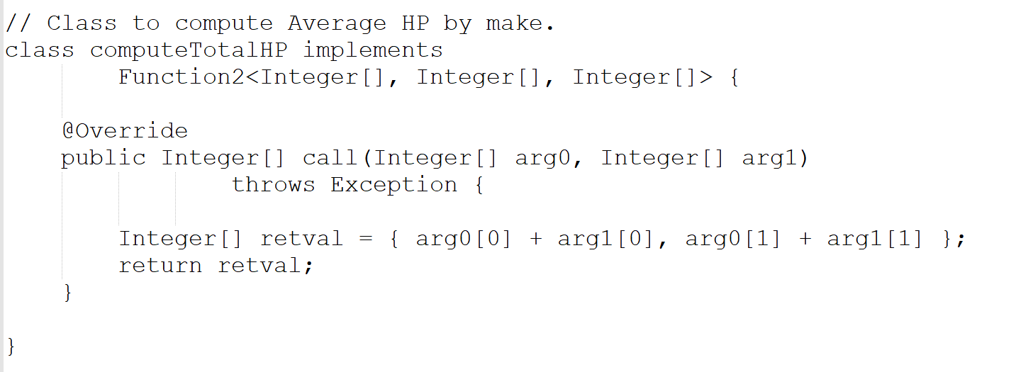

Slide 27
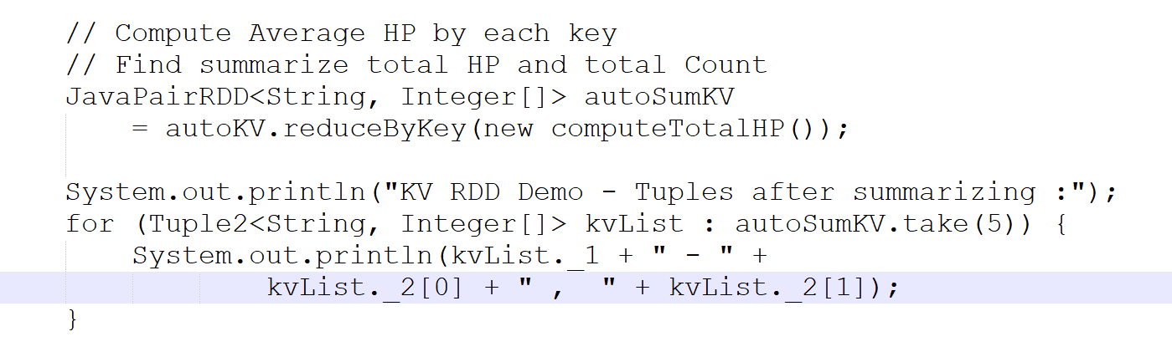

Slide 28
