Slide 1
ADVANCE

Slide 2
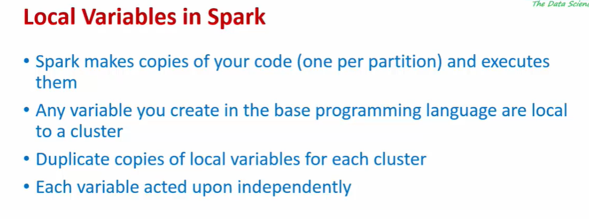

Slide 3
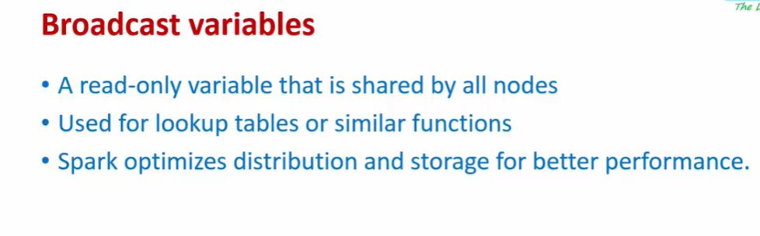
remember broadcast variables are read only variables and you use it for any kind of lookup information
Now What if I need to count something globally across all my notes then you use something called accumulators

Slide 4
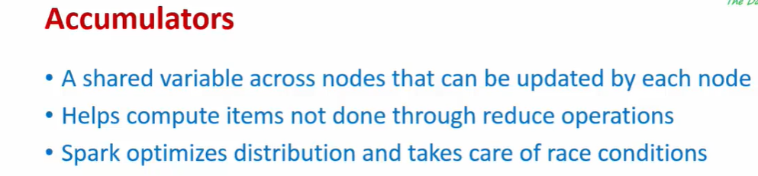
accumulators very similar to a broadcast variable.
it is also shared across all the nodes like a broadcast variable.
But accumulator variables can be updated.
And most importantly SPARK takes care of counting/Accumulating this centrally.
Ex:: you can have a variable to count something and then SPARK will take care
of making sure that count that is a single copy of can maintain and all the nodes go and update that single variable and SPARK TAKES acre of all the
So your count actually becomes accurate.

Slide 5
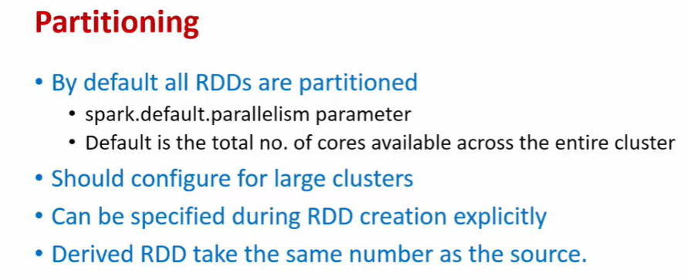

Slide 6
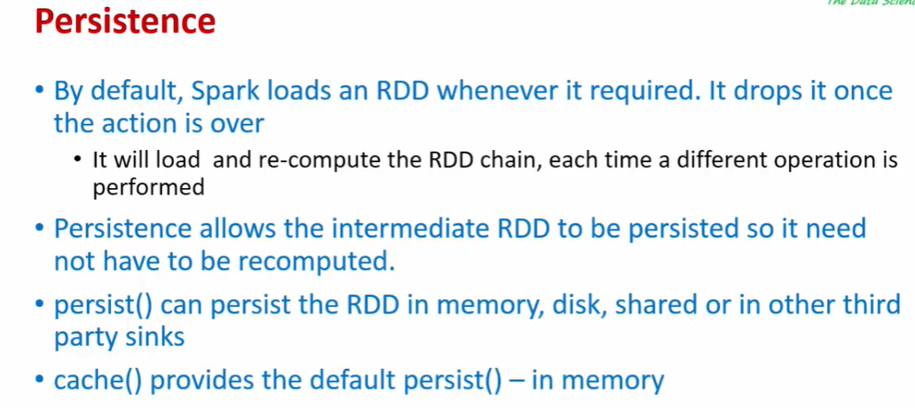

Slide 7
DEMO
accumulators are variables that we can use to accumulate data across multiple partitions and
broadcast variables again can be used to broadcast information to all partitions.

Slide 8
COUNT no of SEDAN & HATCHBACK in AUTO DATASET

Slide 9
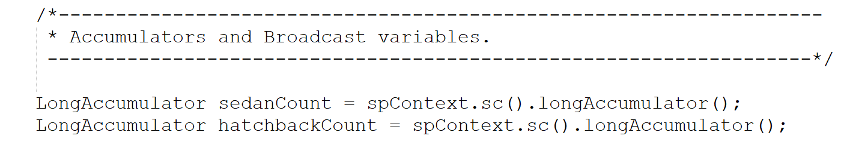
Define ACCUMULATOR
this long accumulator will initialize absolute zero.

Slide 10
Define which String Talks about Sedan /Hatchback

Slide 11
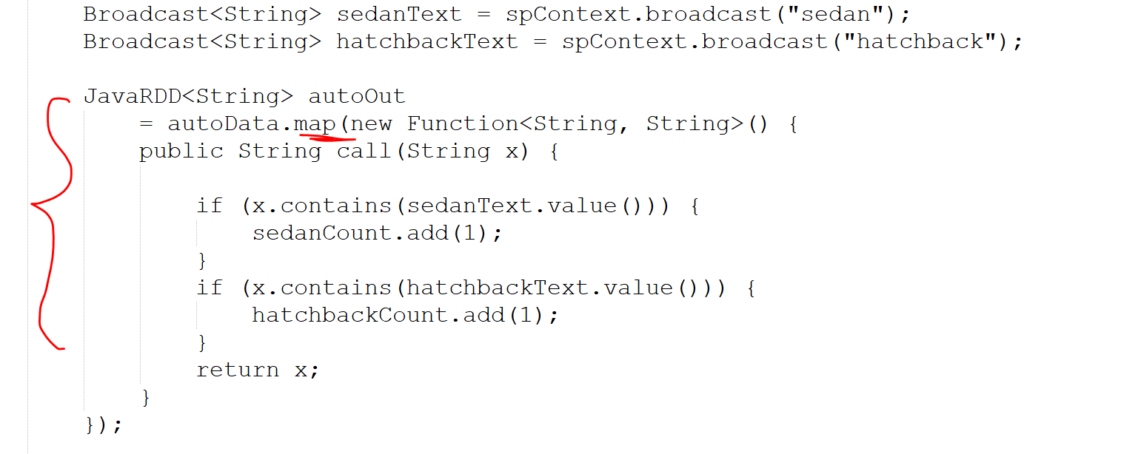

Slide 12
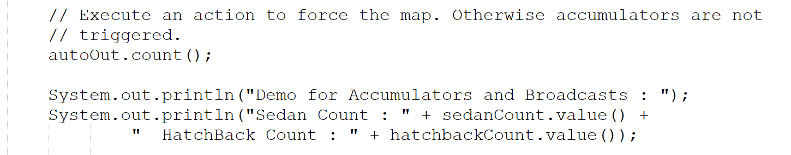

Slide 14
LAB- 2:: PARTITIONING //PERSISTENT

Slide 15
