Slide 1
STREAMING

Slide 2
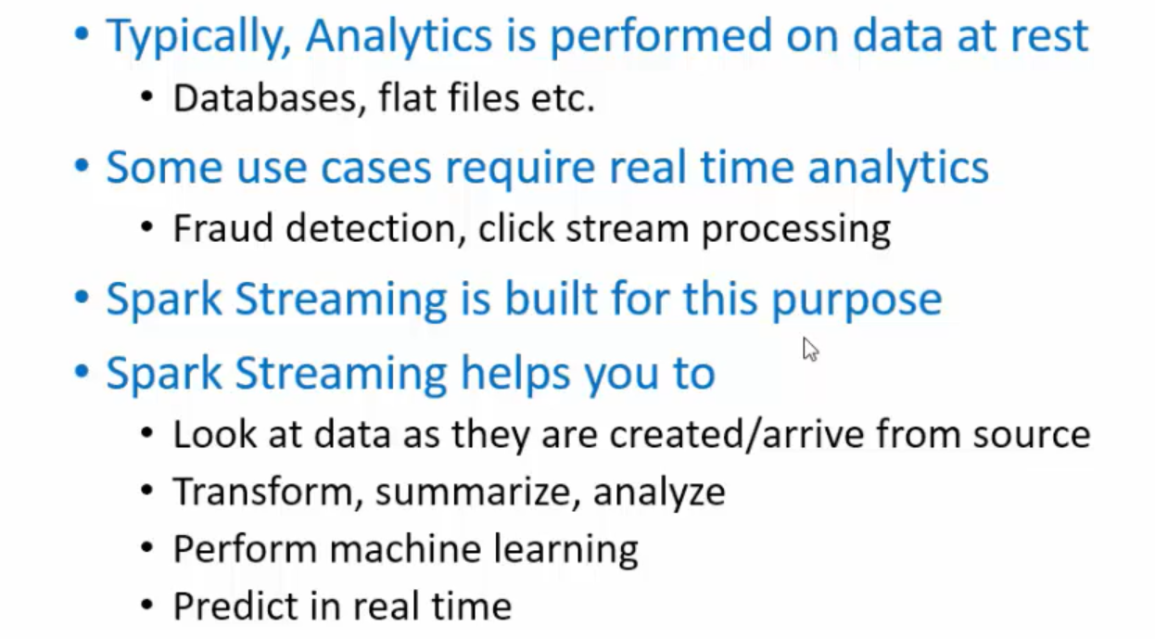
Why Spark STREAMING ?

Slide 3
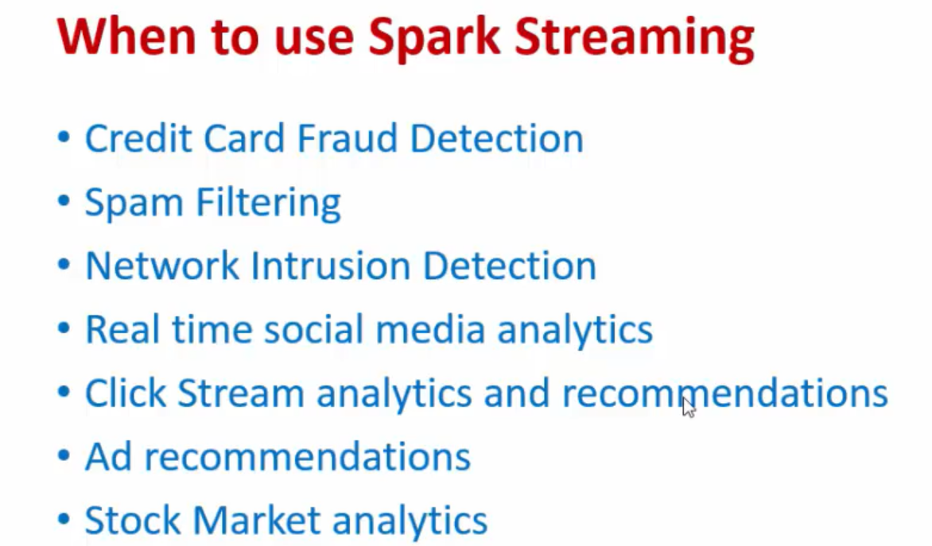

Slide 4
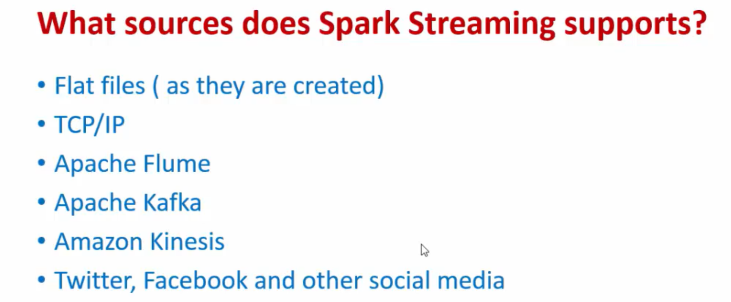

Slide 5
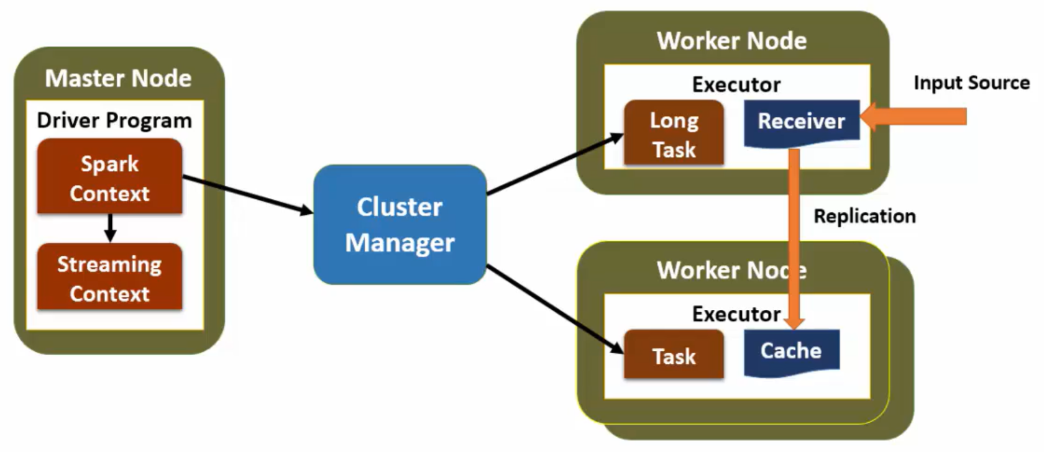

Slide 6
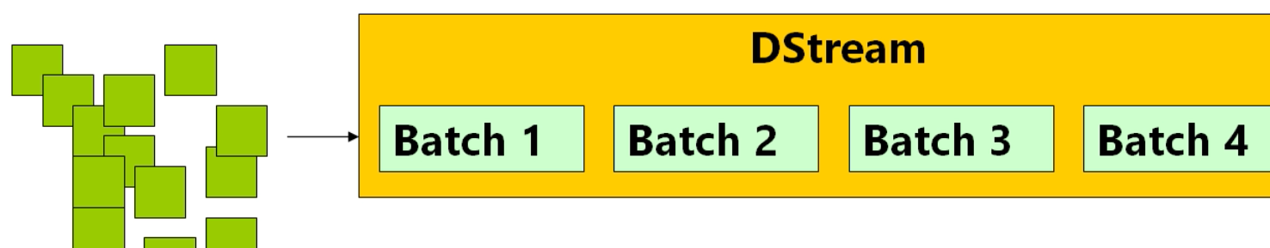

Slide 7
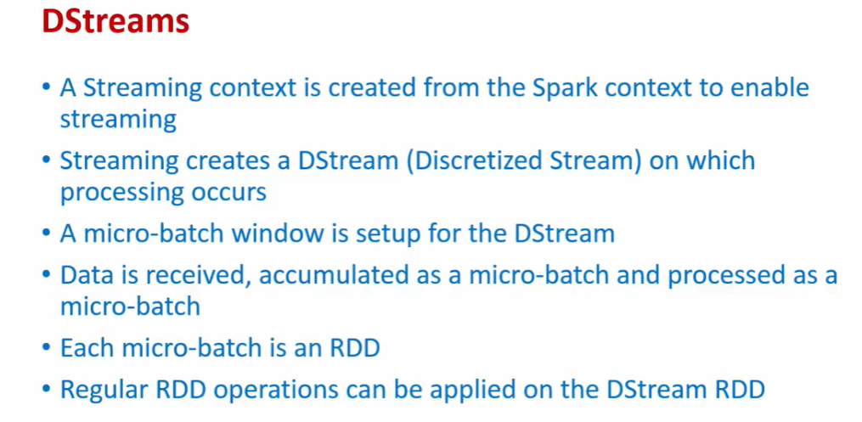

Slide 8
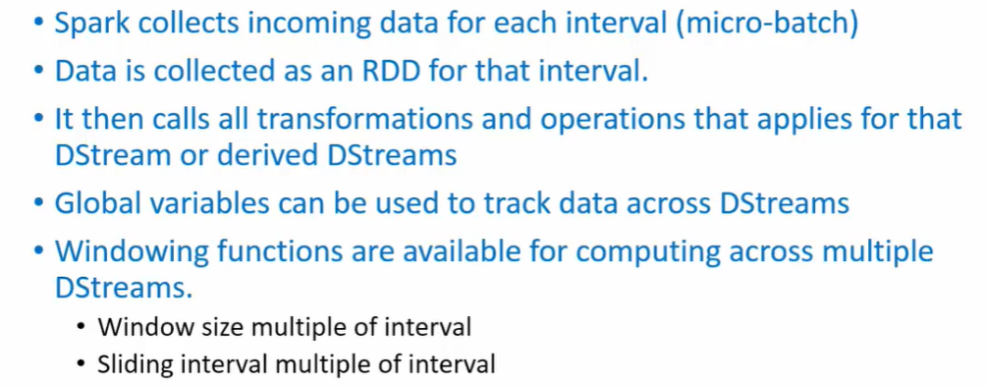

Slide 9
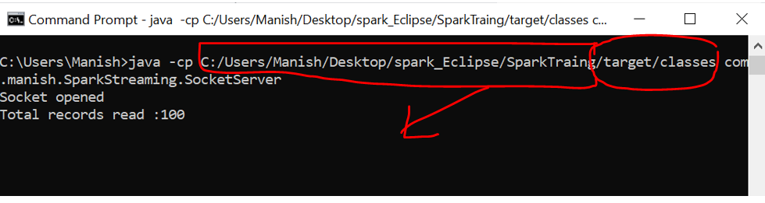
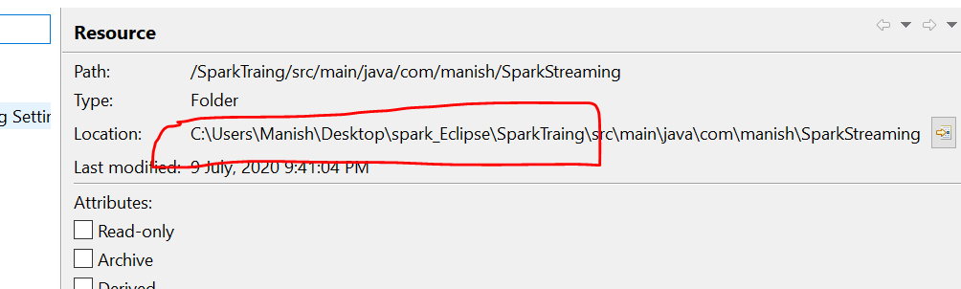
* Run command
*
* java -cp C:/Users/Manish/Desktop/spark_Eclipse/SparkTraing/target/classes com.manish.SparkStreaming.SocketServer
java -cp java_Eclipse__Folder/target/classes packagename.classname
*/

Slide 10
Code From Eclipse

Slide 11
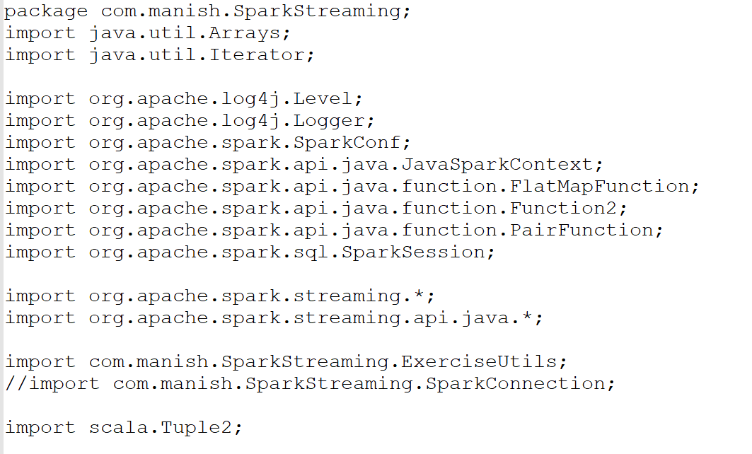

Slide 12
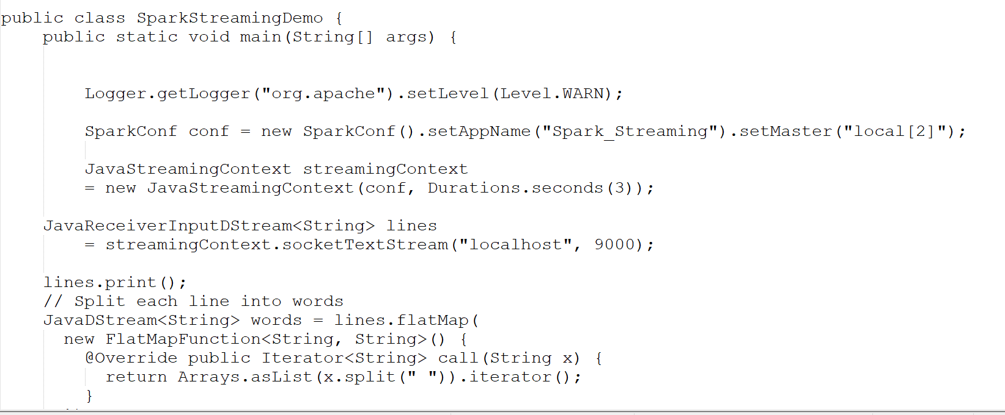

Slide 13
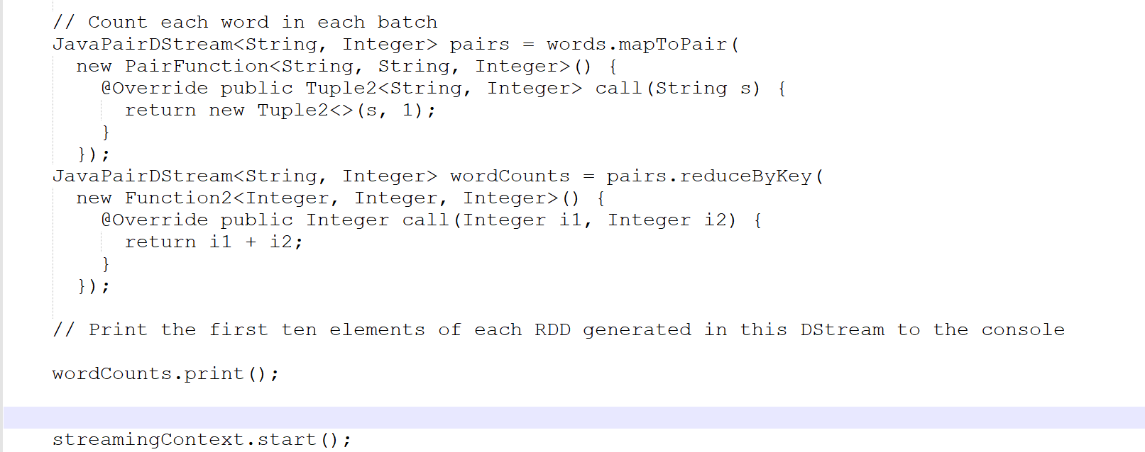

Slide 14
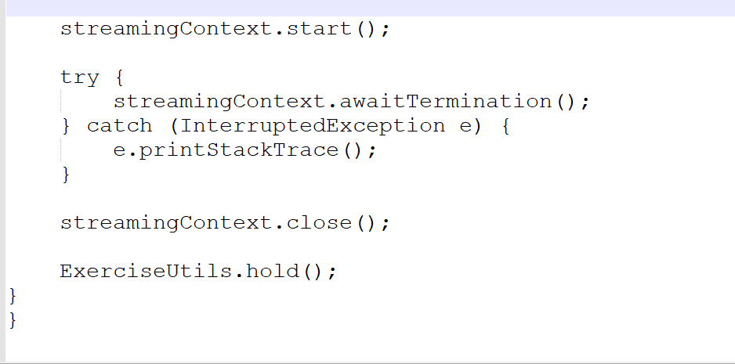

Slide 15
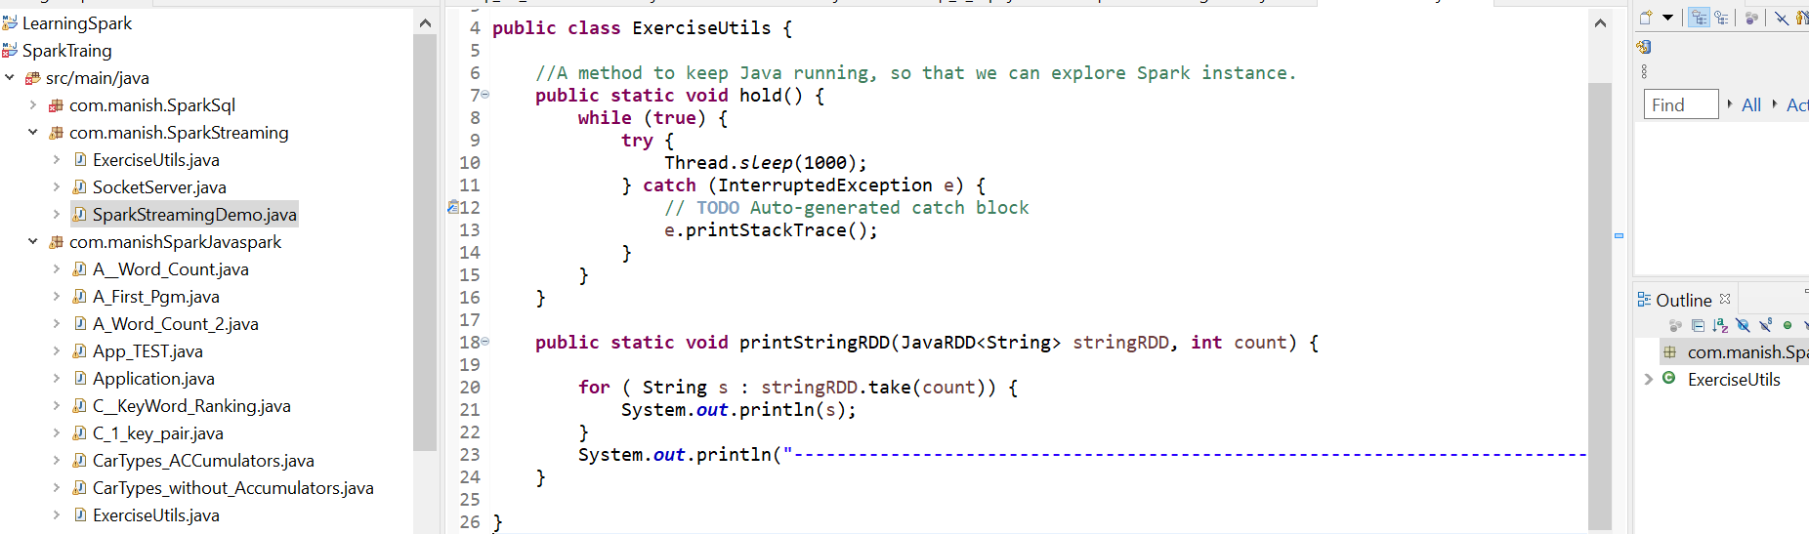
ExecrciseUtil.java

Slide 16
Run Code From Eclipse

Slide 17
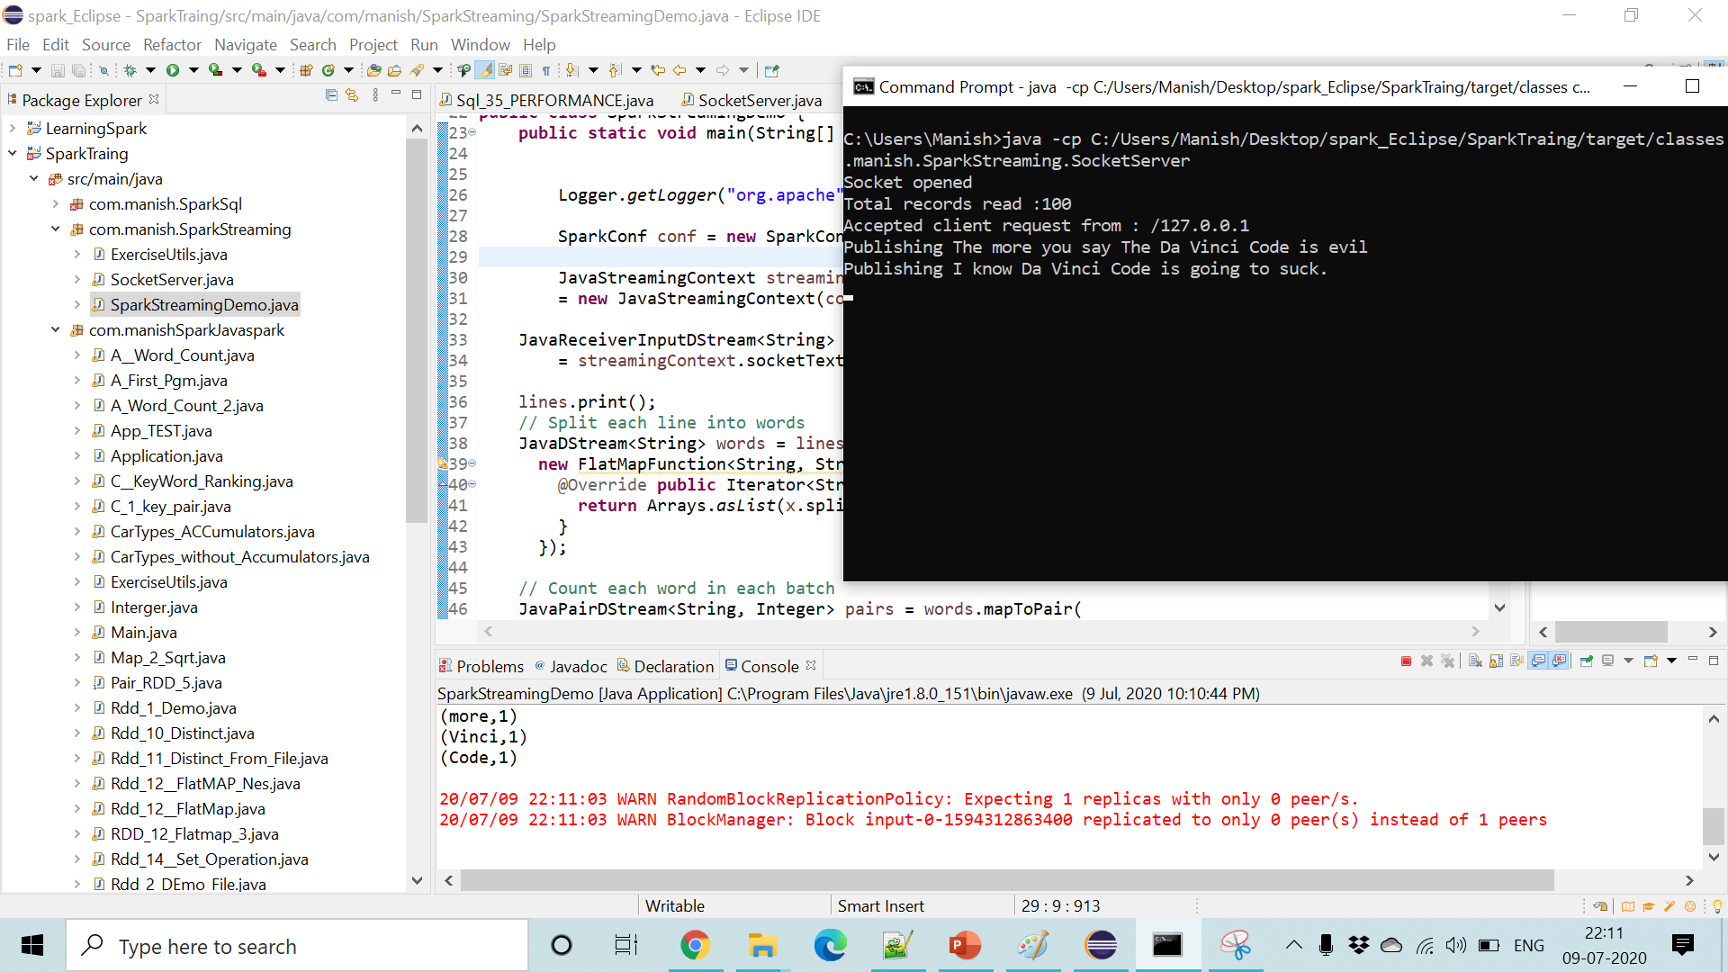

Slide 18
Now, I want How many Errors Was in Last 1 Hr???

Slide 19
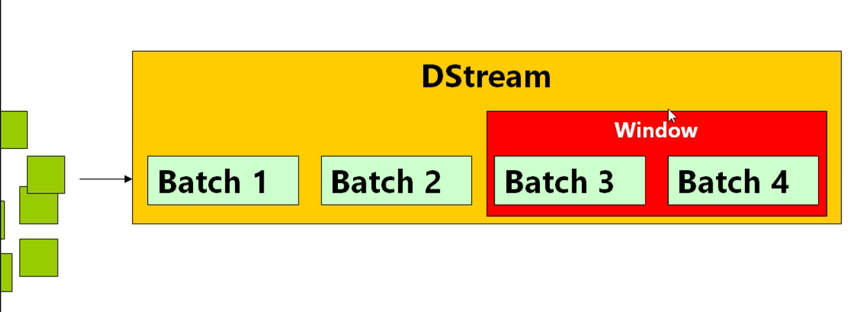
WINDOWING ….

Slide 21
KAFKA

Slide 22
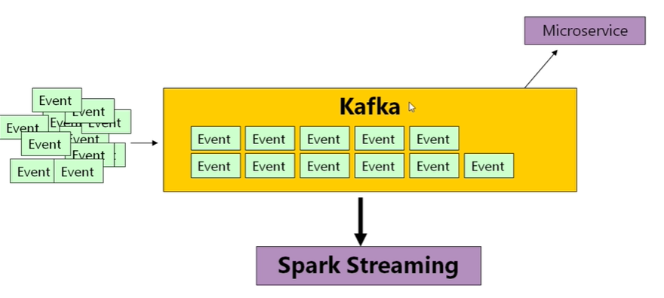

Slide 23
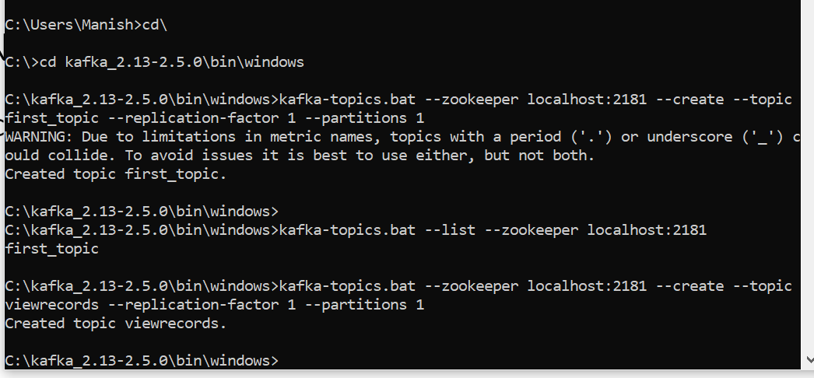
INTALL KAFKA & RUN IT
CREATE TOPIC name:: VIEWRECORDS

Slide 24
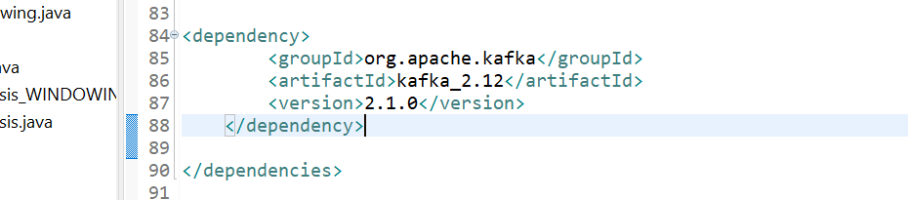
POM FILE :: ADD Dependency

Slide 25
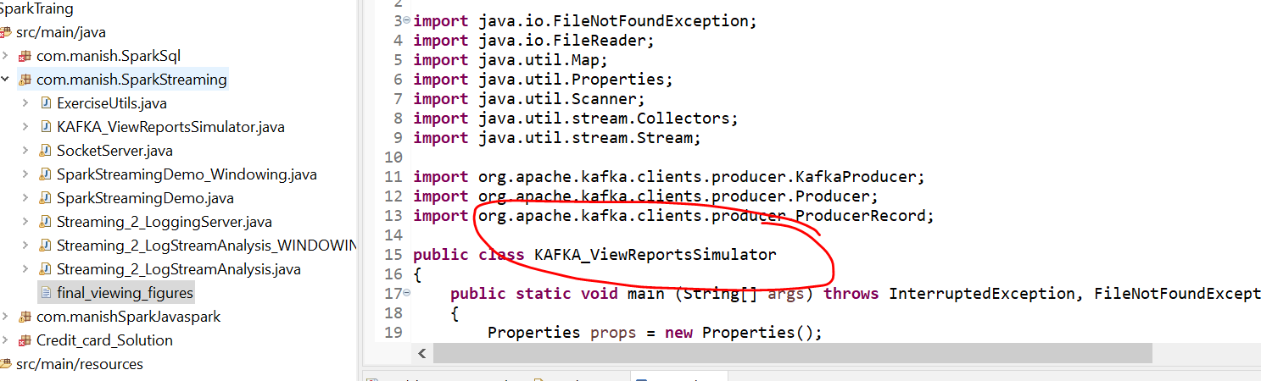
RUN:: Make sure KAFKA is RUNNING

Slide 26
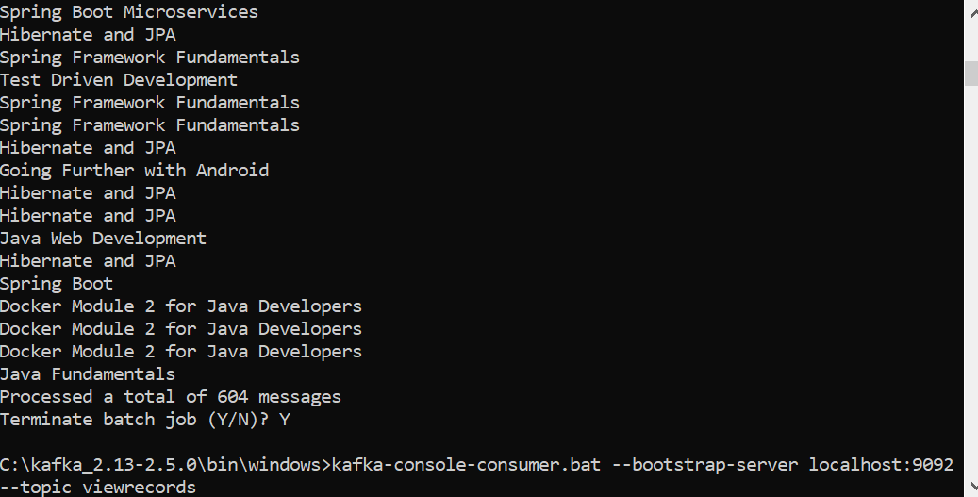
Check Console Consumer
>kafka-console-consumer.bat --bootstrap-server localhost:9092 --topic viewrecords

Slide 27
Maven
<dependency>
<groupId>org.apache.spark</groupId>
<artifactId>spark-streaming-kafka-0-10_2.11</artifactId>
<version>2.3.1</version>
</dependency>

Slide 28
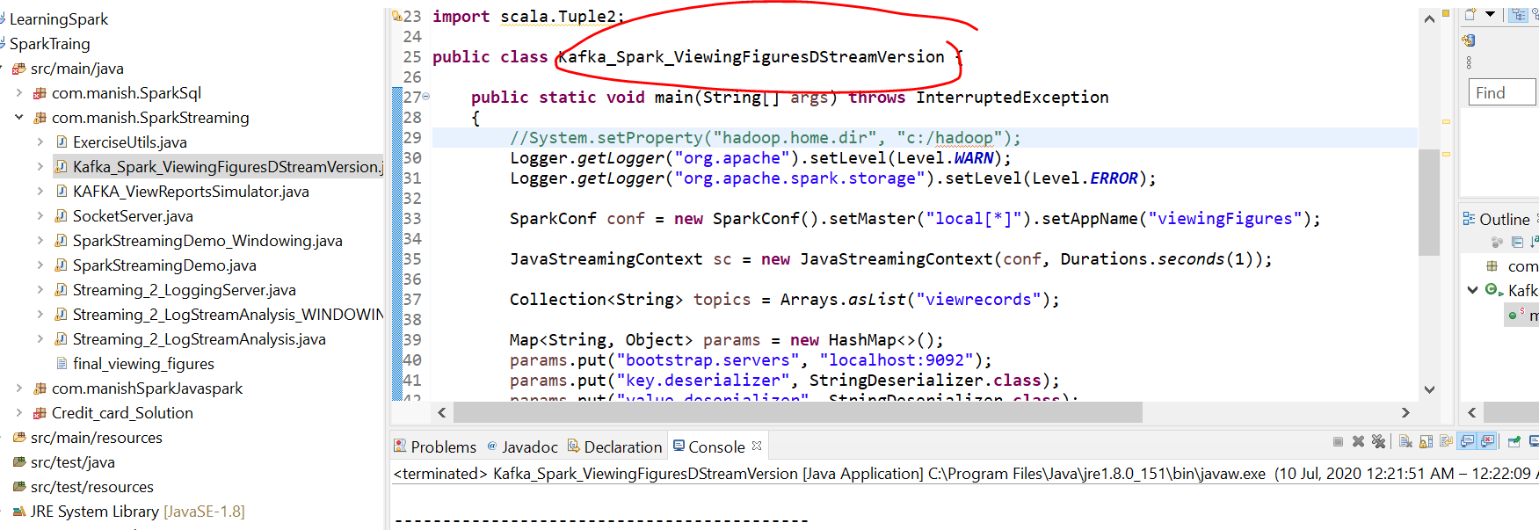
Run

Slide 29
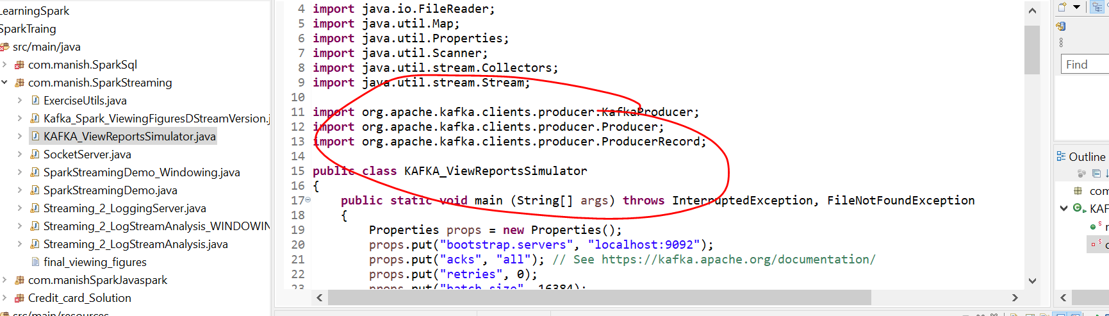
Run Simulator

