Slide 1
SPARK-SUBMIT

Slide 2
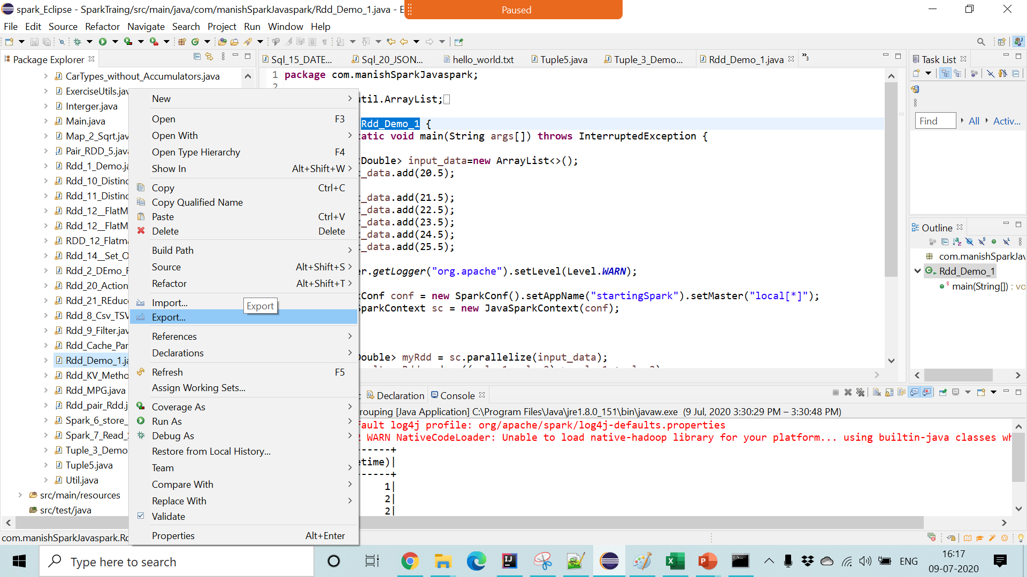
Create JAR FILE

Slide 3
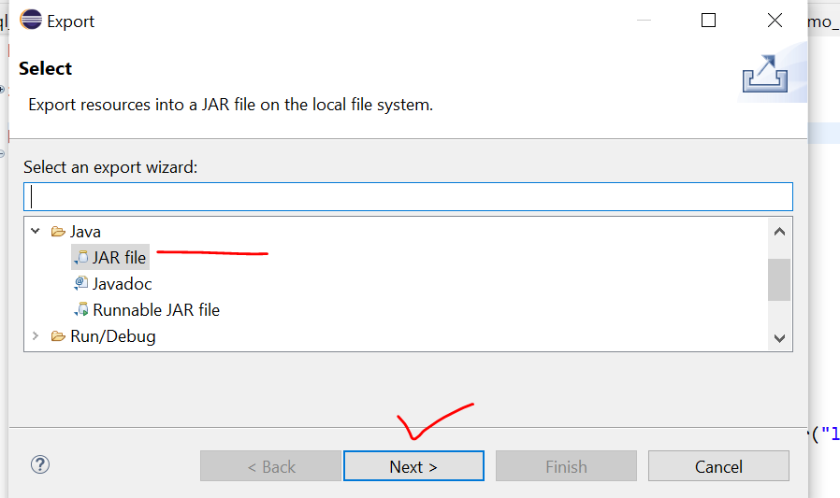

Slide 4
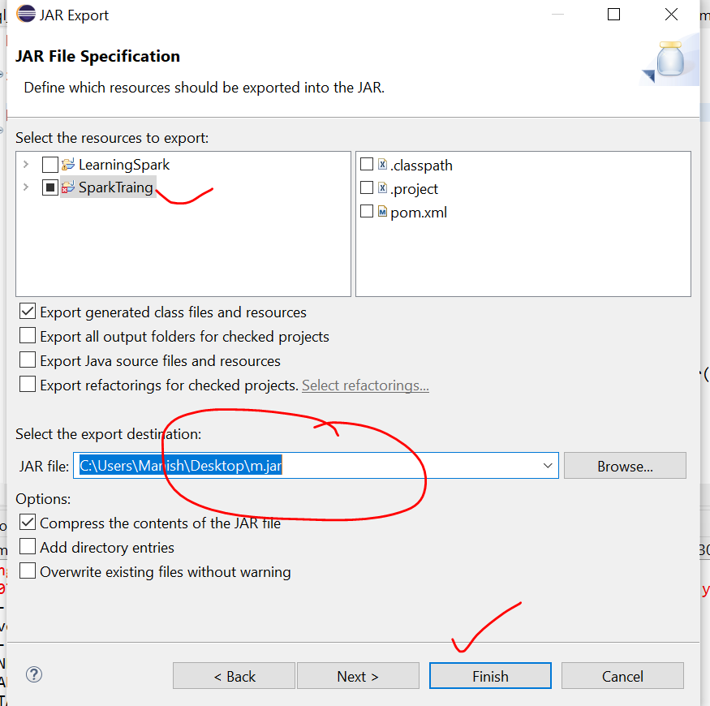

Slide 5
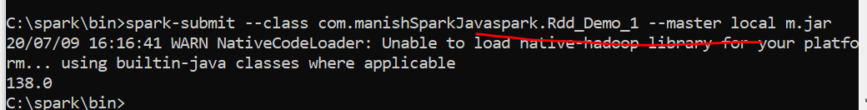
Run JAR
./bin/spark-submit --class com.manishSparkJavaspark.Rdd_Demo_1 --master local m.jar

Slide 6
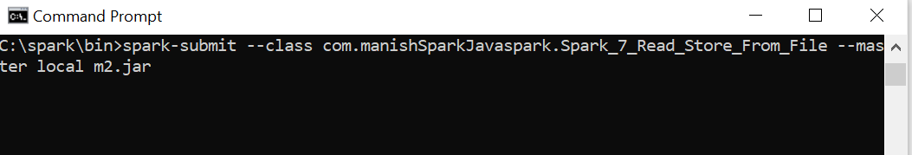
C:\spark\bin>spark-submit --class com.manishSparkJavaspark.Spark_7_Read_Store_From_File --master local C:\Users\Manish\Desktop\m12.jar
spark-submit --class com.manishSparkJavaspark.Spark_7_Read_Store_From_File --master local m2.jar

Slide 7
Cluster Option
./bin/spark-submit --class org.apache.spark.examples.SparkPi \
--master yarn \
--deploy-mode cluster \
--driver-memory 2g \
--executor-memory 1g \
--executor-cores 1 \
--queue thequeue \
examples/lib/shadoop2.6.0-cdh5.12.0.jar

Slide 8
spark-submit --class com.manishSparkJavaspark.Spark_7_Read_Store_From_File --master local --driver-memory 2g --executor-memory 1g --executor-cores 1 C:\Users\Manish\Desktop\m12.jar

Slide 9
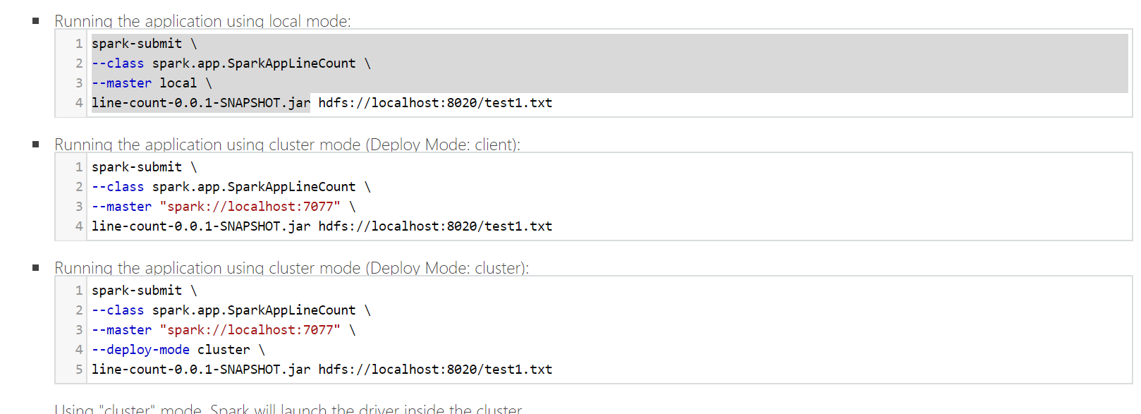

Slide 10
Taking Input From Files

Slide 11
PYSPARK
Open a Terminal
Move to :::/usr/lib/spark/bin
and Run :::
spark-submit --master sparkMaster/local '/home/cloudera/Desktop/sampleapp.py'

