Slide 1
Main Screen
Patashala mgmt
Varshikam
Poorthy
New user
Existing user
User Details (Edit Option)
New Patashala
List of completed varshikams
List of previous exams
Current / Latest Exam
Create a new poorthy exam
Patashala Details
Varshikam Details
Poorthy Details
Sanskrit Qualification
Bank details
List of Patashala-s
User mgmt
Lis of varshikams in progress
New varshikam
Search options needed
Search options needed
Add vidyarthi-s to this exam from eligible visyarthi-s list

Slide 2


Top Level
Web User Interface
Processing
Mobile User Interface
Offline Data upload
Data Base

Slide 3

User Interface
External User
Web User Interface
Authorized User
Processing
External User
Mobile User Interface
Authorized User

Slide 4
External User Interface
Add new user
Enter Varshikam Application
Enter Poorthy application

Slide 5
Authorized User Interface
Add new user
Add new Patashala
Enter Varshikam Application
Enter Poorthy application
Enter Varshikam Results
Enter Poorthy results
Report generation

Slide 6
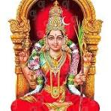
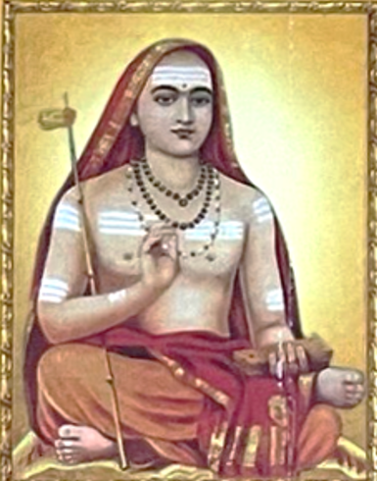
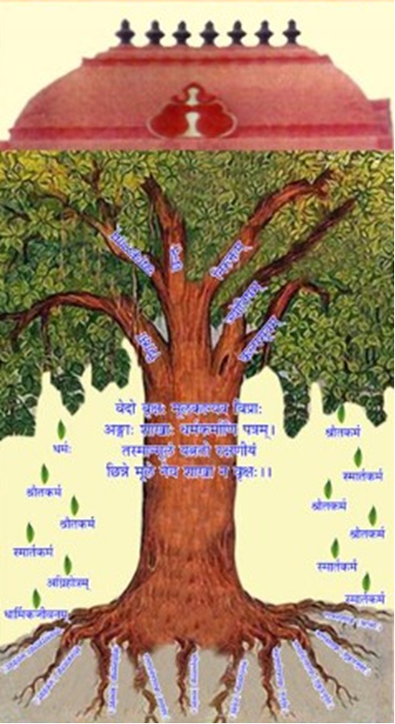
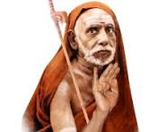
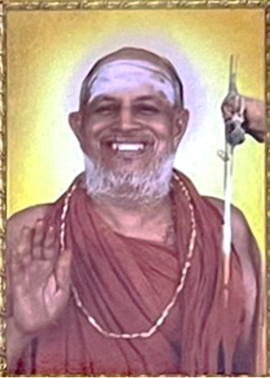
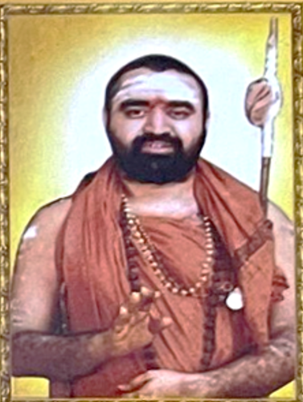
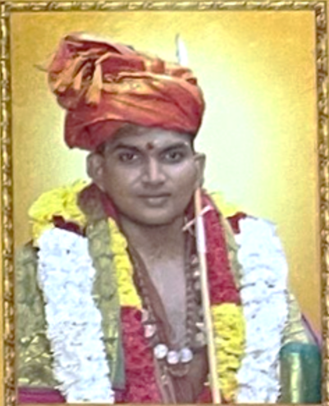
User
Patashala
Poorthy Exam
Varshikam
Veda Rakshana Nidhi Trust
User
New user
Registered user
Patashala
New Patashala
Registered Patashala
Poorthy exam
New exam
Ongoing exams
Completed exams
Varshikam exam
New Varshikam
Ongoing Varshikams
Completed Varshikams

Slide 7
User Management
Unique User Id
Vede & Shaka
Photo
(Click here to upload)
Name
Gothram
Adhaar No
Soothram
Mobile No
Swashaka
Confirmed by
Link to another user
E-mail Address
Date of Birth
Type of user
Vidyaarthi
Guru
DD/MM/YYYY
Father
Examiner
Paatashala details
Address – Line-1
HNY Details
Varshikam details
Address Line – 2
Is HNY?
Yes / No
City
Poorthy details
HNY registration
Date
State
Veda Qualification
PIN Code
HNY Number
Sanskrit Qualification
Father
Link to another user
Bank Details

Slide 8
UM -> Paatashala Details
Patashala Name | Guru / Adhyapakar | Joining Date

Slide 9
UM -> Varshikam Details

Slide 10
UM -> Poorthy Details
Poorthy exam Name | Date | Result

Slide 11
UM -> Veda Qualification

Slide 12
UM -> Sanskrit Qualification
Pareeksha Name | Certificate (image) | Verified by
Parichaya
Abhignya
Vichakshana

Slide 13
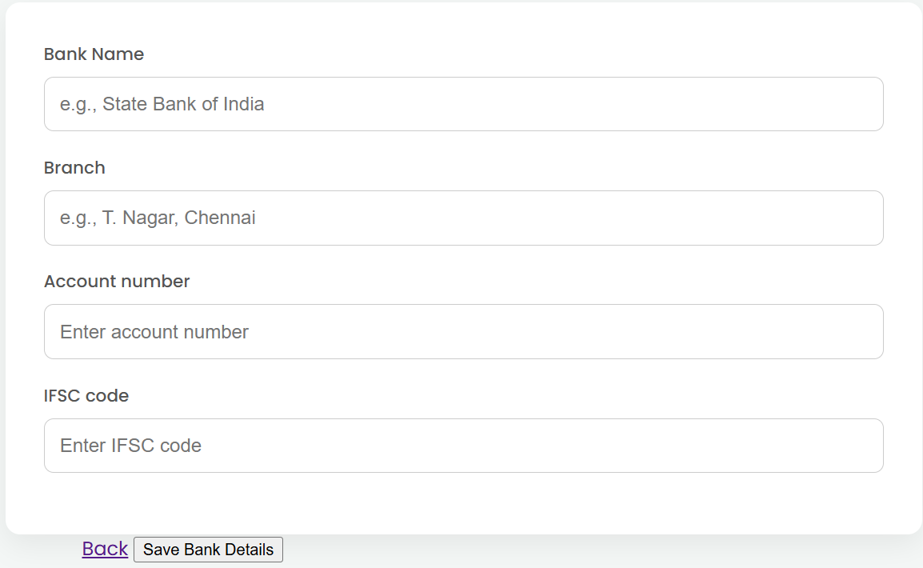
UM -> Bank details

Slide 14
Patashala Management
Patashala Profile
Name
Address
Phone number
E-mail address
Management info
Name of the trust
List of Trustees
Name
Mobile number
Is VRNT providing financial assistance? (Yes / No)
No. of students for each Veda / shaka (optional)
List of Students
vedam / Shaka wise
Joining date
Leaving date
List of Adhyapakar
vedam / Shaka wise
Joining Date
Leaving Date
Bank details of the Trust
Bank Name
Branch
Account number
IFSC code

Slide 15
Varshikam Exam Management
List of Completed Varshikams
List of varshikams in progress
Create new Varshikkam exam

Slide 16
Poorthy Exam Management
Existing Poorthy Exams
Create new Poorthy exam

Slide 17
New Varshikam
Click here to choose the paatashala from existing list
Patashala
Select from list
Click here; List of vidyathi-s for the chosen paatashala should pop-up; Choose one from the list; That should be added to the list shown below
Choose Vidyathri from a list
Vidyaarthi | Veda - Shaka | Varshikam Portions
Vidyarthi – 1
Vidyarthi – 2
….
Click here; The varshikam screen (based on veda-shaka) should come-up; This is where varshikam details can be edited;
Click here
Click here
Click here

Slide 18
Life cycle of User
User Created
New User
Varshikam
Apply for varshikam
At least 3 varshikams
Poorthy
Graduation
Multiple levels – Refer to adjoining table
No. of levels depend on Veda-shaka
Graduation Completed
Completed maximum qualification

Slide 19
Demo sequence
Create new user
Create multiple new users (at least 2)
Create paatashala
Create multiple patashalaas (at least 2)
Add Visyarthis to the patashalaa – These are users created in the previous step
Vidyarthees can be students of more than one patashala
Create varshikam application
Create a new application – (this is created by paatashala)
This should create a varshikam application id
Add a user to this application
Mention the varshikam portions for this user
Show that this is reflected in the user profile
Repeat creating varshikam applications for 3 times
After 3 times show that the Vidyarthi is eligible for poorthy exam
Should also have completed all the portions in varshikam, to be eligible for poorthy exam
Every time show that this is reflected in the user profile
Create poorthy application
The admin will create a new poorthy exam (say Poorthy_VJ_2025)
Student will apply for Poorthy
Check whether the student is eligible
If eligible add the user to the poorthy exam
If not eligible inform user about the same
Show that a new student added to the poorthy exam applicants
Admin will declare the results
Add Marks & exam result (pass/ fail / Absent / Asked to appear for next exam)
Create for each level
Each time show that the Vidyarthi is eligible for next higher level
Every time show that this is reflected in the user profile

Slide 20
Questions to HYD team
What are the tools used?
Language
PHP
Python
Front-end – Nothing separate
Back-end
DB - mySeQL
Hosting
Shared server hosting
Cannot use Java
Development team
How many people were involved?
4 kids – on & Off + Prasad
One person – Madhu – DB admin
Dakshinamurthy
How did you get them involved?
How long did it take to come to this level?
Started in 2017
What is the maintenance challenge & how do you handle this?
Annual Maintenance cost – Rs. 800 pm
If Java is used – Rs. 3000 pm
Hosting cost
Can we do code reuse? Interested in basic framework including fine grain user access control
Small no. of tables
Pre

