Slide 1
Research Review
By,
Dr. U.Vageeswari, M.C.A., M.Phil., Ph.D., NET.,
P.Bhuvaneswari M.C.A., M.Phil., M.Ed., (M.A(Sanskrit)).,
J.Seetharaman M.C.A., M.Phil.,

Slide 2
“An AI-driven approach to automate Padacchedam and Sandhi-Vicheda in Sanskrit texts for accurate digital text processing and pedagogy”
First of its kind addressing Padacchedam (reading aid) and Sandhi-Vicheda (linguistic analysis).
Bridges traditional grammar (Paninian rules) with modern AI/ML techniques.
Provides high-accuracy word segmentation where existing tools are incomplete or error-prone.
Enables digitization of classical Sanskrit texts with minimal manual intervention.
Designed not only as a research tool but also as a pedagogical aid for learners and scholars.

Slide 3
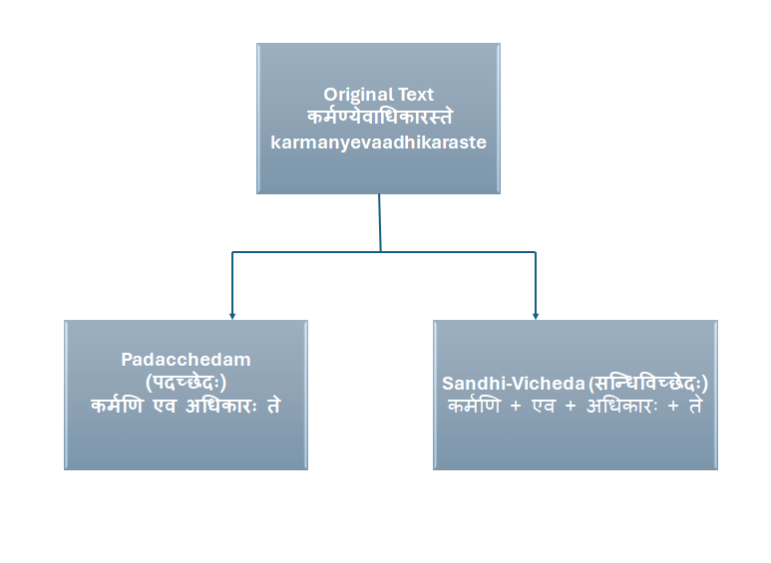
Identified Research Gaps
Lack of large annotated corpora for Sanskrit word segmentation.
Existing rule-based approaches fail in handling multiple valid splits.
Limited integration of grammar (Paninian rules) with machine learning methods.
Insufficient accuracy in current models for Vedic and Classical Sanskrit.

Slide 4
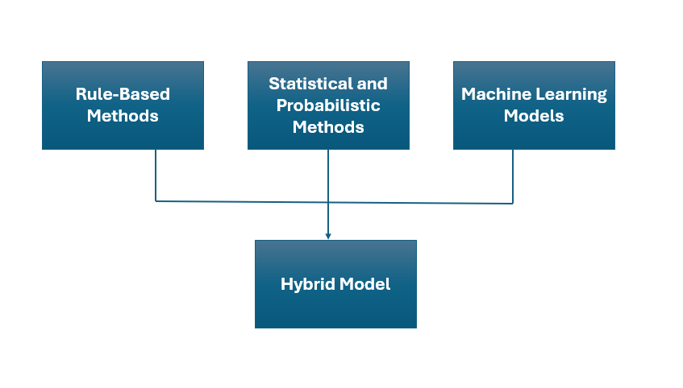
Proposed Research Components
Hybrid Model:Combining rule-based model with machine learning (Transformer/seq2seq) Models for padachedam and Sandhi-Vicheda using Paninian grammar.
Corpus Creation: Annotated dataset from Bhagavad Gītā, Rāmāyaṇa, authoritative literature works like virutharathanakaram grammar book on various chandas, sabthamanjari for samasa reference , and sandhi viveka and samasa kusumavalli

Slide 5
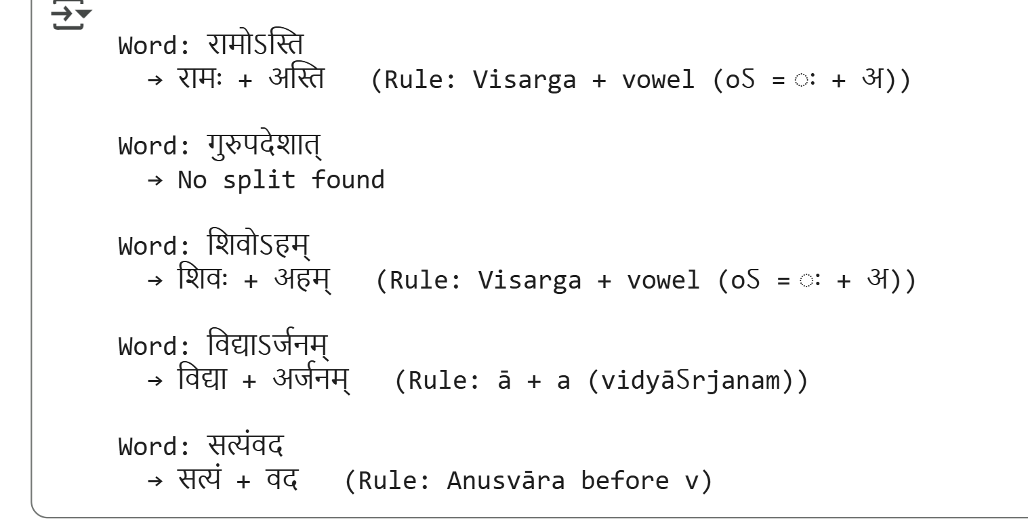
Progress Made So Far
Literature survey of research papers on Sanskrit segmentation.
Prototype Python implementation (rule-based + dictionary lookup).
Collected sample data from ślokas.

Slide 6
Patentability & Publication Status
Patentability
Novelty in dual-output hybrid segmentation engine.
Potential patent scope: “System and Method for Automated Sanskrit Word Segmentation using Hybrid Rule-ML Approach.”
Publication Status
Expected submission: 2026 Q1

