Slide 1
TEAM - 7
Members:
Swetha(Team Lead)
Sneha
Antara paul
shamili
seetharamireddy

Slide 2
Modules Assigned to Our Team
forum administrator/moderator
search user, forum
my location
e mail - sending service
send SMS

Slide 3
my location
Objective:
Google map will show user base location. If user will change his address the map will change accordingly
FrontEnd Layout:
To display the user address in google maps.
In user profile details google map will show user address location.

Slide 4
APPROACH
First, I have to get the address of the user who is logged into the capbook app and displaying the address in google map.
If user login then user profile details will show the address of user in google maps.
Finally got the user location in google map.

Slide 5
Challenges faced
I tried to display the address of users in google map without api key but I came to know with api-key only we can access google maps.
Finally with api-key I got the user location.

Slide 6
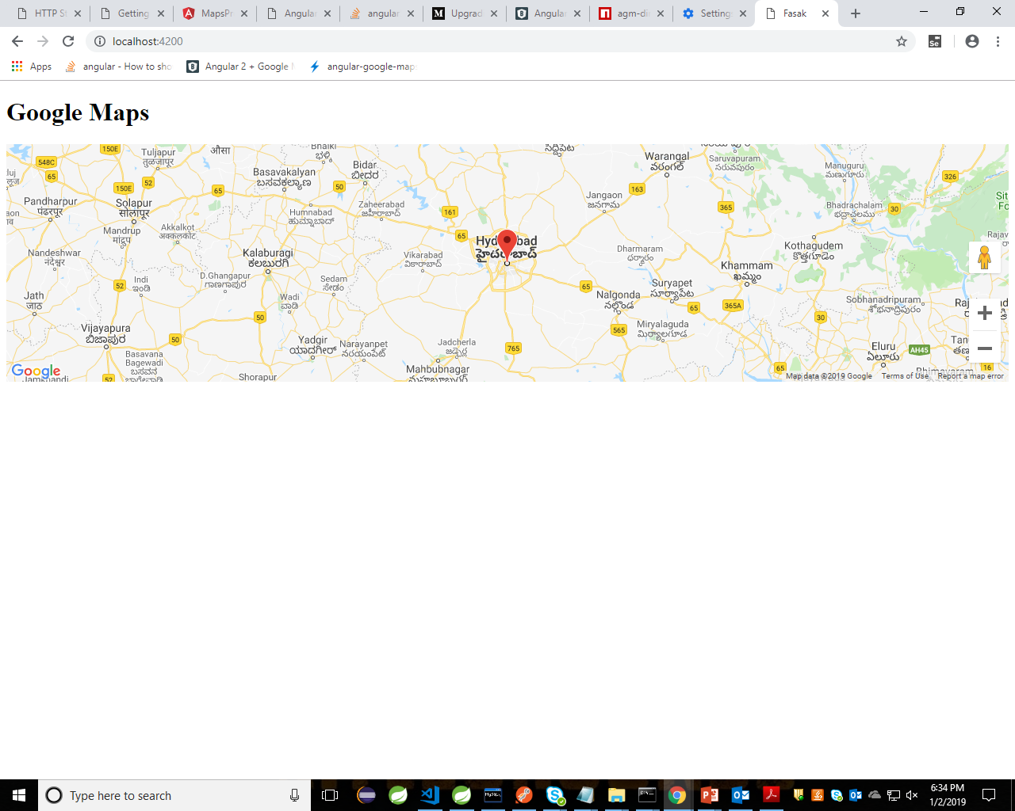
Output-screenshot

Slide 7
Thank You…

