Slide 1
TEAM - 7
Members:
Swetha(Team Lead)
Sneha
Antara paul
shamili
seetharamireddy

Slide 2
Modules Assigned to Our Team
forum administrator/moderator
search user, forum
my location
e mail - sending service
send SMS

Slide 3
forum administrator/moderator
Objective:
Moderator of forum may approve/reject a membership request; also may delete any topic or remove any member from forum
Front-End Layout:
To display the user EMAILS in notifications tab.

Slide 4
APPROACH
First, I need to get the friends list of particular user with E-MAIL ID’S.
then all notifications will be sent to friends via E-MAIL.

Slide 5
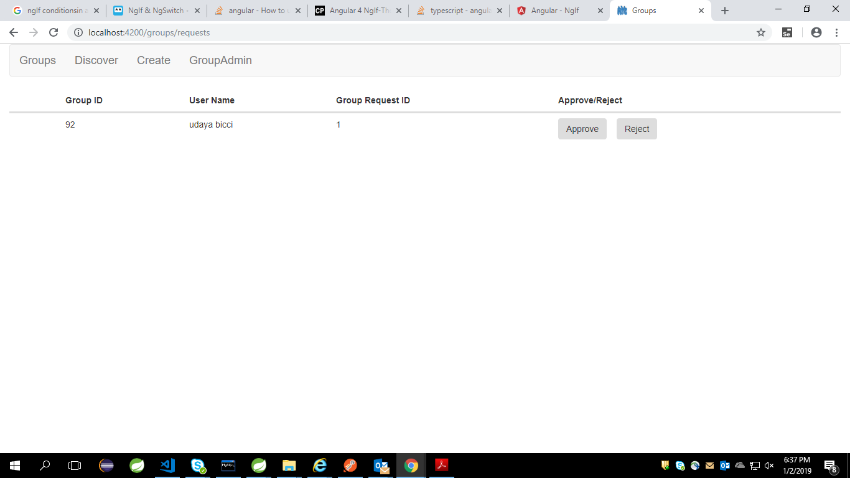
Output-screenshot

Slide 6
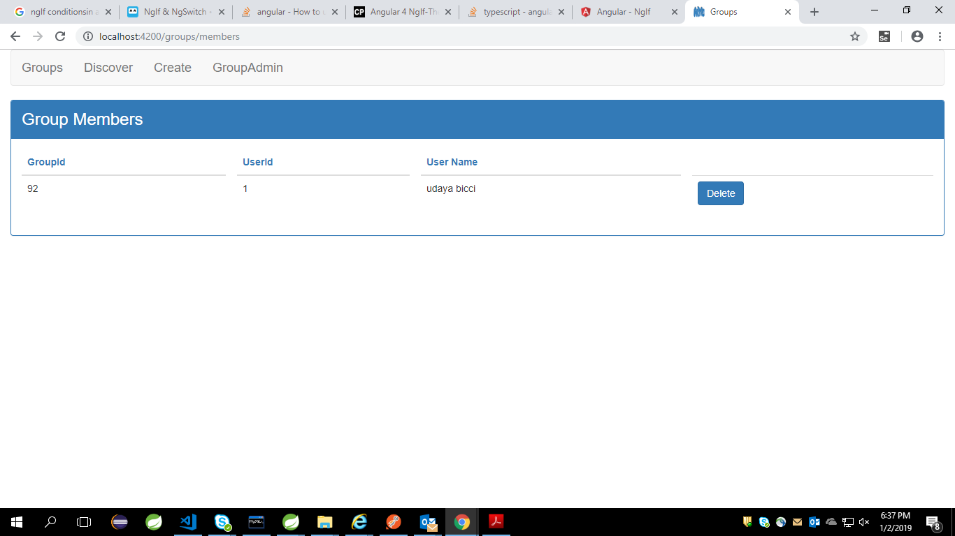

Slide 7
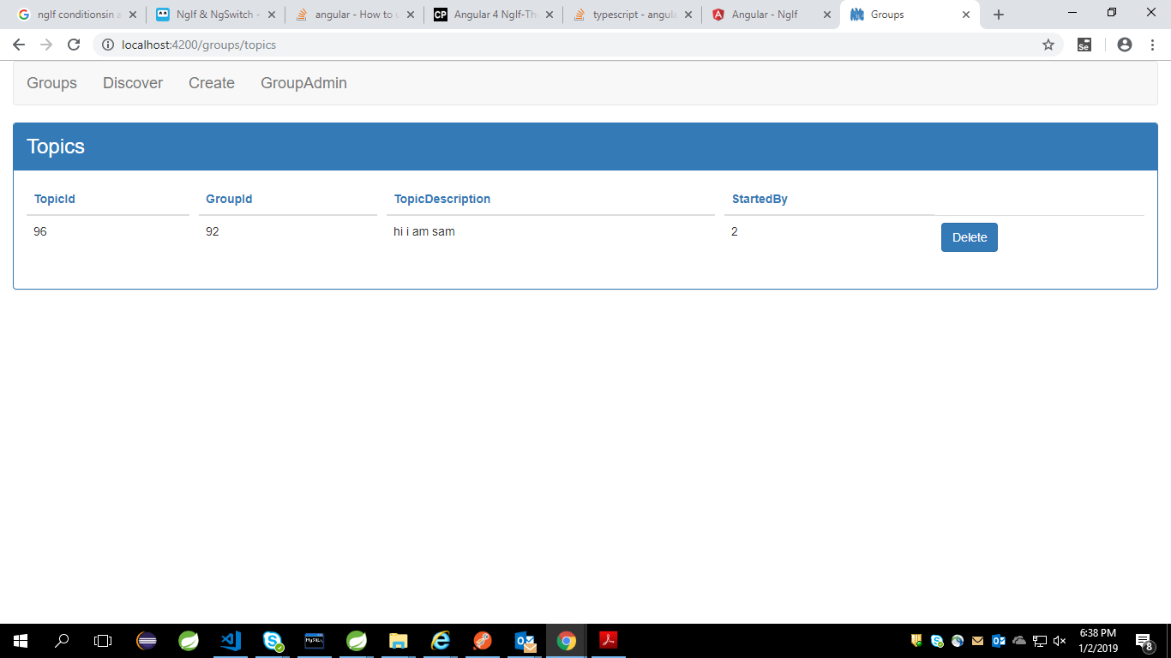

Slide 8
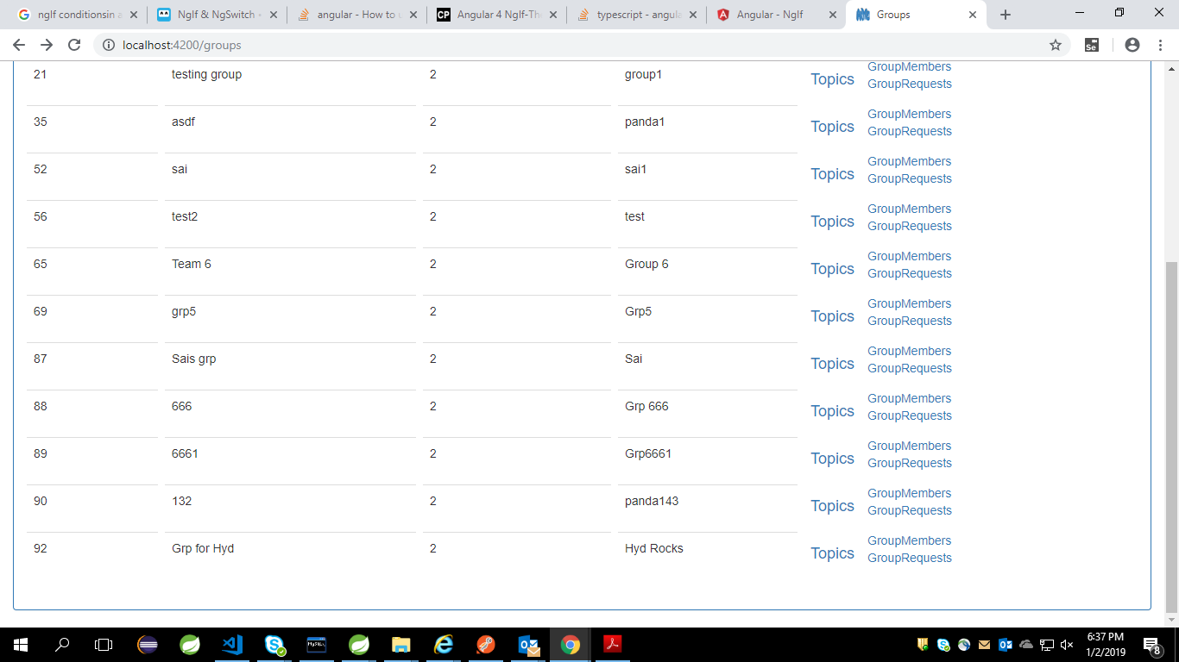

Slide 9
Thank You…

