Slide 1

Java

Slide 2
Introduction to Java
Lineage
History
Pros and Cons
Object Oriented
Platform independent
Multi Threaded
Notes:
1970 and 1980 C
1980 and 1990 C++
1990 and 1995 Java
Java was conceived by James Gosling, Patrick Naughton, Chris Warth, Ed Frank, and Mike
Sheridan at Sun Microsystems, Inc. in 1991.

Slide 3
Introduction to OOPs
Four basic Principles
Encapsulation
Abstraction
Inheritance
Polymorphism

Slide 4
Core Java Basics
Data Types
Type | Size | Range
byte | 8 | -128 to 127
short | 16 | –32,768 to 32,767
int | 32 | –2,147,483,648 to 2,147,483,647
long | 64 | –9,223,372,036,854,775,808 to 9,223,372,036,854,775,807
float | 32 | 1.4e–045 to 3.4e+038
double | 64 | 4.9e–324 to 1.8e+308
char | 16 | To support Unicode character
boolean |  | true or false

Slide 5
Core Java Basics - cont
Operators
Operator | Result
+ | Addition
- | Subtract
* | Multiplication
/ | Division
% | Modulus
++ | Increment
-- | Decrement
Operator | Result
+= | Add and Assign
-= | Subtract and Assign
*= | Multiply and Assign
/= | Divide and Assign
%= | Modulo and Assign

Slide 6
Core Java Basics - Cont
Arrays
Single Dimensional Array
Two Dimensional Array
Multidimensional Array

Slide 7
Core Java Basics - Cont
Control flows
If
If <condition> statement 1 or { set of statements}
&& (and) , || (or)
Nested ifs
If <condition> { if <condition>/Statements { if <condition>/Statements } }
If else if
If <condition> { if <condition>/Statements } else < if <condition>/statements >
Switch
switch <value> case < value match1> statements break; case <value match 2> stmts break; default <default value> break;
Nested switch
Switch <value> case

Slide 8
Core Java Basics - Cont
Iteration
while
While(<condition as a true> { execute set of statements, break, continue}
do-while
do { execute set of statements, break, continue} while<condition>
For
For(assignment; condition; increment/decrement) { set of statements}
for-each
For(datatype <variable> : datatype array) { execution of statement }

Slide 9
Core Java Basics - Cont
Class
What is a Class
It is a blue print of a runtime instance
What is an Object
It is a runtime instance of a class
Constructors(overloading)
Default constructor // a constructor without any arguments
Argument constructor // a constructor with set of arguments
Methods (overloading)
A routine which contains set of statements
Will be called using object reference
Method overloading
this operator – this operator is used to refer current object

Slide 10
Core Java Basics - Cont
Object as parameter and return type
Modifiers
Access Controls
Private
A Class/Variable/Method/Constructor can be accessed with in a class
Default
A Class/Variable/Method/Constructor can be accessed with in package
Protected
A Class/Variable/Method/Constructor can be accessed within sub classes and with in package
Public
A Class/Variable/Method/Constructor can be accessed everywhere
Other Modifiers
static – to define variables and methods at class level
Block level is used to execute a set statement while loading a class into memory
final – To make any variable/Method/Class as immutable
abstract
Method level – Method is not implemented
Class level – It cannot be instantiated

Slide 11
Core Java Basics - Cont
Modifiers
Other Modifiers (continued)

Slide 12
Core Java Basics - Cont
Inheritance
Inheriting properties from one class to another class
Extends is keyword to be used to extend from one class
java.lang.Object class – It is a root class of class heirarchy
Abstract Classes – extends – common behaviour and contract
Class casting – Type casting sub object reference to parent object is called Class casting
Interfaces – implements – enforce contract
Default methods(1.8)
final keyword role in inheritance
Packages – Similarly as folders where classes can be grouped
Inner Classes – it is a nested class can be defined at instance level, class level and method level
Anonymous Inner Classes – A nested class without a name

Slide 13
Core Java Basics - Cont
Java.lang.Object – methods
toString()
wait()
notify()
notifyAll()
equals()

Slide 14
Core Java Basics - Cont
String
StringBuffer
StringBuilder
Wrapper Classes
Integer
Double
Long
Float
Boolean

Slide 15
Core Java Basics - Cont
Exception Handling
Exception/Error is the state occurs during the execution of program which makes the program to stop the current execution and sometime get exited from the whole execution
Java provides the handling of exceptions which occurs by user defined program or by Java.
Java throws exception when java rules are broken or program tries to get executed out of constraints

Slide 16
Core Java Basics - Cont
The syntax of handling exception in program
try{
//execution of statements which can throw exceptions
//conn.close()
}
Catch(exception type1){
//Handle exception type 1
}
Catch(Exception type2){
//Handle exception type2
}
Finally
{
//Handle must tasks.. Like cleaning resource,closing connections, etc..
}

Slide 17
Core Java Basics - Cont
Hierarchy of Exception classes
Throwable
Exception
Error
RuntimeException

Slide 18
Core Java Basics - Cont
Exception Handling
try-catch-finally
throw
throws
Checked Exception
Exception and its subclasses except RuntimeException
Enforced to put it in try catch block or throw them
Unchecked Exception
RuntimeException and its SubClasses
Not enforce to put in try catch block

Slide 19
Core Java Basics - Cont
Multi-Threading – In improved the efficiency of execution
Introduction
Creation of Thread
extends Thread
Implements Runnable
Thread Life cycle
New – Runnable – Running- Blocked/Waiting – Runnable – (execution flow ends) Dead
Thread methods join, yield, sleep, interrupt
Thread synchronization
volatile keyword
wait/notify/notify All

Slide 20
Core Java Basics - Cont
Collections
Array vs Collection
Array is fixed in size(Or you should know size before initializing)
Homogeneous
It does not provide any DS specific method
Collection(I)
Root interface for every collection(Except Map)
Common methods used by List and Set or by any Collection
AbstractCollection is an implementation Collection interface – It implement Collection interface method
List(I)
List can hold duplicate values
Insertion order isreserved - Index
AbstractList extends AbstractCollection and implemennt List interface
Set(I)
Duplicates are not allowed
Insertion order should be preserved
SortedSet
Keep the values in sorted order
NavigableSet
Provides methods to navigate through set

Slide 21
Core Java Basics - Cont
Collections
Queue(I)
If we want to represent FIFO DS we should use Queue collection
Map(I)
If we want to store values in key-value pair then we should go for Map interface classes

Slide 22
Core Java Basics - Cont
Collection Classes
List implementations
ArrayList – Growable array with random access. Suitable for retrieval operations
LinkedList – Growable array with sequential access. Suitable for insertion and removal
Vector – Growable array with random access. It is thread safe DS. Legacy class.
Stack – Growable array with LIFO DS implementation

Slide 23
Core Java Basics - Cont
Collection Classes
Cursors in collection
Cursors are used to retrieve object one after other and also perform CreateReadUpdateDelete operations(not all)
There are three cursors in collection framework
Enumeration – This is legacy cursor, implemented in Vector
Iterator – This same like Enumeration but added in 1.2. It is available in every collection class
ListIterator – This list based iterator. Available only in List interface implementation

Slide 24
Core Java Basics - Cont
Collection Classes
Set implementation classes
Hashset
No Duplicate,Null allowed(only once),No insertion order preserved
Retrieval is based on hashcode
LinkedHashset
No Duplicate,Null allowed(only once), Insertion order preserved
Retrieval is based on hashcode
TreeSet
No duplicate, No Null, Insertion is based on natural sorting order
Any object is getting inserted into TreeSet it has to implement Comparable interface or TreeSet constructor should carry comparator object
Comparator parameter for custom sorting

Slide 25
Core Java Basics - Cont
Collection Classes
Comparator and Comparable
Comparable is an interface needs to be implement by an object which wants to get compared with another object. This way we provide natural comparison of an object
compaterTo(Object) needs to be implemented
Comparator is an interface needs to be implemented to provide custom comparisons of an objects
compare(Object o1, Object o2) needs to be implemented

Slide 26
Core Java Basics - Cont
Collection Classes
Queue
Hold the data in FIFO order manner
PriorityQueue
While inserting it takes natural ordering
BlockingQueue
It is strict bounded queue, when items addition and retrieval waits for items to be added and removed
offer(item, time in milliseconds)
Poll(item, time in milliseconds)
LinkedBlockingQueue -- Optionally bounded , If it implemented based linked list concept it provides additional methods like offerFirst,offerLast,pollFirst,pollLast

Slide 27
Core Java Basics - Cont
Collection Classes
Map
To store key and value pair objects
Key is stored on its hash code so that retrieval can happen fast
No duplicate keys allowed
Put(key,value),get(key)
HashMap vs HashTable(Thread safe, methods are synchronized)
Plain map interface implementation, non-thread safe
WeakHashMap
Weak key references, If keys are not used they will be GCed
IdentityHashMap
Key equality checked by key reference rather key value
ConcurrentHashMap (Threadsafe , block level synchronization)
Thread safe implementation of HashMap

Slide 28
Core Java Basics - Cont
I/O System
I/O system consists of interfaces and classes used for I/O operations
File
Streams
InputStream and OutputStream - mainly for binary data stream
It reads/writes one byte at a time ( 0 – 255 byte)
Readers/Writers
Readers and Writers – mainly for character data stream
It reads/writes one char at a time (0 - 66500)
FileInputStream and FileOutputStream
BufferedInputStream and BufferedOutputStream

Slide 29
Core Java IO Byte Stream Classes
Stream class | Description
BufferedInputStream | Used for Buffered Input Stream.
BufferedOutputStream | Used for Buffered Output Stream.
DataInputStream | Contains method for reading java standard datatype
DataOutputStream | An output stream that contain method for writing java standard data type
FileInputStream | Input stream that reads from a file
FileOutputStream | Output stream that write to a file.
InputStream | Abstract class that describe stream input.
OutputStream | Abstract class that describe stream output.
PrintStream | Output Stream that contain print() and println() method

Slide 30
Core Java IO Character Stream Classes
Stream class | Description
BufferedReader | Handles buffered input stream.
BufferedWriter | Handles buffered output stream.
FileReader | Input stream that reads from file.
FileWriter | Output stream that writes to file.
InputStreamReader | Input stream that translate byte to character
OutputStreamReader | Output stream that translate character to byte.
PrintWriter | Output Stream that contain print() and println() method.
Reader | Abstract class that define character stream input
Writer | Abstract class that define character stream output

Slide 31
Core Java Serialization
What is Serialization?
Object Graph
Transient keyword
Custom Serialization
writeObject
readObject
SerialVersionUID
Externalization
readExternal
writeExternal

Slide 32
Core Java Utils Classes
StringTokenizer
Random
Date
Calendar
Timezone
Locale

Slide 33
Core Java Generics
What is Generic?
Generic Classes
Bounded Generics
Wildcard Generics
Bounded Wildcard Generics
Generic Methods
Generic Constructors
Generic Interfaces

Slide 34
Core Java- Reflection
What is Reflection?
Class
Creation of instance using Class
Constructors
Methods
Accessing Private methods
Use cases – Test execution, Dependency Injection

Slide 35
Advance Java – JDBC API
What is JDBC?
Main Roles
DriverManager
Driver – Main player who provision all requirement to connect and talk to database
Connectivity – JDBC URL :- jdbc:<subprotocol>:<url>:credentials
Connection interface
Statement interface – Normal sql query execution
PreparedStatement - Prepared SQL query execution
CallableStatement – Stored procedure calls
Metadata

Slide 36
Advance Java – J2EE
What is J2EE?
J2EE Architecture
Components
Servlets – Server side script
JSP – Java Server Page
EJB – Enterprise java bean
Services
JDBC, JNDI, JMS, JTA etc
Application Servers – Weblogic, IBM WebSphere, JBoss
Tomcat – Servlet Container

Slide 37
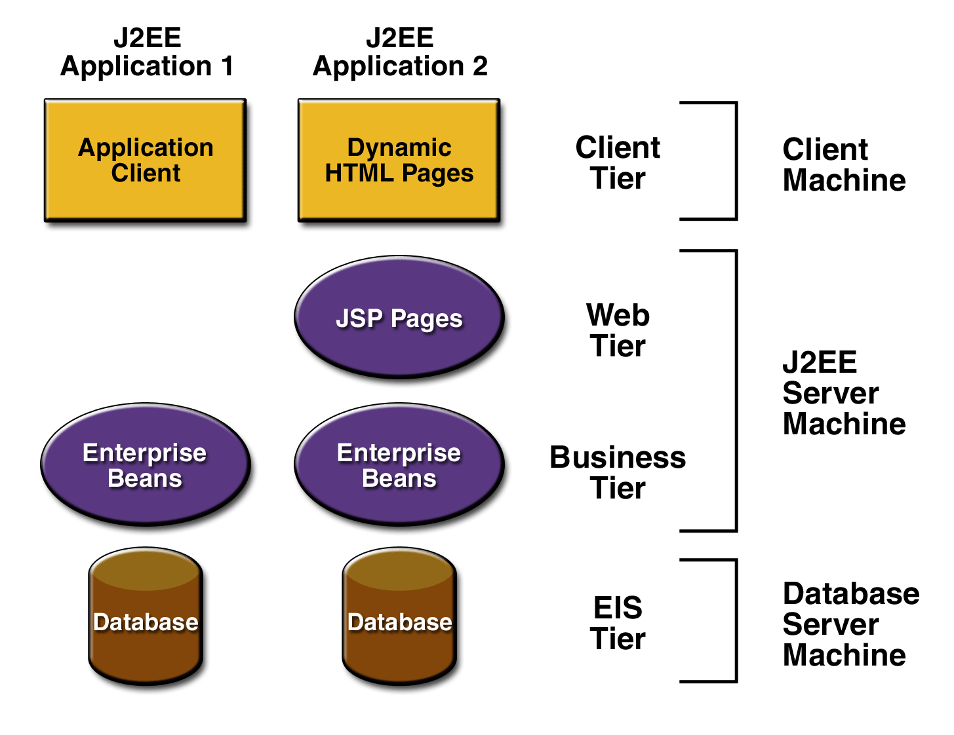
Advance Java – J2EE Architecture
J2EE multi-tiered applications are generally considered to be three-tiered applications because they are distributed over three different locations
client machines
the J2EE server machine
the database or legacy machines at the back end

Slide 38
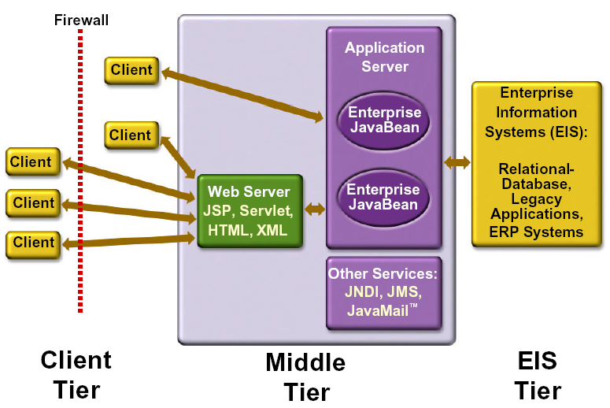
Advance Java – J2EE Architecture
Three-tiered applications that run in this way extend the standard two-tiered client and server model by placing a multithreaded application server between the client application and back-end storage

Slide 39
HTTP/HTTPS
What is HTTP
What is HTTPS – SSL/TLS
HTTP Verbs
GET -
POST -
PUT -
DELETE -
PATCH
TCP/IP
JavaScript/Angular JS
CSS
Apache Web server

Slide 40
Servlets
What is Servlet ? – Its server side script written in java to handle business logic
Life Cycle of Servlet – It is a thread. New(Create an instance of servlet), Instantiate(Pre population),Service(For request servicing), Wait(Goes back to pool), destroy(servlet be deleted).
Servlet – Interface
GenericServlet – Abstract implement
HttpServlet – Abstract implement
UserDefinedServlet – Which extends one the above servlet classes
Deployment Descriptors(web.xml)
Setup
First Servlet
Tomcat – Servlet Container
Deploying first web app

Slide 41
Servlets
Servlet Config – Information shared in a single servlet
Servlet Filters – Filter Chain
Servlet Context – Application Context – Share the information across application
HttpSession – Holds the information at Server
Cookies – Holds the information at client(browser)
Servlet Chaining
Request Dispatcher
Send Redirect
Forward

Slide 42
Advance Java - JSP
What is JSP ? – Scriptlet based page for business logic and presentation logic impl
Life Cycle of JSP
JSP Scriptlet Tag
JSP Expression Tag
JSP Declaration Tag
JSP Implicit Objects
Request -- HttpServletRequest
Response -- HttpServletResponse
Session -- HttpSession
Config -- ServletConfig
Application -- ServletContext
PageContext --
Page – Servlet class level
Error page

Slide 43
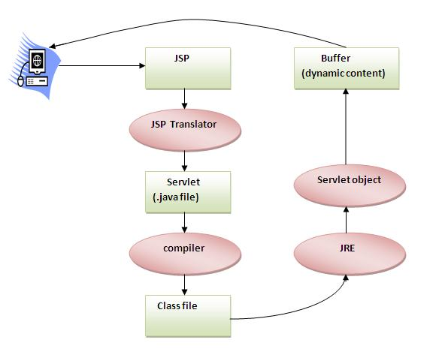
Life cycle of JSP

Slide 44
Advance Java – JSP
JSP Directive
Page
Import
contentType
Errorpage
isErrorPage
isThreadsafe
isELIIgnored
Info
extends
Include
Taglib
JSP Exception – exception implicit object
JSP Action elements
Forward
Include
useBean
Set & Get property
JSP Custom Tags

Slide 45
SOLID – Principles
SOLID principles are the Advanced OOPs principle for designing a robust and extendable object based system
Single Responsibility – An object should and must always implement one responsibility
Open-Closed - Open for extension but closed for modification
Liskov’s Substitute – base class should substitute every sub class
Interface Segregation – Don’t have methods which not needed by all sub classes rather separate the methods in different interfaces
Dependency Invertion – Depend on abstraction not on concretion

Slide 46
Design Patterns
Design pattern is a solution for reoccurring design problem
As per GoF there are three different set of pattern exists
http://www.journaldev.com/1827/java-design-patterns-example-tutorial
Creational Design Patterns
Singleton Pattern -
Factory Pattern - Factory produces all sub classes instance for a super class based on parameters
Abstract Factory Pattern – It is same like factory but it takes another factory as input to generate instances
Builder Pattern --
Prototype Pattern --
Structural Design Patterns
Adapter Pattern -- It becomes mediate between two independent, completely interfaces
Composite Pattern --
Proxy Pattern
Flyweight Pattern
Facade Pattern
Bridge Pattern
Decorator Pattern

Slide 47
Design patterns – Contd..
Behavioral Design Patterns
Template Method Pattern
Mediator Pattern
Chain of Responsibility Pattern
Observer Pattern
Strategy Pattern
Command Pattern
State Pattern
Visitor Pattern
Interpreter Pattern
Iterator Pattern
Memento Pattern

Slide 48
Web services
What is web service ?
What is SOAP
SOAP Message
WSDL
UDDI
What is REST
Resource URI,HTTP Verbs
Relations, Collection URI
Metadata – Content type, Status Code
HATEOAS

