Slide 1

maven In Action
Juven Xu

Slide 2

Juven Xu 许晓斌
www.juvenxu.com
t.sina.com.cn/juvenxu

Slide 3
Agenda
Introduction
Get a general understanding of Maven
Core Concepts
Understand maven coordinate and dependency lifecycle, plugin, and repository.
Core Practices
Be familiar with m2eclipse, understand how to manage tests with Maven, multi-module build (aggregation and inheritance)
Advanced Practices
Understand how to use Maven in web application, how to use Maven to manage project version. how to use Maven profile

Slide 4

Introduction

Slide 5

What is Maven?
Build
Information Aggregation
Rule
Repository
Dependency Management
BIR²D

Slide 6
What is Maven?
Answer 1：build tool
clean
compile
test
report
package
deploy
Ant
TARGET… : PREREQUISITE…
COMMAND
….
…
<?xml version="1.0"?>
<project name="Hello" default="compile">
<target name="compile" description="compile the Java source code to class files">
<mkdir dir="classes"/>
<javac srcdir="." destdir="classes"/>
</target>
<target name="jar" depends="compile" description="create a Jar file ">
<jar destfile="hello.jar">
<fileset dir="classes" includes="**/*.class"/>
<manifest>
<attribute name="Main-Class" value="HelloProgram"/>
</manifest>
</jar>
</target>
</project>
Make
IDE
Shell

Slide 7
Perfect Build
automatic
platform independent
bunch of reusable components
standardized
reproducible

Slide 8


What is Maven?
Answer 2：dependency management tool
log4j:log4j:1.2.15
log4j
org.springframework:spring-core:2.5
spring
org.apache.struts:struts-core:2.1.0
struts
… : … : …
…
…
Central repository

Slide 9
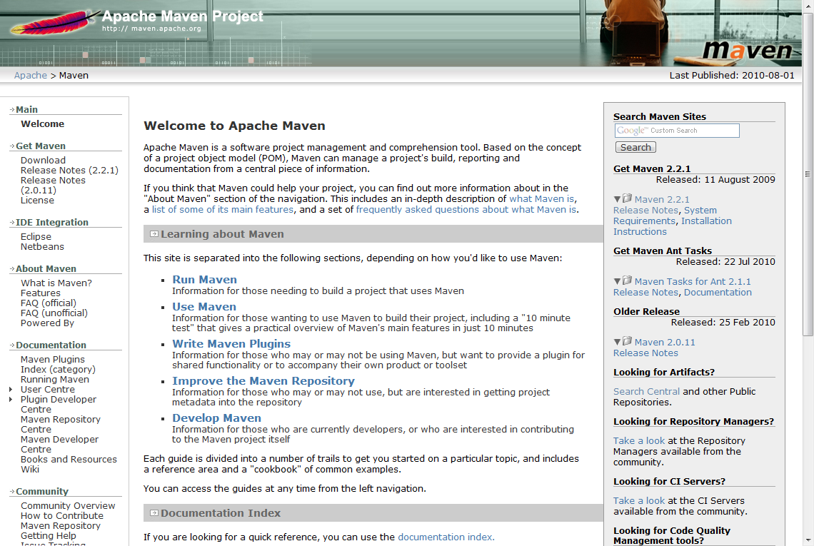
What is Maven?
Answer 3：Information Aggregation

Slide 10

What is Maven?
Answer 4：a set of rules
- pom.xml
- src/main/java
- src/main/resources
- src/test/java
- src/test/resources
- …

Slide 11
What is Maven?
Answer 5：repository
log4j:log4j:1.2.15
org.springframework:spring-core:2.5
org.apache.struts:struts-core:2.1.0
… : … : …

Slide 12
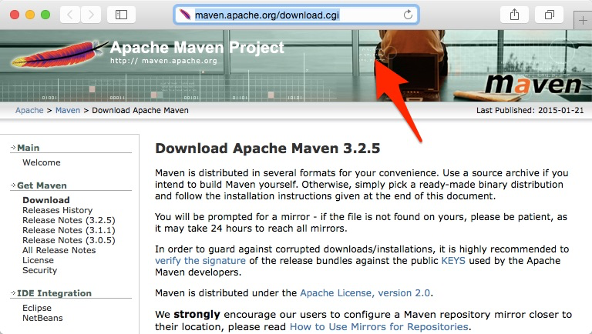
Install Maven

Slide 13
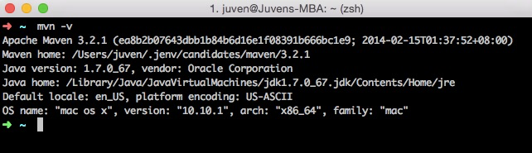
Install Maven
C:\Users\Juven Xu>echo %M2_HOME%
C:\Users\Juven Xu>mvn -v

Slide 14
Maven Install Directory
bin/ running script
boot/ classloader library
conf/ settings.xml
lib/ jar...
~/.m2/repository default local repository

Slide 15
Maven Install
set environment variable
MAVEN_OPTS： -Xms256M -Xmx1024M -XX:MaxPermSize=128m
~/.m2/settings.xml
user scope configuration
easy to future upgrade

Slide 16
Hello World
<?xml version="1.0" encoding="UTF-8"?>
<project xmlns="http://maven.apache.org/POM/4.0.0"
xmlns:xsi="http://www.w3.org/2001/XMLSchema-instance"
xsi:schemaLocation="http://maven.apache.org/POM/4.0.0
http://maven.apache.org/maven-v4_0_0.xsd">
<modelVersion>4.0.0</modelVersion>
<groupId>com.juvenxu.mvnbook</groupId>
<artifactId>hello-world</artifactId>
<version>1.0-SNAPSHOT</version>
<name>Maven Hello World Project</name>
</project>

Slide 17
Hello World
src/main/java/
src/test/java/
<project>
…
<build>
<plugins>
<plugin>
<groupId>org.apache.maven.plugins</groupId>
<artifactId>maven-compiler-plugin</artifactId>
<configuration>
<source>1.6</source>
<target>1.6</target>
</configuration>
</plugin>
</plugins>
</build>
…
</project>
$ mvn clean install

Slide 18
Hello World
mvn archetype:generate
mvn org.apache.maven.plugins:maven-archetype-plugin:2.0:generate

Slide 19

What do you think is the most valuable part of Maven?

Slide 20

Download and install Maven
Apply ~/.m2/settings.xml
Customize your local repository
Create a project

Slide 21
Core
Concepts

Slide 22
Coordinate
groupId - derived from project name, rather than organization name
artifactId - derived from module name, rather than project name
version - project version
packaging - project packaging type, like jar(default)
classifier - additional artifacts, like -javadoc.jar

Slide 23
Coordinate
groupId: com.juvenxu.mvn-training
artifactId mvn-training-ppt (mvn-training-book …)
version 1.0 (2.0，3.0-SNAPSHOT …)
packaging jar (war …)
classifier javadoc, jdk15
com/juvenxu/mvn-training/mvn-training-ppt/1.0/mvn-training-ppt-1.0.jar

Slide 24
Coordinate
<?xml version="1.0" encoding="UTF-8"?>
<project>
<modelVersion>4.0.0</modelVersion>
<groupId>junit</groupId>
<artifactId>junit</artifactId>
<version>4.6</version>
<name>JUnit</name>
<url>http://junit.org</url>
<description>
JUnit is a regression testing framework written by Erich Gamma and Kent Beck. It is used by the developer who implements unit tests in Java.
</description>
<!– other elements…-->
</project>

Slide 25

Snapshot Version
latest state of the project
unstable state of the project

Slide 26
Dependency
<project>
...
<dependencies>
<dependency>
<groupId>log4j</groupId>
<artifactId>log4j</artifactId>
<version>1.2.16</version>
</dependency>
<dependency>
<groupId>junit</groupId>
<artifactId>junit</artifactId>
<version>3.8.1</version>
<scope>test</scope>
</dependency>
<dependency>
<groupId>javax.servlet</groupId>
<artifactId>servlet-api</artifactId>
<version>2.4</version>
<scope>provided</scope>
</dependency>
</dependencies>
...
</project>
Central Repository

Slide 27
Dependency
<project>
...
<dependencies>
<dependency>
<groupId>...</groupId>
<artifactId>...</artifactId>
<version>...</version>
<type>...</type>
<scope>...</scope>
<optional>...</optional>
<exclusions>
<exclusion>
...
</exclusion>
...
</exclusions>
</dependency>
...
</dependencies>
...
</project>
GAV – basic coordinates
type – special type dependency
scope - dependency scope
optional - optional dependency
exclusions - exclude dependency

Slide 28
Dependency Scope
Dependency Scope | Available to main Classpath | Available to test Classpath | Packaged，available to runtime Classpath | Example
compile | Y | Y | Y | log4j
test | - | Y | - | junit
provided | Y | Y | - | servlet-api
runtime | - | - | Y | JDBC Driver Implementation

Slide 29
Dependency Scope
system scope
like provided
explicit path
not recommended
<dependency>
<groupId>javax.sql</groupId>
<artifactId>jdbc-stdext</artifactId>
<version>2.0</version>
<scope>system</scope>
<systemPath>${java.home}/lib/rt.jar</systemPath>
</dependency>

Slide 30
Transitive Dependency
commons-logging
my-app
spring-core
junit
commons-collections
No need to consider what spring-core depends
But when there’s something wrong, you have to figure out what spring-core depends

Slide 31
Dependency Mediation
my-app:1.0-SNAPSHOT
a:3.1.1
c:1.1
d:1.0
b:2.0
d:0.9
Rule 1：Nearest First
Rule 2：If distance is the same, the one who declare first wins

Slide 32
Optional Dependency
X（optional）
A
B
Y（optional）

Slide 33
Optional Dependency
<project>
<modelVersion>4.0.0</modelVersion>
<groupId>com.juvenxu.mvnbook</groupId>
<artifactId>project-a</artifactId>
<version>1.0.0</version>
<dependencies>
<dependency>
<groupId>com.juvenxu.mvnbook</groupId>
<artifactId>project-b</artifactId>
<version>1.0.0</version>
</dependency>
<dependency>
<groupId>mysql</groupId>
<artifactId>mysql-connector-java</artifactId>
<version>5.1.10</version>
</dependency>
</dependencies>
</project>
<project>
<modelVersion>4.0.0</modelVersion>
<groupId>com.juvenxu.mvnbook</groupId>
<artifactId>project-b</artifactId>
<version>1.0.0</version>
<dependencies>
<dependency>
<groupId>mysql</groupId>
<artifactId>mysql-connector-java</artifactId>
<version>5.1.10</version>
<optional>true</optional>
</dependency>
<dependency>
<groupId>postgresql</groupId>
<artifactId>postgresql</artifactId>
<version>8.4-701.jdbc3</version>
<optional>true</optional>
</dependency>
</dependencies>
</project>

Slide 34

Dependency Exclusion
<dependencies>
<dependency>
<groupId>org.hibernate</groupId>
<artifactId>hibernate</artifactId>
<version>3.2.5.ga</version>
<exclusions>
<exclusion>
<groupId>javax.transaction</groupId>
<artifactId>jta</artifactId>
</exclusion>
</exclusions>
</dependency>
<dependency>
<groupId>org.apache.geronimo.specs</groupId>
<artifactId>geronimo-jta_1.1_spec</artifactId>
<version>1.1</version>
</dependency>
</dependencies>

Slide 35
Dependency Grouping
<properties>
<spring.version>2.5</spring.version>
</properties>
...
<dependencies>
<dependency>
<groupId>org.springframework</groupId>
<artifactId>spring-core</artifactId>
<version>${spring.version}</version>
</dependency>
<dependency>
<groupId>org.springframework</groupId>
<artifactId>spring-context</artifactId>
<version>${spring.version}</version>
</dependency>
<dependency>
<groupId>org.springframework</groupId>
<artifactId>spring-aop</artifactId>
<version>${spring.version}</version>
</dependency>
</dependencies>

Slide 36
Dependency Optimization
mvn dependency:analyze
[INFO] [dependency:analyze]
[WARNING] Used undeclared dependencies found:
[WARNING] javax.persistence:persistence-api:jar:1.0:compile
[WARNING] Unused declared dependencies found:
[WARNING] org.hibernate:hibernate-annotations:jar:3.3.0.ga:compile
[WARNING] org.hibernate:hibernate:jar:3.2.5.ga:compile
[WARNING] junit:junit:jar:3.8.1:test
mvn dependency:tree
[INFO] [dependency:tree]
[INFO] org.sonatype.mavenbook.optimize:simple-model:jar:1.0
[INFO] +- org.hibernate:hibernate-annotations:jar:3.3.0.ga:compile
[INFO] | - javax.persistence:persistence-api:jar:1.0:compile
[INFO] +- org.hibernate:hibernate:jar:3.2.5.ga:compile
[INFO] | +- net.sf.ehcache:ehcache:jar:1.2.3:compile
[INFO] | +- commons-logging:commons-logging:jar:1.0.4:compile
[INFO] | +- asm:asm-attrs:jar:1.5.3:compile
[INFO] | +- dom4j:dom4j:jar:1.6.1:compile
[INFO] | +- antlr:antlr:jar:2.7.6:compile
[INFO] | +- cglib:cglib:jar:2.1_3:compile
[INFO] | +- asm:asm:jar:1.5.3:compile
[INFO] | - commons-collections:commons-collections:jar:2.1.1:compile
[INFO] - junit:junit:jar:3.8.1:test

Slide 37
Add junit, log4j, and servlet-api into your project.
Make sure they have the correct scope.
Make sure they are in use with the help of maven-dependency-plugin

Slide 38
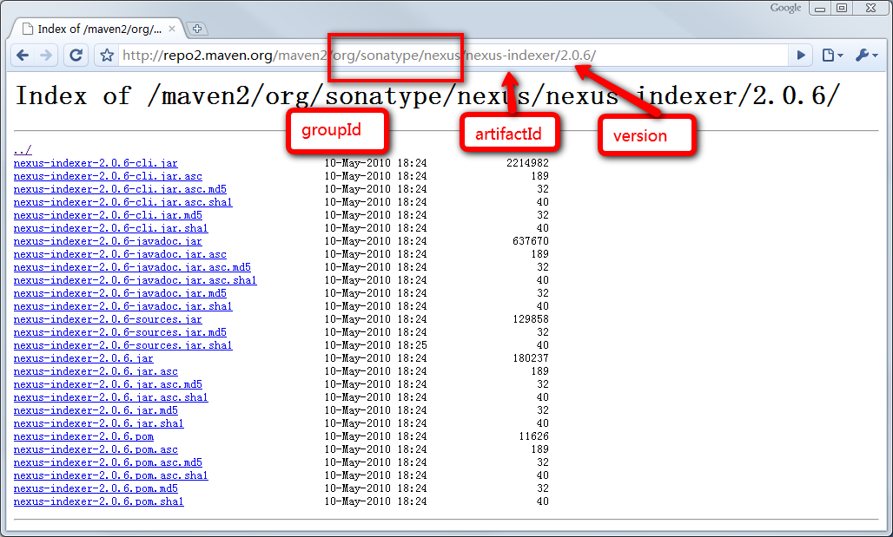
Repository Layout

Slide 39
Repository Types
remote
local
central
remote
http://repo1.maven.org/maven2/
~/.m2/repository
Project A
Project B
Project …
All maven projects use a same local repository by default
Maven downloads artifacts from remote repositories and cache them in local repository
Central repository is the only pre-configured remote repository

Slide 40
Maven Central
03/2003 – 03/2001, 12 billions hits and
03/2003 – 03/2001, 14.3 millions unique IP
01/2009, 60GB
08/2011, 350GB
10/2015, 1,100,00+ artifacts
Java 生态系统的基石

Slide 41
Repository Manager
Save bandwidth
Accelerate build
Deploy artifacts
Save central’s load

Slide 42
Add Remote Repository
<project>
...
<repositories>
<repository>
<id>maven-net-cn</id>
<name>Maven China Mirror</name>
<url>http://maven.net.cn/content/groups/public/</url>
<releases>
<enabled>true</enabled>
</releases>
<snapshots>
<enabled>false</enabled>
</snapshots>
</repository>
</repositories>
<pluginRepositories>
<pluginRepository>
<id>maven-net-cn</id>
<name>Maven China Mirror</name>
<url>http://maven.net.cn/content/groups/public/</url>
<releases>
<enabled>true</enabled>
</releases>
<snapshots>
<enabled>false</enabled>
</snapshots>
</pluginRepository>
</pluginRepositories>
...
</project>
Change local repository
<settings>
...
<localRepository>D:\java\repository</localRepository>
...
</settings>
~/.m2/settings.xml

Slide 43
Deploy Artifacts
Release/Snapshot has different repository url
<!-- in pom.xml -->
<distributionManagement>
<repository>
<id>your-id-releases</id>
<name>Your Staging Repository</name>
<url>http://oss.sonatype.org/service/local/staging/deploy/maven2/</url>
</repository>
<snapshotRepository>
<id>your-id-snapshots</id>
<name>Your Snapshot Repository</name>
<url>http://oss.sonatype.org/content/repositories/your-id-snapshots/</url>
</snapshotRepository>
</distributionManagement>
credential
<!-- in settings.xml -->
<settings>
...
<servers>
...
<server>
<id>your-id-releases</id>
<username>***</username>
<password>***</password>
</server>
<server>
<id>your-id-snapshots</id>
<username>***</username>
<password>***</password>
</server>
</servers>
...
</settings>

Slide 44
Snapshot Version
2.1-SNAPSHOT
2.1-20091214.221414-13
$mvn clean install -U
Update daily by default，-U to force updating
Snapshot is used for artifacts sharing within a team

Slide 45
Mirror
If repository X can provide all the contents of repository Y, then X is a mirror of Y
<settings>
...
<mirrors>
<mirror>
<id>maven.net.cn</id>
<name>one of the central mirrors in China</name>
<url>http://maven.net.cn/content/groups/public/</url>
<mirrorOf>central</mirrorOf>
</mirror>
</mirrors>
...
</settings>
<mirrorOf>*</mirrorOf>：match all remote repositories.
<mirrorOf>external:*</mirrorOf>：match all remote repositories except url with localhost or file:// protocol, in other words, match all repositories which isn’t on this machine.
<mirrorOf>repo1,repo2</mirrorOf>：match repo1 and repo2, use ‘,’ to separate multiple repositories.
<mirrorOf>*,!repo1</mirrorOf>：match all remote repositories except repo1, use ‘!’ to exlude a repository.

Slide 46
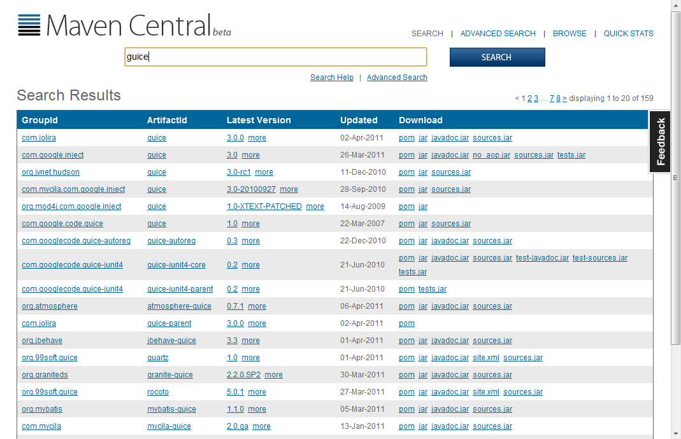
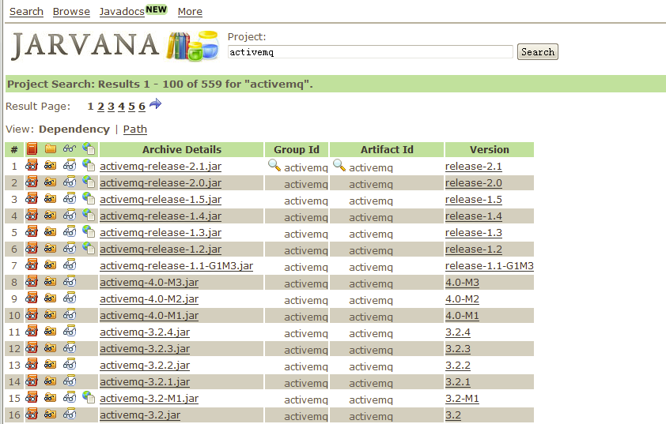
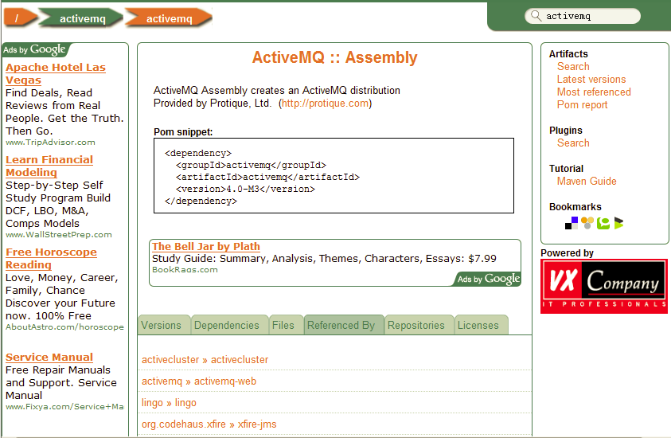
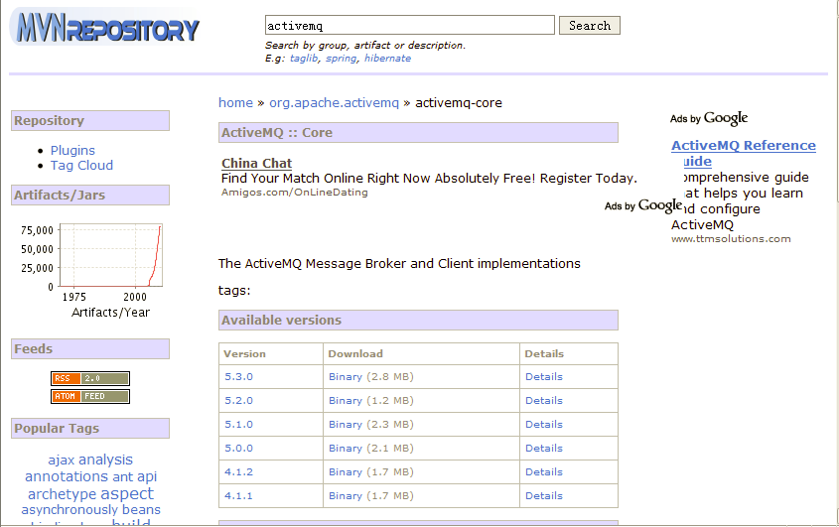
Repository Search Service
http://search.maven.org/
http://www.jarvana.com/jarvana/
http://www.mvnbrowser.com
http://mvnrepository.com/

Slide 47
What should I do when Maven can not find a dependency?

Slide 48


Lifecycle and Plugin
☹ I don’t like the feeling of being empty
☺ Hey buddy, you are not alone, here we come

Slide 49
Lifecycle and Plugin
mvn clean install
pre-clean
clean
post-clean
…
process-resources
compile
…
test
package
install
deploy
pre-site
site
post-site
site-deploy
mvn test
mvn site
3 lifecycles（clean, default, site）are independent
with 1 lifecycle, latter phase depends on former phase
mvn commands matches lifecycle phase

Slide 50

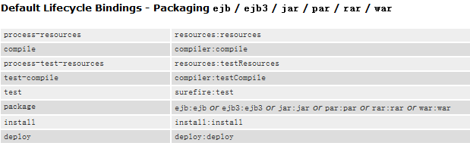
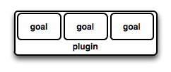

Lifecycle and Plugin
Maven itself is a framework, all tasks are implemented by plugin
Plugin is bound to lifecycle phase, users can specify the phases to run tasks (implicit)
packaging controls the binding between default lifecycle and plugin goal

Slide 51
Lifecycle and Plugin
Default
…
maven-compiler-plugin
compile
compile
…
…
…

Slide 52
Plugin, internal binding
Lifecycle phase | Plugin goal | task
process-resources | maven-resources-plugin:resources | Copy main resource files to output dir
compile | maven-compiler-plugin:compile | Compile main java code to output dir
process-test-resources | maven-resources-plugin:testResources | Copy test resource file to test output dir
test-compile | maven-compiler-plugin:testCompile | Compile test java code to test output dir
test | maven-surefire-plugin:test | Runt tests
package | maven-jar-plugin:jar | Package the jar file
install | maven-install-plugin:install | Install project output artifacts to local repo
deploy | maven-deploy-plugin:deploy | Deploy project output artifacts to remote repo

Slide 53
Plugin，Customized Binding
<build>
<plugins>
<plugin>
<groupId>org.apache.maven.plugins</groupId>
<artifactId>maven-source-plugin</artifactId>
<version>2.1.1</version>
<executions>
<execution>
<id>attach-sources</id>
<phase>verify</phase>
<goals>
<goal>jar-no-fork</goal>
</goals>
</execution>
</executions>
</plugin>
</plugins>
</build>

Slide 54
Plugin Configuration
Command line： $ mvn help:describe -Dcmd=compiler:compile
Plugin global：
Plugin task:
<plugin>
<groupId>org.apache.maven.plugins</groupId>
<artifactId>maven-compiler-plugin</artifactId>
<configuration>
<source>1.5</source>
<target>1.5</target>
</configuration>
</plugin>
<plugin>
<artifactId>maven-antrun-plugin</artifactId>
<executions>
<execution>
<phase>validate</phase>
<goals>
<goal>run</goal>
</goals>
<configuration>
<tasks>
<echo>Hi, Ant Run!</echo>
</tasks>
</configuration>
</execution>
</executions>
</plugin>

Slide 55
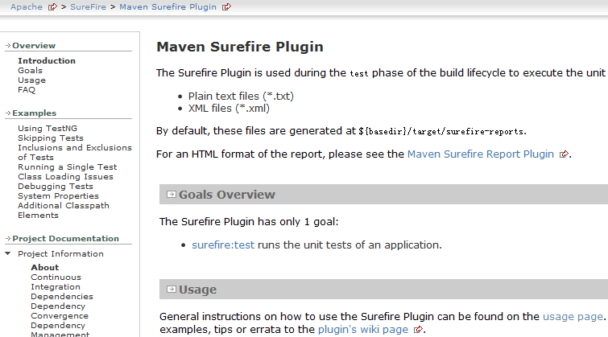
Get Plugin Info
http://maven.apache.org/plugins/index.html
http://mojo.codehaus.org/plugins.html

Slide 56
Get Plugin Info
$ mvn help:describe -Dplugin=org.apache.maven.plugins:maven-compiler-plugin:2.1
Name: Maven Compiler Plugin
Description: The Compiler Plugin is used to compile the sources of your
project.
Group Id: org.apache.maven.plugins
Artifact Id: maven-compiler-plugin
Version: 2.1
Goal Prefix: compiler
This plugin has 3 goals:
compiler:compile
Description: Compiles application sources
compiler:help
Description: Display help information on maven-compiler-plugin.
Call
mvn compiler:help -Ddetail=true -Dgoal=<goal-name>
to display parameter details.
compiler:testCompile
Description: Compiles application test sources.
For more information, run 'mvn help:describe [...] -Ddetail'

Slide 57
Get Plugin Info
$ mvn help:describe -Dplugin=org.apache.maven.plugins:maven-compiler-plugin:2.1
$ mvn help:describe -Dplugin=org.apache.maven.plugins:maven-compiler-plugin
$ mvn help:describe –Dplugin=compiler
$ mvn help:describe –Dplugin=compiler –Dgoal=compile
$ mvn help:describe –Dplugin=compiler -Ddetail

Slide 58
Plugin Resolution
Plugins come from <pluginRepositories>
Without groupId，use org.apache.maven.plugins by default
Plugin Version
Core plugin version are specified in super POM
If not specified, Maven 2 resolve the latest version (including SNAPSHOT)
If not specified, Maven 3 resolve the latest release version.
Plugin Prefix: maven-compiler-plugin -> compiler

Slide 59
Plugin Prefix
/org/apache/maven/plugins/maven-metadata.xml
/org/codehaus/mojo/maven-metadata.xml
<metadata>
<plugins>
<plugin>
<name>Maven Clean Plugin</name>
<prefix>clean</prefix>
<artifactId>maven-clean-plugin</artifactId>
</plugin>
<plugin>
<name>Maven Compiler Plugin</name>
<prefix>compiler</prefix>
<artifactId>maven-compiler-plugin</artifactId>
</plugin>
<plugin>
<name>Maven Dependency Plugin</name>
<prefix>dependency</prefix>
<artifactId>maven-dependency-plugin</artifactId>
</plugin>
</plugins>
</metadata>
Configure settings.xml to check metadata from other groupId
<settings>
<pluginGroups>
<pluginGroup>com.your.plugins</pluginGroup>
</pluginGroups>
</settings>

Slide 60
What do you think is the most useful plugin?

Slide 61
Build sources.jar for your project.
Print console messages before and after compilation.

Slide 62
Parallel Build
20%-50% speed improvement
mvn -T 4 clean install # Builds with 4 threads
mvn -T 1C clean install # 1 thread per cpu core
mvn -T 1.5C clean install # 1.5 thread per cpu core

Slide 63
Core
Practices

Slide 64
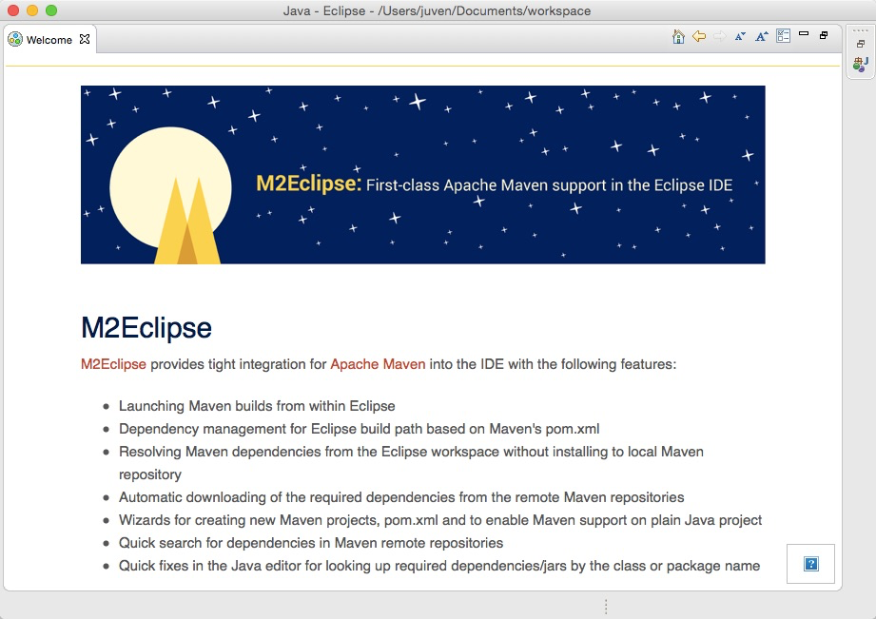
m2eclipse

Slide 65
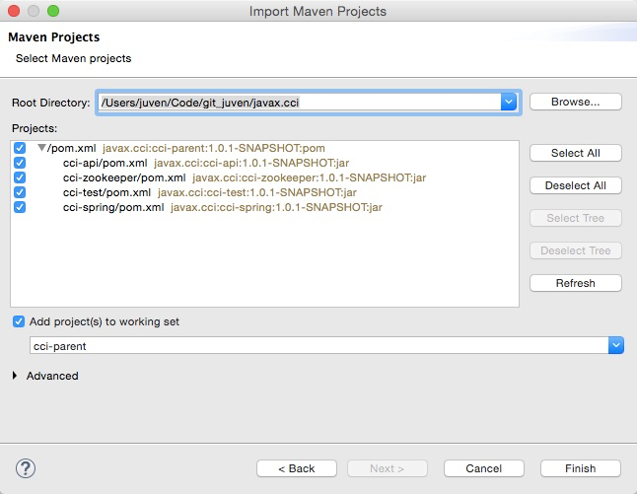
m2eclipse - Import

Slide 66
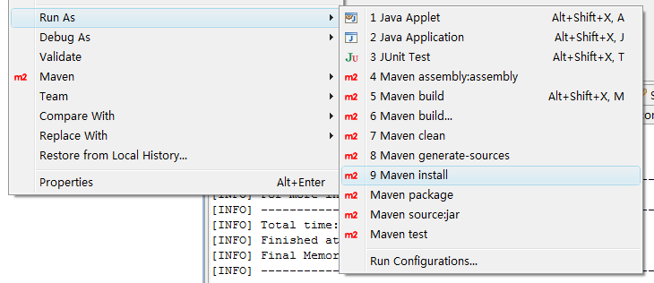
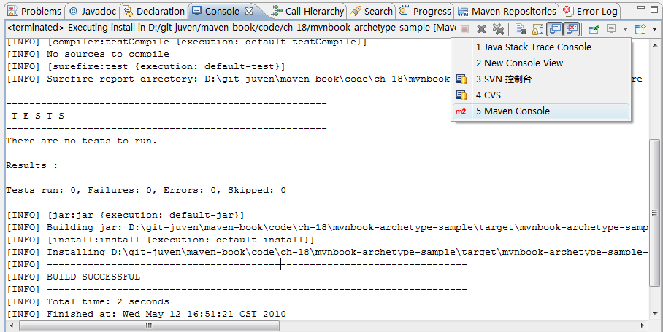
m2eclipse

Slide 67
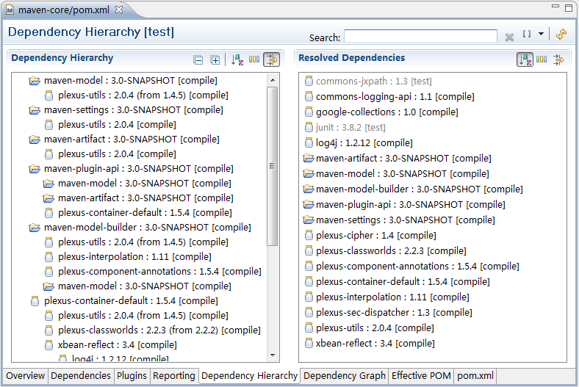
m2eclipse

Slide 68
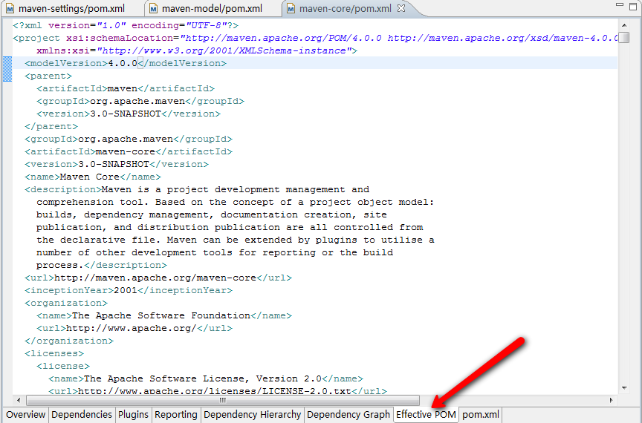
m2eclipse

Slide 69
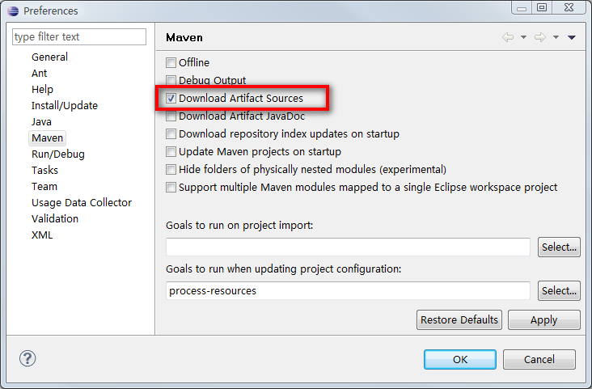
m2eclipse

Slide 70
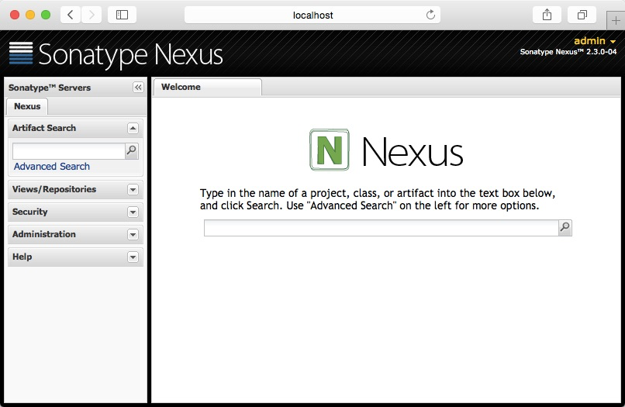
Nexus

Slide 71
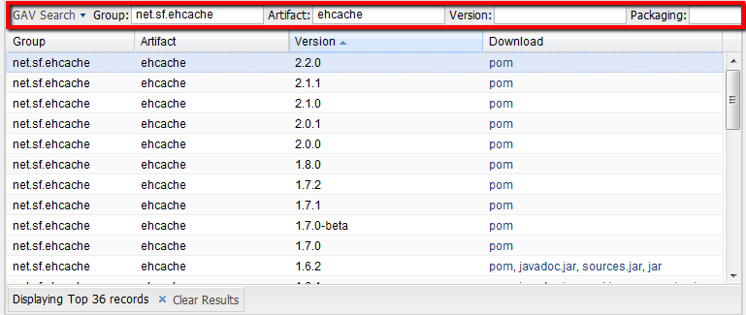
Nexus Search
Simple Search
By GAV
By sha1sum
By classname

Slide 72
Use Nexus Only
<settings>
...
<mirrors>
<mirror>
<id>nexus</id>
<mirrorOf>*</mirrorOf>
<url>http://localhost:8081/nexus/content/groups/public</url>
</mirror>
</mirrors>
<profiles>
<profile>
<id>nexus</id>
<repositories>
<repository>
<id>central</id>
<url>http://central</url>
<releases><enabled>true</enabled></releases>
<snapshots><enabled>true</enabled></snapshots>
</repository>
</repositories>
<pluginRepositories>
<pluginRepository>
<id>central</id>
<url>http://central</url>
<releases><enabled>true</enabled></releases>
<snapshots><enabled>true</enabled></snapshots>
</pluginRepository>
</pluginRepositories>
</profile>
</profiles>
<activeProfiles>
<activeProfile>nexus</activeProfile>
</activeProfiles>
...
</settings>

Slide 73
Deploy to Nexus
<project>
...
<distributionManagement>
<repository>
<id>nexus-releases</id>
<name>Nexus Releases Repository</name>
<url>http://localhost:8081/nexus/content/repositories/releases/</url>
</repository>
<snapshotRepository>
<id>nexus-snapshots</id>
<name>Nexus Snapshots Repository</name>
<url>http://localhost:8081/nexus/content/repositories/snapshots/</url>
</snapshotRepository>
</distributionManagement>
...
</project>
<settings>
...
<servers>
<server>
<id>nexus-releases</id>
<username>admin</username>
<password>*****</password>
</server>
<server>
<id>nexus-snapshots</id>
<username>admin</username>
<password>*****</password>
</server>
</servers>
...
</settings>

Slide 74
Advanced
Practices

Slide 75
Aggregation & Inheritance
aggregation
inheritance
<modules>
<module>module-a</module>
<module>module-b</module>
<module>module-c</module>
</modules>
<parent>
<groupId>com.juvenxu.training</groupId>
<artifactId>training-parent</artifactId>
<version>1.0</version>
</parent>

Slide 76
Aggregation
Aggregate build，so when Maven build the aggregation module, it also build sub modules.
packaging of the aggregation module must be POM
<groupId>..
<artifactId>…
<version>…
<packaging>pom</packaging>
<modules>
<module>module-a</module>
<module>module-b</module>
<module>../module-o</module>
</modules>
Relative path，
Don’t have to be parent-child

Slide 77
Inheritance
Super POM
Project Foo Parent
Project Foo Module A
Project Foo Module B
Project Bar Parent
Project Bar Module A
Reuse configuration
Directory layout don’t have to be parent-child
implicit
<parent>
<groupId>com.juvenxu.training</groupId>
<artifactId>training-parent</artifactId>
<version>1.0</version>
<relativePath>../training-parent/pom.xml</relativePath>
</parent>
explicit

Slide 78
Dependency Management
Parent POM
<project>
<modelVersion>4.0.0</modelVersion>
<parent>
<groupId>com.juvenxu.training</groupId>
<artifactId>training-parent</artifactId>
<version>1.0.0</version>
</parent>
<artifactId>training-ppt</artifactId>
<dependencies>
<dependency>
<groupId>mysql</groupId>
<artifactId>mysql-connector-java</artifactId>
</dependency>
</dependencies>
</project>
<project>
<modelVersion>4.0.0</modelVersion>
<groupId>com.juvenxu.training</groupId>
<artifactId>training-parent</artifactId>
<version>1.0.0</version>
...
<dependencyManagement>
<dependencies>
<dependency>
<groupId>mysql</groupId>
<artifactId>mysql-connector-java</artifactId>
<version>5.1.6</version>
</dependency>
</dependencies>
</dependencyManagement>
...
</project>
Child POM
training-doc
training-ppt

Slide 79
Dependency Management
V.S.
Dependency
<dependencyManagement> will never take effect unless this is a <dependencies>
<dependencies> always takes effect
both can be inherited

Slide 80
Plugin Management
Child POM
Parent POM
<build>
<plugins>
<plugin>
<groupId>org.apache.maven.plugins</groupId>
<artifactId>maven-source-plugin</artifactId>
</plugin>
</plugins>
</build>
<build>
<pluginManagement>
<plugins>
<plugin>
<groupId>org.apache.maven.plugins</groupId>
<artifactId>maven-source-plugin</artifactId>
<version>2.1.1</version>
<executions>
<execution>
<id>attach-sources</id>
<phase>verify</phase>
<goals>
<goal>jar-no-fork</goal>
</goals>
</execution>
</executions>
</plugin>
</plugins>
</pluginManagement>
</build>
training-doc
training-ppt

Slide 81
Import Scope
sometimes the dependencyManagement in parent POM is too long, then we can create a special POM for dependencyManagement and import it.
<project>
<modelVersion>4.0.0</modelVersion>
<groupId>com.juvenxu.sample</groupId>
<artifactId>sample-dependency-infrastructure</artifactId>
<packaging>pom</packaging>
<version>1.0-SNAPSHOT</version>
<dependencyManagement>
<dependencies>
<dependency>
<groupId>junit</groupId>
<artifactid>junit</artifactId>
<version>4.8.2</version>
<scope>test</scope>
</dependency>
<dependency>
<groupId>log4j</groupId>
<artifactid>log4j</artifactId>
<version>1.2.16</version>
</dependency>
</dependencies>
</dependencyManagement>
</project>
<dependencyManagement>
<dependencies>
<dependency>
<groupId>com.juvenxu.sample</groupId>
<artifactid>sample-dependency-infrastructure</artifactId>
<version>1.0-SNAPSHOT</version>
<type>pom</type>
<scope>import</scope>
</dependency>
</dependencies>
</dependencyManagement>
<dependency>
<groupId>junit</groupId>
<artifactid>junit</artifactId>
</dependency>
<dependency>
<groupId>log4j</groupId>
<artifactid>log4j</artifactId>
</dependency>

Slide 82
Super POM
Maven 3：$MAVEN_HOME/lib/maven-model-builder-x.x.x.jar —— org/apache/maven/model/pom-4.0.0.xml
Maven 2：$MAVEN_HOME/lib/maven-x.x.x-uber.jar —— org/apache/maven/project/pom-4.0.0.xml
<build>
<directory>${project.basedir}/target</directory>
<outputDirectory>${project.build.directory}/classes</outputDirectory>
<finalName>${project.artifactId}-${project.version}</finalName>
<testOutputDirectory>${project.build.directory}/test-classes</testOutputDirectory>
<sourceDirectory>${project.basedir}/src/main/java</sourceDirectory>
<!-- TODO: MNG-3731 maven-plugin-tools-api < 2.4.4 expect this to be relative... -->
<scriptSourceDirectory>src/main/scripts</scriptSourceDirectory>
<testSourceDirectory>${project.basedir}/src/test/java</testSourceDirectory>
<resources>
<resource>
<directory>${project.basedir}/src/main/resources</directory>
</resource>
</resources>
<testResources>
<testResource>
<directory>${project.basedir}/src/test/resources</directory>
</testResource>
</testResources>

Slide 83
Super POM
<pluginManagement>
<plugins>
<plugin>
<artifactId>maven-antrun-plugin</artifactId>
<version>1.3</version>
</plugin>
<plugin>
<artifactId>maven-assembly-plugin</artifactId>
<version>2.2-beta-2</version>
</plugin>
<plugin>
<artifactId>maven-clean-plugin</artifactId>
<version>2.2</version>
</plugin>
<plugin>
<artifactId>maven-compiler-plugin</artifactId>
<version>2.0.2</version>
</plugin>
<plugin>
<artifactId>maven-dependency-plugin</artifactId>
<version>2.0</version>
</plugin>
<plugin>
<artifactId>maven-deploy-plugin</artifactId>
<version>2.4</version>
</plugin>
…
…
</pluginManagement>
</build>
<repositories>
<repository>
<id>central</id>
<name>Maven Repository Switchboard</name>
<layout>default</layout>
<url>http://repo1.maven.org/maven2</url>
<snapshots>
<enabled>false</enabled>
</snapshots>
</repository>
</repositories>

Slide 84
Convention Over Configuration
<project name="my-project" default="dist" basedir=".">
<description>
simple example build file
</description>
<property name="src" location="src/main/java"/>
<property name="build" location="target/classes"/>
<property name="dist" location="target"/>
<target name="init">
<tstamp/>
<mkdir dir="${build}"/>
</target>
<target name="compile" depends="init"
description="compile the source " >
<javac srcdir="${src}" destdir="${build}"/>
</target>
<target name="dist" depends="compile"
description="generate the distribution" >
<mkdir dir="${dist}/lib"/>
<jar jarfile="${dist}/lib/MyProject-${DSTAMP}.jar" basedir="${build}"/>
</target>
<target name="clean"
description=“clean up” >
<delete dir="${build}"/>
<delete dir="${dist}"/>
</target>
</project>
<project>
<modelVersion>4.0.0</modelVersion>
<groupId>com.juvenxu.mvnbook</groupId>
<artifactId>my-project</artifactId>
<version>1.0</version>
</project>

Slide 85
Organization POM
Maintain a company POM, all projects’ POM inherit from it
Consolidate plugin version
Consolidate plugin configuration，(like maven-compiler-plugin java 1.5)
distributionManagement URL（with Nexus）

Slide 86
Reactor
[INFO] ------------------------------------------------------------------------
[INFO] Reactor Build Order:
[INFO]
[INFO] Account Aggregator
[INFO] Account Parent
[INFO] Account Email
[INFO] Account Persist
[INFO]
[INFO] ------------------------------------------------------------------------
………….
………….
account-aggregator
account-email
account-persist
account-parent

Slide 87

Reactor
In a multi module Maven project，Reactor is a build structure composed by all the modules, it manages all the dependency and inheritance relationship among modules, and calculate a reasonable build order.
Cut Reactor
-am, --also-make :also build its dependencies
-amd, -- also-make-dependents :also build its dependents
-pl, --projects <arg> :specify what to build, use comma to separate
-rf , --resume-from <arg> :resume the reactor from the specified module

Slide 88
Add a new module to your project
Add a parent/aggregation module
Apply dependencyManagement

Slide 89
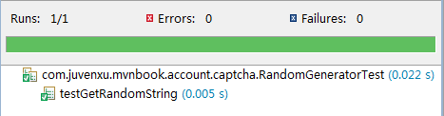
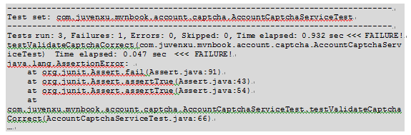
Testing
the ‘test’ goal of maven-surefire-plugin is bound to ‘test’ phase of default lifecycle
target/surefire-reports
execuated by default
**/Test*.java
**/*Test.java
**/*TestCase.java

Slide 90
Skip Test
$ mvn package –DskipTests
$ mvn package –Dmaven.test.skip=true
<plugin>
<groupId>org.apache.maven.plugins</groupId>
<artifactId>maven-surefire-plugin</artifactId>
<version>2.5</version>
<configuration>
<skipTests>true</skipTests>
</configuration>
</plugin>
<plugin>
<groupId>org.apache.maven.plugins</groupId>
<artifactId>maven-compiler-plugin</artifactId>
<version>2.1</version>
<configuration>
<skip>true</skip>
</configuration>
</plugin>
<plugin>
<groupId>org.apache.maven.plugins</groupId>
<artifactId>maven-surefire-plugin</artifactId>
<version>2.5</version>
<configuration>
<skip>true</skip>
</configuration>
</plugin>

Slide 91
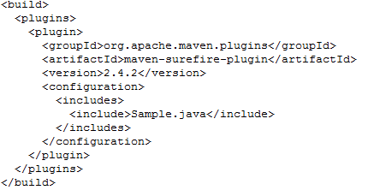
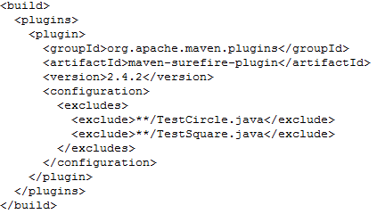
Test
Include and Exclude test
specify tests at runtime
mvn test -Dtest=SquareTest
mvn test -Dtest=List*Test
mvn test -Dtest=SquareTest,List*Test
mvn test -Dtest=MyClass#myMethod (from 2.8)

Slide 92
TestNG
1
<dependency>
<groupId>org.testng</groupId>
<artifactId>testng</artifactId>
<version>5.9</version>
<scope>test</scope>
<classifier>jdk15</classifier>
</dependency>
<?xml version="1.0" encoding="UTF-8"?>
<suite name="Suite1" verbose="1">
<test name="Regression1">
<classes>
<class name="com.juvenxu.mvnbook.account.captcha.RandomGeneratorTest" />
</classes>
</test>
</suite>
2
<plugin>
<groupId>org.apache.maven.plugins</groupId>
<artifactId>maven-surefire-plugin</artifactId>
<version>2.5</version>
<configuration>
<suiteXmlFiles>
<suiteXmlFile>testng.xml</suiteXmlFile>
</suiteXmlFiles>
</configuration>
</plugin>
3
<plugin>
<groupId>org.apache.maven.plugins</groupId>
<artifactId>maven-surefire-plugin</artifactId>
<version>2.5</version>
<configuration>
<groups>util,medium</groups>
</configuration>
</plugin>
@Test( groups = { "util", "medium" } )

Slide 93
Reuse test code
Test code won’t be packaged by default
Build the test.jar
dependency
<plugin>
<groupId>org.apache.maven.plugins</groupId>
<artifactId>maven-jar-plugin</artifactId>
<version>2.2</version>
<executions>
<execution>
<goals>
<goal>test-jar</goal>
</goals>
</execution>
</executions>
</plugin>
<dependencies>
<dependency>
<groupId>com.myco.app</groupId>
<artifactId>foo</artifactId>
<version>1.0-SNAPSHOT</version>
<type>test-jar</type>
<scope>test</scope>
</dependency>
</dependencies>

Slide 94
Do you often skip tests？
why？

Slide 95
Web Application
<packaging>war</packaging>
+ project
|
+ pom.xml
|
+ src/
+ main/
| + java/
| | + ServletA.java
| | + ...
| |
| + resources/
| | + config.properties
| | + ...
| |
| + webapp/
| + WEB-INF/
| | + web.xml
| |
| + img/
| |
| + css/
| |
| + js/
| +
| + index.html
| + sample.jsp
|
+ test/
+ java/
+ resources/
- war/
+ META-INF/
+ WEB-INF/
| + classes/
| | + ServletA.class
| | + config.properties
| | + ...
| |
| + lib/
| | + dom4j-1.4.1.jar
| | + mail-1.4.1.jar
| | + ...
| |
| + web.xml
|
+ img/
|
+ css/
|
+ js/
|
+ index.html
+ sample.jsp

Slide 96
jetty-maven-plugin
<plugin>
<groupId>org.mortbay.jetty</groupId>
<artifactId>jetty-maven-plugin</artifactId>
<version>7.1.6.v20100715</version>
<configuration>
<scanIntervalSeconds>10</scanIntervalSeconds>
<webAppConfig>
<contextPath>/test</contextPath>
</webAppConfig>
</configuration>
</plugin>
1
$ mvn jetty:run
$ mvn jetty:run -Djetty.port=9999
3
<settings>
<pluginGroups>
<pluginGroup>org.mortbay.jetty</pluginGroup>
</pluginGroups>
…
</settings>
2
http://wiki.eclipse.org/Jetty/Feature/Jetty_Maven_Plugin

Slide 97
Do you heavily rely on hot deploy?

Slide 98
Version Number
1.3.4-beta-2 <main>.<minor>.<incremental>-<qualifier>
1.0.0-SNAPSHOT & 1.4.1-20091030-124744-108
Unstable version, in development
Handy for get the latest status from other module
Auto update: daily; Force update： -U
Principal：Don’t depends on any external SNAPSHOT
Main release
Minor release
Bug fix
Milestone, alpha, beta…

Slide 99
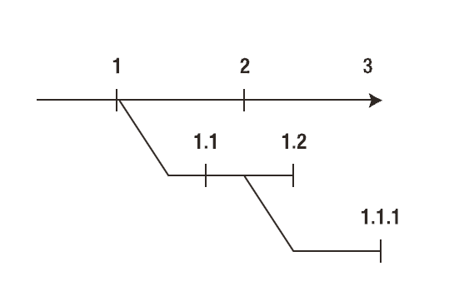
Version Number
from ‘Practical API Design’ by Jaroslav Tulach

Slide 100
Trunk、Tag、Branch
Trunk：main body of development, always in an active state from project start, where you can get the latest source code and almost all the history.
Branch：a copy of code derived from a certain point in the trunk that is used for applying major changes to the code (bug fix, experiment etc.) while preserving the integrity of the code in the trunk. If the major changes work according to plan, they are usually merged back into the trunk.
Tag：a point in time on the trunk or a branch that you wish to preserve, usually it’s a stable state, like release of the software.

Slide 101
Release a Version
All tests must pass
No SNAPSHOT dependency
No SNAPSHOT plugin
All code is committed to SCM

Slide 102
Release a Version
tag
1.1.1
branch
1.1.1-SNAPSHOT
tag
1.1.0
merge
tag
1.2.0
tag
1.0.0
trunk
1.0.0-SNAPSHOT
1.1.0-SNAPSHOT
1.2.0-SNAPSHOT
1.3.0-SNAPSHOT

Slide 103
maven-release-plugin
How to release a version？
(trunk) 1.0-SNAPSHOT -> 1.0
tag 1.0
(trunk) 1.0 -> 1.1-SNAPSHOT
Checkout 1.0, build and deploy it to repository
1
4
<scm>
<connection>scm:svn:http://localhost/svn/myapp/trunk/</connection>
<developerConnection>scm:svn:https://localhost/svn/myapp/trunk/</developerConnection>
</scm>
mvn release:prepare
5
2
mvn release:perform
<distributionManagement>…
3
<plugin>
<groupId>org.apache.maven.plugins</groupId>
<artifactId>maven-release-plugin</artifactId>
<version>2.0</version>
<configuration>
<tagBase>https://localhost/svn/myapp/tags/</tagBase>
</configuration>
</plugin>

Slide 104
maven-release-plugin
How to create a branch
(trunk) 1.1.0-SNAPSHOT -> 1.1.1-SNAPSHOT
branch 1.1.1-SNAPSHOT
(trunk) 1.1.1-SNAPSHOT-> 1.1.0-SNAPSHOT
3
<plugin>
<groupId>org.apache.maven.plugins</groupId>
<artifactId>maven-release-plugin</artifactId>
<version>2.0</version>
<configuration>
<tagBase>https://192.168.1.103/app/tags/</tagBase>
<branchBase>https://192.168.1.103/app/branches/</branchBase>
</configuration>
</plugin>
4
$ mvn release:branch -DbranchName=1.1.x \
-DupdateBranchVersions=true -DupdateWorkingCopyVersions=false

Slide 105
Release your project with maven-release-plugin

Slide 106
versions-maven-plugin
update versions for all modules with one command
$ mvn versions:set -DnewVersion=1.1-SNAPSHOT
list dependency updates
$ mvn versions:display-dependency-updates
commit or revert change
$ mvn versions:commit $ mvn versions:revert
http://mojo.codehaus.org/versions-maven-plugin/

Slide 107
Maven Properties
Internal Properties. eg: ${basedir}, ${version}
POM. eg: ${project.version}
Settings. eg: ${settings. localRepository}
System Properties.
Java Internal: ${user.home}
Pass in from mvn cmd：mvn test -Dmaven.test.skip=true ${maven.test.skip}
Environment Variable. eg: ${env.M2_HOME}
User Defined：
<properties>
<spring.version>2.5</spring.version>
<struts.version>2.0</struts.version>
</properties>
…
${spring.version}
….

Slide 108
properties-maven-plugin
<project>
<build>
<plugins>
<plugin>
<groupId>org.codehaus.mojo</groupId>
<artifactId>maven-properties-plugin</artifactId>
<version>1.0-alpha-2</version>
<executions>
<execution>
<phase>initialize</phase>
<goals>
<goal>read-project-properties</goal>
</goals>
<configuration>
<files>
<file>etc/config/dev.properties</file>
</files>
</configuration>
</execution>
</executions>
</plugin>
</plugins>
</build>
</project>
http://haroon.sis.utoronto.ca/zarar/properties-maven-plugin/index.html

Slide 109
Resource Directory
Default resource directory defined in Super POM
${project.basedir}/src/main/resources
${project.basedir}src/test/resources
Customized resource directory (not recommended)
...
<resources>
<resource>
<directory>src/resource1</directory>
</resource>
<resource>
<directory>src/resource2</directory>
</resource>
<resource>
<directory>src/resource3</directory>
</resource>
</resources>
...

Slide 110
Resource Filtering
...
<resource>
<directory>src/main/resources</directory>
<filtering>true</filtering>
</resource>
...
/src/main/resources/database.properties
mysql.username=${mysql.username}
mysql.password=${mysql.password}
/target/classes/database.properties
mysql.username=mysql-admin
mysql.password=mysql-pwd
/pom.xml
<properties>
<mysql.username>mysql-admin</mysql.username>
<mysql.password>mysql-pwd</mysql.password>
<properties>

Slide 111
Web Resource Filtering
...
<plugin>
<groupId>org.apache.maven.plugins</groupId>
<artifactId>maven-war-plugin</artifactId>
<version>2.1-beta-1</version>
<configuration>
<webResources>
<resource>
<filtering>true</filtering>
<directory>src/main/webapp</directory>
<includes>
<include>**/*.css</include>
<include>**/*.js</include>
</includes>
</resource>
</webResources>
</configuration>
</plugin>
...

Slide 112
Profile
Dev env
Dev env
-Pdev
Test env
Product env
Test env
-Ptest
build
Product env
-Pproduction

Slide 113
Profile
Available elements in POM Profile
<profiles>
<profile>
<id>dev</id>
<properties>
<db.driver>com.mysql.jdbc.Driver</db.driver>
<db.url>jdbc:mysql://localhost:3306/test</db.url>
<db.username>dev</db.username>
<db.password>dev-pwd</db.password>
</properties>
</profile>
<profile>
<id>test</id>
<properties>
<db.driver>com.mysql.jdbc.Driver</db.driver>
<db.url>jdbc:mysql://192.168.1.100:3306/test</db.url>
<db.username>test</db.username>
<db.password>test-pwd</db.password>
</properties>
</profile>
</profiles>
<project>
<repositories></repositories>
<pluginRepositories></pluginRepositories>
<distributionManagement></distributionManagement>
<dependencies></dependencies>
<dependencyManagement></dependencyManagement>
<modules></modules>
<properties></properties>
<reporting></reporting>
<build>
<plugins></plugins>
<defaultGoal></defaultGoal>
<resources></resources>
<testResources></testResources>
<finalName></finalName>
</build>
</project>
Available elements in Settings Profile
<project>
<repositories></repositories>
<pluginRepositories></pluginRepositories>
<properties></properties>
</project>

Slide 114
Activate Profile
Command line: $ mvn clean install -Pdev-x,dev-y
Settings:
System Property:
<settings>
...
<activeProfiles>
<activeProfile>dev-x</activeProfile>
</activeProfiles>
...
</settings>
<profile>
<activation>
<property>
<name>test</name>
<value>x</value>
</property>
</activation>
...
</profile>

Slide 115
Activate Profile
OS:
Activate by default:
<profile>
<activation>
<os>
<name>Windows XP</name>
<family>Windows</family>
<arch>x86</arch>
<version>5.1.2600</version>
</os>
</activation>
...
</profile>
<profiles>
<profile>
<id>dev</id>
<activation>
<activeByDefault>true</activeByDefault>
</activation>
...
</profile>
</profiles>
File exists?
<profile>
<activation>
<file>
<missing>x.properties</missing>
<exists>y.properties</exists>
</file>
</activation>
...
</profile>
$ mvn help:active-profiles
$ mvn help:all-profiles

Slide 116
Activate Integration Test in Profile
<project>
<build>
<plugins>
<plugin>
<groupId>org.apache.maven.plugins</groupId>
<artifactId>maven-surefire-plugin</artifactId>
<version>2.5</version>
</plugin>
</plugins>
</build>
<profiles>
<profile>
<id>full</id>
<build>
<plugins>
<plugin>
<groupId>org.apache.maven.plugins</groupId>
<artifactId>maven-surefire-plugin</artifactId>
<version>2.5</version>
<configuration>
<includes>
<include>**/*IT.java</include>
</includes>
</configuration>
</plugin>
</plugins>
</build>
</profile>
</profiles>
<project>
Naming Convention
Unit Test：*Test.java
Integration Test：*IT.java

Slide 117
Activate Integration Test in Profile
<project>
<build>
<plugins>
<plugin>
<groupId>org.apache.maven.plugins</groupId>
<artifactId>maven-surefire-plugin</artifactId>
<version>2.5</version>
<configuration>
<groups>unit</groups>
</configuration>
</plugin>
</plugins>
</build>
<profiles>
<profile>
<id>full</id>
<build>
<plugins>
<plugin>
<groupId>org.apache.maven.plugins</groupId>
<artifactId>maven-surefire-plugin</artifactId>
<version>2.5</version>
<configuration>
<groups>unit,integration</groups>
</configuration>
</plugin>
</plugins>
</build>
</profile>
</profiles>
<project>
TestNG, test group
@Test(groups={“unit”})
@Test(groups={“integration”})

Slide 118
Create a set of unit tests
Create a set of integration tests
Run unit tests only by default
Run integration tests within a profile

Slide 119
What kind of diversity do you have in your build environment?

Slide 120

Free Discussion

