Slide 1
IPL ANALYSIS DASHBOARD
Interactive Cricket Analytics using Power BI
DATA ANALYTICS | POWER BI | DAX | DATA VISUALIZATION

Slide 2

Project Overview
A full-cycle Power BI analytics project built on Indian Premier League data — from raw data ingestion through interactive dashboard delivery. The project demonstrates end-to-end business intelligence development, combining data engineering, modeling, DAX computation, and visual storytelling into a single, production-quality deliverable.
Comprehensive IPL Analysis
Interactive BI Dashboards
Modern BI Proficiency
Ingested and analyzed multi-season IPL data at both match and ball-by-ball granularity to uncover team and player performance patterns across the tournament's history.
Built dynamic Power BI dashboards with interactive filters, KPI cards, and drill-through capabilities — enabling stakeholders to explore data-driven cricket insights on demand.
Demonstrates hands-on mastery of Power BI, DAX, Power Query ETL, and relational data modeling — core competencies for data analyst and BI developer roles.

Slide 3

Project Objectives
Six clearly scoped analytical objectives drive the dashboard design, ensuring every visual element maps directly to a measurable performance question.
Performance Analysis
Player & Metric Tracking
Analyze IPL team performance across seasons
Evaluate individual player performance metrics
Compare season-wise performance variations
Identify top batsmen and bowlers by key statistics
Track Orange Cap (leading run scorer) and Purple Cap (leading wicket taker) trends across seasons
Analyze runs, wickets, fours, sixes, and match outcomes at granular level
Collect & Clean Data
Build Models
Aggregate sources and ensure quality.
Develop analytics and validation routines.
Define Metrics
Deliver Insights
Specify KPIs tied to objectives.
Visualize findings and recommend actions.

Slide 4





Dataset
The analysis is built on four interconnected datasets covering every dimension of IPL competition — from individual deliveries to aggregate team records. All data was cleaned and transformed prior to modeling to ensure analytical accuracy.
Ball-by-Ball Data
IPL Match Data
Granular match-level records capturing every delivery, run type, dismissal, and fielding event across all seasons.
Match results, venues, toss decisions, winning margins, and outcome metadata for every fixture.
Player Data
Team Data
Individual player statistics, batting/bowling profiles, team affiliations, and career milestones.
Team-level aggregated metrics including wins, losses, net run rates, and season standings.
All four datasets were cross-validated and integrated via a structured relational schema to eliminate redundancy and ensure consistency across analytical views.

Slide 5
Data Preparation
A rigorous six-stage data preparation pipeline was executed using Power Query — transforming raw, heterogeneous source files into a clean, analysis-ready relational model. This ETL layer is the analytical foundation of the entire dashboard.
1
Data Cleaning
2
Missing Value Handling
Identified and removed duplicate records, corrected structural inconsistencies, and standardized player and team name formats across all source tables.
Applied context-sensitive imputation or exclusion strategies for incomplete records to preserve dataset integrity without introducing analytical bias.
3
Data Type Correction
4
Power Query Transformation & Modeling
Enforced consistent column data types — numeric, date, and categorical — across all imported tables to prevent calculation errors in DAX.
Automated ETL pipelines for data integration; established primary and foreign key relationships to form a structured, queryable relational schema.

Slide 6
DAX Measures
Six categories of custom DAX measures power every KPI, chart, and filter in the dashboard. Each measure was authored to be performant, reusable, and semantically precise — following best practices for calculated column vs. measure architecture.
Total Runs
Total Wickets
SUM(runs_scored)
Aggregate of all runs scored across selected filters.
COUNTROWS(dismissals)
Count of all valid dismissal events by bowler or team.
Total Matches
Win / Loss Ratio
DISTINCTCOUNT(match_id)
Unique match count supporting season and team slicing.
DIVIDE(Matches Won, Total Matches)
Calculated win rate for team performance benchmarking.
Total Fours & Sixes
Centuries & Half-Centuries
CALCULATE(SUM, boundary_type)
Boundary hit aggregations separated by scoring type.
COUNTROWS(FILTER(...))
Milestone achievement counts per batsman per season.

Slide 7
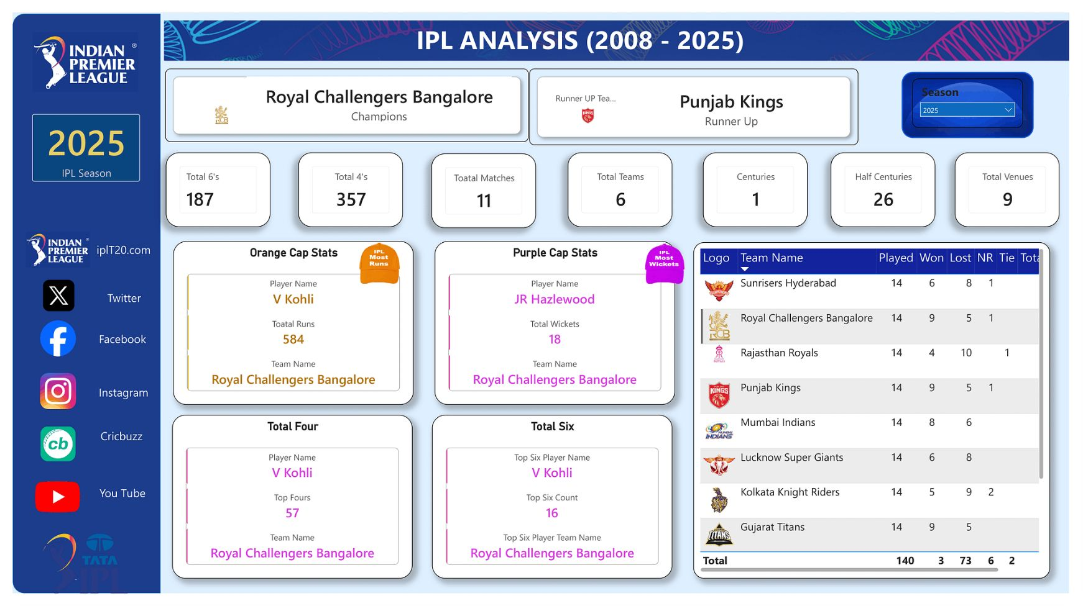

Dashboard Overview
The Power BI dashboard delivers a multi-page interactive experience covering team performance, player rankings, and cap leaderboards — all controlled via season-based slicers for temporal drill-down.
Interactive Season Filters
KPI Cards & Team Metrics
Player Rankings & Cap Visualizations
Season-based slicers enable temporal drill-down, allowing users to isolate any IPL edition for focused comparison.
At-a-glance key performance indicators surface total runs, wickets, matches, and win rates; comparative charts benchmark franchises side-by-side.
Ranked tables and trend visuals highlight Orange Cap and Purple Cap leaders across seasons, with individual player drill-through statistics.

Slide 8





Key Insights
The dashboard surfaces seven categories of actionable intelligence — translating raw match data into clear narratives about batting excellence, bowling dominance, and franchise consistency.
Top Teams
Leading Run Scorers
Leading Wicket Takers
Consistent high-performing franchises identified across multiple seasons through win-rate and net run-rate analysis.
Dominant batsmen ranked by career IPL runs, highlighting players who shaped the Orange Cap narrative season after season.
Most effective bowlers surfaced by total wickets and economy, revealing Purple Cap contenders across all editions.
Season-wise Variations
Batting & Bowling Trends
Performance fluctuations and growth trends across seasons expose how team strategies and player form evolved over time.
Strategic insights into boundary frequency, strike rates, and economy rates reveal tactical patterns that define match outcomes.

Slide 9
Analytics & Business Value
Beyond technical execution, the dashboard delivers measurable analytical value — demonstrating how structured BI solutions translate raw sports data into strategic intelligence for stakeholders.
Analytical Capabilities Delivered
Stakeholder Value
Quick understanding of IPL performance metrics at a glance
Team and player comparison for strategic analysis
Performance trend identification for predictive insights
Supports data-driven decision-making for franchise management, analysts, and scouts
Demonstrates real-world application of analytics in professional sports contexts
Scalable architecture adaptable to other cricket leagues or sports datasets
4
6
Datasets Integrated
DAX Measure Categories
Ball, match, player & team
Runs, wickets, matches, ratios, boundaries, milestones
7
1
Insight Domains
Unified Dashboard
Teams, batsmen, bowlers, caps, trends, seasons, tactics
End-to-end interactive Power BI solution

Slide 10

Conclusion
This project represents a complete, production-quality BI solution — demonstrating the full data analytics lifecycle from raw data through interactive insight delivery. Every layer of the pipeline reflects industry-standard practices applicable to analyst and BI developer roles.
01
02
Power BI Dashboard Development
DAX Formula Creation & Optimization
Multi-page interactive report with slicers, KPI cards, and drill-through navigation.
Custom measures for aggregations, ratios, and conditional milestone counts.
03
04
Power Query ETL & Data Modeling
Data Cleaning, Validation & Visualization
Automated transformation pipelines and relational schema with primary/foreign key integrity.
End-to-end data quality assurance paired with purposeful, insight-driven visual storytelling.
Portfolio Takeaway: This project demonstrates business intelligence and analytics expertise directly applicable to data analyst, BI developer, and sports analytics roles across industries.

Slide 11
Sources
Dashboard Screenshot
IPL_Aanalysis_Dashborad.png
Original Power BI dashboard deliverable — authored by Javed Ali as part of this portfolio project.

