Slide 1
Application of Stack
Infix to postfix conversion :
We are already familiar with arithmetic expression in infix notation. In infix notation a binary operation is placed between its operand.
For example :
A + B
Which is said to be infix notation.
We notice that the operator + is placed between the operands A and B. If we write the same expression in the fashion
+AB
It is called prefix notation or polish notation.
AB+
Is called postfix notation or reverse polish notation.

Slide 2
Let us compute the value of the arithmetic expression.
7 + 4 * 5
One may calculate this value as 55. another may calculate its value as 27.
If you go with the presidence of operator you will find the value as 27. i.e.
4 * 5
is evaluate first and then it will be added to 7.
If you go with left to right evaluation you will find the value as 55. i.e.
7 + 4 as the first evaluation and 5 will be multiplied to it.

Slide 3
The infix expression are normally evaluating from left to right. Using parenthesis we can change the order of evaluation. Now, consider the following equation.
A * B+ C + D * E
In the above expression A and B would multiply first, adding it to C and then multiplying D and E and add the result in the previous one. Therefore, we have followed the sequence as follows :
A B * C + D E * +
This notion is called the postfix notation or reverse polish notation. In postfix notation, an operation is placed immediately after its operand. We can convert the infix expression to postfix form using stack.

Slide 4
Suppose, we have to convert infix expression. The following steps are used to convert infix expression into the postfix form.
When an operand is used, it is immediately placed onto the output.
When an operator is used, place it onto the stack.
If we see right parenthesis, then we pop the stack, writing symbols until we encounter an corresponding left parenthesis.
If we see another symbol (‘+’, ‘*’, ‘(’) then we pop entries from the stack until we find an entry of lower priority. When the popping is done, push the operator onto the stack.
Finally, we read the end of input, we pop the stack until it is empty writing symbols onto the output.

Slide 5
To see how above algorithm work, let us convert an infix expression into its postfix form. Suppose we have to convert the infix expression :
a + b * c + (d * e+ f)
Into postfix form, first the symbol a is read on and passed to the output. Then ‘ +’ is read because it is operator. It is pushed onto the stack. Next b is read and passed through the output. The state of stack and output is as follows.
a
+
b
*
c
+
(
d
*
e
+
f
)
Stack
output

Slide 6
Evaluation of postfix expression.
We can also use stack to evaluate expression in postfix form. To do this :
When an operand is encountered it is pushed into the stack.
When an operator is encountered it is applied to the first two operands then we obtain by popping the stack and the result is pushed into the stack.

Slide 7
Example :
Evaluate the following in stack:
5
3
2
4
+
5
*
+
6
+
-
5
3
2
4
+
5
*
+
6
+
-
=
39
=
6
=
30
=
34
=
33
Stack

Slide 8
Evaluate the following postfix expression
5,6,*,18,2,/,+
20,2,+,20,18,-,/,6,3+,*
20,8,4,/,2,3,+,*,-
39
99
10

Slide 9
Convert A*(B+C*D)+E TO POSTFIX

Slide 10
Character Scanned | Stack | Output
A |  | A
* | * | A
( | *( | A
B | *( | AB
+ | *(+ | AB
C | *(+ | ABC
* | *(+* | ABC
D | *(+* | ABCD
) | * | ABCD*+
+ | + | ABCD*+*
E | + | ABCD*+*E
 |  | ABCD*+*E+

Slide 11
Convert the infix expression to postfix expression
A-B+C*D%E*G/H

Slide 12
Input | Stack status | Output
A | Empty | A
- | - | A
B | - | AB
+ | + | AB-
C | + | AB-C
* | +* | AB-C
D | +* | AB-CD
% | +% | AB-CD*
E | +% | AB-CD*E
* | +* | AB-CD*E%
G | +* | AB-CD*E%G
/ | +/ | AB-CD*E%G*
H | +/ | AB-CD*E%G*H
 | Empty | AB-CD*E%G*H/+

Slide 13
Convert infix to postfix
A*B+(C-D/F)
AB*CDF/- +

Slide 14
Convert the infix expression to postfix
A*B+(P-Q)/(X+Y-M)

Slide 15
Character Scanned | Stack | Output
A | EMPTY | A
* | * | A
B | * | AB
+ | + | AB*
( | +( | AB*
P | +( | AB*P
- | +(- | AB*P
Q | +(- | AB*PQ
) | + | AB*PQ
/ | +/ | AB*PQ-
( | +/( | AB*PQ-
X | +/( | AB*PQ-X
+ | +/(+ | AB*PQ-X
Y | +/(+ | AB*PQ-XY
- | +/(- | AB*PQ-XY+
M | +/(- | AB*PQ-XY+M
) |  | AB*PQ-XY+M-/+

Slide 16
Convert the infix expression to postfix
A+((B+C)+(D+E)*F)/G

Slide 17
Character Expression | Stack | Output
A | Empty | A
+ | + | A
( | +( | A
( | +(( | A
B | +(( | AB
+ | +((+ | AB
C | +((+ | ABC
) | +( | ABC+
+ | +(+ | ABC+
( | +(+( | ABC+
D | +(+( | ABC+D
+ | +(+(+ | ABC+D
E | +(+(+ | ABC+DE
) | +(+ | ABC+DE+
contd

Slide 18
Character scanned | Stack | Output
* | +(+* | ABC+DE+
F | +(+* | ABC+DE+F
) | + | ABC+DE+F*+
/ | +/ | ABC+DE+F*+
G | +/ | ABC+DE+F*+G
 |  | ABC+DE+F*+G/+

Slide 19
Evaluate the postfix expression
50,60,+,20,10,-,*

Slide 20
Symbol | Op1 | Op2 | Result | Stack
50 |  |  |  | Top->50
60 |  |  |  | Top->60,50
+ | 50 | 60 | 110 | Top->110
20 |  |  |  | Top->20,110
10 |  |  |  | Top->10,20,110
- | 20 | 10 | 10 | Top->10,110
* | 110 | 10 | 1100 | Top->1100

Slide 21
Evaluate the postfix expression
30,5,2,*12,6,/,+,-

Slide 22
Symbol | Op1 | Op2 | Result | Stack
30 |  |  |  | Top->30
5 |  |  |  | Top->5,30
2 |  |  |  | Top->2,5,30
* | 5 | 2 | 10 | Top->10,30
12 |  |  |  | Top->12,10,30
6 |  |  |  | Top->6,12,10,30
/ | 12 | 6 | 2 | Top->2,10,30
+ | 10 | 2 | 12 | Top->12,30
- | 30 | 12 | 18 | Top->18

Slide 23
Evaluate the postfix expression
5,20,15,-,*,25,2,*,+

Slide 24
Symbol | Op1 | Op2 | Result | Stack
5 |  |  |  | Top->5
20 |  |  |  | Top->20,5
15 |  |  |  | Top->15,20,5
- | 20 | 15 | 5 | Top->5,5
* | 5 | 5 | 25 | Top->25
25 |  |  |  | Top->25,25
2 |  |  |  | Top->2,25,25
* | 25 | 2 | 50 | Top->50,25
+ | 25 | 50 | 75 | Top->75

Slide 25
Evaluate the postfix expression
25,8,3,-,/,6,*,10,+

Slide 26
Symbol | Op1 | Op2 | Result | Stack
25 |  |  |  | Top->25
8 |  |  |  | Top->8,25
3 |  |  |  | Top->3,8,25
- | 8 | 3 | 5 | Top->5,25
/ | 25 | 5 | 5 | Top->5
6 |  |  |  | Top->6,5
* | 5 | 6 | 30 | Top->30
10 |  |  |  | Top->10,30
+ | 30 | 10 | 40 | Top->40

Slide 27
Evaluate the postfix expression
15,3,2,+,/,7,+,2,*

Slide 28
Symbol | Op1 | Op2 | Result | Stack
15 |  |  |  | Top->15
3 |  |  |  | Top->3,15
2 |  |  |  | Top->2,3,15
+ | 3 | 2 | 5 | Top->5,15
/ | 15 | 5 | 3 | Top->3
7 |  |  |  | Top->7,3
+ | 3 | 7 | 10 | Top->10
2 |  |  |  | Top->2,10
* | 10 | 2 | 20 | Top->20

Slide 29
Determine the missing number (?) and operator (?) in the following postfix expression which results in 55 after evaluation.
4 | 10 | 5 | + | * | ? | 3 | ? | -
2 +
Or
15 /

Slide 31
Circular linked list
The linked lists that we have seen so far are often known as linear linked lists. The elements of such a linked list can be accessed first by setting up a pointer pointing to the first node in the list and then traversing the entire list using this pointer.
Circular linear linked list is a list similar to linear linked list, only the difference is that rather than storing NULL in the link field of last node we store address of the first node in a such a way from last node we can go directly to first node in the list.
Ex :
10 | 600
20 | 300
30 | 800
40 | 700
50 | 100
100
600
300
800
700

Slide 32
Doubly linked list
Doubly linked list is also called as two way chain. Here node is divided into three parts where three fields of information is stored, they are :
1) left link(LLINK): Holds the address of previous node.
2) into field(INFO) : Holds the data item
3) right link(RLINK) : Holds the address of the next node.
In doubly linked list traversal is possible in both directions.
In doubly linked list leftmost node in the first node contains NULL and right most node in the last node contains NULL value.
LLINK | INFO | RLINK
1000
2000
3000
4000
NULL | 10 | 2000
1000 | 20 | 3000
2000 | 30 | 4000
3000 | 40 | NULL

Slide 33
Data File Handling
Most computer programs work with files. This is because files helps in storing information permanently. Like Word processors create document files. Compilers read source files and generate executable files.
In C++ file input/output facilities are implemented through a component header file of C++ standard library. This header file is <fstream.h>.
The fstream library predefines a set of operations for handling file related input and output. It defines certain classes that help one perform file input and output.
The I/O system of C++ handles file operations which are very much similar to the console input & output operations. It uses files streams as an interface between the program and the files. The stream that supplies data to the program is known as input stream and the one that received data from the program is known as output stream.

Slide 34
In other words the input stream extracts (or reads) data from the file and the output stream inserts (or writes) data to the file. Following figure illustrates it.
Intput stream
Read data
Data
input
Disk file
Program
Data
Out put
Write data
Output stream

Slide 35
Classes for file stream operations
The file I/O system of C++ contains a set of class that define the file handling methods. These classes designed to manage the disk files which are declared in <fstream.h>. Therefore we must include this file in a program that works with files. The classes defined inside <fstream.h> derive from classes under <iostream.h>.

Slide 36
The important stream classes required for file operations are:
ifstream
ofstream
fstream
ifstream :
This stream is an input stream and the file open in this stream can only be available for reading. We must create an ifstream object, which will be used to open file and read from it. While creating an object we have to put name of the file which is to be opened in brackets.
For example : if it is required to open a file “student.dat” for reading, then we have to write :
ifstream sfile (“student.dat”);
In the above example the ifstream is a class and sfile is the object which is passing a parameter as a file name to the class.

Slide 37
ofstream :
This stream is an output stream and the file open in this stream can only be available for writing. We must create an ofstream object, which will open a file and write data into it. While creating an object we have to put name of the file which is to be opened in brackets.
For example : if it is required to open a file “student.dat” for reading, then we have to write :
ofstream sfile (“student.dat”);
(By default a new one is created if file does not exist.)

Slide 38
fstream :
This stream is an input stream as well as output stream. That is supports both input and output simultaneously. So when we are using fstream we have to specify in which mode we went to access the file.
The statement
fstream sfile (“student.dat”);
Opens a file named student.dat in text mode for input and output with read and write permission.

Slide 39
Opening and closing a file.
As stated earlier, for opening a file we must first create a file stream and then link it to the file name. A file stream can be defined using the classes ifstream, ofstream, and fstream that are contained in the header file fstream. The class to be used depends upon the purpose that is, whether we want to read data from the file or write data to it. A file can be opened in two ways :
1. Using the constructor function of the class.
2. Using the member function open() of the class.
The first method is usful when we use only one file in the stream. The second method is used when we went to manage multiple files using one stream.

Slide 40
Opening files using Constructor.
We know that a constructor is used to initialize an object while it is being created. Here, a file name is used to initialize the file stream object. This involves a following steps :
1. Create a file stream object to manage the stream using the appropriate class. That is to say, the class ofstream is used to create a output stream and the class ifstream to create the input stream.
2. Initialize the filer object with the desired filename.
For example, the following statement opens a file named “results” for output:
Ofstream outfile (“results”); // output only

Slide 41
This creates outfile as an ofstream object. The manages the output stream. This object can be any valid C++ name such as o_file, myfile or fout. This statement also opens the file results and attaches it to the output stream outfile.
Similarly, the following statement declares infile as an ifstream object and attaches it to the file data for reading (input).
ifstream infile(“data”); //input only
The program may contain statements like :
outfile<<“TOTAL”;
outfile<<sum;
infile>>number;
infile>>string;

Slide 42
We can also use the same file for both reading and writing data. The programs would contain the following statements :
Program1
……
……
Ofstream outfile(“salary”);
……
……
Program
……
……
Ifstream infile(“Salary”
……
……

Slide 43
The connection with a file is closed automaticall when the stream object. Expires (when the prgram terminates). In the above statement, when the program 1 is terminated, the salary file is doscoected from the outfile stream. Similar action takes place when the program 2 is terminated.
Instead of using two programs, one for writing data (output) and another for reading dta (input), we can use a single program to do both the operations on a file. For example :
……
……
outfile.close();
Ifstream infile(“salary”);
……
……
Infile.close();

Slide 44
Although we have used a single program, we created two file stream objects, outfile (to put data to the file) and infile (to get data from the file). Note that the use of a statement like
outfil.close();
Disconnects the file salary from the output stream outfile. Remember, the object outfile still exists and the salary file may again be connected to outfile later or to any other stream. In this example, we are connecting the salary file to infile stream to read data.

Slide 45
Below program use a single file for both writing and reading the data. First, it takes data from the keyboard and writes it to the file. After the writing is completed, the file is closed. The program again opens the same file, reads the information already written to it and display the same on the screen.
#include<iostream.h>
#include<conio.h>
#include<fstream.h>
void main()
{
clrscr();
ofstream outf("ITEM"); //connect item file to outf
cout<<"Enter item name:";
char name[30];
cin>>name; //get name from keyboard and
Outf<<name<<“\n”; // write to file ITEM
cout<<"Enter item cost:";
float cost;
cin>>cost; //get cost from keyboard and

Slide 46
outf<<cost<<"\n"; // Write to file ITEM
outf.close(); // Disconnect ITEM file from outf
ifstream inf("ITEM"); //connect ITEM file to inf
Inf>>name; // read name from file ITEM
inf>>cost; // read cost from file ITEM
cout<<"\n";
cout<<"Item name:"<<name<<"\n";
cout<<"Item cost:"<<cost<<"\n";
inf.close(); //Disconnect ITEM file from inf.
getch();
}

Slide 47
Below program uss a single file for both writing and reading the data. First, it takes data from the keyboard and writes it to the file. After the writing is completed, the file is closed. The program again opens the same file, reads the information already written to it and display the same on the screen.
#include<iostream.h>
#include<conio.h>
#include<fstream.h>
void main()
{
clrscr();
ofstream outf("ITEM");
cout<<"Enter item name:";
char name[30];
cin>>name;
cout<<"Enter item cost:";
float cost;
cin>>cost;
#include<iostream.h>
#include<conio.h>
#include<fstream.h>
void main()
{
clrscr();
ofstream outf("ITEM");
cout<<"Enter item name:";
char name[30];
cin>>name;
cout<<"Enter item cost:";
float cost;
cin>>cost;
outf<<cost<<"\n";
outf.close();
ifstream inf("ITEM");
inf>>cost;
cout<<"\n";
cout<<"Item name:"<<name<<"\n";
cout<<"Item cost:"<<cost<<"\n";
inf.close();
getch();
}

Slide 48
CAUTION
When a file is opened for writing only, a new file is created if there is no file of that name. If a file by that name exists already, then its contents are deleted and the file is presented as a clean file.
Opening Files using open()
As started earlier, the functin open() can be used to open multiple files that use the same strem object. For example, we may want to process a set of files sequentially. In such cases, we may create a single stream object nd use it to open each file in turn. This is done as follows.
File-stream-class stream-object;
Stream-object.ope(“filename”);

Slide 49
Example :
ofstream outfile;
outfile.open(“data1”);
……
……
outfile.close();
outfile.open(“DATA2”);
……
……
outfile.close();
……
……

Slide 50
The previous program segment opens two files in sequence for writing the data. Note that the first file is closed before opening the second one. This is necessary because a stream can be connected to only one file at a time.

Slide 51
Example Programs
1)write a program to create a file marks containing the marks of 10 students.
#include<fstream.h>
#include<iostream.h>
int main()
{
ofstream fout(“marks.txt”);
int num;
cout<<”enter the 10 numbers”;
for(“int i=1;i<=10;i++)
{
cout<<”enter the number”;
cin>>num;
fout<<num<<endl;
}
fout.close();
}

Slide 52
#include<fstream.h>
Int main()
{
ifstream fin(“marks.txt”);
int num,max=0;
cout<<“the numbers in the file are “;
for(int i=1;i<=10;i++)
{
fin>>num;
cout<<num<<endl;
if(num>max)
max=num;
}
cout<<“the maximum number is “<<max;
fin.close();
}

Slide 53
Write a program to create a file containing the first name,last name and age of the student.Also read the name of the file from the user.
#include<fstream.h>
#include<iostream.h>
int main()
{
char fname[30],lname[30];
int age;
char filename[20];
cout<<”enter the first name”;
cin>>fname;
cout<<”enter the last name\n”;
cin>>lname;
cout<<”enter the age\n”;
cin>>age;
cout<<”enter the name of the file in which you want to create”;
cin>>filename;
cout<<filename<<”file is created”;
ofstream student(filename);
student<<fname<<”\n”<<lname<<”\n”<<age<<“\n”;
}

Slide 54
Program to read the contents of the above file
#include<fstream.h>
#include<iostream.h>
int main()
{
char fname[30],lname[30];
int age;
char filename[20];
cout<<”enter the name of file\n”;
cin>>filename;
ifstream stude(filename);
stude>>fname>>lname>>age;
cout<<”\n first name”<<fname;
cout<<”\n last name”<<lname;
cout<<”\n age “<<age;
}

Slide 55
Two methods to detect end of file
(Assume fin to be an ifstream object.
While(!fin.eof())
While(fin)

Slide 56
Write a program to read all the contents of the file test.txt which contains number of strings.
#include<ifstream.h>
Int main()
{
char str[20];
ifstream file(“test.txt”);
while(file)
{
file.getline(str,20);
cout<<str;
}
file.close();
}

Slide 57
#include<ifstream.h>
Int main()
{
char str[20];
ifstream file(“test.txt”);
while(!file.eof())
{
file.getline(str,20);
cout<<str;
}
file.close();
}

Slide 58
Write a function in C++ to read the contents of a text file “Places.txt ” and display those lines on screen,which are starting with P or S.
Void readfile()
{
ifstream fin(“Places.txt”)
char line[250];
while(!fin.eof())
{
fin.getline(line,250];
if(line[0]==‘P’||line[0]==‘S’)
cout<<line;
}
fin.close();
}

Slide 59
Prelims 2018
Consider a text file named CALL_RECORD.TXT which contains the following information on each line
1)phone_no:of type long unsigned int
2)date:a character array of size 10 (format 21-06-2017)
3)calltime:a character array of size 5
4)Talktime:of type unsigned integer.
Write a user defined function named find() which accepts a phone number to be searched as parameter and displays all the entries for the same,existing in the file.Also calculate the total talktime for display.

Slide 60
Void find(long unsigned int p)
{
ifstream a(“call_record.txt”);
char date[10],calltime[5];
unsigned int talktime,total=0;
long unsigned int phone_no;
while(a>>phone_no>>date>>calltime>>talktime)
{
if(p==phone_no)
{
cout<<phone_no<<date<<calltime<<talktime<<endl;
total=total+talktime;
}
cout<<talktime;
}
a.close();
}

Slide 61
#include<iostream.h>
#include<conio.h>
#include<fstream.h>
void main()
{
clrscr();
ofstream fout;
fout.open("country");
fout<<"United States of America\n";
fout<<"United Kingdom\n";
fout<<"South Korea\n";
fout.close();
fout.open("capital");
fout<<"Washington\n";
fout<<"London\n";
fout<<"Seoul\n";
fout.close();
const int N=80;
char line[N];
ifstream fin;
fin.open("country");
cout<<"contents of country file\n";
while(fin)
{
fin.getline(line,N);
cout<<line<<"\n";
}
fin.close();
fin.open("capital");
cout<<"\nContents of capital file\n";
while(fin)
{
fin.getline(line,N);
cout<<line<<"\n";
}
fin.close();
getch();
}

Slide 62
OUTPUT
contents of country file
United States of America
United Kingdom
South Korea
Contents of capital file
Washington
London
Seoul

Slide 63
Suppose at a time we may need to use two or more files simultaneously,in such case we need to create two separate input streams for handling the two input files.
Following proram reads from two files simultaneously.
for(int i=1;i<=10;i++)
{
if(fin1.eof()!=0)
{
cout<<"Exit from country\n";
exit(0);
}
fin1.getline(line,SIZE);
cout<<"Capital of "<<line;
if(fin2.eof()!=0)
{
cout<<"Exit from capital\n";
exit(0);
}
fin2.getline(line,SIZE);
cout<<endl<<line<<"\n\n";
}
getch();
}
#include<iostream.h>
#include<fstream.h>
#include<stdlib.h>
#include<conio.h>
void main()
{
clrscr();
const int SIZE=80;
char line[SIZE];
ifstream fin1,fin2;
fin1.open("Cou");
fin2.open("Cap");

Slide 64
Detecting end-of-file
Detecting of the end-of-file condition is necessary for preventing any further attempt to read data from the file. This was illustrated in last two programs by using the statement
While(fin)
If(fin1.eof()!=0) { exit(0)};
An ifstream object such as fin, return a value of 0 if any error occurs in the file operation including the end-of-file condition. Thus the while loop terminates when fin returns a value of zero on reaching the end-of-file condition. Remember this loop may terminate due to other failures as well.
There is another approach to detect the end –of-file condition. Note that we have used following statement in program.
eof() is a membre function of ios class. It returns a non-zero value if the end-of-file (EOF) condition is encountered, and a zero, otherwise. Therefore, the above statement terminates the program on reaching the end of the file.

Slide 65
More about open(): File Modes
We have used ifstream and ofstream constructors and the function open() to create new files as well as to open the existing files. Remember, in both these methods, we used only one argument that was the filename. However these functions can take two arguments, the second one for specifying the file mode. The general form of the function open() with two arguments is :
Stream-object.open(filename”, mode);
The second argument mode (called file mode parameter) specifies the purpose for which the file is opened. How did we then open file without providing the second argument in the previous examples?

Slide 66
The prototype of these class member functions contain default value for the second argument and therefore they use the default values in the absence of the actual values. The default value are as follows.
ios::in for ifstream functions meaning open for reading only.
ios::out for ofstream functions meaning open for writing only.
Parmeter | Meaning
ios::app ios::ate ios::binary ios::in ios::nocreate ios::noreplace ios::out ios::trunc | Append to end-of-file Go to end-of-file Binary file Open file for reading only Open fails if the file does not exist Open fails if the file already exists Open file for writing only Delete the contents of the file if it exists.

Slide 67
Note :
Opening a file in ios::out mode also opens it in the ios::trunc mode by default.
Both ios::app and ios::ate take us to the end of the file when it is opened. The difference between the two parameters is that the ios::app allows us to add data to the end of the file only, while ios::ate mode permits us to add data or to modify the existing data anywhere in the file. In both the cases, a file is created by the specified name, if it does not exist.
The parameter ios::app can be used only with the files capable of output.
Creating a stream using ifstream implies input and creating a system using ofstream implies output. So in these cases it is not necessary to provide the mode parameters.
The fstream

Slide 68
5. The fstream class does not provide a mode by default and therefore, we must provide the mode explicitly when using an object of fstream class.
6. The mode can combine two or more parameters using the bitwise OR operator (symbol | ) as shown below :
fout.open(“data”,ios::app | ios::nocreate)
this opens the file in the append mode but fails to open the file if it does not exist.

Slide 69
File Pointers and their Manipulations
Each file has two associated pointers known as the file pointers. One of them is called input pointer (or get pointer) and the other is called the output pointer (or put pointer). We can use these pointers to move through the files while reading or writing. The input pointer is used for reading the contents of a given file location and the output pointer is used for writing to a file location. Each time an input or output operation takes place, the appropriate pointer is automatically advanced.
Default Actions
When we open a file in read-only mode, the input pointer is automatically set at the beginning so that we can read the file from the start. Similarly, when we open a file in write-only mode, the existing contents are deleted and the output

Slide 70
pointer is set at the beginning. This enables us to write to the file from the start. In case, we want to open an existing file to add more data, the file is opened in ‘append’ mode. This moves the output pointer to the end of the file (i.e. the end of the existing contents ).
“hello”file
Open for reading only
H | E | L | L | O |  | W | O | R | L | D
Input pointer
“hello”file
Open in append mode
(for writing more data)
H | E | L | L | O |  | W | O | R | L | D
output pointer
Open for writing only
output pointer

Slide 71
Functions for Manipulation of file pointers
Al the actions on the file pointers as shown in above figure take place automatically by dfault. How do we then move a file pointer to any other desired position inside the file? This is possible only if we can take control of the movement of the file pointers ourselves. The file stream classes support the following functions to manage such situations:
Seekg() Moves get pointer (input) to a specified location.
Seekp() Moves put pointer (output) to a specified location.
tellg() Gives the current position of the get pointer.
tellp() Gives the current position of the put pointer.
For example, the statement
Infile.seekg(10);

Slide 72
Moves the file pointer to the byte number 10. Remember,. The bytes in a file are numbered beginning from zero. Therefore, the pointer will be pointing to the 11th byte in the file.
Consider the following statement:
ofstream fileout;
fileout.open(“hello”. Ios::app);
int p=fileout.tellp();
On execution of these statements, the output pointer is moved to the end of the file “hello” and the value of p will represent the number of bytes in the file.

Slide 73
Moves the file pointer to the byte number 10. Remember,. The bytes in a file are numbered beginning from zero. Therefore, the pointer will be pointing to the 11th byte in the file.
Consider the following statement:
ofstream fileout;
fileout.open(“hello”. Ios::app);
int p=fileout.tellp();
On execution of these statements, the output pointer is moved to the end of the file “hello” and the value of p will represent the number of bytes in the file.

Slide 74
#include<iostream.h>
#include<fstream.h>
using namespace std;
int main()
{
fstream a("hi.txt",ios::out|ios::in);
char abc[20];
a<<"Hi good morning";
//cout<<a.tellp();
a.seekp(2);
a<<" Hello";
//a.seekg(8);
a.seekg(0,ios::beg);
cout<<a.tellg();
a.getline(abc,20);
cout<<abc;
}

Slide 75
Specifying the offset
We have just now see how to move a file pointer to a desired location using the ‘seek’ functions. The argument to these functions represents the absolute position in the file.
‘Seek’ functions seekg() and seekp() can also be used with two arguments as follows :
seekg (offset, refposition);
seekp (offset, refposition);
The parameter offset represents the number of bytes the file pointer is to be moved from the location specified by the parameter refposition. The refposition takes one of the following three constants defined in the ios class.
ios::beg start of the file
ios::cur current position of the pointer
ios::end End of the file

Slide 76
The seekg() function moves the associated file’s ‘get’ pointer while the seekp() function moves the associated file’s ‘put pointer. Below table lists some sample pointer offset calls and their actions. fout is an ofstream object.
Pointer Offset calls
Seek call | Action
fout.seekg(o,ios::beg); fout.seekg(o,ios::cur); fout.seekg(o,ios::end); fout.seekg(m,ios::beg); fout.seekg(m,ios::cur); fout.seekg(-m,ios::cur); fout.seekg(-m,ios::end); | Go to start Stay at the current position Go to the end of file Move to (m+1)th byte in the file Go forward by m byte from the current position Go backward by m bytes from the current position Go backward by m bytes from the end

Slide 77
Text Files
1)Here data is stored in the form of ASCII characters irrespective of the data types
2)Here each line of text is terminated with special character called EOL
3)Here some internal translations take place when this EOL character is read or written
4)Text files can be manipulated using the text editor or a program

Slide 78
Binary Files
1)Here data is stored in binary form
2)There is no delimiter for a line
3)No translation occurs in binary
4)These types of files can be manipulated using a program only.

Slide 79
Sequential Input and Output Operations
The file stream classes support and number of member functions for performing the input and output operations on file. One pair of functions, put() and get(), are designed for handling a single character at a time. Another pair of functions, write() and read() are designed to write and read blocks of binary data.
put() and get() functions
The function put() writes a single character to the associated stream. Similarly, the function get() reads a single character from the associated stream. Below program illustrates how these functions work on a file. The program requests for a string. On receiving the string, the program writes it, character by character, to the file using the put() function in a for loop. Note that the length of the string is used to terminate the for loop.

Slide 80
The program then displays the contents of the file on the screen. It uses the function get() to fetch a character from the file and continues to do so until the end-of-file condition is reached. The character read from the file is displayed on the screen using the operator <<.
#include<iostream.h>
#include<fstream.h>
#include<string.h>
#include<conio.h>
void main()
{
char string[30];
cout<<"Enter a string\n";
cin>>string;
int len=strlen(string);
fstream file;
file.open("TEXT",ios::in|ios::out);
for(int i=0;i<len;i++)
file.put(string[i]);
file.seekg(0);
char ch;
while(file)
{
file.get(ch);
cout<<ch;
}
getch();
}

Slide 81
NOTE
We have used an fstream object to open the file. Since an fstream object can handle both the input and output simultaneously, we have opened the file in ios::in | ios::out mode. After writing the file, we want to read the entire file and display its contents. Since the file pointer has already moved to the end of the file, we must bring it back to the start of the file. This is done by the statement
file.seekg(0);

Slide 82
Write statements using seekg() to achieve the following (Assume fout as the file stream object)
To move the pointer by 15 bytes forward from the current position in the file
To go backward by 20 bytes from the end of the file.
i)Fout.seekg(15,ios::cur);
ii)fout.seekg(-20,ios::end);

Slide 83
Difference between get and getline
Get()-function is used to read a single character from the input stream in a text file.
Fetching stops if the delimiting character is encountered
Getline()-This function is used to read a string from the input stream in a text file.
After reading,extracts the delimiting character from the input stream.

Slide 84
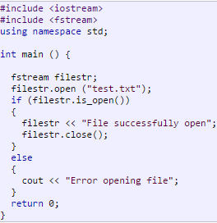
You can use is_open() to check if the file was successfully opened.

Slide 85
write() and read() functions
The functions write() and read(), unlike the functions put() and get(), handle the data in binary form. This means that the values are stored in the disk file in the same format in which they are stored in the internal memory. Below shown figure shows how an int value 2594 is stored in the binary and character formats. An int takes two bytes to store its value in the binary form, irrespective of its size. But a 4 digit int will take four bytes to store it in the character form.
2 bytes
00001010 | 00100010
2 | 5 | 9 | 4
4 bytes

Slide 86
The binary format is more accurate for storing the umbers as they are stored in the exact internal representation. There are no conversions while saving the data and therefore saving the much faster.
The binary input and output functions takes the following form :
infile.read ((char*)&V,sizeof(V));
infile.write ((char*)&V,sizeof(V));
These functions take two arguments. The first is the address of the variable V, and the second is the length of that variable in bytes. The address of the variable must be cast to type char* (i.e. pointer to character type). Below program illustrates how these two functions are used to save an array of float numbers and then recover them for display on the screen.

Slide 87
Reading and writing
Objects to file

Slide 88
#include<iostream.h> #include<fstream.h> using namespace std; class person { private: char name[20]; int age; public: void set(); }; void person::set() { cout<<"enter the name"<<endl; cin>>name; cout<<"enter the age"<<endl; cin>>age; }
int main() { person xyz; fstream a; a.open("aaa.dat",ios::binary|ios::app|ios::out); xyz.set(); a.write((char *)&xyz,sizeof(xyz)); }

Slide 89
#include<iostream.h> #include<fstream.h> class person { private: char name[20]; int age; public: void show(); }; void person::show() { cout<<" the name is"<<endl; cout<<name; cout<<" the age is"<<endl; cout<<age; }
int main() { person xyz; ifstream b; b.open("aaa.dat",ios::binary|ios::in); while(b.read((char *)&xyz,sizeof(xyz))) { xyz.show(); } }

Slide 90
Modifying Record
To modify a record,the file is opened in I/O mode and an important step is performed that gives the beginning address of record being modified.
After the record is modified,the file pointer is once again placed at the beginning position of this record and then record is re-written.

Slide 91
Modifying a record

Slide 92
#include<iostream.h>
#include<fstream.h>
#include<stdio.h>
#include<string.h>
using namespace std;
class stu
{
int rollno;
char name[25];
//char clas[4];
float marks;
char grade;
public:
void getdata();
void putdata();
int getrno();
void modify();
};
void stu::getdata()
{
cout<<"Roll no\n";
cin>>rollno;
cout<<"name\n";
cin>>name;
//cout<<"class\n";
//cin>>clas;
cout<<"marks\n";
cin>>marks;
if(marks>=75)
grade='A';
else if (marks>=60)
grade='B';
else if(marks>=50)
grade='C';
else if(marks>=40)
grade='D';
else grade='F';
}
contd

Slide 93
void stu::putdata()
{
cout<<"Roll no"<<rollno<<"\t Name"<<name<<"\t marks"<<marks<<"\t grade"<<grade<<endl;
}
int stu::getrno()
{
return rollno;
}
void stu::modify()
{
cout<<"Roll no"<<rollno<<"\t Name"<<name<<"\t marks"<<marks<<"\tgrade"<<grade<<endl;
cout<<"Enter new details"<<endl;
cout<<"enter the name"<<endl;
cin>>name;
cout<<"enter the marks"<<endl;
cin>>marks;
if(marks>=75)
grade='A';
else if (marks>=60)
grade='B';
else if(marks>=50)
grade='C';
else if(marks>=40)
grade='D';
else grade='F';
}
contd

Slide 94
int main()
{
fstream fio;
fio.open("zzz.dat",ios::in|ios::out|ios::binary);
long pos;
stu s1,stud;
int rno;
char found='f';
cout<<"Enter roll no whose data is to be modified";
cin>>rno;
while(!fio.eof())
{
pos=fio.tellg();
fio.read((char*)&s1,sizeof(s1));
if(s1.getrno()==rno)
{
s1.modify();
fio.seekg(pos);
fio.write((char *)&s1,sizeof(s1));
found='t';
break;
}
}
if(found=='f')
cout<<"record not found"<<endl;
fio.seekg(0);
cout<<"Now the file contains\n";
while(fio.read((char*)&s1,sizeof(s1)))
{
s1.putdata();
}
fio.close();
}

Slide 95
Deletion of a record

Slide 96
To delete a record,the position of the record is to be got by performing a search
Keep copying the records in a temporary file say temp.dat
Do not copy the record to be deleted to temporary file temp.dat
Copy rest of records to temp.dat
Delete original file say stu.dat
Rename temp.dat as stu.dat

Slide 97
int main()
{
ifstream fio(“stu.dat”,ios::binary);
ofstream file(“temp.dat“,ios::binary);
stu s1,stud;
int rno;
char found='f‘,confirm=‘n’;
cout<<"Enter roll no whose data is to be deleted";
cin>>rno;
while(!fio.eof())
{
fio.read((char*)&s1,sizeof(s1));
if(s1.getrno()==rno)
{
s1.putdata();
found=‘t’;
cout<<“Are you sure you want to delete y/n”;
cin>>confirm;
if(confirm==‘n’)
file.write((char *)&s1,sizeof(s1));
}
else
file.write((char *)&s1,sizeof(s1));
}
if(found=='f')
cout<<"record not found"<<endl;
fio.close();
file.close();
remove(“stu.dat”);
rename(“temp.dat”,”stu.dat”);
CONTD

Slide 98
fio.open(“stu.dat”,ios::in)
cout<<“now the file contains\n”;
while(!fio.eof())
{
fio.read((char *)&stud,sizeof(stud));
stud.putdata();
}
fio.close();
}

Slide 100
{
cout.setf(ios::showpoint);
cout<<setw(10)<<setprecision (2)<<height[i];
}
infile.close();
getch();
}
#include<iostream.h>
#include<fstream.h>
#include<iomanip.h>
#include<conio.h>
const char*filename="BINARY";
void main()
{
float height[4]={175.5,153.0,167.25,160.70};
ofstream outfile;
outfile.open(filename);
outfile.write((char*)&height,sizeof(height));
outfile.close();
for(int i=0;i<4;i++)
height[i]=0;
ifstream infile;
infile.open(filename);
infile.read((char*)&height,sizeof(height));
for(i=0;i<4;i++)

Slide 101
Reading and Writing a Class Object
We mentioned earlier that one of the shortcomings of the I/O system of C is that it can handle user-defined data types such as class objects. Since the class objects are the central elements fo C++ programming, it is quite natural that the language supports features for writing to and reading from the disk files objects directly. The binary input and output functions read() and write() are designed to do exactly this job. These functions handle the entire structure of an object as a single unit, using the computer’s internal representation of data. For instance, the function write() copies a class object from memory byte by byte with no conversion. One important point to remember is that only data members are written to the disk file and the member functions are not.

Slide 102
Below program illustrates how class objects can be written to and read from the disk files. The length of the object is obtained using the sizeof operator. This length represents the sum total of length of all data members of the object.
#include<iostream.h>
#include<fstream.h>
#include<iomanip.h>
#include<conio.h>
#include<stdlib.h>
class INVENTORY
{
char name[10];
int code;
float cost;
public:
void readdata(void);
void writedata(void);
};
void INVENTORY::readdata(void)
{
cout<<"Enter name:";
cin>>name;
cout<<"Enter code";
cin>>code;
cout<<"Enter cost";
cin>>cost;
}
void INVENTORY::writedata(void)
{
cout<<setiosflags(ios::left)
<<setw(10)<<name
<<setiosflags(ios::right)
<<setw(10)<<code
<<setw(10)
<<setw(10)<<cost
<<endl;

Slide 103
}
void main()
{
INVENTORY item[3];
fstream file;
file.open("STOCK.DAT",ios::in|ios::out);
cout<<"ENTER DETAILS FOR THREE ITEMS\n";
for(int i=0;i<3;i++)
{
item[i].readdata();
file.write((char*)&item[i],sizeof(item[i]));
}
file.seekg(0);
cout<<"\nOUTPUT\n\n";
for(i=0;i<3;i++)
{
file.read((char*)&item[i],sizeof(item[i]));
item[i].writedata();
}
file.close();
}

Slide 104
#include<iostream.h>
#include<fstream.h>
#include<iomanip.h>
#include<conio.h>
#include<stdlib.h>
class INVENTORY
{
char name[10];
int code;
float cost;
public:
void getdata(void);
void putdata(void);
};
void INVENTORY::getdata(void)
{
cout<<"Enter name:";
cin>>name;
cout<<"Enter code";
cin>>code;
cout<<"Enter cost";
cin>>cost;
}
void INVENTORY::putdata(void)
{
cout<<setw(10)<<name
<<setw(10)<<code
<<setw(10)
<<setw(10)<<cost
<<endl;
}
void main()
{
INVENTORY item;
fstream file;
file.open("STOCK.DAT",ios::ate|ios::binary|ios::in|ios::out);
file.seekg(0,ios::beg);
cout<<"CURRENT CONTENTS OF STOCK\n";
while(file.read((char*)&item,sizeof(item)))
{
item.putdata();
}
file.clear();

Slide 105
item.getdata();
file.write((char*)&item,sizeof(item));
file.seekg(0);
cout<<"CONTENTS OF APPEND FILE\n";
while(file.read((char*)&item,sizeof(item)))
{
item.putdata();
}
file.close();
}

Slide 106
Searching records from a file

Slide 107
int person::getrno()
{
return rollno;
}
#include<iostream.h>
#include<fstream.h>
using namespace std;
class person
{
private:
int rollno;
char name[20];
int age;
public:
void show();
int getrno();
};
void person::show()
{
cout<<"The roll no is "<<endl;
cout<<rollno;
cout<<" the name is"<<endl;
cout<<name;
cout<<" the age is"<<endl;
cout<<age;
}
Prog contd on next slide

Slide 108
int main()
{
int rno;
char found='n';
person xyz;
ifstream b;
b.open("qqq.dat",ios::binary|ios::in);
cout<<"Enter the rollno "<<endl;
cin>>rno;
while(b.read((char *)&xyz,sizeof(xyz)))
{
if(xyz.getrno()==rno)
{
xyz.show();
found='y';
break;
}
}
if(found=='n')
cout<<"Record not found"<<endl;
b.close();
}

Slide 109
Write a function in C++ to count the number of alphabets present in text file “NOTES.TXT”
Void countalphabet()
{
ifstream fil(“NOTES.TXT”);
int caplha=0;
char ch=fil.get();
while(!fil.eof())
{
if(isaplha(ch))
caplha++;
ch=fil.get();
}
cout<<“No of alphabets “<<calpha<<endl;
}

Slide 110
Program to count number of characters.
#include<fstream.h> #include<conio.h> int main() { ifstream fin; fin.open("out.txt"); clrscr(); char ch; int count=0; while(!fin.eof()) { fin.get(ch); count++; } cout<<"Number of characters in file is "<<count; fin.close(); getch(); return 0; }

Slide 111
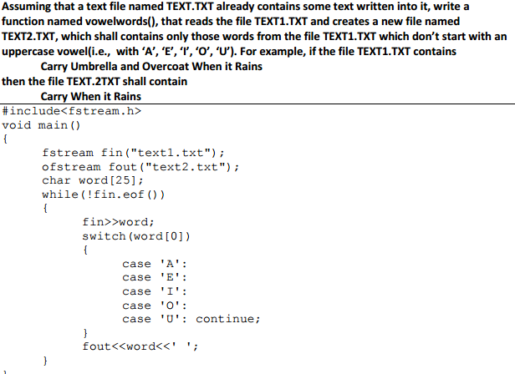

Slide 112
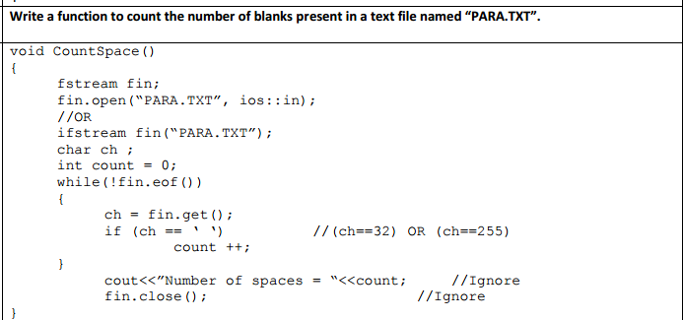

Slide 113
Program to count number of lines
#include<fstream.h> #include<conio.h> int main() { ifstream fin; fin.open("out.txt"); char str[80]; int count=0; while(!fin.eof()) { fin.getline(str,80); count++; } cout<<"Number of lines in file is "<<count; fin.close(); getch(); return 0; }

Slide 114
Assume that a text file STORY.TXT contains some text.
Define a C++ function named count(),that reads the file STORY.TXT and displays the number of alphabets present in it.
Prelims 2016

Slide 115
void count()
{
int n=0;
char c;
ifstream fin(“story.txt”);
while(fin.get(c ))
{
if(c>=‘A’ && c<=‘Z’)||(c>=‘a’&&c<=‘z’))
count++;
}
cout<<“Total number of alphabets are “<<count;
fin.close();
}

Slide 116
Program to copy contents of file to another file.
#include<fstream.h> int main() { ifstream fin; fin.open("out.txt"); ofstream fout; fout.open("sample.txt"); char ch; while(!fin.eof()) { fin.get(ch); fout<<ch; } fin.close(); return 0; }

Slide 117
class phonelist
{
char name[20];
char adress[30];
char areacode[5];
char phoneno[15];
Public:
Void register();
Void show();
Int checkcode(char ac[])
{
return strcmp(areacode,ac)
}
}
Write a function transfer in c++ that would copy all those records which are having areacode as DEL from phone.dat to phonebook.dat

Slide 118
Soloution
void transfer()
{
ifstream fin(“phone.dat”,ios::binary|ios::in);
ofstream fout(“phonebook.dat”,ios::out|ios::binary);
phonelist p;
while(fin)
{
fin.read((char *)&p,sizeof(p));
if(p.checkcode(“DEL”)==0);
fout.write ((char *)&p,sizeof(p));
}
fin.close();
fout.close();
}

Slide 119
Write a function in C++ to search for a book from the binary file “Book.dat” and display its details if found.In case the book is not found then the function should display appropriate message.Assume that the binary file “Book.dat” contains objects of the following class types.
Class book
{
Int bno;
Char bname[20];
Public:
Int getbkno(){return bno;}
Void input{cin>>bno;gets(bname);}
Void output{cout<<bno<<bname<<endl;}
};

Slide 120
void search()
{
book b;
ifstream fin;
int bno;flag=0;
fin.open(“book.dat”,ios::binary|ios::in);
cin>>bno;
while(fin.read((char*)&b,sizeof(b)))
{
if (b.getbkno()==bno)
{
b.output();
flag=1;
break;
}
}
if(flag==0)
cout<<“book not found”;
fin.close();
}

Slide 121
Given a binary file “ACADEMICS.DAT”containing records of the following type.
Class exam
{
char name[20];
char address[20];
char status[15];
Public:
void admission();
void show();
int check_result(char s[])
{
return strcmp(status,s);
}
};

Slide 122
Write a function promote() in c++ that would copy all those records which are having status as “PASS” from “ACADEMICS.DAT” TO “FINAL.DAT”

Slide 123
void promote()
{
fstream a,b;
exam e;
int c;
a.open(“academics.dat”,ios::in|ios::binary);
b.open(“final.dat”,ios::out|ios::binary);
while(a)
{
a.read(char *)&e,sizeof(e))
c=e.check_result(“PASS”);
if(c==0)
b.write((char *)&e,sizeof(e));
}
a.close();
b.close();
}

Slide 124
A binary file “Student.dat” contains the objects of the following class declarations
Class student
{
int rollno;
char name[40];
public:
char class[10];
void readdata();
void display();
};

Slide 125
Write a main program to split this file into two files “first.dat” which will contain the details of students who have obtained “FIRST” class and “second.dat” which will contain the details of students who have obtained second class.

Slide 126
#include<iostream.h>
#include<fstream.h>
#include<string.h>
int main()
{
fstream f1,f2,f3;
student s1;
f1.open(“student.dat”ios::in|ios::binary);
f2.open(“first.dat”,ios::in|ios::out|ios::binary);
f3.open(second.dat”,ios::in|ios::out|ios::binary);
while(s1)
{
f1.read((char *)&s1,sizeof(s1));
if(strcmp(s1.class,”FIRST”)==0);
f2.write((char *)&s1,sizeof(S1));
if(strcmp(s1.class,”SECOND”)==0)
f3.write((char *)&s1,sizeof(s1));
}
f1.close();
f2.close();
f3.close();
}

Slide 127
Consider the following class declaration
Class country
{
int code;
char name[20];
char capital[20];
long int popul;
public:
void readdata()
{
cin>>code>>name>>capital>>popul;
}
void dispdata()
{
cout<<ccode<<name<<capital<<popul;
}
};

Slide 128
Write a function in c++ called addfile() to append N objects of type COUNTRY to a binary data file named cdata.dat where N is passed as an argument to the function addfile().

Slide 129
include<fstream.h>
void addfile(int n)
{
ofstream fout;
country c;
fout.open(“cdata.dat”,ios::binary|ios::app);
for(int i=1;i<=N;i++)
{
c.readdata();
fout.write((char *)&c,sizeof(c ));
}
fout.close();
}

Slide 130
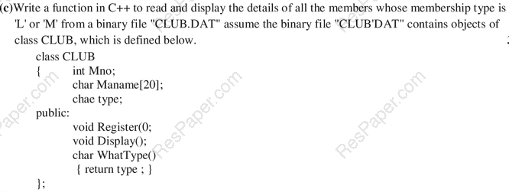

Slide 131
void displayl_m()
{
club c;
fstream fin;
fin.open(“club.dat”,ios::binary|ios::in);
while(fin)
{
fin.read((char *)&c,sizeof(c ))
if(c.whattype()==‘l’||c.whattype()==‘m’)
c.display();
}
fin.close();
}

Slide 132
Write a function in C++ to search for the details (number and calls)of those mobile phones which have 1000 calls from a binary file “mobile.dat”.Assuming that this binary file contains records/objects of class mobile which is defined below.

Slide 133
Class mobile
{
char number[10];
int calls;
public:
void enter()
{
gets(number);
cin>>calls;
}
void billing
{
cout<<number<<“#”<<calls<<endl;
}
int getcalls()
{
return calls;
}
};

Slide 134
void search()
{
ifstream fin(“phones.dat”,ios::in|ios::binary)
phone p;
while((fin.read((char *)&p,sizeof(p));
{
If(p.getcalls()>=1000)
p.billing();
}
fin.close();
}

Slide 135
Write a function in c++ to search for a camera from a binary file “camera.dat” containing the objects of class CAMERA (as defined below).The user should enter the model no and the function should search and display the details of the camera.

Slide 136
Class camera
{
long modelno;
float megapixel;
int zoom;
char details[120];
public:
void enter();
{
cin>>modelno>>megapixel>>zoom;gets(details);
}
void display();
{
cout<<modelno<<megapixel<<zoom<<details<<endl;
}
long getmodelno()
{
return modelno;
}
}

Slide 137
Void search(long mno)
{
fstream file;
file.open(“camera.dat”,ios::in|ios::binary);
camera c;
Int found=0;
while(file.read((char *)&c,sizeof( c )))
{
if(c.getmodelno()==mno)
{
c.display();
found=1;
break;
}
}
If(found==0)
Cout<<“not found”;
File.close();
}

Slide 138
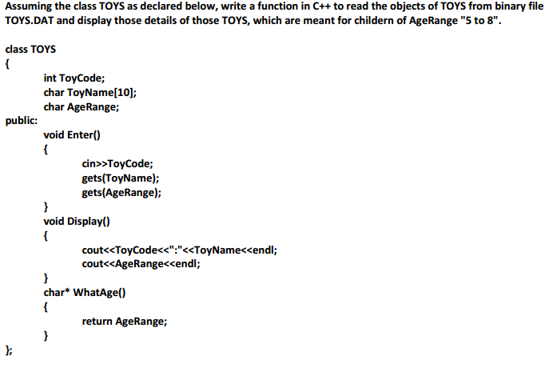

Slide 139
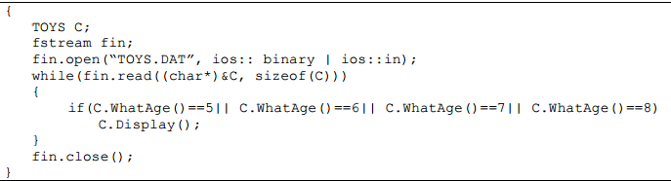
void displayagerange()

Slide 140
Write a function in C++ called count_to() to count the prescence of a word ‘to’ in a text file “NOTES.txt”
Example if content of notes.txt is as follows
The function count_to() will display
Count of –to- in file :3
It is very important to know that
Smoking is injurious to health
Let us take initiative to stop it.

Slide 141
Void count_to()
{
fstream fil;
fil.open(“NOTES.TXT”,ios::in|ios::binary);
char count=0,word[5];
while(!fil.eof())
{
fil>>word;
if(strcmp(word,”to”)==0)
count++;
}
fil.close();
cout<<“Count of file<<count;
}

Slide 142
Observe the program segment given below carefully and fill in the blanks marked as statement 1 and statement 2using seekg() and tellg() functions for performing the required tasks.

Slide 143
#include<fstream.h>
Class employee
{
int eno;char ename[20];
public:
//function to count total number of records
int countrec();
};
Int employee::countrec()
{
fstream file;
file.open(“EMP.DAT”,ios::binary|ios::in);
______________________________________//statement 1
int bytes = ____________________________//statement 2
int count=bytes/sizeof(item);
return count;
}
File.seekg(0,ios::end);
File.tellg()

Slide 144
A binary file bloodbank.dat contains the objects of class bbank declared as follows:
Class bbank
{
int sr_no;
char name[25];
long int telno;
public:
int age;
char bloodgr[4];
void getdata();
void display()
};

Slide 145
Write a main program to append five records of class bbank to this file and then display the details from this file whose blood group is “o+” and whose age is less than 50.

Slide 146
int main()
{
fstream f1;
bbank b1;
f1.open(“bloodbank.dat”ios::in|ios::binary|::ios::app|ios::out)
for(i=0;i<5;i++)
{
b1.getdata();
f1.write((char *)&b1,sizeof(b1));
}
f1.seekg(0);
while(f1.read((char *)&b1,sizeof((b1));
{
if(strcmp((b1.bloodgr,”o+”)&&(b1.age<50))
b1.dsplay()
}
f1.close();
}

Slide 147
Given a file “TELEPHONE.DAT” containing the records of the following
Class directory
{
char name[20];
char address[30];
char areacode[5];
long int phoneno;
public:
void register();
void show();
};
Write a member function copy() in C++ that would copy all the records not having areacode as “321” from TELEPHONE.DAT” to MASTER.DAT
Prelims 2016

Slide 148
void copyabc()
{
directory s;
fstream f1,f2;
f1.open(“telephone.dat”,ios::in|ios::binary);
f2.open(“master.dat”,ios::out|ios::binary);
While(f1.read(char *)&s,sizeof(s))
{
if(strcmp(s.areacode,”321”)!=0)
f2.write((char *)&s,sizeof(s));
}
f1.close();
f2.close();
}

Slide 149
Assuming a binary file fun.dat is containing objects belonging to the class LAUGHTER as defined beow.Write a user defined function to add more objects belonging to the class laugher to the bottom of it.
Class laughter
{
Int idno;
Char type[5];
Char desc[255];
Public:
Void newentry()
{
Cin>>idno;
Gets(type);
Cin>>desc;
}
Void showonscreen()
{
Cout<<idno<<” ”<<type<<endl<<desc<<endl;
}
};

Slide 150
void write()
{
fstream fout(“fun.dat”,ios::app|ios::binary);
laughter lg;
lg.newentry();
fout.write(char *)&lg,sizeof(lg));
fout.close();
}

Slide 151
Write a program to search the name and address of a person having more than 30 years of age.(Assume that a file employee.dat already contains the data in necessary form)

Slide 152
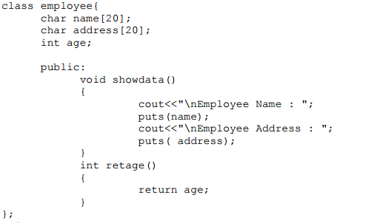

Slide 153
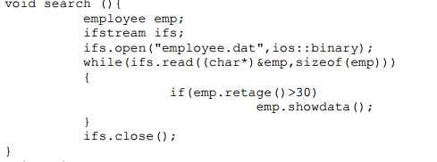

Slide 155
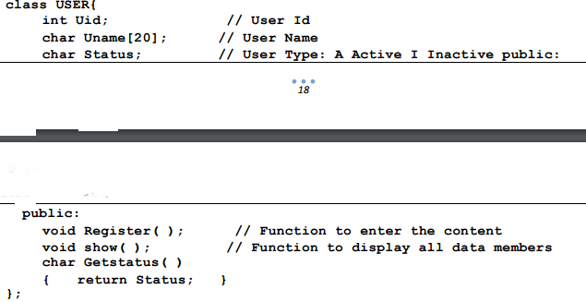

Slide 156
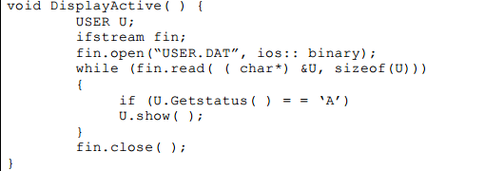

Slide 157
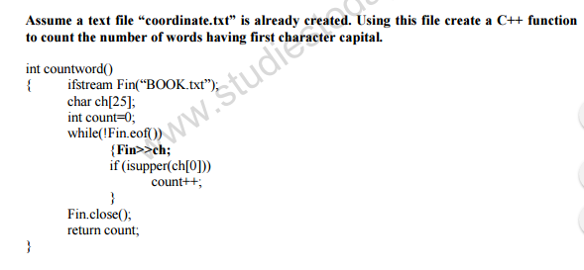

Slide 158
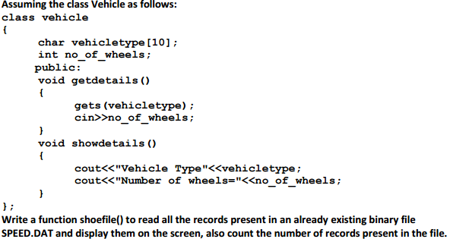

Slide 159
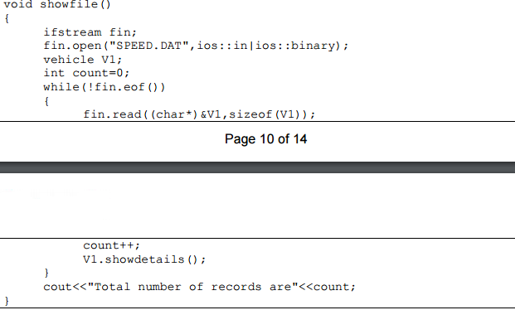

Slide 160
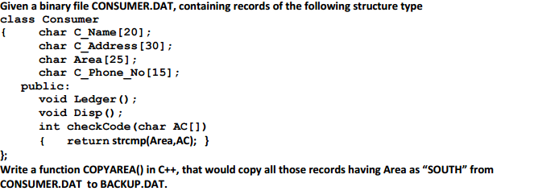

Slide 161
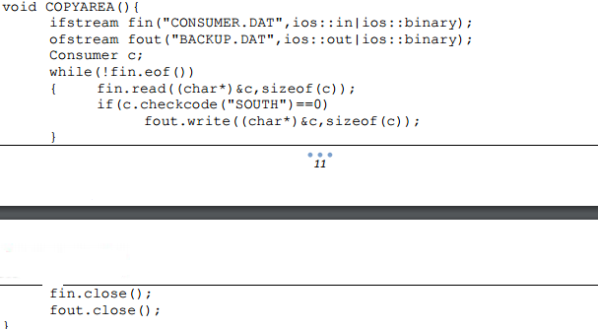

Slide 162
Given a binary file named result.dat containing objects of the following class.
Class student
{
int roll;
char name[30];
float percent;
public:
void getdata()/* to accept all data members from users.
void putdata()/* to display all data members.
float get_percent()
{
return percent;
}
};
Write a user defined function shortlist() which reads the objects from the file “result.dat “ and writes them to a new file named qualify.dat if percent is greater than or equal to 80.
Prelims 2018

Slide 163
Void shortlist()
{
student z;
fstream a,b;
a.open(“results.dat”,ios::in|ios::binary);
b.open(“qualify.dat”,ios::out|ios::binary);
while(a.read((char *)&z,sizeof(z))
{
if(z.get_percent()>=80)
b.write((char*)&z,sizeof(z));
}
a.close();
b.close();
}

