Slide 1
Inheritance

Slide 2
The mechanism of deriving a new class from an old one is called inheritance or derivation.
The old class is referred to as the base class and the new one is called the derived class or subclass.
The main advantages of the inheritance are:-
reusability of the code
to increase the reliability of the code and
to add some enhancement to the base class.

Slide 3
The derived class inherits some or all the traits from the base class.
A derived class with only one base class is called single inheritance.
A dervied class with several base classes is called multiple inheritance.

Slide 4
The traits of one class may be inherited by more than one class .This is called as hierarchical inheritance.
The mechanism of deriving a class from another derived class is called as multilevel inheritance.

Slide 5
Single Inheritance
A
B

Slide 6
Multiple Inheritance
A
B
C

Slide 7
Hierarchical Inheritance
A
B
C
D

Slide 8
Multilevel Inheritance
A
B
C

Slide 9
HYBRID INHERITANCE
A
B
C
D

Slide 10
Defining a derived class
Class derived - class name : visibility mode base-class name
{
………// members of the derived class
}

Slide 11
The visibility mode is optional and the default visibility mode is private.

Slide 12
When a base class is privately inherited by a derived class,
‘public members of the base class become private members of the derived class and therefore the public members of the base class can only be accessed by the member functions of the derived class.

Slide 13
When a base class is publicly inherited public members of the base class become public members of the derived class and therefore they are accessible to the objects of the derived class.

Slide 14
In both cases private members are not inherited and private members will never become members of the derived class.

Slide 15
For example :
class ABC : private XYZ
{
Members of ABC
};
class ABC : public XYZ
{
Members of ABC
};
class ABC : XYZ
{
Members of ABC
};

Slide 16
In the first example class ABC privately inherits the properties of XYZ. So the public members of the base class (XYZ) become private members of the derived class and therefore the public members of the base class can only be accessed by the member function of the derived class. The object of the derived class cannot access the member functions of the base class.
In a next example class ABC publicly inherits the properties of XYZ so the public member of the base class become public members of the derived class.

Slide 17
class b
{
int a;//private
public:
int b;
void get_ab();
int get_a(void);
void show_a(void);
}; class d:private b
{
int c;
public:
void mul(void);
void display(void);
};
void b::get_ab(void)
{
a=5,b=10;
}
void b::show_a()
{
cout<<"A="<<a<<endl;
}
int b::get_a()
{
return a;
}
void d::mul(void)
{
c=b*get_a();
}
void d::display()
{
cout<<"\nA="<<get_a();
cout<<"\nB="<<b;
cout<<"\nC="<<c;
}
void main()
{
clrscr();
d D;
D.get_ab();
D.mul();
D.show_a();
D.display();
D.b=20;
D.mul();
D.display();
}
//wont work
//wont work
//wont work
//a cannot be accesed directly

Slide 18
class b
{
int a;
public:
int b;
void get_ab();
int get_a(void);
void show_a(void);
};
class d:public b
{
int c;
public:
void mul(void);
void display(void);
};
void b::get_ab(void)
{
a=5,b=10;
}
void b::show_a()
{
cout<<"A="<<a<<endl;
}
int b::get_a()
{
return a;
}
void d::mul(void)
{
c=b*get_a();
}
void d::display()
{
cout<<"\nA="<<get_a();
cout<<"\nB="<<b;
cout<<"\nC="<<c;
}
void main()
{
clrscr();
d D;
D.get_ab();
D.mul();
D.show_a();
D.display();
D.b=20;
D.mul();
D.display();
getch();
}

Slide 19
TYPES OF DERIVATION
We have seen that private member of a base class cannot be inherited and therefore it is not available for the derived class directly.
What do we do if the private data need to be inherited by a derived class?
This can be accomplished by modifying the visibility limit of the private member by making it public.
This would make it accessible to all the other functions of the program, thus taking away the advantage of data hiding.

Slide 20
C++ provides a third visibility modifier, protected, which serve a limited purpose in inheritance. A member declared as protected in accessible by the member function within its class and any class immediately derived from it. It cannot be accessed by the functions outside these two classes.
class alpha
{
private: //optional
….. //visible to member functions
….. //within its class
Protected:
….. //visible to member functions
….. //of its own and derived class
Public:
….. //Visible to all functions
….. //in the program
};

Slide 21
When a protected member is inherited in public mode, it becomes protected in the derived class too and therefore is accessible by the member functions of the derived class. It is also ready for further inheritance. A protected member inherited in the private mode derivation, becomes private in the derived class.
VISIBILITY OF INHERITED MEMBERS
Base class visibility | Derived class visibility
 | Public derivation | Private derivation | Protected derivation
Private Protected Public | Not inherited Protected Public | Not inherited Private Private | Not Inherited Protected Protected

Slide 22
PUBLIC INHERITANCE
In a public derivation
Each public member in the base class is public in the
derived class.
Each protected member in the base class is protected in the
derived class.
Each private member in the base class is private in the
derived class.
For example the following program segment illustrate how to access each member of the base class by the derived class member.

Slide 23
Members in
DerivedD
x not accessible
y protected
z public
W private
class baseA
{
private:
int x;
protected:
int y;
public:
int z;
};
class derivedD:public basea
{
private:
int w;
};
The datamembers of the derived
class derivedD is
int x;
int y;
int z;
int w;

Slide 24
Showing Private Derivation
class student
{
private:
int x;
void getdata();
public:
int y;
void putdata();
protected:
int z;
void check();
};
Class marks:private student
{
private:
int a;
void readdata();
public:
int b;
void writedata();
protected:
int c;
void checkvalue();
};

Slide 25
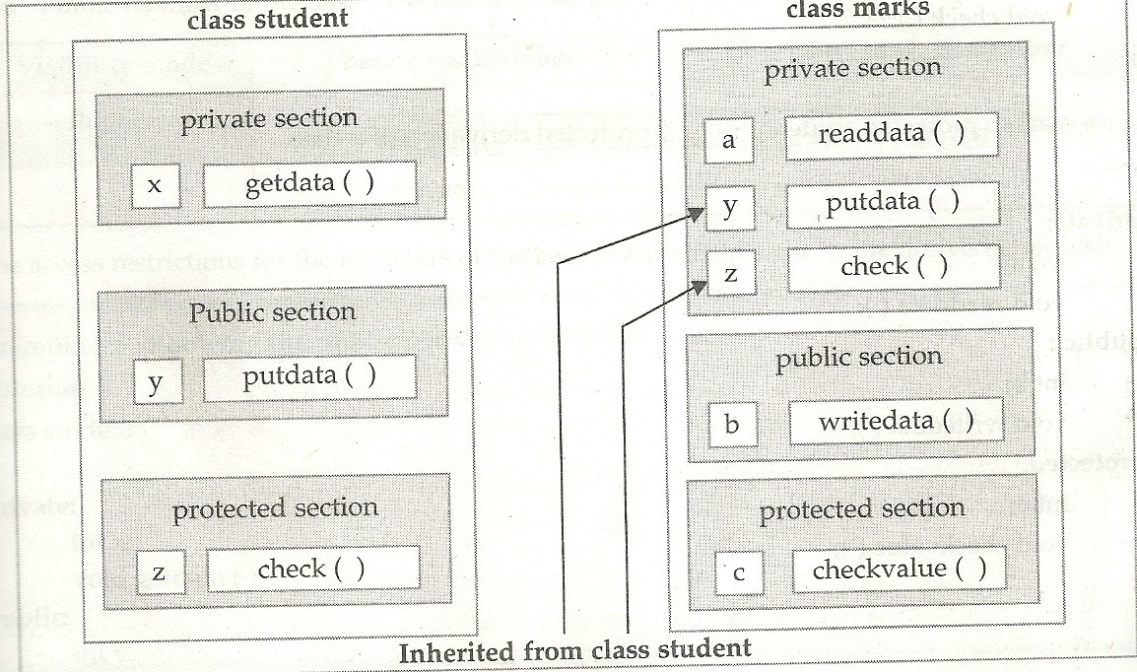

Slide 26
Showing Protected
class student
{
private:
int x;
void getdata();
public:
int y;
void putdata();
protected:
int z;
void check();
};
class marks: protected student
{
private:
int a;
void readdata();
public:
int b;
void writedata();
protected:
int c;
void checkvalue();
};

Slide 27
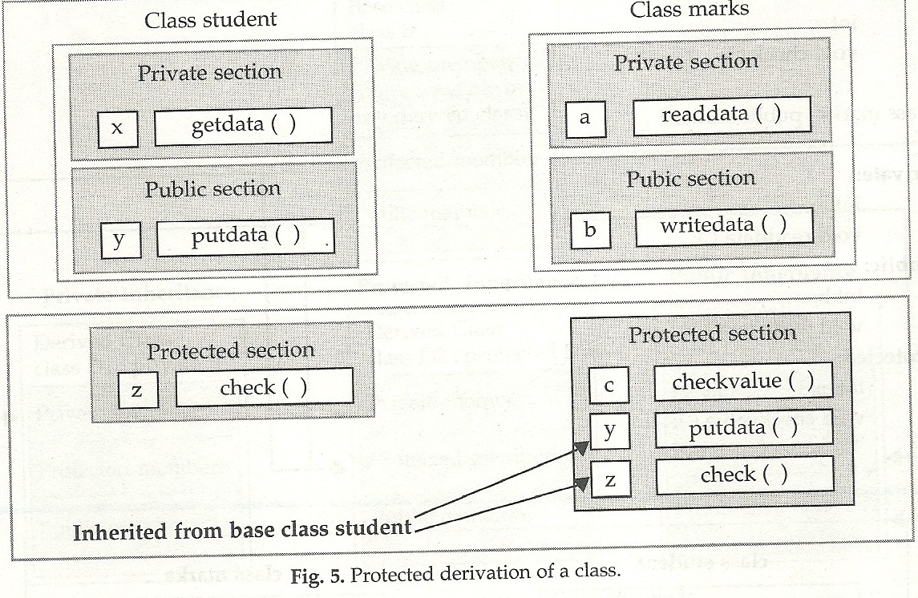

Slide 28
Showing Public Derivation
class student
{
private:
int x;
void getdata();
public:
int y;
void putdata();
protected:
int z;
void check();
};
class marks: public student
{
private:
int a;
void readdata();
public:
int b;
void writedata();
protected:
int c;
void checkvalue();
};

Slide 29
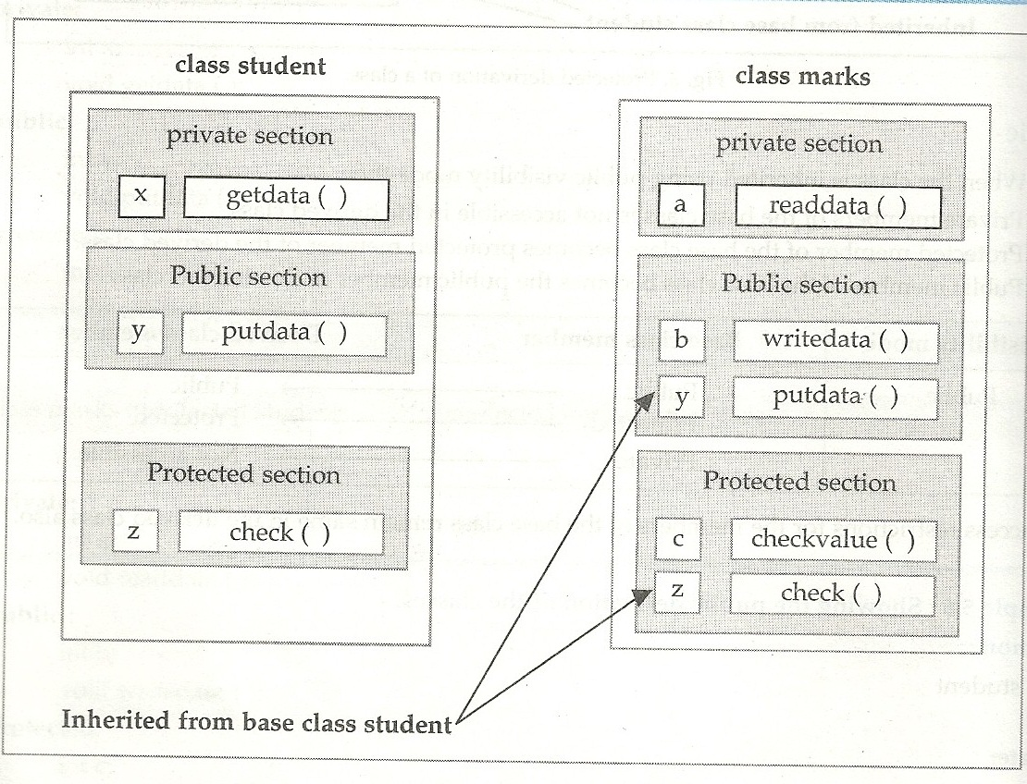

Slide 30
MULTIPLE INHERITANCE
A class can inherit the attributes of two or more classes as shown in below given figure. In known as multiple inheritance. Multiple inheritance allows us to combine the features of several existing classes as a starting point for defining new classes.
B-1
B-2
……
B-n
D
Multiple inheritance is the process of creating a new class from more than one base classes. The syntax for multiple inheritance is similar to that of single inheritance.

Slide 31
The syntax of a derived class with multiple base classes is as follows :
class D : visibility B-1, Visibility B-2…
{
…..
….. (Body of D)
…..
};
FOR EXAMPLE :

Slide 32
class M
{
protected:
int m;
public:
void get_m(int);
};
class N
{
protected:
int n;
public:
void get_n(int);
};
class P:public M, public N
{
public:
void display(void);
};
void M::get_m(int x)
{
m=x;
}
void N::get_n(int y)
{
n=y;
}
void P::display(void)
{
cout<<"m="<<m<<"\n";
cout<<"n="<<n<<"\n";
cout<<"m*n="<<m*n<<"\n";
}
void main()
{
clrscr();
int a,b;
cout<<"Enter the value of a & b";
cin>>a>>b;
P p;
p.get_m(a);
p.get_n(b);
p.display();
}

Slide 33
AMBIGUITY RESOLUTION IN INHERITANCE
Occasionally, we may face a problem in using the multiple inheritance, When a function or data members with the same name appears in more than one base class, to avoid ambiguity between the derived class and one of the base classes or between the base class themselves it is better to use the scope resolution operator (::) along with data members and member function.
Class baseA
{
Public:
Int I;
Void getdata();
};
Class baseB
{
Public:
Int I;
Void getdata();
};
Class deriveC:public baseA, public baseB
{
Public:
Int I;
Void getdata();
};

Slide 34
void main()
{
derived obg;
Obg.getdata();
};
The members are ambiguous without scope operators. When the member function getdata() is accessed by the class object, naturally, the compiler cannot distinguish between the member function of the class baseA and the class baseB. Therefore it is essential to declare the scope operator to call a base class member as illustrated below:
obj.basea::getdata();
obj.baseb::getdata();

Slide 35
MULTILEVEL INHERITANCE
In single inheritance we have seen that we can derive a class from single base class. Sometimes it is possible that the derived class is also the base class for another class. This type of inheritance is known as multilevel inheritance. Below figure shows a multilevel inheritance between three classes A, B and C. The class A serves as a base class for the derived class B which in turn serves as a base class for the derived class C. The class B is known as intermediate base class since it provides a link for the inheritanc ebetween A and C.
Base class
A
Grandfather
Intermediate base class
B
Father
Derived Class
C
Child

Slide 36
A derived class with multilevel inheritance is declared as follows :
Class A {…..} //Base class
Class B: public A {…..}; //B derived from A
Class C: public B {…..}; //C derived from B

Slide 37
class test:public student
{
protected:
float sub1;
float sub2;
public:
void get_marks(float, float);
void put_marks(void);
};
void test::get_marks(float x,float y)
{
sub1=x;
sub2=y;
}
void test::put_marks()
{
cout<<"Marks in SUB1="<<sub1<<"\n";
cout<<"Marks in SUB2="<<sub2<<"\n";
}
#include<iostream.h>
class student
{
protected:
int roll_number;
public:
void get_number(int);
void put_number(void);
};
void student::get_number(int a)
{
roll_number=a;
}
void student::put_number()
{
cout<<"Roll Number:"<<roll_number<<endl;
}

Slide 38
class result:public test
{
float total;
public:
void display(void);
};
void result::display(void)
{
total=sub1+sub2;
put_number();
put_marks();
cout<<"Total="<<total<<"\n";
}
int main()
{
result student1;
student1.get_number(111);
student1.get_marks(75.0,59.0);
student1.display();
return 0;
}

Slide 39
Practice Questions on Inheritance

Slide 40
Class student
{
int rno;
char name[20];
float marks;
protected:
void result();
public:
student();
void register();
void display();
};
Class faculty
{
long fcode;
char name[20];
protected:
float pay;
public:
faculty();
void enter();
void show();
};
Class course:public student,private faculty
{
long ccode[10];char coursename[50];
char startdate[8],enddate[8];
public();
course();
void commence();
void cdetail();
};

Slide 41
1)Which type of inheritance is illustrated in the above code?
2)Write the names of all the data members, which is are accessible from member function commence of class course.
3)Write the names of member functions which are accessible from objects of class course.
4)Write the names of all members which are accessible from objects of class faculty.

Slide 42
1)Multiple Inheritance
2)CCode,Coursename,startdate,enddate,pay
3)Commerce(),Cdetail(),Register(),Display()
4)Enter(),Show()

Slide 43
Class student
{
int rno;
char name[20];
float marks;
protected:
void result();
public:
student();
void register();
void display();
};
Class faculty
{
long fcode;
char name[20];
protected:
float pay;
public:
faculty();
void enter();
void show();
};
class course:public student,private teacher
{
long ccode[10];char coursename[50];
char startdate[8],enddate[8];
public();
course();
void commence();
void cdetail();
};

Slide 44
1)Write the names of member functions which are accessible from objects of class course.
2)Write the names of all data members,which is/are accessible from member function commence of class course.
3)Write the names of all data members which are accessible from objects of class faculty.
4)Which type of inheritance is illustrated in the above C++ code.

Slide 45
1)Void commence(),void cdetail(),void enroll(),void display()
2)ccode,coursename,startdate,enddate,salary
3)void enter(),void show()
4)multiple inheritance

Slide 46
Class chairperson
{
Long cid;
Char cname[20];
Protected:
Char description[40];
Void allocate();
Public:
Chairperson();
Void assign();
Void show();
};
Class director
{
int did;
char dname[20];
protected:
char profile[30];
public:
director();
void input();
void output();
};
Class company:private chairperson,public director
{
int cid;
char city[20],country[20];
public:
company();
void enter();
void display();
};

Slide 47
1)What type of inheritance is illustrated in the above c++ code.
2)Write the names of all the data members accessible by objects of type class company?
3)Write the names of all member functions which are accessible by objects of class type company.
4)Write the names of all members which are accessible from member functions of class director.

Slide 48
1)Multiple Inheritance
2)No data members
3)Enter(),Display(),Input(),Output()
4)Data members:Did,Dname,Profile
Member Functions:Input(),Output()

Slide 49
class facetoface
{
char centercode[10];
public:
void input();
void output();
};
class online
{
char website[50];
public:
void sitein();
void siteout();
};
class training:public facetoface,private online
{
long tcode;
float charge;
int period;
public:
void register();
void show();
};

Slide 50
1)Which type of inheritance is shown in the above example?
2)Write the names of all member functions accessible from show() function of class training.
3)Write names of all members accessible through an object of class training.
4)Is the function Output() accessible inside the function siteout()?Justify your answer.

Slide 51
1)Multiple Inheritance.
2)Register(),Sitein(),Siteout(),Input(),Output()
3)Register(),Show(),Input(),Output()
4)No.Not accessible ,Output() is member of class facetoface and siteout() is a member of class online,and both the classes are two independent classes.

Slide 52
class regular
{
char schoolcode[10];
public:
void inregular();
void outrgeular();
};
class distance
{
char studycentrecode[5];
public:
void indistance();
void outdistance();
};
class course:public regular,private distance
{
char code[5];
float fees;
int duration;
public:
void incourse();
void outcourse();
};

Slide 53
1)Which type of inheritance is shown in the above example?
2)write names of all member functions accessible from outcourse function of class course.
3)Write names of all members accessible through an object of class course.
4)Is the function Inregular() accessible inside the function indistane()?Justify your answer.

Slide 54
1)Multiple Inheritance
2)Incourse,Indistance(),Outdistance(),Inregular(),
outregular()
3)incourse(),outcourse(),inregular(),outrgegular()
4)No function is not accessible because inregular() is member of class regular and indistance() is a member of class distance and class regular and distance are two independent classes.

Slide 55
HIERARCHICAL INHERITANCE
We have seen that we can derive one derived class from single base class and several base classes for a single derived class.
It is possible to derive more than one derived class from a single class. This type of inheritance is shown as hierarchical inheritance.
Student
Arts
Commerce
Science
Medical
Non-Medical

Slide 56
#include<iostream.h>
#include<conio.h>
class baseemp
{
private:
char name[25],address[25],city[15],state[5];
public:
void input_data(void);
void print_data(void);
};
class derivedemp:public baseemp
{
double salary, gross;
float da,hra;
public:
void input_salary(void);
double cal_da(void);
double cal_hra(void);
double cal_gross(void);
void print_salary(void);
};
class derivedcust:public baseemp
{
int acc_no, balance;
public:
void read_cust();
void show_cust();
};
void baseemp::input_data(void)
{
cout<<"\nEnter the name:";
cin>>name;
cout<<"\nEnter the address:";
cin>>address;
cout<<"\nEnter city:";
cin>>city;
cout<<"\nEnter state:";
cin>>state;
}

Slide 57
double derivedemp::cal_hra(void)
{
return(0.15*salary);
}
double derivedemp::cal_gross(void)
{
return(salary+da+hra+salary);
}
void derivedemp::print_salary(void)
{
print_data();
cout<<"\nBasic salary\t\t\t\t:"<<salary;
cout<<"\nDearness allowance\t\t\t:"<<da;
cout<<"\nHouse rent allowance\t\t\t:"<<hra;
cout<<"\nGross\t\t\t\t\t:"<<gross;
}
void derivedcust::read_cust(void)
{
input_data();
cout<<"\nEnter the Account number:";
cin>>acc_no;cout<<"\nEnter the Balance amount:";
void baseemp::print_data(void)
{
cout<<"\nname\t\t\t\t\t:"<<name;
cout<<"\nAddress\t\t\t\t\t:"<<address;
cout<<"\nCity\t\t\t\t\t:"<<city;
cout<<"\nState\t\t\t\t\t:"<<state;
}
void derivedemp::input_salary(void)
{
input_data();
cout<<"\nEnter salary:";
cin>>salary;
da=cal_da();
hra=cal_hra();
gross=cal_gross();
}
double derivedemp::cal_da(void)
{
return(1.20*salary);
}

Slide 58
cin>>balance;
}
void derivedcust::show_cust(void)
{
print_data();
cout<<"\nCustomer Account Number\t\t\t:"<<acc_no;
cout<<"\nCustomer Balance\t\t\t:"<<balance;
}
void main()
{
clrscr();
derivedemp emp;
derivedcust cust;
cout<<"\n\nEnter the particulars of Employee";
emp.input_salary();
emp.print_salary();
cout<<"\nEnter the particulars of Customer:";
cust.read_cust();
cust.show_cust();
}

Slide 59
Practice Questions

Slide 60
class doll
{
char dcode[5];
protected:
float price;
void calcprice(float)
public:
dolls();
void dinput();
void dshow();
};
Class softdolls:public dolls
{
Char sdname[20];
Float weight;
Public:
Softdolls();
Void sdinput();
Void sdshow();
};
Class electronicdolls:public dolls
{
Char edname[20];
Char batterytype[10];
Int batteries;
Public:
Electronicdolls();
Void edinput();
Void edshow();
};

Slide 61
1)Which type of inheritance is shown in the above example?
2)Write the names of all data members accessible from member functions of class softdolls.
3)Write names of all member functions accessible by an object of class electronic dolls

Slide 62
Soln:
1)Multi-level Inheritance
2)Data members:sdname,weight,price
3)edinput(),edshow(),sdinput(),sdshow(),dinput(),
dshow().

Slide 63
Class stationery
{
Char type;
Char manufacturer[10];
Public:
Stationery();
Void read_sta_details();
Void disp_sta_details();
};
Class office:public stationery
{
Int no_of_types;
Float cost_of_sta;
Public:
Void read_off_details();
Void disp_off_details();
};
Class printer:private office
{
Int no_of_users;
Char delivery_date[10];
Public:
Void read_pri_details();
Void disp_pri_details();
};
Int main()
{
Printer myprinter;
}

Slide 64
1)Mention the members which are accessible by myprinter declared in main function ?
2)What is the size of myprinter in bytes.
3)Mention the names of functions accessible from the member function read_pri_details() of class printer.

Slide 65
Soloution:
1)Data members:None
2)Member functions: Read_pri_details(),Disp_pri_details()
2)29 bytes
3)Read_sta_details(),Disp_sta_details(),Read_off_details(),disp_off_details(),read_pri_details(),disp_pri_details().

Slide 66
Class teacher
{
Char tno[5],tname[20],dept[10];
Int workload;
Protected:
Float salary;
Void assignsal(float);
Public:
Teacher();
Void tentry();
Void tdisplay();
};
Class student
{
Char admno[10],sname[20],stream[10];
Protected:
Int attendance,totmarks;
Public:
Student();
Void sentry();
Void sdisplay();
};
Class school:public student,public teacher
{
Char scode[10],schname[20];
Public:
School();
Void schentry();
Void schdisplay();
};

Slide 67
1)Which type of inheritance is depicted in the above code?
2)Write names of all members accessible from member functions of class school
3)if class school is derived privately from class teacher and privately from class student,then name the member function(s)that could be accessed through objects of class school.

Slide 68
Soln:
1)Multiple Inheritance
2)Data members:Salary,Attendence,Total Marks,Scode,Schname.
Member functions:Assignsal(),Tentry(),Tdisplay(),Sentry(),Sdisplay(),Schentry(),Schdisplay().
3)Schentry(),Schdisplay()

Slide 69
HYBRID INHERITANCE
There could be situations where we need to apply two or more types of inheritance to design a program, for instance consider the case of processing the student results. Assume that we have to give weightage for sports before finalising the results. The weightage for sports is stored in a separate class called sports. The new inheritance relationship between the various classes would be as shown in given below figure :
STUDENT
TEST
SPORTS
RESULT
Multilevel, Multiple Inheritance.

Slide 70
#include<iostream.h>
class student
{
protected:
int roll_number;
public:
void get_number(int a)
{
roll_number=a;
}
void put_number(void)
{
cout<<"Roll No:"<<roll_number<<"\n";
}
};
class test:public student
{
protected:
float part1, part2;
public:
void get_marks(float x, float y)
{
part1=x;
part2=y;
}
void put_marks(void)
{
cout<<"Marks obtained:"<<"\n"
<<"Part1="<<part1<<"\n"
<<"Part2="<<part2<<"\n";
}
};
class sports
{
protected:
float score;
public:
void get_score(float s)
{
score=s;
}

Slide 71
int main()
{
result student_1;
student_1.get_number(1234);
student_1.get_marks(27.5,33.0);
student_1.get_score(6.0);
student_1.display();
return 0;
}
void put_score(void)
{
cout<<"Sports wt:"<<score<<"\n";
}
};
class result:public test,public sports
{
float total;
public:
void display(void);
};
void result::display(void)
{
total=part1+part2+score;
put_number();
put_marks();
put_score();
cout<<"Total Score:"<<total<<"\n";
}

Slide 72
Class furniture
{
Char type;
Char mode[10];
Public:
Furniture();
Void read_fur_details();
Void disp_fur_details();
};
Class sofa:public furniture
{
Int no_of_seats;
Float cost_of_sofa;
Public:
Void read_sofa_details();
Void disp_sofa_details();
};
Class office:private sofa
{
Int no_of_pieces;
Char delivery_date[10];
Public:
Void read_office_details();
Void disp_office_details();
};
Int main()
{
Office my furniture;
}

Slide 73
1)Mention the member names which are accessible by myfurniture declared in main() function.
3)Mention the names of the functions accessible from the member function read_office_details() of class office.

Slide 74
Data Members:None
Member functions:read_office_details() ,disp_office_details()
2)Read_fur_details(),disp_fur_Details()
Read_sofa_Details(),disp_sofa_details()
Disp_office_details().

Slide 75
class Bill : public Paint
{
float Charges;
void Calculate();
public :
Bill();
void Billing();
void Print();
};
class Exterior
{
int OrderId;
char Address[20];
protected:
float Advance;
public:
Exterior();
void Book();
void View();
};
class Paint:public Exterior
{
int WallArea,ColorCode;
protected:
char Type;
public:
Paint();
void PBook();
void PView();
};

Slide 76
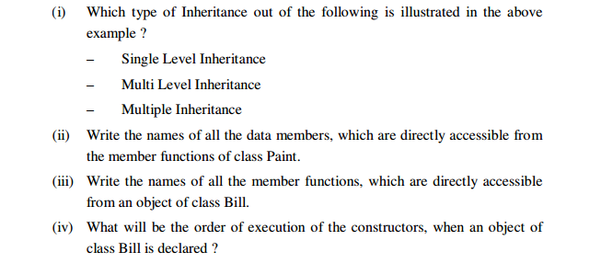

Slide 77
1)Multi Level Inheritance
2) WallArea, ColorCode,Type, Advance
3) Billing(), Print(), PBook(), PView(), Book(), View()
4) Exterior(), Paint(), Bill()

Slide 78
Virtual Base Class
Consider a situation in which all three kinds of inheritance namely multilevel ,hierarchal and multiple inheritance are involved.

Slide 79
GRANDPARENT
PARENT 1
PARENT 2
CHILD

Slide 80
The child has two direct base classes parent 1 and parent 2 which themeselves have a common base class grandparent.
The child inherits the traits of the grandparent via two separate paths.It also inherits the traits via the straight line.
The grandparent is sometimes referred to as indirect base class.

Slide 81
All the public and the protected members of grandparent are inherited by the child twice.First via parent and then via parent 2.
This duplication can be avoided by making the common base class(ancestor class)as the virtual base class.

Slide 82
Class A //grandparent
{
};
Class B1 :virtual public A // parent 1
{
};
Class b2:virtual public A //parent 2
{
};
Class C:public B1,Public B2 //child
{
};

Slide 83
ABSTRACT CLASS
An abstract class is one that is not used to create objects.
An abstract class is designed only to act as a base class(to be inherited by other classes).

Slide 84
Constructors in Derived Classes
If any base class contains a constructor with arguments then it is mandatory for the derived class to have a constructor and pass arguments to the base class constructor.
When both the base and the derived class contain constructors the base class constructor is executed first and then the constructor in the derived class is executed.

Slide 85
General form
The general form of declaring a base class constructor is
Derived-constructor(Arglist1,Arglist 2,…….Arglist N,Arglist(D)
Base1(arglist1),
Base2(arglist2),
……
BaseN(ArglistN),
{
Body of dervied constructor
}

Slide 86
The header line of the derived constructor function contains two parts seperated by a :
The first part provides the declaration of the arguments that are passed to the derived constructor and the second part lists the function calls to the base constructor.

Slide 87
Containership
C++ supports a way of inheriting properties of one class into another.
This approach takes the view that an object can be a collection of many other objects.
That is a class can contain objects of other classes.

Slide 88
class alpha{….};
class beta{…};
class gamma
{
alpha a;
beta b;
};
All objects of gamma class will contain the objects a and b.This kind of relationship is called containership or nesting.

Slide 89
class gamma
{
alpha a;
beta b;
Public:
Gamma(arglist):a(arglist),b(arglist)
{
// contsructor body
}

Slide 90
Declare an abstract class named student with the following members
1)roll of type integer under private visibility label
2)constructor to initialise data member roll.
3)display()-a function under public visibility label to display the data member roll.
Declare an abstract class member marks with the following member’s
1)Percent of type float under private visibility label
2)Constructor to initialise data member percent.
3)Display()-a function under public visibility label to display the data member percent.
Declare a class named school with the following members
1)Name-a character array of size 30 under private visibility label.
2)a of type student under private visibility label
3)b-of type marks under private visibility label
4)Constructor to initialise data member name.
5)display()- a function under public visibility label to display the data member name.
Write a main program to accept the input values and display the data members of all the classes using display();
Board 2014

Slide 91
class student
{
int roll;
public:
Student(int x)
{
roll=x;
display();
}
Void display()
{
cout<<roll;
}
};
Class marks
{
Float percent;
Public:
Marks(float y)
{
percent=y;
display();
}
Void display()
{
cout<<percent;
}
};
Class school
{
char name[30];
student a;
marks b;
public:
school( int p,float q,char *s):a(p),b(q)
{
strcpy(name,s);
display();
}
void display()
{
cout<<name;
}
};
Int main()
{
school z(1000,90,”John”);
}

Slide 92
Consider the following class declaration and answer the questions given bellow (Assume that Fname and Sname are abstract classes)
class Fname
{
Char firstname [10]
Char gender;
Float height;
Public:
Fname (char F[ ], char g, float H)
{
Strcpy (firstname F)
Gender = G;
Height =H;
}
Void display ()
};

Slide 93
Class sname
{
Char surname [12]
Int Rollno;
Public :
Sname (chan S [ ], int R)
{
Strcpy (surname,S):
Rollno = R;
}
Void display ();
};
Class mname : public fname, public Sname
{
Char Midname [15];
Int age;
Public :
………………………
…………………………
Void display();
};

Slide 94
1)Write the constructor function for the derived class Mname.
2)Considering “a” to be an object of derived class, write statements to access display () function of each class.

Slide 95
Mnane Fi [ ],( Chan Ge , Float He,char Si [ ], int Ro char Mi [ ], int Ag): Fname(Fi , Ge , He),Sname (Si, Ro)
{
Strcpy (midname, MI)
Age =Ag;
}
Void Main ( )
{
a.Display ();
a.Fname : : display ();
a.Sname : : display();
}

Slide 96
IMPORTANT
In Multiple inheritance base class constructors are called in the order they appear in the declaration of the derived class.
In Containership the constructors are called in the order the objects are declared in the nested class..

Slide 97
Declare an abstract class “Bank ”consisting of the following members:
i)custno:of type integer under private visisbility label
ii)Define a constructor to initialize data member custno
iii)display()-a function under public visibility label to display data member custno
Declare an abstract class named account consisting of the following memebers:
i)deposit:of type integer under private visibility label
Ii)Define a constructor to initialize data member deposit.
Iii)display()-a function under public visibility label to display data memebr deposit.
Prelims 2016
contd

Slide 98
Declare a class named customer consisting of the following members:
i)a of type bank under private visibility label.
Ii)b of type account under private visibility label
Iii)name a character array of size 30 under private visibility labe;
Iv)define a constructor to initialize the data member name
V)display() a function under protected visibility label to display the data member name.
Write a main program to accept the input values and send it as arguments to an appropriate constructor.Also display the data members of all the classes.

Slide 99
#include<iostream.h>
#include<string.h>
Class bank
{
int custno;
public: bank(int x)
{
custno=x;
}
void display()
{
cout<<custno<<endl;
}
}

Slide 100
Class account
{
int deposit;
public: account(int y)
{
deposit=y;
}
void display()
{
cout<<deposit<<endl;
}
}

Slide 101
Class customer
{
bank a;
account b;
char name[30];
protected: void display()
{
a.display();
b.display();
cout<<name<<endl;
}
public: customer(int p,int q,char *s):a(p),b(q)
{
strcpy(name,s);
display();
}

Slide 102
int main()
{
customer z(1000,25000,”xyz”);
}

Slide 103
Prelims 2016
Declare an abstract class named train consisting of the following members:
Trno:of type integer under private visibility label
Declare another abstract class named destination consisting of the following members
Place:a character array of size 30 under private visibility label
Derive a class named ticker from class train and destination both in public mode.The class has the following member:
contd

Slide 104
Fare:of tpe integer under private visibility label.
Define a single member function in each class mentioned above in such a way that for input:
1002 /*train number trno */
Mumbai /*place*/
500/*fare*/
The output should be “cost per ticket for train number 1002 going to mumbai is 500”
Write a relevant function for the above.

Slide 105
#include<iostream>
Class train
{
int trno;
public:
train(int x)
{
trno=x;
cout<<“cost per ticket for train number “<<trno<<“going to”;
}
}

Slide 106
Class destination
{
char place[30];
public:
destination(char *s)
{
strcpy(place,s);
cout<<“Mumbai is ”;
}
};

Slide 107
Class ticket:public train,public destination
{
int fare;
public:
ticket(int p,char *q,int r):train(p),destination(q) {
fare=r;
cout<<fare;
}
};

Slide 108
Int main()
{
ticket z(1002,”mumbai”,500)
}

Slide 109
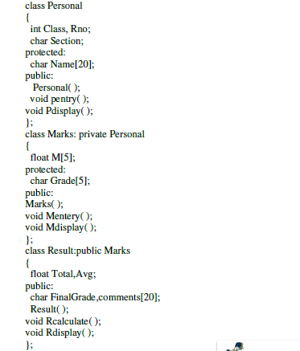

Slide 110
1)Which type of inheritance is shown in the above example.
ii)Write the names of those data members which can be directly accessed by objects of class result
iii)Write the names of those member functions which can be directly accesed from the object of class result
iv)Write the names of those data members which can be directly accessed from the Mentry() function of class marks
i)Multi-level inheritance
ii) Finalgrade ,comments
iii)Rcalculate(),Rdisplay(),Mentry(),Mdisplay()
iv)Name,m,grade

Slide 111
class livingbeing
{ char specification[20];
int average;
public:
void read();
void show();
};
class ape: private livingbeing
{
int no_of_organs,no_of_bones;
protected:
int iq_level;
public:
void readape();
void showape();
};
class human:public ape
{ char race[20];
char habitation[30];
public:
void readhuman();
};

Slide 112
(i)Name the members, which can be accessed from the member
functions of class human.
Ans: Data Members - ape::iq_level
human::race
human::habitation
Member Function – ape::readape( )
ape::showape( )
(ii)Name the members, which can be accessed by an object of
class human.
Ans: Data Members - No data members can be accessed.
Member Functions: ape::readape();
ape::showape();
human::readhuman();

Slide 113
class Toys { char Tcode[5]; protected: float Price; void Assign(float); public: Toys(); void Tentry(); void Tdisplay(); };
class ElectronicToys:public Toys { char ETName[20]; int No_of_Batteries; public: ElecronicToys(); void ETEntry(); void ETDisplay(); };
class SoftToys:public Toys { char STName[20]; float Weight; public: SoftToys(); void STentry(); void STDisplay(); };

Slide 114
Which type of Inheritance is shown in the above example?
Write name of all data members accessible from member function of the class SoftToys.
Write name of member functions accessible an object of the class ElectronicToys ?

Slide 115
2)
Toys::Price, SoftToys::STName, SoftToys::Weight
3)ElectronicToys::ETEntry( ), Electronic Toys::ETDisplay( ), Toys::TEntry( ), Toys::TDisplay( )

Slide 116
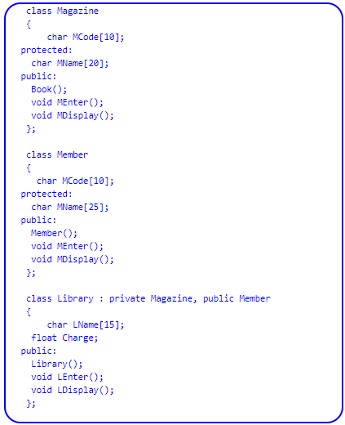

Slide 117
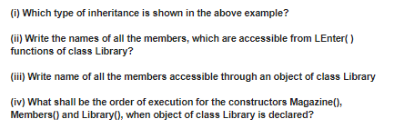

Slide 118
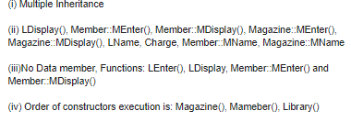

Slide 119
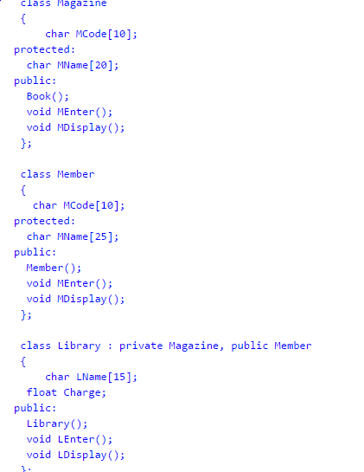

Slide 120
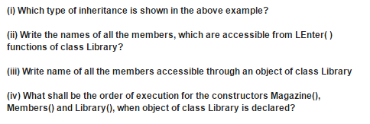

Slide 121
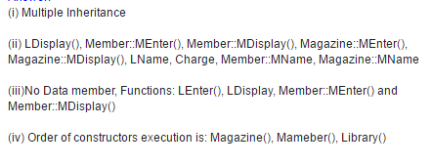

Slide 122
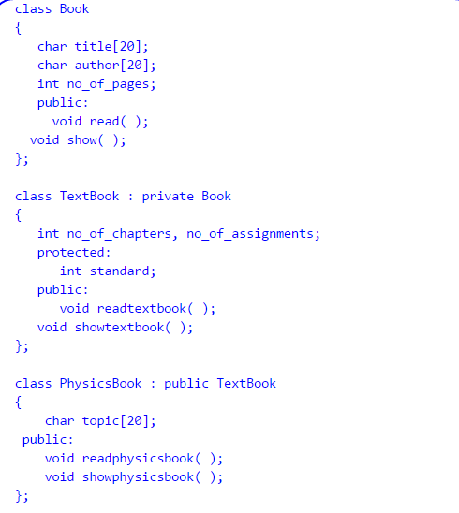

Slide 123
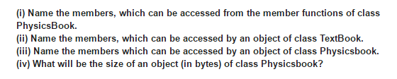

Slide 124
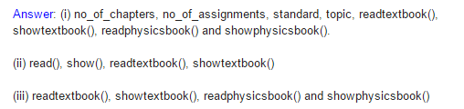

Slide 125
Declare an abstract class named customer which has the following members:
1)cno:of type integer under private visibility label
2)display() a function under protected visibility label to display data member cno
3)Define a comstructor to initialise the data member cno
Derive a class named account from customer under protected mode which has the following members:
1)deposit:of type integer under private visibility label
2)intr:of type float under private visibility label
3)Display(): a function under protected visibility label to display the data members intr and deposit.
4)Define a constructor to initialise data member deposit and set intr with computed value as deposit*0.05*3
Derive a class named named person from account under protected mode.It has the following members:
1)Name:a character array of size 30 under private visibility label
2)display():a function under protected visibility label to display the data member name.
3)Define a constructor to initialise the data member name.
Write a main program to create an object of class person to initialise data members of all classes.Use the same object to display the data members of all the classes.
Prelims 2018

Slide 126
#include<iostream.h>
#include<string.h>
class customer
{
int cno;
protected:
void display()
{
cout<<cno<<endl;
}
public:
customer(int c)
{
cno=c;
}
};
class account:protected customer
{
int intr,deposit;
protected:
void display()
{
cout<<intr<<" "<<deposit<<endl;
}
public:
account(int cn,int depo):customer(cn)
{
deposit=depo;
intr=deposit*0.05*3;
}
};
CONTD

Slide 127
class person:protected account
{
char name[30];
protected:
void display()
{
cout<<name<<endl;
}
public:
person(int cc,int dd, char *s):account(cc,dd)
{
strcpy(name,s);
customer::display();
account::display();
display();
}
};
int main()
{
person z(1234,10000,"xyz");
}

Slide 128
Declare an abstract class named customer which has the following members:
1)cno:of type integer under private visibility label.
2)display():a function under public visibility label to display data member cno.
3)Define a constructor to initialise the data member cno.
Declare an abstract class named account which has the following members:
1)Deposit: of type integer under private visibility label.
2) display():a function under public visibility label to display data member deposit.
3)Define a constructor to initialise data member deposit.
Declare a class named person which has the following members:
1)a:of type customer under private visibility label.
2)b of type account under private visibility label.
3)name a character array of size 30 under private visibility label.
4)Define a constructor to initialise the data member name.
5)display() a function under protected visibility label to display the data member name.
Write a main program to create an object of class person to initialise data members of all classes.Also display the data members of all classes.

Slide 129
Class account
{
int intr,deposit;
protected:
public:
account(int depo)
{
deposit=depo;
}
void display()
{
cout<<deposit<<endl;
}
};
#include<iostream.h>
#include<string.h>
class customer
{
int cno;
public:
customer(int c)
{
cno=c;
}
void display()
{
cout<<cno<<endl;
}
};
CONTD

Slide 130
class person
{
char name[30];
customer a;
account b;
protected:
void display()
{
cout<<name<<endl;
}
public:
person(int cc,int dd,char *s):a(cc),b(dd)
{
strcpy(name,s);
a.display();
b.display();
display();
}
};
Int main()
{
person z(1234,1000,”xyz”
}

