Slide 1
Structures

Slide 2
A struct (short for structure) allows us to group variables of mixed data types together into a single unit.
Because structs are user-defined, we first have to tell the compiler what our struct looks like before we can begin using it. To do this, we declare our struct using the struct keyword.

Slide 3
struct Employee
{
int nID;
int nAge;
float fWage;
};
The Employee struct contains 3 variables inside of it: two ints and a float. These variables are called members (or fields).

Slide 4
In order to use the Employee struct, we simply declare a variable of type Employee:
Employee Joe;
In order to access the individual members, we use the member selection operator (which is a period).

Slide 5
Employee sJoe;
sJoe.nID= 14; // initialize nID within sJoe
sJoe.nAge = 32; // initialize nAge within sJoe
sJoe.fWage = 24.15;// initialize fWage within sJoe

Slide 6
Difference between class and a structure
Members of a class are private by default and members of struct are public by default.
When deriving a struct from a class/struct, default access-specifier for a base class/struct is public. And when deriving a class, default access specifier is private.

Slide 7
Arrays of Structures
struct inventory
{
int part_no;
float cost;
float price;
};

Slide 8
Pointer To Structure
struct Book
{
char name[10];
int price;
}
int main()
{
struct Book a; //Single structure variable struct
Book* ptr; //Pointer of Structure type
ptr = &a;
struct Book b[10]; //Array of structure variables
struct Book* p; //Pointer of Structure type
p = &b;
}

Slide 9
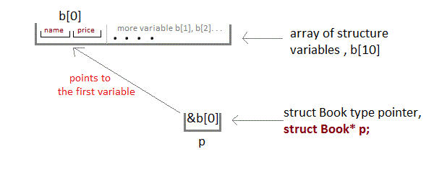

Slide 10
Accessing Structure members with pointer
To access members of structure with structure variable, we used the dot . operator. But when we have a pointer of structure type, we use arrow -> to access structure members.

Slide 11
struct Book
{
char name[10];
int price;
}
int main()
{
struct Book b;
struct Book* ptr = &b;
ptr->name = "Dan Brown";
ptr->price = 500;
}

Slide 12
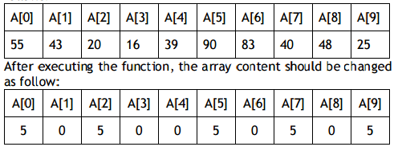
Write the definition of a function Alter(int A[], int N) in C++, which should change all the multiples of 5 in the array to 5 and rest of the elements as 0.
For example, if an array of 10 integers is as follows:

Slide 13
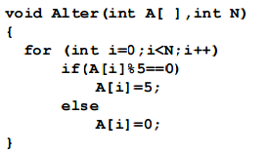

Slide 14
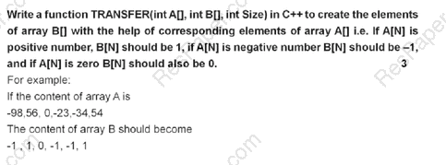

Slide 15
