Slide 1
Constructors And Destructors

Slide 2
A constructor is a special member function whose task is to initialize the objects of its class.
It is special because its name is same as the class name.
The constructor is invoked whenever an object of its associated class is created.

Slide 3
It is called constructor because it constructs the values of the data members of the class.

Slide 4
Constructor is a special member function whose task is to initialise the object of its class whenever an object is created.
It is special because its name is the same as the class name. the constructor is invoked whenever an object of its associated class is created.

Slide 5
Class integer
{
int m,n
public:
integer(void); //constructor declared
};
integer :: integer (void) //constructor defined
{
m=0;n=0;
}

Slide 6
When a class contains a constructor it is guaranteed that an object created by the class will be initialized automatically.
Example
Integer int1;
Not only creates the object int1 of type integer but also initializes its data members m and n to zero.

Slide 7
A constructor that accepts no parameters is called as default constructor.
The constructor function can also be defined as an inline function.

Slide 8
Special characteristics of a constructor
They should be declared the public section
They are invoked automatically when the objects are created.
They do not have any return types not even void and therefore cannot return values.
Like other C++ functions they can have default arguments.

Slide 9
Constructors cannot be virtual
We cannot refer to their adresses
They cannot be inherited through a derived class and call the base class constructor.
They make implicit calls to the operators new and delete when memory allocation is required.

Slide 10
//A program using class with constructor
class integer
{
int m,n,char name[20];
public:
integer();
void display();
};
integer::integer()
{
m=0;
n=0;
strcpy(name,”abc”);
}
void integer::display()
{
cout<<“ the value of m= “<<m<<endl;
cout<<“ the value of n= “<<n<<endl;
cout<<“The name is “<<name<<endl;
}
void main()
{
integer i;
i.display();
}

Slide 11
Parameterized Constructors
The constructor defined earlier initializes the data members of all the objects to zero.
It may be necessary to initialize the various data elements of different objects with different values when they are created.
C++ allows us to pass arguments to the constructor function when objects are created.

Slide 12
Constructor that can take arguments are called parameterized contructor.

Slide 13
Class integer
{
Int m,n;
Public:
Integer(int x,int y) //parameterized constructor
};
Integer::integer(int x,int y)
{
M=x;n=y;
}

Slide 14
We must pass initial values as arguments to the constructor function.
It can be done in two ways.
By calling the constructor explicitly
By calling the constructor implicitly.

Slide 15
Integer int 1=integer(0,100); //explicit call
Integer int1(0,100) //implicit call

Slide 16
MULTIPLE CONSTRUCTORS IN A CLASS
So far we have used two kinds of constructors they are :
integer( ); //No arguments
integer (int,int); //two arguments.
When more than one constructor function is defined in a class, we say that the constructor is overloaded.

Slide 17
#include<iostream>
using namespace std;
class Example
{
int a,b;
public:
Example()
{
a=50;
b=100;
}
Example(int x,int y)
{
a=x;
b=y;
}
void Display()
{
cout<<"\nValues :"<<a<<"\t"<<b;
}
};
int main()
{
Example Object(10,20);
Example Object2;
// Constructor invoked.
Object.Display();
Object2.Display();
// Wait For Output Screen
}

Slide 18
DEFAULT CONSTRUCTOR
A constructor that accepts no parameters is a default constructor.
CONSTRUCTOR WITH DEFAULT ARGUMENTS
C++ also permits to define constructor with default arguments. For ex. the constructor complex( ) can be declared as following.
Complex (float real, float image=0);
The default value of the argument image is zero.
Complex C(5.0);
Assign the value 5.0 to the real variable and 0.0 to image (by default)

Slide 19
COPY CONSTRUCTORS
Copy Constructor is a type of constructor which is used to create a copy of an already existing object of a class type.
As it is used to create an object, hence it is called a constructor. And, it creates a new object, which is exact copy of the existing copy, hence it is called copy constructor.

Slide 20
A constructor that accepts a reference to its own class as a parameter is called copy constructor.
The copy constructors are used in the following situations:
The initilization of an object by another object of
the same class.
Return of objects as a function value.
Starting the object as by value parameters of a
function.

Slide 21
The general format of a copy constructor is,
The symbolic representation of the above format is:
x::x(x &ptr)
Where x is user defined class name and ptr is pointer to a class object x.
Normally the copy constructors take an object of their own class as arguments and produce such an object. The copy constructor usually do not return a function value.
Class_name::class_name(class_name &ptr)

Slide 22
#include<iostream.h>
using namespace std;
class play
{
int count,number;
public:
play();
play(play &);
void disp();
void change(int,int);
};
play::play()
{
count=10;
number=20;
}
play::play(play &x)
{
count=x.count;
number=x.number;
}
void play::disp()
{
cout<<count<<endl;
cout<<number<<endl;
}
void play::change(int c,int n)
{
count=c;
number=n;
}
int main()
{
play p;
p.disp();
play q(p);
q.disp();
play r=q;
r.disp();
}

Slide 23
#include<iostream.h>
using namespace std;
class play
{
int count,number;
public:
play();
play(play &);
void disp();
void change(int,int);
};
play::play()
{
count=10;
number=20;
}
play::play(play &x)
{
count=x.count+20;
number=x.number;
}
void play::disp()
{
cout<<count<<endl;
cout<<number<<endl;
}
void play::change(int c,int n)
{
count=c;
number=n;
}
int main()
{
play p;
p.disp();
play q(p);
q.disp();
play r=q;
r.disp();
}

Slide 24
Class student student(student &s)
{ {
Int rno; rno=s.rno;
Int cl; cl=s.cl;
Char name[20]; strcpy(name,s.name);
Public: }
Student() void readdata()
{ {
Rno=0; cout<<“enter details”;
Cl=0; cin>>rno>>cl>>name;
Strcpy(name,”abc”); }
} void displaydata()
student(int r,int c,char n[20]) {
{ cout<<rno<<cl<<name;
rno=r; }
cl=c; };
strcpy(name,n); int main()
} {
student s1(1,20,”xyz”);
student s3(s1);
s3.displaydata();
}

Slide 25
Multiple constructors in a class
Consider the following

Slide 26
Class integer
{
Int m,n;
Public:
Integer(){m=0;n=0;} //constructor 1
Integer(int a,int b)
{
m=a;n=b; //constructor 2
}
Integer (integer &i)
{
m=i.m;n=i.n; //constructor 3
}

Slide 27
The first constructor receives no arguments,the second receives two integer arguments and the third receives one integer object as an argument.
The declaration integer a;
Would automatically invoke the first constructor and set both m and n of a to 0;
Integer b(20,40) would call the second constructor and initialize the data members m and n of b to 20 and 40.

Slide 28
Integer c(b);
Would invoke the third constructor which copies the values of b into c.
In other words it set the values of every data elements of c to the value of the corresponding data elements of b .

Slide 29
Dynamic Initialization of Objects
Dynamic initialization means that the initial values may be provided during runtime.
Even class objects can be initialized dynamically. i.e with the values provided at runtime
The benefit of dynamic initialization is that it provides the flexibility of assigning initial values at run time.
(For ex:Refer to word file)

Slide 30
Destructors
The destructor is used to destroy the objects that have been created by a constructor.
The destructor is a member function whose name is the same name as the class name but is preceded by a tilde.
~integer()
{
}

Slide 31
Special Characteristics Destructor
They are called automatically when the objects are destroyed
These de-initialize each object before the object goes out of scope
No Arguments and return types pemitted with destructors(Not even void)
They cannot be inherited
Address of a destructor cannot be taken
It can call member functions of its class

Slide 32
A destructor does not take any arguments nor does it return any values.
It will be invoked implicitly by the compiler upon exit from the program.
If you fail to declare a destructor for a class,the compiler automatically generates one,the default constructor.
If more than one object is being destructed,the destructors are invoked in the reverse order in which the constructor were called.

Slide 33
What will be the output of the following
(Refer to word file for destructor example)

Slide 34
#include<iostream.h>
using namespace std;
class student_rec
{
int m1,m2,m3;
float percentage;
public:
student_rec()
{
m1=m2=m3=0;
percentage=0.0;
}
void calc_perc(int x,int y,int z)
{
m1=x;m2=y;m3=z;
percentage=(m1+m2+m3)/3.0;
display_perc();
}
void display_perc()
{
cout<<endl<<"percentage="<<percentage<<"%";
}
};
int main()
{
student_rec s1;
s1.display_perc();
s1.calc_perc(35,90,85);
s1.display_perc();
}
Percentage=0%
Percentage=70%

Slide 35
class match
{
int time;
public:
match() //function 1
{
time=0;
cout<<"Match commences"<<endl;
}
void details() //function 2
{
cout<<"Inter section basketball match"<<endl;
}
match(int duration) //function 3
{
time=duration;
cout<<"another match begins now";
}
match(match &m) //function 4
{
time=m.duration;
cout<<"like previous match"<<endl;
}
};

Slide 36
Which category of constructor –function 4 belongs and what is the use of it?
Write statements that will call member functions 1 and 3.
1)Copy constructor-It is used to copy the data from an existing object to another object being constructed.
2)Match m; //function 1
Match n(10); //function 3

Slide 37
Class sports
{
Int time
public:
sports() //function 1
{
time=0;
}
void display() //function 2
{
cout<<“it is a sports festival”;
}
sports ( int duration) //function 3
{
time=duration;
}
sports(sports &f) //function 4
{
time=f.duration;
}
};

Slide 38
1)Which feature of object oriented programming is demonstrated using function1 ,function 3 and function 4 ?
Constructor overloading/Function overloading/Polymorphism

Slide 39
2)Which category of constructor function 4 belongs to and what is the purpose of using it?
Copy Constructor
Copy Constructor is invoked when an object is created and
initialized with values of an already existing object.

Slide 40
3)Identify the type of constructor depicted in function 3?
Parameterized Constructor

Slide 41
Class exam
{
Char subject [20];
Int marks;
Public:
Exam() //function 1
{
Strcpy(subject,”Computer”);
Marks=0;
}
Exam( char p[]) //function 2
{
strcpy(subject,p);
marks=0;
}
Exam(int m) //function 3
{
strcpy(subject,”Computer”);
marks=m;
}
Exam(char p[],int m) //function 4
{
Strcpy(subject,p);
Marks=m;
}

Slide 42
Q.1)Which feature of OOP is demonstrated using function 1,function 2,function 3 and function 4 in the above class.
Constructor Overloading

Slide 43
Write statements that would execute function 3 and function 4 of class exam.
1)exam e(90)
2)exam e(“computer science”,100)

Slide 44
#include<iostream.h>
int c=0;
class sample
{
public:
sample()
{
c++;
cout<<“\n no of objects created”<<c;
}
~sample()
{
Cout<<“\n No. of objects destroyed”<<c;
C--;
}
};
int main()
{
cout<<“\n enter in the main block”;
sample s1,s2,s3;
cout<<“\n enter in block 2”;
sample s4;
cout<<“\n again in the main block”;
}

Slide 45
Output:
En1ter in the main block
No. of object created 1
No. of object created 2
No. of object created 3
Enter in block 2
No of object created 4
Again in Main Block
No.of object destroyed 4
No.of object destroyed 3
No.of object destroyed 2
No.of object destroyed 1

Slide 46
#include<iostream.h>
int c=0;
class sample
{
public:
sample()
{
c++;
cout<<"\n no of objects created"<<c;
}
~sample()
{
cout<<"\n No. of objects destroyed"<<c;
c--;
}
};
int main()
{
cout<<"\n enter in the main block";
sample s1,s2,s3;
{
sample s4;
}
cout<<"\n enter in block 2";
sample s5;
cout<<"\n again in the main block";
}

Slide 47
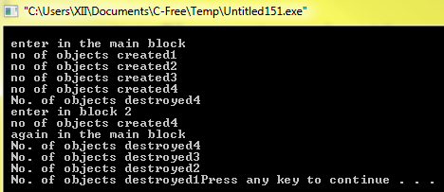

Slide 48
Find out the errors in the program
class number
{
int x=10;
float y;
number ()
{
x=y=10;
}
Public:
number (number t)
{
x=t.x;
y=t.y;
}
~()
{
Cout<<“Object destroyed “;
}
}
int main()
{
number a1,a2(a1);
}

Slide 49
Error :int x=10; //class members cannot be initialized in the class
Constructors should be declared in the public section of a class
Reference operator is missing in the definition of the copy constructor
In destructor the class name is missing
Semicolon is missing after the definition of the class.

Slide 50
void game::change()
{
type=(type=='P')?'G':'P';
}
void game::play(int gs)
{
score+=gs;
if(score>=30)
level=3;
else if (score>=20)
level=2;
else
level=1;
}
int main()
{
game a('G'),b;
b.show();
a.play(11);
a.change();
b.play(25);
a.show();
b.show();
}
#include<iostream.h>
using namespace std;
class game
{
int level,score;
char type;
public:
game(char gtype='p')
{
level=1;
score=0;
type=gtype;
}
void play(int gs);
void change();
void show()
{
cout<<type<<" @ "<<level<<" "<<score<<endl;
}
};
P @ 1 0
P @ 1 11
P @ 2 25

Slide 51
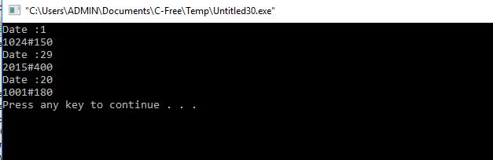
#include<iostream.h>
using namespace std;
class Stock
{
long int ID;
float Rate;
int Date;
public:
Stock(){ID=1001;Rate=200;Date=1;}
void RegCode(long int I,float R)
{
ID=I;
Rate=R;
}
void Change(int New,int DT)
{
Rate+=New;
Date=DT;
}
void Show()
{
cout<<"Date :"<<Date<<endl;
cout<<ID<<"#"<<Rate<<endl;
}
};
int main()
{
Stock a,b,c;
a.RegCode(1024,150);
b.RegCode(2015,300);
b.Change(100,29);
c.Change(-20,20);
a.Show();
b.Show();
c.Show();
}

Slide 52
#include<iostream.h>
#include<conio.h>
#include<ctype.h>
class Class
{
int Cno,total;
char section;
public:
Class(int no=1)
{
Cno=no;
section='A';
total=30;
}
void addmission(int c=20)
{
section++;
total+=c;
}
void ClassShow()
{
cout<<Cno<<":"<<section<<":"<<total<<endl;}
} ;
void main()
{
Class C1(5),C2;
C1.addmission(25);
C1.ClassShow();
C2.addmission();
C1.addmission(30);
C2.ClassShow();
C1.ClassShow();
}
5:B:55
1:B:50
5:C:85

Slide 53
Board 2007
class a
{
public:
a()
{
cout<<“constructor a”<<endl;
}
~a()
{
cout<<“destructor a”<<endl;
}
};
class b
{
public:
b()
{
cout<<“constructor b”<<endl;
}
~b()
{
cout<<“destructor b”<<endl;
}
};
class c
{
a ob1,ob2;
b ob3;
public:
c()
{
cout<<“constructor c”<<endl;
}
~c()
{
cout<<“destructor c”<<endl;
}
};
};
Void main()
{
c oc;
b ob;
a oa;
}

Slide 54
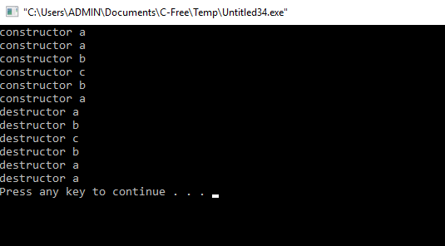

Slide 55
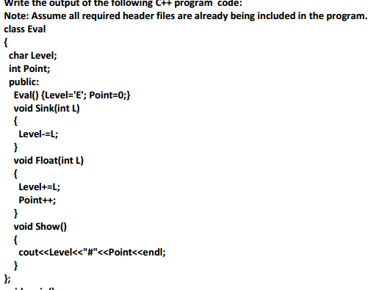
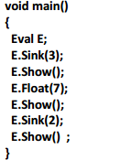


Slide 56

#include<iostream.h>
#include<string.h>
void jumbleup(char []);
using namespace std;
int main()
{
char str[80]="HARMONIOUS";
jumbleup(str);
cout<<str<<endl;
}
void jumbleup(char text[80])
{
int l =strlen(text);
for(int c=0;c<l-1;c+=2)
{
char ct=text[c];
text[c]=text[c+1];
text[c+1]=ct;
}
for(int c=1;c<l;c+=2)
if(text[c]>='M' && text[c]<='U')
text[c]='@';
}

Slide 57
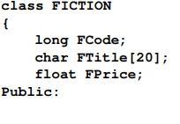
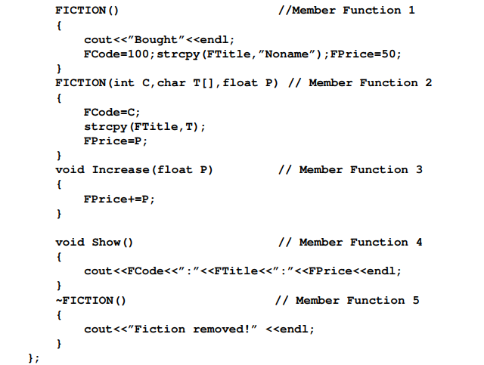
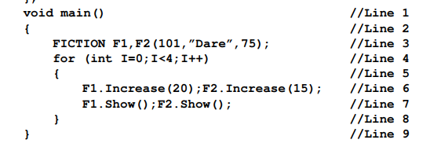

Slide 58
Which specific concept of object oriented programming out of the following is illustrated by Member Function 1 and Member Function 2 combined together ?
(ii) How many times the message “Fiction removed!” will be displayed after executing the above C++ code ? Out of Line 1 to Line 9, which line is responsible to display the message “Fiction removed!” ?

Slide 59
Consider the following class declaration:
Class A
{
int x;
};
Class B
{
float y;
};
class C:B,A
{
char z;
};
Define constructor for class C

Slide 60
C(int p,float Q,char r):B(q),A(p)
{
z=r;
}

