Slide 1
Node js
Be-practical Tech Solutions..!

Slide 2
Introduction
Node.js is a platform (server-side) which is built on google chrome's javascript v8 engine.
It is open source , cross platform and is capable of generating real time web applications.
It is developed by Ryan Dahl with the team of other developers working at joyent in 2009.
Its initial release only supports linux.
It is written in C,C++ and javascript. It's package ecosystem 'NPM' is the largest ecosystem of open source libraries in the world.

Slide 3
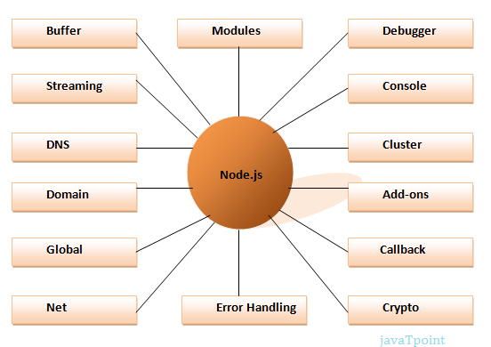
Parts of Node.js

Slide 4
Installation
Based on the architecture of your Operating System, you can download the latest version of node.js from the downloads page of node's official website
https://nodejs.org/en/download/

Slide 5
Hello World in Node js
There can be a console-based and web-based node.js applications.
//file-name : hello-world-in-node.js
console.log('hello world');
You can run the above code using the following command : node hello-world-in-node.js

Slide 6
Create a Server in node js
Node provide us with the inbuilt HTTP module which we can use to create the server. Get the access to the module by using require.
Mention the host i.e. localhost (127.0.0.1) to serve it locally.
Mention the port. We are using port : 3000 for our example.
Create a server using the createServer() method. createServer() method takes a callback function as arguments. This callback is executed each time a request is received.
The two arguments of createServer() method are request and response.

Slide 7
Continue
request : which contains all the information related to client's request such as URL, custom headers , client info , etc.
response : which is used to return the data back to the client.
response.writeHead() is an inbuilt method which is used to send the status code and the MIME type (Multi-Purpose Internet Mail Extensions) .
And after that we are just Printing the value on the console using console.log() function.
response.end() is an inbuilt function which is used to tell the server that the request has been fulfilled. Along with that we can also send one response using this.
server.listen() is an inbuilt method used to bind to the port an start listening for incoming connections.

