Slide 1
Nodejs
Be-practical Tech Solutions..!

Slide 2
Crypto introduction
crypto module in node.js is used to provide cryptographic functionalities.
includes a set of wrappers for OpenSSL's hash , HMAC , verify , cipher , decipher and sign functions.

Slide 3
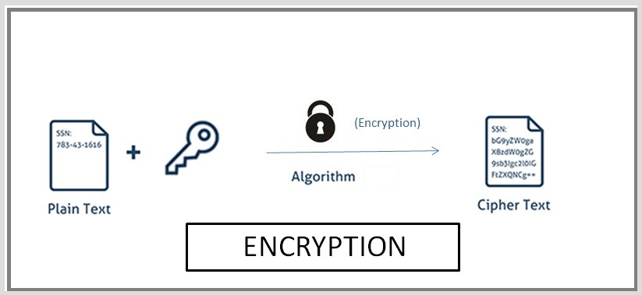
Crypto

Slide 4
What is hashing ?
Hashing is a process of generating a fixed length value from a string using mathematical functions. It is used for providing security.
Every hash generated using hashing is :
Unique: In hashing , for every unique input we will get unique output.
we will get the same output for same input no matter how many times you input the same data But if we just slightly change the input it will change the output to a large extent.
Fixed length : Hashing algorithms always generate the hash with the same length. The length of input does not affect the length of the output.
Irreversible : Generated hashes are irreversible in nature. We can not change the hash to the input text again.

Slide 5
Examples of different hashing algorithms
md5 hashing algorithm : MD5 stands for Message Digest 5 is a widely used hash function which produces 128-bit hashes.
Whirlpool hashing algorithm : This hashing algorithm takes input of any length less than 2²⁵⁶ bits and outputs a 512-bit hash.
SHA1 hashing algorithm : Secure Hash Algorithm 1 is a cryptographic hash function which generates a hash value which is typically rendered as a hexadecimal number of exactly 40 digits long. It produces a 160-bit hash value which is known as message digest.
SHA224 hashing algorithm : Secure Hash Algorithm 224 comes under SHA2 and it is a cryptographic hash function which is used to generate hash values .It produces a 224-bit hash value which is known as message digest.

Slide 6
Continue
SHA256 hashing algorithm : Secure Hash Algorithm 256 comes under SHA2 and it is a cryptographic hash function which is used to generate hash values. It produces a 256-bit hash value which is known as message digest.
SHA384 hashing algorithm : Secure Hash Algorithm 384 comes under SHA2 and it is a cryptographic hash function which is used to generate hash values. It produces a 384-bit hash value which is known as message digest.
SHA512 hashing algorithm : Secure Hash Algorithm 512 comes under SHA2 and it is a cryptographic hash function which is used to generate hash values. It produces a 512-bit hash value which is known as message digest.

Slide 7
Continue
ripemd-160 hashing algorithm : RIPEMD (RACE Integrity Primitives Evaluation Message Digest) 160 is an improved version of ripemd and it usually generates a 40 digit hexadecimal number.
Please Note that encrypting passwords with SHA is unsafe and we strongly recommend that you should not use it in production.

Slide 8
Perform Hashing on a file
Hashing a file : We are hashing the contents of a file using node.js streams , node.js filesystem and SHA256 cryprographic hashing algorithm.
Problems with hashing
One of the biggest problems with hashing includes the rainbow table which is a precomputed table for reversing cryptographic hash functions.

Slide 9
What is hmac ?
HMAC ( keyed-hash message authentication code ) is a kind of MAC (Message authentication code ) which involves performing the hash functions using a secret cryptographic key.
ust like hash, in HMAC also every generated hash using hashing algorithms is

Slide 10
Examples of different HMAC algorithms
SHA256 HMAC: It is same as hashing the input with SHA256 hashing algorithm as explained above, the only difference is it involves hashing with the help of a secret key.
sha512 HMAC : It is same as hashing the input with SHA512 hashing algorithm as explained above, the only difference is it involves hashing with the help of a secret key.
md5 HMAC : It is same as hashing the input with md5 hashing algorithm as explained above, the only difference is it involves hashing with the help of a secret key.
Whirlpool hmac : It is same as hashing the input with Whirlpool hashing algorithm as explained above, the only difference is it involves hashing with the help of a secret key

