Slide 1
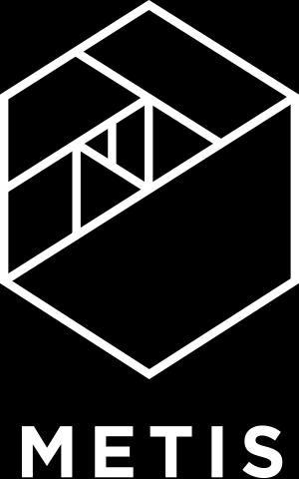
Model Evaluation
Notes:
Today we are going to discuss how we can tweak our ML models so that they not only
describe the training dataset in hand well
but also generalize outside the training set.

Slide 2
Machine Learning Workflow
Problem Statement
What problem are you trying to solve?
Data Collection
What data do you need to solve it?
Data Exploration & Preprocessing
How should you clean your data so your model can use it?
Modeling
Build a model to solve your problem?
Validation
Did I solve the problem?
Decision Making & Deployment
Communicate to stakeholders or put into production?
Notes:
Use this slide to provide context for what we are about to discuss. Can relate to examples discussed in the introduction.

Slide 3
Machine Learning Workflow
Problem Statement
What problem are you trying to solve?
Data Collection
What data do you need to solve it?
Data Exploration & Preprocessing
How should you clean your data so your model can use it?
Modeling
Build a model to solve your problem?
Validation
Did I solve the problem?
Decision Making & Deployment
Communicate to stakeholders or put into production?
Notes:
Use this slide to provide context for what we are about to discuss. Can relate to examples discussed in the introduction.

Slide 4
Two Main Types of Machine Learning
Dataset
Goal
Example
Supervised Learning
Has a target column
Make predictions
Fraud detection
Unsupervised Learning
Does not have a target column
Find structure in the data
Customer segmentation
Notes:
There are 2 types of ML: Supervised and Unsupervised
Supervised has a target column or label. The goal is for the ML algorithm to learn how to predict the label.
Unsupervised does not have a target column. The goal is for the ML algorithm to find structure. There is no right or wrong answer, so the user will need to test different models and see which results tend to make more sense.

Slide 5
Two Main Types of Machine Learning
Dataset
Goal
Example
Supervised Learning
Has a target column
Make predictions
Fraud detection
Unsupervised Learning
Does not have a target column
Find structure in the data
Customer segmentation
Notes:
There are 2 types of ML: Supervised and Unsupervised
Supervised has a target column or label. The goal is for the ML algorithm to learn how to predict the label.
Unsupervised does not have a target column. The goal is for the ML algorithm to find structure. There is no right or wrong answer, so the user will need to test different models and see which results tend to make more sense.

Slide 6
Two Main Types of Machine Learning
Dataset
Goal
Example
Supervised Learning
Has a target column
Make predictions
Fraud detection
Unsupervised Learning
Does not have a target column
Find structure in the data
Customer segmentation
Notes:
There are 2 types of ML: Supervised and Unsupervised
Supervised has a target column or label. The goal is for the ML algorithm to learn how to predict the label.
Unsupervised does not have a target column. The goal is for the ML algorithm to find structure. There is no right or wrong answer, so the user will need to test different models and see which results tend to make more sense.

Slide 7
Supervised Learning: Evaluating Predictions
Regression
outcome is continuous (numerical)
Classification
outcome is a category
Notes:
If we have categories we want to predict, that is, classes, it’s a classification problem
E.g. transaction is fraudulent / good , which customers are going to cancel this month, democrat / republican?

Slide 8
Modeling Best Practice
Use cost function to fit model
Develop multiple models
Compare results and choose best one

Slide 9
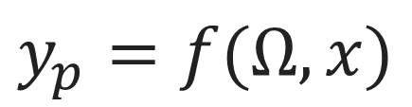
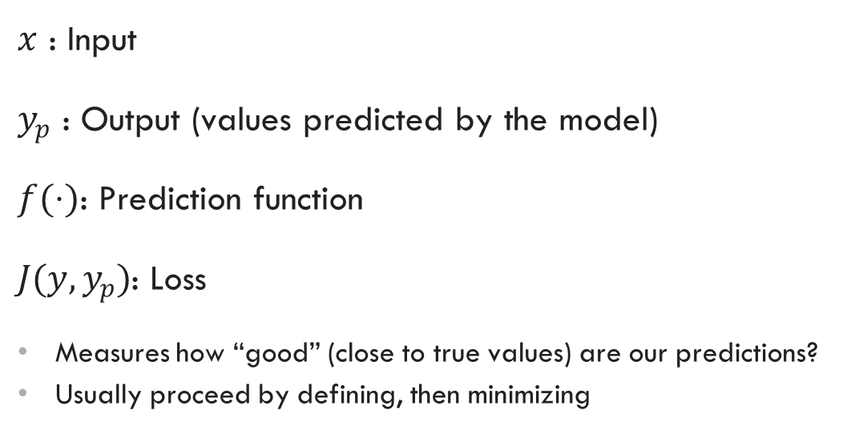
Supervised Learning: Model Elements
$x$ : Input
$y_{p}$ : Output (values predicted by the model)
$f(⋅)$: Prediction function
$J(y,y_{p})$: Loss
Measures how “good” (close to true values) are our predictions?
Usually proceed by defining, then minimizing
$$y_{p}=f(Ω, x)$$

Slide 10
Example: Film Performance Data
Notes:
Solution lies in the existing data used to fit our model.
Let’s say this is some historical training set we have.

Slide 11
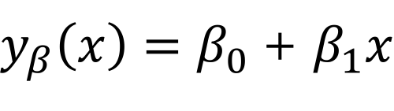
Model Evaluation: Regression
x10⁸
2.0
Box Office
1.0
0.0
1.0
2.0
x10⁸
Budget
$y_{β}\left(x\right)=β_{0}$ + $β_{1}x$
box office revenue
coefficient 0
coefficient 1
movie budget
Notes:
Our target var is box office revenue
Our feature is movie budget only
B0 is called the “intercept”
And B1, coeff of x, is the slope of the line.

Slide 12
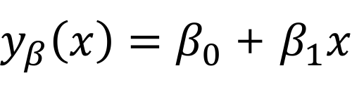
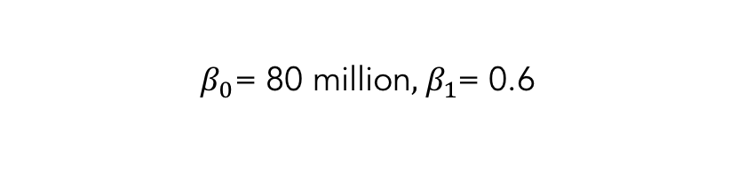
Linear Regression Example
x10⁸
2.0
Box Office
1.0
0.0
1.0
2.0
x10⁸
Budget
$y_{β}\left(x\right)=β_{0}$ + $β_{1}x$
${ β}_{0}\text{= }\text{80 }\text{million}, { β}_{1}$= 0.6
Notes:
This is the best line, defined by coefficients B0 and B1.
How did we get here though? We minimized a cost function!

Slide 13
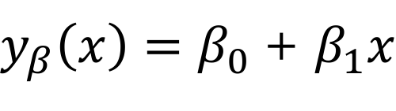
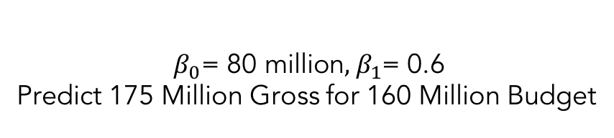
Linear Regression: Predictions
x10⁸
2.0
Box Office
1.0
0.0
1.0
2.0
x10⁸
Budget
$y_{β}\left(x\right)=β_{0}$ + $β_{1}x$
${ β}_{0}\text{= }\text{80 }\text{million}, { β}_{1}$= 0.6
Predict 175 Million Gross for 160 Million Budget
Notes:
With this line, we can predict what the box office revenue will be, for a new movie.
And it is not going to be a any random prediction.
It’s going to be relatively accurate.

Slide 14
Which Model Fits the Best?
x10⁸
2.0
Box Office
1.0
0.0
1.0
2.0
x10⁸
Budget
Notes:
So let’s analyze how we found that special line.
Why not this purple line instead of the blue?

Slide 15
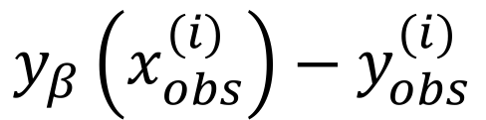
Calculating the Residuals
x10⁸
2.0
Box Office
1.0
0.0
1.0
2.0
x10⁸
Budget
$$y_{β}\left(x_{obs}^{(i)}\right)−y_{obs}^{(i)}$$
predicted value
observed value
Notes:
For a given line, we have predicted values (values on the line), and the ground truth from our training set
Thus, for any movie, we know the magnitude of the error in our predictions!

Slide 16
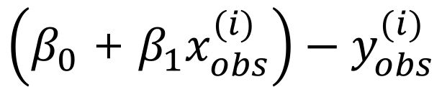
Calculating the Residuals
x10⁸
2.0
Box Office
1.0
0.0
1.0
2.0
x10⁸
Budget
$$\left(β_{0}\text{ + }β_{1}x_{obs}^{(i)}\right)−y_{obs}^{(i)}$$
Notes:
This is the error formula for a given observation.
Since this can be negative, we’re more interested in a positive version of this.
Something like the absolute value of this (L1 norm)
Or the euclidean distance / length of the gray line segments (L2 norm) – more popular

Slide 17
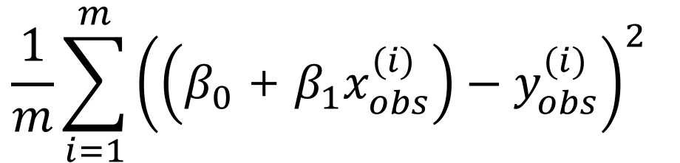
Mean Squared Error
x10⁸
2.0
Box Office
1.0
0.0
1.0
2.0
x10⁸
Budget
$$\frac{1}{m}\sum_{i=1}^{m}{{\left(\left(β_{0}\text{ + }β_{1}x_{obs}^{(i)}\right)−y_{obs}^{(i)}\right)}^{2} }$$
Notes:
This is probably the most popular cost function for linear regression
It’s called the Mean Squared Error
It gives us the average length of the gray line segments in the figure.
Here, x’s and y’s are given in the trainingset, and we’re thinking of this as a function of B0 and B1

Slide 18
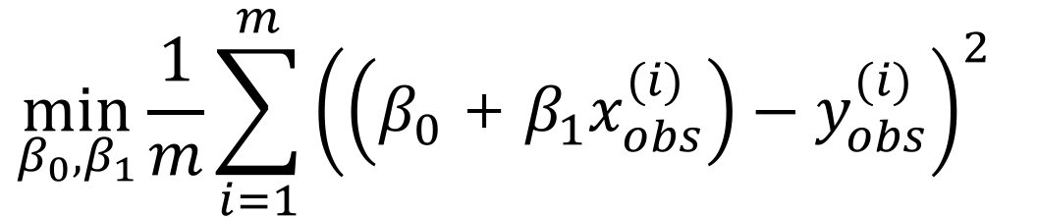
Minimum Mean Squared Error
x10⁸
2.0
Box Office
1.0
0.0
1.0
2.0
x10⁸
Budget
$$\min_{β_{0},β_{1}}\frac{1}{m}{\sum_{i=1}^{m}{{\left(\left(β_{0}\text{ + }β_{1}x_{obs}^{(i)}\right)−y_{obs}^{(i)}\right)}^{2} }}$$
Notes:
The pair of values (B0, B1) which minimizes this gives us the best line!

Slide 19
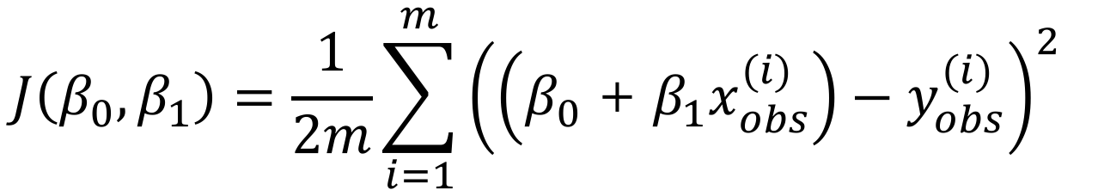
Cost Function
x10⁸
2.0
Box Office
1.0
0.0
1.0
2.0
x10⁸
Budget
$$J\left(β_{0},β_{1}\right)=\frac{1}{2m}\sum_{i=1}^{m}{{\left(\left(β_{0}\text{ + }β_{1}x_{obs}^{(i)}\right)−y_{obs}^{(i)}\right)}^{2} }$$
Notes:
Sometimes the cost function will be written like this. Minimizing this is equivalent to the previous function.

Slide 20
Modeling Best Practice
Use cost function to fit model
Develop multiple models
Compare results and choose best one

Slide 21
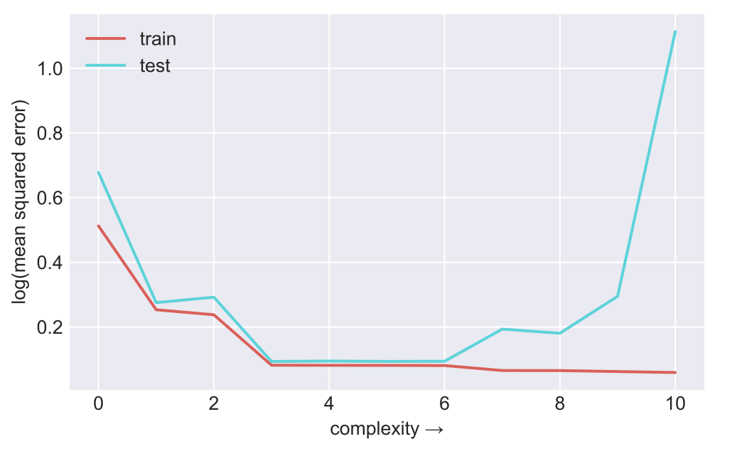
Under-fitting vs Overfitting
A learning curve can also help diagnose whether a model is under-fit or overfit.
Plot the performance score by the model complexity.
More features means more complexity.
When train and test performance are similar - but low - the model is under-fit.
When test performance suffers, while train performance improves, the model is overfit.
Overfit
Underfit
Train/Test Graph
Notes:
Idea here is that you want your cross-validation score to be near your training score.

Slide 22
Under-fitting vs Overfitting
There is a relationship between under-fit and over-fit models and the number of samples and features.
In general, the number of samples should be greater than your number of features.
If overfitting:
adding more features usually hurts adding more samples usually helps
If under-fitting:
adding samples generally doesn’t help
strong explanatory generally variables helps
Performance Graph
Notes:
Underfitting means that our model is not performing well on the training data—the data it sees.
Overfitting means that our model is not performing well on the validation data—data the model does not see.

Slide 23

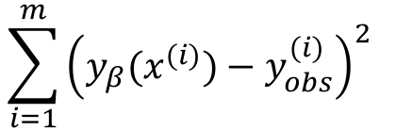

Other Measures of Error
$$\sum_{i=1}^{m}{{\left(y_{β}(x^{(i)})−y_{obs}^{(i)}\right)}^{2} }$$
Sum of Squared Error (SSE):
$$\sum_{i=1}^{m}{{\left(\overline{y_{obs}}−y_{obs}^{(i)}\right)}^{2} }$$
Total Sum of Squares (TSS):
$$1 − \frac{SSE}{TSS}$$
Correlation Coefficient (R²):
Notes:
These are some model metrics.
Sum of Squared Error, or Sum of Squared Residuals. This is the total squared error the model is making. Related to the cost function.

Slide 24
Other Measures of Error
$$\sum_{i=1}^{m}{{\left(y_{β}(x^{(i)})−y_{obs}^{(i)}\right)}^{2} }$$
Sum of Squared Error (SSE):
$$\sum_{i=1}^{m}{{\left(\overline{y_{obs}}−y_{obs}^{(i)}\right)}^{2} }$$
Total Sum of Squares (TSS):
$$1 − \frac{SSE}{TSS}$$
Correlation Coefficient (R²):
Notes:
Total sum of squares;
Difference between our observed values and the average observed value.
Notice there is no predictions involved with this one.
It’s a measure of how the observed values differ from the mean. Are they concentrated around the mean or not?

Slide 25
Other Measures of Error
$$\sum_{i=1}^{m}{{\left(y_{β}(x^{(i)})−y_{obs}^{(i)}\right)}^{2} }$$
Sum of Squared Error (SSE):
$$\sum_{i=1}^{m}{{\left(\overline{y_{obs}}−y_{obs}^{(i)}\right)}^{2} }$$
Total Sum of Squares (TSS):
$$1 − \frac{SSE}{TSS}$$
Correlation Coefficient (R²):
Notes:
This is the famous R^2 metric.
SSE measures the distance between truth and our predictions
TSS measures the distance between truth and average truth.
SSE is the unexplained variation by our model
TSS is the total variation of the truth values
So R2 is a measure of the explained variation by our model! (1-unexplained/total = explained / total)
Keep in mind that this can be applied to any regression algorithm, not restricted to linear reg.

Slide 26
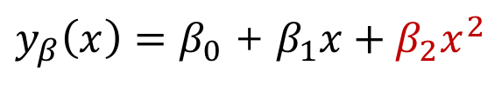
Addition of Polynomial Features
$y_{β}\left(x\right)=β_{0}$ + $β_{1}x+β_{2}x^{2}$
Capture higher order features of data by adding polynomial features
"Linear regression" means linear combinations of features
Box Office
Budget
Notes:
Another preprocessing trick we can apply is to create new features out of the ones we already have.
We have seen this during the overfitting discussion. Instead of a line, we can add budget^2 to the list of features and fit a polynomial.

Slide 27
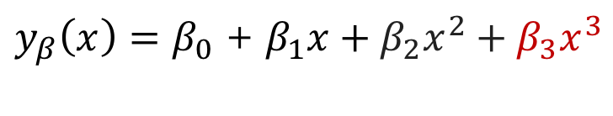
Addition of Polynomial Features
$y_{β}\left(x\right)=β_{0}$ + $β_{1}x+β_{2}x^{2}+β_{3}x^{3}$
Capture higher order features of data by adding polynomial features
"Linear regression" means linear combinations of features
Box Office
Budget
Notes:
The resulting algorithm is still linear regression, since the outcome is still a linear combination of the features.
The non-linear relationship between one feature and the other does not make the algorithm non-linear.

Slide 28
How Well Does the Model Generalize?
Polynomial Degree = 1
Polynomial Degree = 4
Polynomial Degree = 15
Model
True Function
Samples
Y
Y
Y
X
X
X
Poor at Training
Poor at Predicting
Good at Training
Poor at Predicting
Just Right
Notes:
Another way to find the best model is to ask how well does it generalize?
Model on left performs poorly during both training and predicting
Model on right performs perfectly during training, poorly when predicting
Middle model is just right for both training and prediction

Slide 29
Underfitting vs Overfitting
Polynomial Degree = 1
Polynomial Degree = 4
Polynomial Degree = 15
Model
True Function
Samples
Y
Y
Y
X
X
X
Underfitting
Just Right
Overfitting
Notes:
These concepts have names:
Example on left is underfitting the data—model is too simple to represent data
Example on right is overfitting the data—model is too complex to represent data
As we've discussed, center example is just right

Slide 30
Bias – Variance Tradeoff
Polynomial Degree = 1
Polynomial Degree = 4
Polynomial Degree = 15
Model
True Function
Samples
Y
Y
Y
X
X
X
High Bias
Low Variance
Low Bias
High Variance
Just Right
Notes:
In machine learning lingo, the situation on the left is high bias and low variance
On right is low bias and high variance
So, how do we know that we have achieved the center, a balance of bias and variance?
Put differently, we want to find the combination of parameters that will generalize to unknown/new data

Slide 31
Training and Test Splits
Notes:
Solution lies in the existing data used to fit our model.
Let’s say this is some historical training set we have.

Slide 32
Training and Test Splits
Training
Data
Test
Data
Notes:
Split the data into two parts—one is usually larger than the other (say 60/40 or 70/30)
Larger data set is the training data that we use to train the model, as before
Smaller data set is unseen until last step where the error of the model is calculated
Ensures the model generalizes to new situations
Make sure the splits are independent from each other!

Slide 33
Using Training and Test Data
Training
Data
fit the model
measure performance
- predict label with model
- compare with actual value
- measure error
Test
Data
Notes:
To summarize, the training data is used to fit the model
Using this model, predict results on the test data
Measure performance

Slide 34
Using Training and Test Data
Training Data
Test Data
x10⁸
x10⁸
4.0
4.0
3.0
3.0
2.0
2.0
1.0
1.0
0.0
1.0
2.0
x10⁸
0.0
1.0
2.0
x10⁸
Notes:
Let's look at an actual scenario
Here we have split data in to training and test sets
Will be performing linear regression – that is, we’re going to fit a line that explains the training set.

Slide 35
Using Training and Test Data
Training Data
Test Data
x10⁸
x10⁸
4.0
4.0
3.0
3.0
2.0
2.0
1.0
1.0
0.0
1.0
2.0
x10⁸
0.0
1.0
2.0
x10⁸
Fit the model
Notes:
Perform regression on the the training data
Determine parameters of best fit

Slide 36
Using Training and Test Data
Training Data
Test Data
x10⁸
x10⁸
4.0
4.0
3.0
3.0
2.0
2.0
1.0
1.0
0.0
1.0
2.0
x10⁸
0.0
1.0
2.0
x10⁸
Make predictions
Notes:
Predict value for each point in the test data based on previously determined parameters
Predictions are shown by purple squares
How did the predictions do?

Slide 37
Using Training and Test Data
Training Data
Test Data
x10⁸
x10⁸
4.0
4.0
3.0
3.0
2.0
2.0
1.0
1.0
0.0
1.0
2.0
x10⁸
0.0
1.0
2.0
x10⁸
Measure error
Notes:
Measure error for each predicted point
Residuals used for error metric are shown as black lines
Model with smallest error value is chosen as best fit

Slide 38
Fitting Training and Test Data
Training
Data
X_train
model( X_train, Y_train ).fit()
model
Y_train
Test
Data
X_test
model
.predict( X_test )
Y_predict
Notes:
Conceptual workflow for using train and test data
Training data (both features and labels) are given to a model, K-nearest neighbors is shown here
Model parameters are fit using this data
Error is then calculated on the features that were split into the test data set

Slide 39
Fitting Training and Test Data
Training
Data
X_train
model( X_train, Y_train ).fit()
model
Y_train
Test
Data
X_test
model
.predict( X_test )
Y_predict
error_metric( Y_test, Y_predict)
test error
Y_test
Notes:
The predicted labels (Y_predict) can then be compared to the actual ones (Y_test)
Can use these two data sets to calculate the error
Choice of error metric depends on situation, but we will cover these at the end of this lecture

Slide 40
Train and Test Splitting: The Syntax
Import the train and test split function
from sklearn.model_selection import train_test_split
Split the data and put 30% into the test set
train, test = train_test_split(data, test_size=0.3)
Other method for splitting data:
from sklearn.model_selection import ShuffleSplit
Notes:
Let's take a look from a practical stand point now about how the data are split
Scikit learn has a model selection library that contains train_test_split

Slide 41
Train and Test Splitting: The Syntax
Import the train and test split function
from sklearn.model_selection import train_test_split
Split the data and put 30% into the test set
train, test = train_test_split(data, test_size=0.3)
Other method for splitting data:
from sklearn.model_selection import ShuffleSplit
Notes:
This is used to split the data into train and test sets
Can set parameters like the percent of test (or train data)

Slide 42
Train and Test Splitting: The Syntax
Import the train and test split function
from sklearn.model_selection import train_test_split
Split the data and put 30% into the test set
train, test = train_test_split(data, test_size=0.3)
Other method for splitting data:
from sklearn.model_selection import ShuffleSplit
Notes:
There are other ways of splitting the data
For example, the data can be stratified, which means to ensure the label composition is uniformly distributed
This is to guarantee that we don’t get an unlucky split that’s skewed. Our splits should be similar to the original dataset.

Slide 43
Cross Validation
Notes:
XXX

Slide 44
Beyond a Single Test Set: Cross Validation
Training
Data
Validation
Data
Notes:
Even better than calculating error on a single test split is to use cross validation to calculate the error
Involves splitting the data into two parts, like before
This time we will call them training and validation data
However, we will be doing this split multiple times and then will be averaging the resulting error
This takes more time, however the performance measure is more statistically significant.

Slide 45
Beyond a Single Test Set: Cross Validation
Training Data
Test Data
x10⁸
x10⁸
4.0
4.0
3.0
3.0
2.0
2.0
1.0
1.0
0.0
1.0
2.0
x10⁸
0.0
1.0
2.0
x10⁸
Best model for this test set
Notes:
As before, the model parameters are determined from training data
Error calculated on the validation data is recorded

Slide 46
Beyond a Single Test Set: Cross Validation
Training
Data 1
Validation
Data 1
Notes:
The process is actually repeated many times for different splits
Here is the first split with the training data on top
Smaller validation set on the bottom

Slide 47
Beyond a Single Test Set: Cross Validation
Training
Data 2
Validation
Data 2
Notes:
The second set could look something like this with the validation set encompassing a different data set

Slide 48
Beyond a Single Test Set: Cross Validation
Validation
Data 3
Training
Data 3
Notes:
And then here would be the third cross validation split with the validation data being a different part of the data

Slide 49
Beyond a Single Test Set: Cross Validation
Validation
Data 4
Training
Data 4
Notes:
And this is the final cross validation split

Slide 50
Beyond a Single Test Set: Cross Validation
Training Split
Training Split
Training Split
Test Split
+
Training Split
Training Split
Test Split
Training Split
+
Training Split
Test Split
Training Split
Training Split
+
Test Split
Training Split
Training Split
Training Split
Average cross validation results.
Notes:
Errors are averaged together and a single performance measure for the model is produced

Slide 51
Beyond a Single Test Set: Cross Validation
Training Split
Training Split
Training Split
Test Split
+
Training Split
Training Split
Test Split
Training Split
+
Training Split
Test Split
Training Split
Training Split
+
Test Split
Training Split
Training Split
Training Split
Average cross validation results.
Notes:
This can be used to compare models: We can do this for several models, and choose the best model
To contrast, choosing the best model by testing on a single test split can be a bad idea, as trying many things can produce a result that does really well on THAT test split, but not so much on others.

Slide 52
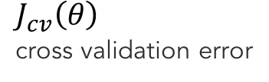
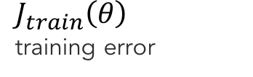
Model Complexity vs Error
$J_{cv}\left(θ\right)$
cross validation error
error
$J_{train}\left(θ\right)$
training error
Notes:
Let’s look at how the error metrics (usually) behave with various levels of model complexity.
Training error: we’re fitting our model on the training data, and then testing it on the same training data (bad practice if this is the only thing that we do)
Cross-validation error: same as before, averaged out error values obtained from the various test splits.
Error for the training data will continue to decrease and eventually plateau
Doesn't increase because we can always fit training data better with more complex model.

Slide 53
Model Complexity vs Error
$J_{cv}\left(θ\right)$
cross validation error
error
$J_{train}\left(θ\right)$
training error
Notes:
However, Effect of polynomial complexity on cross validation error is a different story
Error will decrease for a while and then start to increase again
Increase signifies failure of model to generalize

Slide 54
Model Complexity vs Error
$J_{cv}\left(θ\right)$
cross validation error
error
$J_{train}\left(θ\right)$
training error
model complexity
Notes:
This can be used to find the best model parameters, such as the best polynomial degree
Here is what the error looks like on the training and cross validation data sets on a validation curve

Slide 55
Model Complexity vs Error
Polynomial Degree = 1
Model
True Function
Samples
$J_{cv}\left(θ\right)$
cross validation error
error
Y
$J_{train}\left(θ\right)$
training error
X
model complexity
Underfitting: training and cross validation error are high
Notes:
Models associated with left side of this curve are underfitting the data
Diagnostic is that they have high error for both training and cross validation data
Training error probably can be improved with a more complicated model.

Slide 56
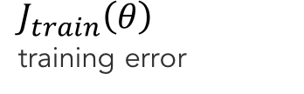
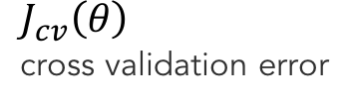
Model Complexity vs Error
Polynomial Degree = 15
Model
True Function
Samples
$J_{cv}\left(θ\right)$
cross validation error
error
Y
$J_{train}\left(θ\right)$
training error
X
model complexity
Overfitting: training error is low, cross validation is high
Notes:
Models associated with the right side of this curve are overfitting the data
Diagnostic is that training error is low while cross validation error is high
Cross validation error can probably be improved by simplifying the model a little bit

Slide 57
Model Complexity vs Error
Polynomial Degree = 4
Model
True Function
Samples
$J_{cv}\left(θ\right)$
cross validation error
error
Y
$J_{train}\left(θ\right)$
training error
X
Just right: training and cross validation errors are low
Notes:
Middle of the curve is where we'd like to be
Diagnostic here is that both training and cross validation error are low, and they are close to each other.

Slide 58
Cross Validation: The Syntax
Import the train and test split function
from sklearn.model_selection import cross_val_score
Perform cross-validation with a given model
cross_val = cross_val_score(KNN, X_data, y_data, cv=4, scoring='neg_mean_squared_error')
Other methods for cross validation:
from sklearn.model_selection import KFold, StratifiedKFold
Notes:
The model selection library of scikit learn also contains a cross validation scoring function

Slide 59
Cross Validation: The Syntax
Import the train and test split function
from sklearn.model_selection import cross_val_score
Perform cross-validation with a given model
cross_val = cross_val_score(model, X_data, y_data, cv=4, scoring='neg_mean_squared_error')
Other methods for cross validation:
from sklearn.model_selection import KFold, StratifiedKFold
Notes:
Cross validation requires the model, feature data, label data, number of splits and method of scoring
Will return the average score of all cross validations

Slide 60
Cross Validation: The Syntax
Import the train and test split function
from sklearn.model_selection import cross_val_score
Perform cross-validation with a given model
cross_val = cross_val_score(model, X_data, y_data, cv=4, scoring='neg_mean_squared_error')
Other methods for cross validation:
from sklearn.model_selection import KFold, StratifiedKFold
Notes:
There are other, lower level, methods available for splitting data into multiple cross validation splits
Difference generally is whether or not the labels are stratified into the splits.

Slide 61
Classification Error Metrics
Notes:
XXX

Slide 62
Choosing the Right Error Measurement
You are asked to build a classifier for leukemia
Training data: 1% patients with leukemia, 99% healthy
Measure accuracy: total % of predictions that are correct
Notes:
In this lecture, we have extensively covered how models are selected based on splitting the data and calculating the error
Let's then move on to how to calculate this error
The choice of the “right” error metric depends heavily on the question and the data
For example, assume we are classifying patients likely to get leukemia
In our training data, a large majority (99%) of patients are healthy
Let's say we build a classifier and use accuracy as the metric

Slide 63
Choosing the Right Error Measurement
You are asked to build a classifier for leukemia
Training data: 1% patients with leukemia, 99% healthy
Measure accuracy: total % of predictions that are correct
Build a simple model that always predicts "healthy"
Accuracy will be 99%...
Notes:
However, a simple model could be built that always predicts healthy – USELESS model
And this model would result in 99% accuracy
Thus, we see the importance in understanding the data and choosing the appropriate metric
Accuracy is often not the right metric for a binary classification problem!

Slide 64
Confusion Matrix
Confusion Matrix
Predicted
Positive
Predicted Negative
Actual Positive
True Positive
(TP)
False Negative
(FN)
Actual Negative
False Positive
(FP)
True Negative
(TN)
Notes:
When thinking about errors with classification, we often talk about a confusion matrix
The vertical axis contains rows that correspond to the ground truth, either positive or negative here
And the horizontal axis corresponds to what the model predicts, either true or positive
The (blue) diagonal elements are correctly predicted values

Slide 65
Confusion Matrix
Confusion Matrix
Predicted
Positive
Predicted Negative
Actual Positive
True Positive
(TP)
False Negative
(FN)
Type II Error
Actual Negative
False Positive
(FP)
True Negative
(TN)
Type I Error
Notes:
The (red) off-diagonal elements correspond to errors
The bottom left is a false positive, which is also sometimes called a type I error
The top right is a false negative, which is also sometimes called a type II error

Slide 66
Confusion Matrix
Accuracy: Predicting Correctly
Predicted
Positive
Predicted Negative
Actual Positive
True Positive
(TP)
False Negative
(FN)
Actual Negative
False Positive
(FP)
True Negative
(TN)
TP + TN
Accuracy =
TP + FN + FP + TN
Notes:
We can calculate accuracy as the sum of both correct predictions (positives and negatives)
The denominator is the total number of samples
This is probably the most common error metric, but it can be deceiving in situations where the populations are skewed

Slide 67
Confusion Matrix
Recall: Identifying All Positive Instances
Predicted
Positive
Predicted Negative
Actual Positive
True Positive
(TP)
False Negative
(FN)
Actual Negative
False Positive
(FP)
True Negative
(TN)
TP
Recall or Sensitivity
=
TP + FN
Notes:
Recall (or sensitivity) is another common error metric
Recall measures the percentage of the actual positive class that is correctly predicted
In other words, it is the capture rate.
What percentage of the true leukemia cases is your model capturing?
Notice: you can easily achieve 100% recall by predicting everything to be positive. Everyone has leukemia => 100% recall

Slide 68
Confusion Matrix
Precision: Identifying Only Positive Instances
Predicted
Positive
Predicted Negative
Actual Positive
True Positive
(TP)
False Negative
(FN)
Actual Negative
False Positive
(FP)
True Negative
(TN)
TP
Precision =
TP + FP
Notes:
To balance that, enter precision: another error metric is precision
Precision measures the percentage of the the predicted positive class that is correct
When the model predicts leukemia, how often is it right?
If you always predict leukemia, then your recall is 100% but your precision will suffer a lot!
Notice: you can predict 1 really sure case to be leukemia, and everything else is non-leukemia, and achieve 100% precision.
In that case your recall will be very low! You only captured 1 true case!
So there is a trade-off here.

Slide 69
Confusion Matrix
Specificity: Avoiding False Alarms
Predicted
Positive
Predicted Negative
Actual Positive
True Positive
(TP)
False Negative
(FN)
Actual Negative
False Positive
(FP)
True Negative
(TN)
TN
Specificity =
FP + TN
Notes:
Next we have specificity
Specificity is concerned with how correctly the actual negative class is predicted
In other words, it is ”recall” for class 0

Slide 70
Confusion Matrix
Error Measurements
Predicted
Positive
Predicted Negative
Actual Positive
True Positive
(TP)
False Negative
(FN)
Actual Negative
False Positive
(FP)
True Negative
(TN)
TP + TN
Accuracy =
TP + FN + FP + TN
TP
Precision =
TP + FP
Notes:
Putting these all together, we have accuracy and precision

Slide 71
Confusion Matrix
Error Measurements
Predicted
Positive
Predicted Negative
Actual Positive
True Positive
(TP)
False Negative
(FN)
Actual Negative
False Positive
(FP)
True Negative
(TN)
TP + TN
TP
Accuracy =
Recall or Sensitivity
=
TP + FN + FP + TN
TP + FN
TP
TN
Precision =
Specificity =
TP + FP
FP + TN
Notes:
And recall and specificity

Slide 72
Confusion Matrix
Error Measurements
Predicted
Positive
Predicted Negative
Actual Positive
True Positive
(TP)
False Negative
(FN)
Actual Negative
False Positive
(FP)
True Negative
(TN)
TP + TN
TP
Accuracy =
Recall or Sensitivity
=
TP + FN + FP + TN
TP + FN
Precision * Recall
F1 = 2
TP
TN
Precision + Recall
Precision =
Specificity =
TP + FP
FP + TN
Notes:
The last important metric is the F1 score
The F1 score is 2 times the product of precision and recall over their some
This is the harmonic mean
F1 score is a nice metric because it uses both precision and recall
It tries to capture that tradeoff between recall / precision
Optimizing F1 will not allow for the corner cases like predicting everything to be 1.

Slide 73
Receiver Operating Characteristic (ROC)
1.0
Perfect
Model
0.8
Better
0.6
True Positive Rate (Sensitivity)
Random
Guess
0.4
0.2
Worse
0.2
0.4
0.6
0.8
1.0
False Positive Rate (1 – Specificity)
Evaluation of model at all possible thresholds
Notes:
Another method of evaluating a model is called the Receiver Operating Characteristic (ROC) curve
A ROC curve indicates sensitivity on the Y-axis and the False positive rate (1 – Specificity) on the X-axis
This looks at the predict_proba() output which is a list of scores, not classes!
and plots the recall, fpr values for various score thresholds.
So we are not interested in the classes predicted, but how meaningful the class probabilities output by the model are!
The diagonal of this matrix represents the value that can be obtained by random guessing
The lower right portion we want to avoid—models that end up here are doing worse than guessing
This almost never happens in real life.
The top left is where we want to be and the closer to the top left corner the better

Slide 74
Area Under Curve (AUC)
1.0
AUC 0.9
0.8
AUC 0.75
0.6
True Positive Rate (Sensitivity)
0.4
AUC 0.5
0.2
0.2
0.4
0.6
0.8
1.0
False Positive Rate (1 – Specificity)
Measures total area under ROC curve
Notes:
This gives a measure of “how well are we separating the two classes”
0.5 is random – useless model.
1 is perfect classification.
This is a “balanced” metric, as opposed to accuracy which can have an inflated value even with a useless (predict all 0s) model.
The curve will always connect the bottom left to upper right. In practice, it will be mostly convex.

Slide 75

Multiple Class Error Metrics
Predicted
Class 1
Predicted
Class 2
Predicted
Class 3
TP1 + TP2 + TP3
Accuracy =
$$\sum{\begin{aligned}Incorrect \\ Classifications\end{aligned}}$$
Actual Class 1
TP1
Incorrect
Classifications
Actual Class 2
TP2
Most multi-class error metrics are similar to binary versions—
just expand elements as a sum
Actual Class 3
TP3
Notes:
Here is an example confusion matrix for a 3 class classification problem
The blue diagonal is the true predictions by the model.

Slide 76
Multiple Class Error Metrics
Predicted
Class 1
Predicted
Class 2
Predicted
Class 3
TP1 + TP2 + TP3
Actual Class 1
TP1
Accuracy =
Total
Actual Class 2
TP2
Most multi-class error metrics are similar to binary versions—
just expand elements as a sum
Actual Class 3
TP3
Notes:
Accuracy is the ratio of this diagonal by the total number of samples

Slide 77
Multiple Class Error Metrics
Predicted
Class 1
Predicted
Class 2
Predicted
Class 3
TP1 + TP2 + TP3
Actual Class 1
TP1
Accuracy =
Total
Actual Class 2
TP2
Most multi-class error metrics are similar to binary versions—
just expand elements as a sum
Actual Class 3
TP3
Notes:
There is no direct generalization of roc, precision recall etc.
We can look at precision, recall, specificity etc for each class as a one-vs-all approach.
It is important to pick / define the right metric for the problem in hand
What is the cost of misclassifying Class1 as Class2? Class3 as Class1? Etc.

Slide 78
Classification Error Metrics: The Syntax
Import the desired error function
from sklearn.metrics import accuracy_score
Calculate the error on the test and predicted data sets
accuracy_value = accuracy_score(y_test, y_pred)
Lots of other error metrics and diagnostic tools:
from sklearn.metrics import precision_score, recall_score, f1_score, roc_auc_score, confusion_matrix, roc_curve, precision_recall_curve
Notes:
The error metrics are located in the appropriately named metrics library of scikit-learn

Slide 79
Classification Error Metrics: The Syntax
Import the desired error function
from sklearn.metrics import accuracy_score
Calculate the error on the test and predicted data sets
accuracy_value = accuracy_score(y_test, y_pred)
Lots of other error metrics and diagnostic tools:
from sklearn.metrics import precision_score, recall_score, f1_score, roc_auc_score, confusion_matrix, roc_curve, precision_recall_curve
Notes:
They follow a similar syntax where the inputs are the actual and predicted labels, respectively

Slide 80
Classification Error Metrics: The Syntax
Import the desired error function
from sklearn.metrics import accuracy_score
Calculate the error on the test and predicted data sets
accuracy_value = accuracy_score(y_test, y_pred)
Lots of other error metrics and diagnostic tools:
from sklearn.metrics import precision_score, recall_score, f1_score, roc_auc_score, confusion_matrix, roc_curve, precision_recall_curve
Notes:
There are many other error metrics and diagnostic tools
Some of them take in the predicted CLASSES (accuracy, f1, precision, recall), some of them take in the predicted PROBABILITIES (roc_auc_score, acerage_precision_score)
Read the docs.

Slide 82
Precision Recall Curve (PR Curve)
1.0
Model 1
Model 2
0.8
0.6
Precision
0.4
0.2
0.2
0.4
0.6
0.8
1.0
Recall
Measures trade-off between precision and recall
Notes:
Similar to ROC curve, we can plot the precision – recall values for various score thresholds.
This is an unbalanced metric.
This will mostly be a decreasing curve
The curve will end at recall=1 (predict all 1s) and precision =N1/(N0+N1)
So area under the curve will depend on how unbalanced the dataset is.

