Slide 1

Validation And Testing:
Selecting Models And Estimating Their Quality

Slide 2

LEARNING GOALS
Understand the importance of estimating model generalization error (testing) and practical methodologies for doing so
Learn validation/cross-validation strategies for model selection
Recognize the difference between validation and testing
Train (60%)
Validation (20%)
Test (20%)

Slide 3


Testing: Estimating Generalization Error

Slide 4
TESTING
Generalization Error: How well can we expect a model to perform on new data from the same distribution as the training data?
Predictive models are only useful if they can give us good target approximations for samples that we haven’t seen before
Example: Zillow predicts the market value of a home before it’s listed for sale, training a model on known listing prices
So when evaluating models, we should attempt to measure how well they generalize, i.e. estimate performance on samples we didn’t train on. We call this testing.

Slide 5
TESTING, IN PRACTICE
Simulate generalization: We can hold out a portion of our labeled dataset to simulate the real-world challenge of unseen samples
We call this a test set, and exclude it from the data we train on
We then estimate generalization error by making predictions on test, and scoring those predictions against the ground truth (our test labels)
Train (80%)
Test (20%)

Slide 6
TESTING, IN PRACTICE; cont.
1. Fit model to training data
Train (80%)
Test (20%)

Slide 7
TESTING, IN PRACTICE; cont.
1. Fit model to training data
2. Score model on testing data
Train (80%)
Test (20%)

Slide 8
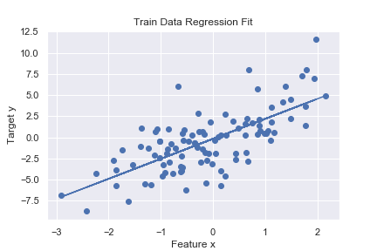
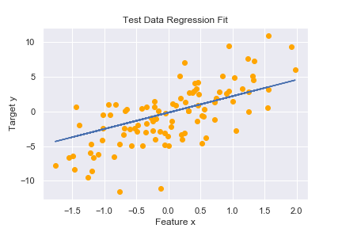
TEST USUALLY UNDERPERFORMS TRAIN
Model is optimized to perform as well as possible on train, so it’s no surprise that it tends to have a worse evaluation score on test (though this is not guaranteed).
R^2: .49
R^2: .43

Slide 9
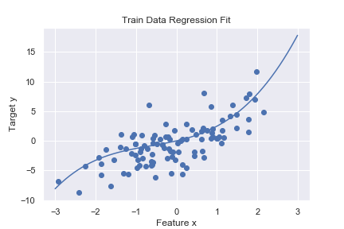
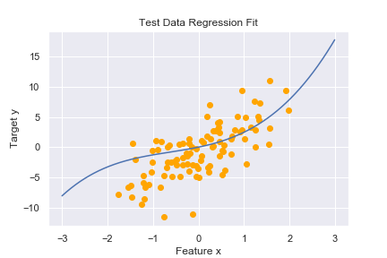
THE RISK OF OVERFITTING
Out of sample evaluations let us check for overfitting: more complex models can get arbitrarily better at predicting the train data, but will start to fit to spurious patterns and generalize more poorly
Degree 4 R^2: .54
Degree 4 R^2: .42

Slide 10
Validation: Optimizing Our Modeling Choices

Slide 11
VALIDATION: OPTIMIZING CHOICES
When we construct predictive models, we typically have many choices:
Features: which data columns do we include/exclude or engineer?
Preprocessing: how should we handle nulls? Should we standardized the scale of the features?
Hyper-parameters: What degree polynomial regression should we fit? What regularization strength should we use? How does a random forest model compare to a linear regression model?

Slide 12
VALIDATION IN PRACTICE
We can make some choices using our domain knowledge and good instincts, but a validation framework gives us an empirical way to choose and avoid over/under-fitting
We validate with the usual best generalization end-goal in mind: we exclude validation data from training, and use it to score predictions across a range of model choices
We can then select a choice of model based on the strongest validation score - i.e., this score gives us direct feedback on a possible choice. Once we’ve chosen a model, we can combine our train and validation sets, retrain the model, and get the test score
Train (60%)
Validation (20%)
Test (20%)

Slide 13
VALIDATION IN PRACTICE; cont.
1. Train candidate models
Linear Regression
Polynomial Regression
Ridge Regression
Train (60%)
Validation (20%)
Test (20%)

Slide 14
VALIDATION IN PRACTICE; cont.
1. Train candidate models
2. Score candidates
Linear Regression
R^2: .35
Polynomial Regression
R^2: .50
Ridge Regression
R^2: .25
Train (60%)
Validation (20%)
Test (20%)

Slide 15
VALIDATION IN PRACTICE; cont.
3. Retrain best candidate on train + validation
Polynomial Regression
Train + Valid (80%)
Test (20%)

Slide 16
VALIDATION IN PRACTICE; cont.
4. Score final model on test
Polynomial Regression
R^2: .48
Train + Valid (80%)
Test (20%)

Slide 17
VALIDATION: KEY CONSIDERATIONS
Validation is not testing: This is a very common pitfall. Once you’ve used a data set to influence your model choices through direct feedback, it can’t be used to give an unbiased estimate of generalization error
Fair comparisons: Candidate models should be compared against the same validation scheme
Data efficiency: after we use a portion of our data for validation, we should reuse it as training data to improve the final model

Slide 18
Cross Validation: Optimizing Our Optimization Of Choices

Slide 19
CROSS VALIDATION: ADDING MORE RIGOR
Cross-validation is about reliability and efficiency: what if we overfit to an unlucky validation set? Can we use more of our data than just one hold-out for validation?
K-Fold partitioning: randomly divide our non-test data into K equal-sized groups. Each group will be used as a validation set once, and we’ll compare candidate models via mean scores across all validation scores.
K is usually 5 or 10: depends on problem and size of data, but these are common choices

Slide 20
CROSS VALIDATION IN PRACTICE
Train data:
divided into
5 folds
Do the following, for each candidate model
Test, held out

Slide 21
CROSS VALIDATION IN PRACTICE
Train on black folds
Train data:
divided into
5 folds
Validate on cyan fold
Validation R^2 scores: .45,

Slide 22
CROSS VALIDATION IN PRACTICE
Train on black folds
Train data:
divided into
5 folds
Validate on cyan fold
Validation R^2 scores: .45, .39,

Slide 23
CROSS VALIDATION IN PRACTICE
Train on black folds
Train data:
divided into
5 folds
Validate on cyan fold
Validation R^2 scores: .45, .39, .57,

Slide 24
CROSS VALIDATION IN PRACTICE
Train on black folds
Train data:
divided into
5 folds
Validate on cyan fold
Validation R^2 scores: .45, .39, .57, .49,

Slide 25
CROSS VALIDATION IN PRACTICE
Train on black folds
Train data:
divided into
5 folds
Validate on cyan fold
Validation R^2 scores: .45, .39, .57, .49, .50

Slide 26
CROSS VALIDATION IN PRACTICE
Produces a set of results for each candidate model
Linear regression
Train data:
divided into
5 folds
Validation R^2 scores: .45, .39, .57, .49, .50
Poly regression
Validation R^2 scores: .53, .43, .67, .55, .51

Slide 27
CROSS VALIDATION IN PRACTICE
Summarize candidates by mean score, select best
Linear regression
Train data:
divided into
5 folds
5-Fold validation mean R^2 score: .48
Poly regression
5-Fold validation mean R^2 score: .54

Slide 28
CROSS VALIDATION IN PRACTICE
Polynomial regression selected as best candidate model
Train data:
recombined
Test, held out
Poly regression, retrained on all data, final score on test
R^2: .48

Slide 29
Validation And Testing: Recap

Slide 30
WORKFLOW METHOD 1: Train/Valid/Test
Collect set of candidate models. Fit each on train, score on validation, select final model via best validation score
Retrain final model on train + validation, report score on test as estimate of generalization error
Train (60%)
Validation (20%)
Test (20%)

Slide 31
WORKFLOW METHOD 2: CV/Test
Collect set of candidate models. Run each through a K-fold CV loop, select final model via best mean validation score
Retrain final model on combined folds, report score on test as estimate of generalization error
Train Fold 1
Train Fold 2
Train Fold 3
Train Fold 4
Train Fold 5
Test (20%)

Slide 32
VALIDATION VS. CV - WHEN TO USE?
Simple validation is significantly faster and often representative enough when working with very large samples (~millions+)
Cross validation is more appropriate with small-medium size data or when variance in results between different validation sets is high

Slide 33
CAN WE PUSH EVEN FURTHER?
There’s nothing stopping us from doing repeated rounds of CV with different random K-folds for even more rigor
Also an alternate form of testing: run CV on all data to select, then run another K-Fold loop to get multiple/mean out of sample scores
We usually take means across validation folds in CV to compare model candidates, but we can also gain information from distributions of scores across folds (e.g. variance)
Nested CV is another advanced technique for a more robust combination of CV and testing: see here for detail.

Slide 34
SUMMARY
Training
Validation
Testing
In sample
Model building
Optimize model parameters (fit)
Out of sample
Feedback to model selection
Optimize choices: features and model hyper-parameters
Out of sample
No feedback to model selection
Final estimate of model generalization error

Slide 35
