Slide 1


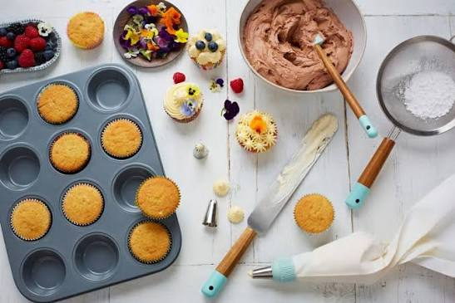
MY FAVOURITE HOBBIES
Reading
Travelling
Baking
Notes:
My favorite hobbies are reading travelling and baking. These hobbies make my free time enjoyable and help me learn new things and develop my creativity.

Slide 2

Plan the trip
Pack bags
Explore new places
Create memories
TRAVELLING
A joyful hobby that explores new places
Travelling is my favorite hobby because it allows me to explore new places ,experience different cultures, and create beautiful memories
Notes:
Travelling is an enjoyable hobby that allows me to explore new places ,experience different cultures ,and create beautiful memories.

Slide 3
READING
Choose a book
Read daily
Think about the story
Share what I learn
A quiet hobby that build imagination
Reading is my favourite way to relax and learn new things. A good book can introduced new ideas, knowledge and improve vocabulary
Notes:
Reading is a quiet and useful hobby. It improves my imagination , increases my knowledge and helps me learn new words and ideas.

Slide 4
Choose a recipe
Prepare ingredients
Bake
Enjoy & share
BAKING
A creative hobby that bring joy
Baking is my favourite hobby because I enjoy making delicious treats and trying new recipes. It allows me to be creative and share happiness with others
Notes:
Baking is a creative hobby that I enjoy in mu free time. I like trying new recipes, making delicious treats, and sharing them with others

