Slide 1

Case Study – Chickpea Harvesting
By – Md Javed Momin

Slide 2
Version Used
Data Cleaning : MS Excel 365
Database : MYSQL Server 8.0
Visualization : Power BI

Slide 3
Data Cleaning Steps – Columm Renaming
I used Concatenate function to combine two cells where I combined District and Parameters in one cell without which it would be difficult to analyse the data.
= CONCATENATE(Cell Number, Cell Number, Cell Number …)
= CONCATENATE(F2, “ ”, “-”, “ ”,F3)
Output : District 1 - T2M_MIN

Slide 4
Data Cleaning Steps – Inconsistent Date & Time Values
In Date & Time Column, Inconsistent Data was noticed.
Ex : 01-01-2013 12:00:00 AM and 14-01-2013 00:00
So, I used Flash Fill (Ctrl + E) where I manually entered First Two Rows so that Excel can understand the Pattern and then Used Flash Fill to get Consistent Data Formatting (Only Date Ignoring Time)

Slide 5
Data Cleaning Steps : Extracting Month No
I Extracted Month No which helped in analysing the data.
Month No : Excel TEXT Function was used.
=TEXT(B2,"m")
O/P : 1

Slide 6
Data Cleaning Steps : Extracting Month Name
I Extracted Month Name which helped in analysing the data.
Month Name : Excel TEXT Function was used.
=TEXT(B2,“MMM")
O/P : Jan

Slide 7
Analysing MAX Temperature
I used Excel’s Pivot Functions for Analysing the Data.
I calculated Average MAX Temperature of each district and grouped it by months.
Later, I took the average of those 32 districts and grouped it by months.

Slide 8
Months | Max Temperature (Average)
Jan | 24.07
Feb | 28.64
Mar | 33.64
Apr | 39.1
May | 41.65
Jun | 39.83
Jul | 35.32
Aug | 32.89
Sep | 33.2
Oct | 33.19
Nov | 29.46
Dec | 25.36

Slide 9
MAX Temperature
The MAX Temperature was recorded in May having Temperature of 41.65

Slide 10
Analysing MIN Temperature
I used Excel’s Pivot Functions for Analysing the Data.
I calculated Average MIN Temperature of each district and grouped it by months.
Later, I took the average of those 32 districts and grouped it by months.

Slide 11
Months | Min Temperature (Average)
Jan | 8.38
Feb | 11.78
Mar | 17.08
Apr | 22.60
May | 26.82
Jun | 28.07
Jul | 26.56
Aug | 24.78
Sep | 23.35
Oct | 19.90
Nov | 15.08
Dec | 10.43

Slide 12
MIN Temperature
The MAX Temperature was recorded in Jan having Temperature of 8.38

Slide 13
Analysing Rainfall (mm)
I used Excel’s Pivot Functions for Analysing the Data.
I calculated Average Rainfall (mm) of each district and grouped it by months.
Later, I took the average of those 32 districts and grouped it by months.

Slide 14
Months | Rainfall (mm) (Average)
Jan | 0.33
Feb | 0.17
Mar | 0.38
Apr | 0.25
May | 0.63
Jun | 2.56
Jul | 7.25
Aug | 6.21
Sep | 2.98
Oct | 0.51
Nov | 0.25
Dec | 0.12

Slide 15
SQL Query : Write a query to find which month got the highest rainfall in the State.
SELECT MONTHNAME, SUM(District1_Rainfall + District2_Rainfall + District3_Rainfall + District4_Rainfall +
District5_Rainfall + District6_Rainfall + District7_Rainfall+ District8_Rainfall+ District9_Rainfall +
District10_Rainfall + District11_Rainfall + District12_Rainfall+ District13_Rainfall+ District14_Rainfall+
District15_Rainfall+ District16_Rainfall + District17_Rainfall+ District18_Rainfall+ District19_Rainfall+
District20_Rainfall + District21_Rainfall+ District22_Rainfall+ District23_Rainfall+ District24_Rainfall+
District25_Rainfall+ District26_Rainfall+ District27_Rainfall+ District28_Rainfall+ District29_Rainfall+
District30_Rainfall+ District31_Rainfall+ District32_Rainfall)
AS Total_Rainfall FROM WEATHER_DATA
GROUP BY MONTHNAME
ORDER BY Total_Rainfall DESC
LIMIT 1

Slide 16
Max_Rainfall_Month | Max_Rainfall (mm)
Jul | 79149.66

Slide 17
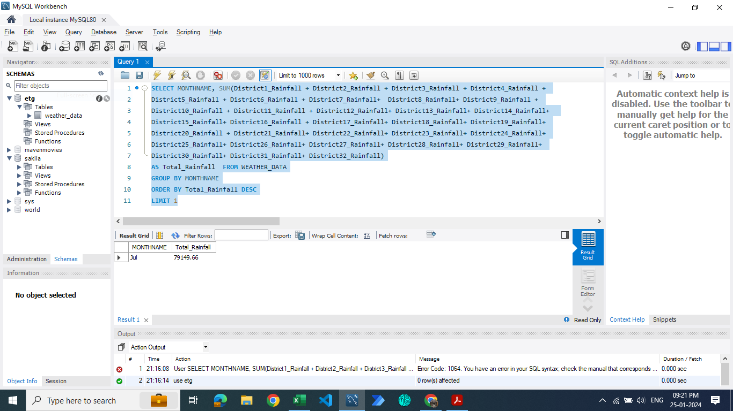

Slide 18
Yield Prediction
I analysed in Excel as I was unable to perform in Python/R.
I used Linear Regression Method for the same.
The Equation of Line was : y = 5.6702x + 779.35
Here, 'x' represents the numerical years, and 'y' represents the predicted yield.

Slide 19
Years | Yield (kg/Hectare) | X
2013-14 | 705.1
2014-15 | 792.9
2015-16 | 842.7
2016-17 | 823.1
2017-18 | 803.3
2018-19 | 922
2019-20 | 845.1
2020-21 | 704.7
2021-22 | 830.38 | x=9
2022-23 | 836.05 | x=10
2023-24 | 841.72 | x=11

Slide 21
Power BI Analysis
I analysed the Data in Power BI as well & created meaningful visualizations.
Parameters Analysed :
A) MIN Rainfall (mm)
B) MAX Rainfall (mm)
C) MIN Temperature (Average)
D) MAX Temperature (Average)
E) MIN Temperature (Average) by month
F) MAX Temperature (Average) by month
G) Average Rainfall (mm) by month
H) Temperature Vs Rainfall by month
Filters Used : Seasons & Years

Slide 22
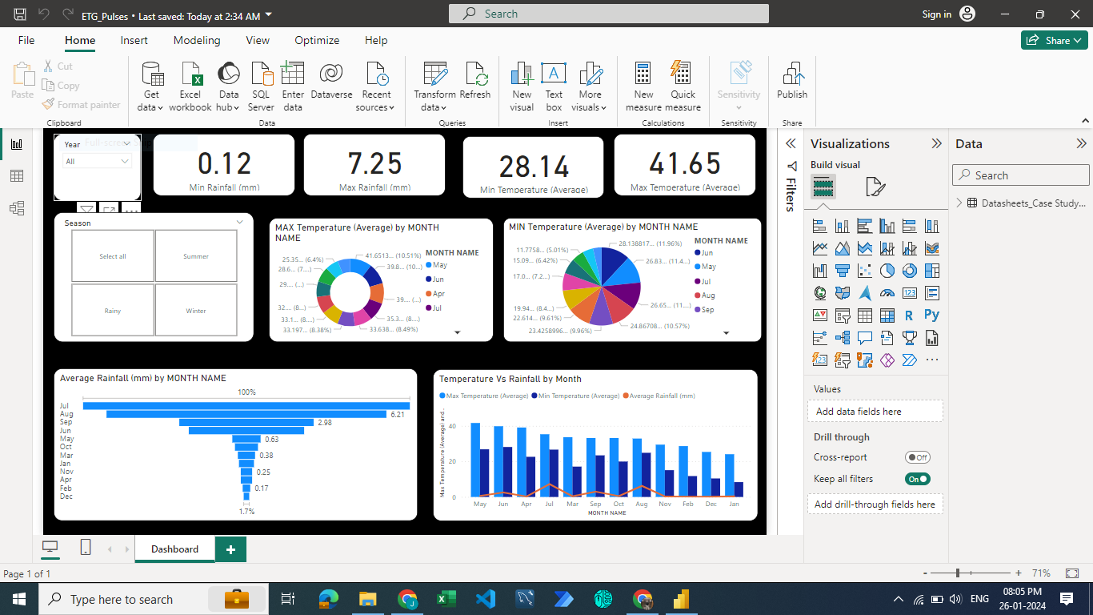

Slide 23
Thank You !!!

