Slide 1
Use Case for Scripted AuthN in OpenAM 13
@author Javed Shah

Slide 2
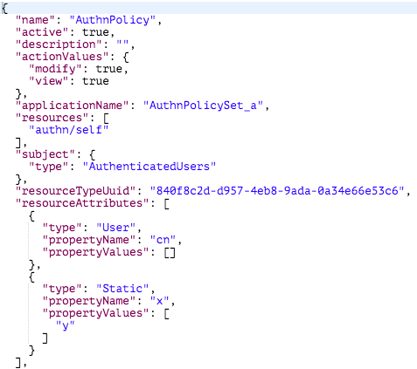
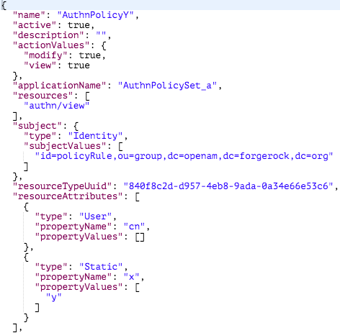
Policy Configuration for Demo

Slide 3


Scripting Demo
Acquire ssoToken using REST
Evaluate policy for the resource “authn/self” and “authn/view”

Slide 4
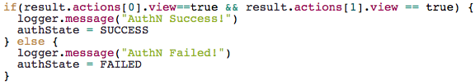
Scripting Demo
Policy decision
Check Policy decision and permit if requested actions ALLOWED
Logout the service account or the user

